Slide 1
Estate Planning Overview
Tuesday, March 16, 2024
Free PDF
Presented By:
Alan Gassman, JD, LL.M. (Taxation), AEP® (Distinguished)
agassman@gassmanpa.com
1245 Court Street
Clearwater, FL 33756

Slide 2
INTRODUCTION
Term life insurance is the simplest form of life insurance.
Life insurance is a contract between a life insurance company and the person or people who own a life insurance policy.
The contract basically says that if premium payments are made on time, the carrier will pay a death benefit when a person dies, or sometimes before this, if the person has a near fatal illness and needs cash before he or she dies.
In order to buy life insurance, a person has to fill out an application and take a physical examination, which normally includes blood testing, urine testing, and an EKG that is administered at the applicant’s home or office by a nurse.
The questionnaire will include the last five years of medical information, and the carrier will spend 5 to 8 weeks reviewing the medical records that it obtains from doctors’ offices and other medical facilities, running a credit report and looking at the other medical records.
Normally, an application is a “formal application,” and the information in the application goes to a Bureau that all life insurance companies have access to for up to 8 years after the application is filed.
An “informal application” is an application made to only one carrier that is not shared with the Bureau unless or until the carrier agrees to issue a policy.

Slide 3
INTRODUCTION
Once the carrier has the information and has decided that it is willing to issue a policy, it will make an offer that will include the death benefit and the premium costs.
Different carriers will give different offers, and there is much to think about beyond just what the death benefit and premium amounts will be.
These other factors include:
The strength, size and history of the carrier.
For term insurance, whether there is a right to convert to a permanent policy before premium amounts go up, and when that “conversion option” can be exercised.
Who will be your sales agent or policy representative? – Do you prefer to deal directly with a carrier or with an individual who sells you the policy?
If a policy application is not completely truthful, then there may be no death benefit – but if the insured lives longer than two years after the policy is issued, the policy may be “incontestable.”

Slide 4
A Crucial Consideration
Deciding who will own the policy,
and what person or trust will be the beneficiary, is an important question to answer.

Slide 5
What Alan Tells His Clients About Buying Term Insurance
You can ask an independent agent who writes for many carriers to have the client take the physical so that they can get quotes from several carriers.
You can ask that all results and quotes be confidential and not given to the bureau that all carriers belong to and share information with. Once a carrier turns the client down or "rates" the client all other carriers know.
This is called an "informal application" and then the carriers can each give informal quotes for term coverage. If the client likes the quote then he or she can buy it.

Slide 6
What Alan Tells His Clients About Buying Term Insurance, Continued
You might spread this among 2 or 3 carriers in case one goes under.
Better to buy six $500,000 policies with separate carriers than one $3,000,000 policy with one carrier for financial security. You cannot reduce the amount of coverage in a life insurance policy once purchased, but you can terminate smaller policies to adjust coverage downward when appropriate.
Sample term rates for "preferred," "standard" and "standard smoker" individuals at ages 35, 40, 45, 50 and 55 are as follows:

Slide 7
Buying Term Insurance
AGE 30
 | PREFERRED |  | STANDARD |  | STANDARD SMOKER
 | MALE | FEMALE | MALE | FEMALE | MALE | FEMALE
10 Year Term | $378 | $328 | $658 | $518 | $1,548 | $1,218
15 Year Term | $458 | $398 | $768 | $688 | $1,918 | $1,438
20 Year Term | $608 | $478 | $968 | $738 | $2,278 | $1,638
30 Year Term | $938 | $768 | $1,518 | $1,218 | $3,908 | $3,018
AGE 40
 | PREFERRED |  | STANDARD |  | STANDARD SMOKER
 | MALE | FEMALE | MALE | FEMALE | MALE | FEMALE
10 Year Term | $505 | $435 | $925 | $785 | $2,405 | $2,005
15 Year Term | $655 | $575 | $1,215 | $1,035 | $3,125 | $2,485
20 Year Term | $865 | $745 | $1,505 | $1,255 | $4,345 | $3,185
30 Year Term | $1,495 | $1,135 | $2,465 | $1,985 | $7,175 | $5,275

Slide 8
Buying Term Insurance
AGE 50
 | PREFERRED |  | STANDARD |  | STANDARD SMOKER
 | MALE | FEMALE | MALE | FEMALE | MALE | FEMALE
10 Year Term | $1,235 | $1,025 | $2,145 | $1,625 | $6,435 | $4,295
15 Year Term | $1,785 | $1,235 | $2,805 | $2,065 | $7,825 | $5,725
20 Year Term | $2,225 | $1,625 | $3,425 | $2,715 | $10,425 | $6,865
30 Year Term | $4,025 | $2,645 | $6,245 | $4,785 | $13,719 | $10,109
AGE 60
 | PREFERRED |  | STANDARD |  | STANDARD SMOKER
 | MALE | FEMALE | MALE | FEMALE | MALE | FEMALE
10 Year Term | $3,098 | $2,198 | $4,808 | $3,278 | $13,028 | $8,308
15 Year Term | $4,488 | $3,048 | $7,088 | $5,218 | $17,658 | $12,978
20 Year Term | $5,798 | $4,078 | $9,488 | $6,668 | $22,048 | $15,058
30 Year Term | Not Available | Not Available | Not Available | Not Available | Not Available | Not Available

Slide 9
Consider the Following for Term Life Policies
Request deadlines for conversion on term policy coverage.
2. Understand convertibility features and quality of carriers convertibility options.
3. Will it be possible to reduce the policy or should policies be purchased in smaller increments?
4. Use multiple carriers to enhance financial security?
Schedule for replacing term coverage or converting to permanent coverage well before conversion deadline, which is usually one year before the last year of the fixed term competitive rate coverage.
Consider keeping previous coverage in place two years or less for contestability purposes.
What riders would be considered for term insurance policies?
Term insurance with premium refund – is this ever worthwhile?
Is there second-to-die term or any equivalent? – Consider a minimum pay variable or universal no-load coverage with minimum annual payments to have second-to-die coverage available and at least temporarily in place.

Slide 10
How Much
Life Insurance
Do You Need?

Slide 11
The Six-Three SolutionSM
In The Flip Side, we presented a risk to following traditional spending guidelines. These traditional guidelines suggest limiting spending to 4% of investment assets.⁽¹⁾ This is a conservative guideline designed to preserve financial security in the future. The flip-side of the traditional advice is that following it is likely to result in under-utilizing your wealth.
The greatest fear of the newly retired is running out of money. Unfortunately, this fear steers some down an excessively safe road that may lead to a life’s dream being unfulfilled. Preserving financial security without living life too cautiously is the greatest challenge faced in planning a successful retirement.
The 4% guideline was developed using various analytic models to balance current spending with future financial security. These models typically present failure as running out of money, which is a horrifying thought for the newly retired. Running out of money suggests a life of standing on a street corner begging for change or living in a dingy apartment eating cat food. This is a vision of failure that is completely unacceptable.
However, running totally out of money overstates the risk. Sensible retirees will continuously monitor their resources and will make adjustments along the way to balance spending with wealth. For retirees following a sensible plan, the risk is not running out of money - it is having to reduce spending in the future. This is a risk some are willing to take in exchange for more liberal spending today.
Determining how much risk in future spending one is willing to take in exchange for higher spending today is the art and science of selecting the appropriate retirement budget. Those who are anxious about security should plan conservatively. It is impossible to enjoy wealth without peace of mind. Peace of mind, every day, will provide much more happiness than a trip to Italy.
However, those who can live with a little future uncertainty, without falling into despair every time the stock market blips, may be able to capture the best of both worlds. These people may be able to live a bit more freely without excessive worry about the future. To do so, it is necessary to create a back-up plan, which must be realistic, detailed and followed with discipline. Each plan must be customized to address individual objectives and philosophies. However, all of these plans share one basic dynamic – exchanging higher spending now for the risk of having to reduce spending in the future.
Credit: Resource Consulting Group; Service Mark used with permission of Resource Consulting Group and Michael David, Orlando, FL

Slide 12
The Six-Three SolutionSM
We developed the Six-Three SolutionSM for those who would prefer to use their wealth while living. In this plan, total spending, including giving and taxes, is budgeted at 6% rather than the typically recommended 4%. Of this 6%, base spending is limited to 3%. Expenses like taxes, food, mortgage payments, insurance, health care, utilities, club dues, car payments, regular household spending and all other spending that is necessary to support the minimum acceptable standard of living should be no more than 3% of beginning investment assets.
Total spending is budgeted at 6% of investment assets, but it must be possible to stop the extra spending without disrupting the basic structure of the lifestyle. For example, skipping a vacation, dining out less often and cutting back on holiday spending can be accomplished with less disruption to one’s lifestyle than selling a home or dropping a country club membership. Extra spending could include dining out, travel, clothing, jewelry, art, hunting, fishing, golf and giving.
Which spending belongs in which category will vary from person to person. Some would consider giving a necessary part of the minimum required spending and club dues as optional. That is a personal choice. The reason giving was categorized as discretionary spending and country club dues as base spending is that giving is easier to skip for a year, whereas it may be impossible to stop paying dues without dropping the membership.
Some clubs permit one to become temporarily inactive and some charities are highly dependent on annual giving. A person for whom this was true might put giving in the base category and club dues in the splurge category. These details will vary from person to person. We are not making any statements about the ethical discretion to give; we are just illustrating the way some might divide spending. The bottom-line is that half of spending is marked as spending you can live without, either temporarily or permanently.
Credit: Resource Consulting Group; Service Mark used with permission of Resource Consulting Group and Michael David, Orlando, FL

Slide 13
The Six-Three SolutionSM
To illustrate how this would work, we will review a plan for a retired person with $3 million in investment assets. In traditional planning, spending $120,000 (4% of $3 million) per year would be considered affordable. The Six-Three SolutionSM would budget spending at $180,000, as long as base spending was no more than $90,000.
A cash flow system would be established transferring $7,500 ($90,000 ÷ 12) per month to an operating account. Annually, the difference between 6% of investment assets and the amount transferred to the operating account would be transferred to a splurge account. In the first year, the splurge account would be funded with $90,000.
If investment performance is good in the first year, the second year deposit to the splurge account is higher; if investment performance is poor, the deposit is less. Regardless of investment performance, the deposit to the operating account would be increased by the inflation rate.
For some people, perfect retirement planning would result in having their wealth expire at the same time they do. Unfortunately, this objective cannot be met in the real world when date of death and investment results are not known. The Six-Three SolutionSM is a way to walk a little closer to the edge without taking too much risk of falling off. For the right people, this plan will allow better matching of wealth to one’s objectives.
The Six-Three SolutionSM is not right for everyone. However, if you think it might be right for you, please contact us. We will be happy to explore it with you.
The 4% spending guideline is frequently misunderstood and misused. For a complete explanation of this guideline, see our technical summary titled “Understanding the 4% Withdrawal Guideline”.
Credit: Resource Consulting Group; Service Mark used with permission of Resource Consulting Group and Michael David, Orlando, FL

Slide 14
N.E.S.T. Analysis System
30 year old married couple
Illustrations show the annual investments needed to achieve $5,000,000 of inflation-adjusted retirement resources in 25, 30, and 25 years.
How much would a 30-year-old have to invest per year to have $5,000,000 (in inflation-adjusted money)?
HINT: Start early!
INVESTMENT GROWTH: | 6% GROWTH PER YEAR* | 8% GROWTH PER YEAR*
55 Years Old Annual Investments Required: | $193,631.94 | $142,625.75
60 Years Old Annual Investments Required: | $130,374.38 | $107,835.79
65 Years Old Annual Investments Required: | $90,807.66 | $82,749.90
*Rate of return prior to retirement, 5% rate of return during retirement.

Slide 15
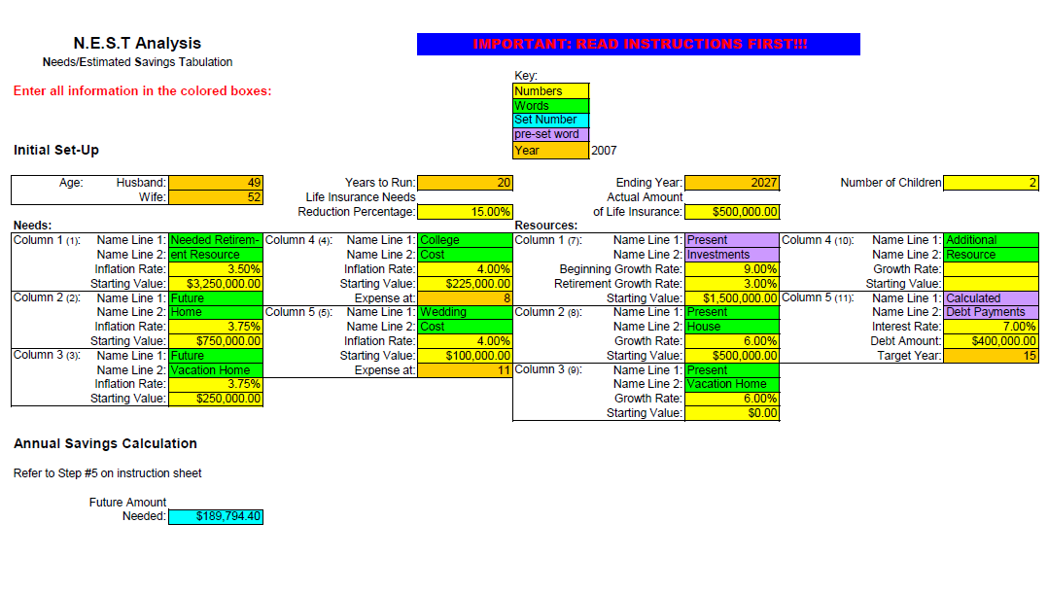
N.E.S.T. Analysis Needs/Estimated Savings Tabulation

Slide 16
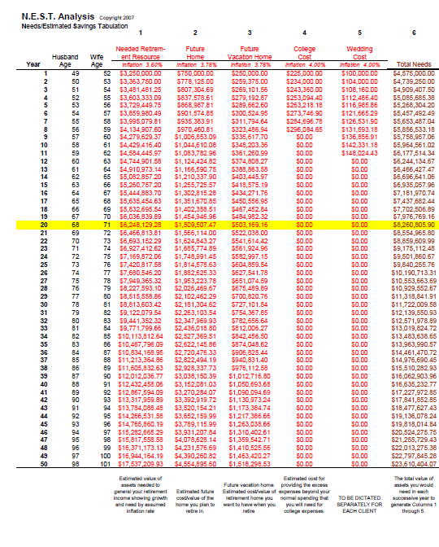
N.E.S.T. Analysis – Needs/Estimated Savings Tabulation

Slide 17
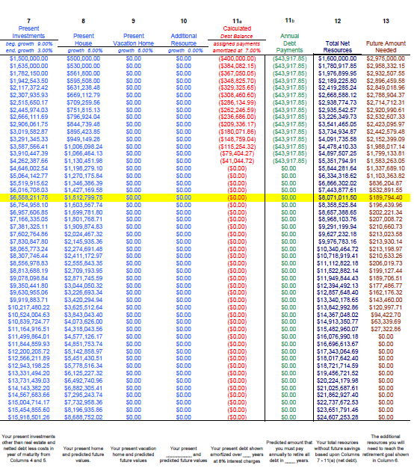
N.E.S.T. Analysis – Needs/Estimated Savings Tabulation

Slide 18
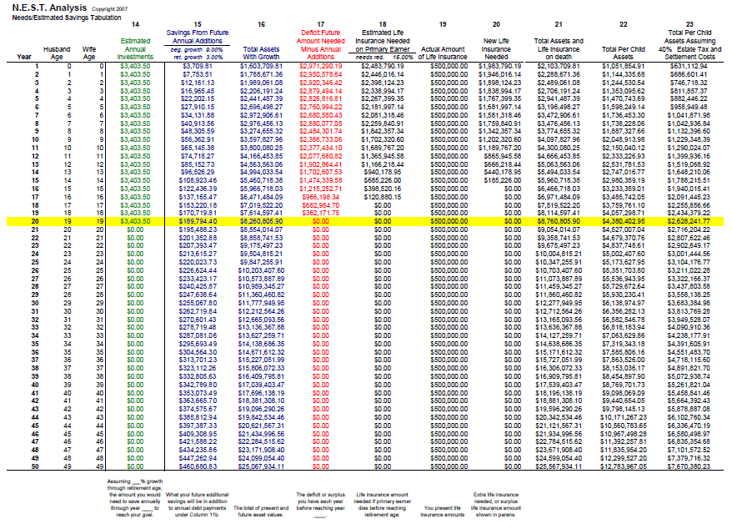
N.E.S.T. Analysis – Needs/Estimated Savings Tabulation

Slide 19
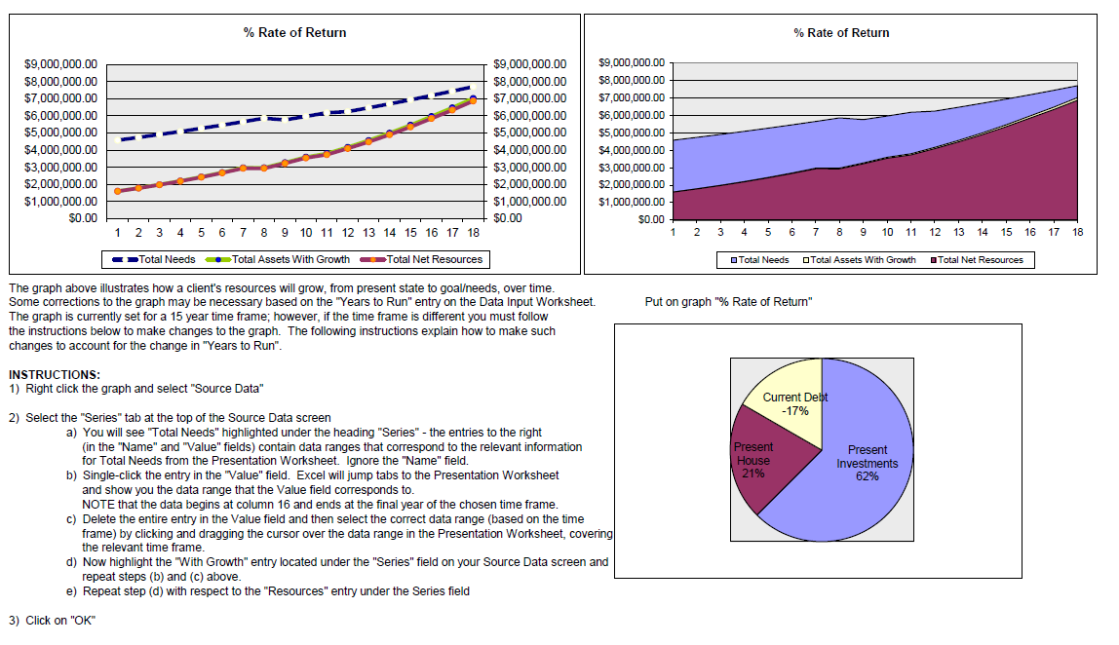

Slide 20
Permanent Cash Value Products
Four primary varieties of permanent life insurance products have the expectation of an increasing cash value that will, to some degree, provide a return on investment to pay or help pay mortality and maintenance costs that might eventually facilitate having the cash value replace the death benefit at an advanced age can take a number of forms.

Slide 21
 | Term Life | Whole Life | Universal Life | Variable Universal Life | Guaranteed Universal Life | Equity Index Life Distinguishing Feature
Distinguishing Feature | Provides protection for a specific period | Lifetime protection for as long as premiums are paid | Guaranteed minimum interest rate on investments accumulated in the accounts – interest rates are based on bonds only and can be higher than the minimum guaranteed | Combines premium and death benefit flexibility of universal life with investment choice of variable life | Death benefit is guaranteed if specified premiums are made timely for a given period of years | No loss of cash value in negative stock market years – rate of return will be a portion of index performance
Premium | Fixed, but will increase at each renewal | Fixed | Flexible since they are set by the policyholder | Flexible, like universal life | Fixed | Flexible, like universal life
Cash Value | None | Guaranteed | Account value minus the surrender charges | Not guaranteed; depends on performance of stocks | Can generate significant cash value (albeit at a higher premium) | See above
Death Benefit | Face amount of policy if death occurs within the term | Face amount of policy if in force when death occurs | Option A: maintain level death benefit Option B: face amount increases as cash value grows Option C: death benefit increases to facilitate a return of all premiums on death | Same options as universal life | Guaranteed if premiums paid timely; accelerated death benefit rider for chronic and terminal illness | Same options as universal life
Can Borrow Against Cash Value | N/A | Yes | Yes | 50%; Subject to Regulation U | May lose “no-lapse” guarantee | Depends upon policy
Cash Value at Risk if Carrier Fails | N/A | Yes | Yes | No | Yes | Yes
Can be Sold without Series 6 License | Yes | Maybe | Yes | No | Yes | Yes
Life Settlement | Yes | Maybe | Yes | Maybe | Yes | Yes
Regulated By | State | State | State | FINRA and State | State | State

Slide 22
Life Insurance Product | First Year Commission ($) | Next Six Years Commissions | Total Seven Year Commissions
20-year term policy Premium: $2,500/year Mutual Fund Investment: $27,500/year | $2,500 (the first year premium) | $5,775 (3% of the Mutual Fund Investment) ($27,000 x 6 = $162,000) | $8,275
Fee-for-Service no-load life insurance Premium: $30,000 | 0 | Between 1% and 2% of cash value (advisor fee) | Between 1% and 2% of cash value (May be $6,000)
No commission concessions Premium: $30,000 | $18,000; plus 3% of annual premiums a year plus next 6 years | $900 for the next 6 years; plus 2-4% of premium ($600 to $1,200 per year) | $23,400
Discount commission Premium: $30,000 Advisor agrees to discount commissions by 90% | $1,800 | $2,100 a year for 7 years | $7,170

Slide 23
When looking at an existing permanent policy, we typically ask about the following:
What is the exact premium history, and the rate of return thus far?
Should the death benefit be decreased, or contributions made to meet but not exceed the minimum corridor guidelines?
The same as #2 above, but to meet the modified endowment contract guidelines, if the client will never need to borrow or otherwise withdraw from the policy during his or her lifetime.
Withdraw as much as possible tax free, and convert remaining value to a lower cost annuity.
Should the policy be sold?
Are there riders that can be eliminated to enhance expected rate of return?
If the insured or insureds are in very good health, as compared to the mainstream insureds who have purchased policies of the same type from the same carrier many years back, then a replacement policy may be worth considering.
If the death benefit is no longer needed, then withdrawing the maximum amount that can be taken out (up to the tax basis) tax free, and converting the remaining policy values into a variable or fixed annuity to defer taxation may be the best planning strategy.

Slide 24
Riders on the Storm
Disability Premium Waiver – a provision that will not require the insured to pay the usual recurring fee to maintain the health insurance policy if the person responsible for paying the premiums is seriously injured. Insurance companies vary in their definition of a disability.
Contractual guarantee that if cash value crashes, policy loans need never be repaid.
Option to increase death benefit without taking physical.
Automatic incrementally increasing death benefit at preset pricing.
Term-like coverage on spouse, commonly provided by American Dental Association and similar group policies
For second-to-die only:
Divisible into two separate policies in the event of divorce (“split option”).
Pays a death benefit to the heirs after both spouses are dead
Second-to-die can help pay estate taxes and/or provide financial legacy to children

Slide 25
Tax Talk for Permanent Life Policies
Premiums are not deductible in the vast majority of circumstances.
Cash value income used to pay for death benefit is in essence tax-free.
Can withdraw up to tax basis and then borrow from policy tax-free, but borrowing causes interest differential rate to be paid to the carrier, except with respect to private placement policies
If death benefit is reduced or started at the modified endowment contract (“MEC”) level, then any pledging of or borrowing from the policy or withdrawal of basis will carry out income first, and subject the owner to the 10% excise tax, unless the owner is an individual over age 59 1/2
If policy destructs, income may result - if policy is cashed in, ordinary income (not capital gains) will be based upon the cash surrender value received, minus basis, and basis will be based upon premiums paid minus income within the policy that was used to purchase additional death benefit. If a loan is owed to the policy, then the amounts owed are considered to be additional amounts received for income calculation.
1035 Exchanges.

Slide 26
INTRODUCTION
Term life insurance is the simplest form of life insurance.
Life insurance is a contract between a life insurance company and the person or people who own a life insurance policy.
The contract basically says that if premium payments are made on time, the carrier will pay a death benefit when a person dies, or sometimes before this, if the person has a near fatal illness and needs cash before he or she dies.
In order to buy life insurance, a person has to fill out an application and take a physical examination, which normally includes blood testing, urine testing, and an EKG that is administered at the applicant’s home or office by a nurse.
The questionnaire will include the last five years of medical information, and the carrier will spend 5 to 8 weeks reviewing the medical records that it obtains from doctors’ offices and other medical facilities, running a credit report and looking at the other medical records.
Normally, an application is a “formal application,” and the information in the application goes to a Bureau that all life insurance companies have access to for up to 8 years after the application is filed.
An “informal application” is an application made to only one carrier that is not shared with the Bureau unless or until the carrier agrees to issue a policy.

Slide 27
INTRODUCTION
Once the carrier has the information and has decided that it is willing to issue a policy, it will make an offer that will include the death benefit and the premium costs.
Different carriers will give different offers, and there is much to think about beyond just what the death benefit and premium amounts will be.
These other factors include:
The strength, size and history of the carrier.
For term insurance, whether there is a right to convert to a permanent policy before premium amounts go up, and when that “conversion option” can be exercised.
Who will be your sales agent or policy representative? – Do you prefer to deal directly with a carrier or with an individual who sells you the policy?
If a policy application is not completely truthful, then there may be no death benefit – but if the insured lives longer than two years after the policy is issued, the policy may be “incontestable.”

Slide 28
A Crucial Consideration
Deciding who will own the policy,
and what person or trust will be the beneficiary, is an important question to answer.

Slide 29
What Alan Tells His Clients About Buying Term Insurance
You can ask an independent agent who writes for many carriers to have the client take the physical so that they can get quotes from several carriers.
You can ask that all results and quotes be confidential and not given to the bureau that all carriers belong to and share information with. Once a carrier turns the client down or "rates" the client all other carriers know.
This is called an "informal application" and then the carriers can each give informal quotes for term coverage. If the client likes the quote then he or she can buy it.

Slide 30
What Alan Tells His Clients About Buying Term Insurance, Continued
You might spread this among 2 or 3 carriers in case one goes under.
Better to buy six $500,000 policies with separate carriers than one $3,000,000 policy with one carrier for financial security. You cannot reduce the amount of coverage in a life insurance policy once purchased, but you can terminate smaller policies to adjust coverage downward when appropriate.
Sample term rates for "preferred," "standard" and "standard smoker" individuals at ages 35, 40, 45, 50 and 55 are as follows:

Slide 31
Buying Term Insurance
AGE 30
 | PREFERRED |  | STANDARD |  | STANDARD SMOKER
 | MALE | FEMALE | MALE | FEMALE | MALE | FEMALE
10 Year Term | $378 | $328 | $658 | $518 | $1,548 | $1,218
15 Year Term | $458 | $398 | $768 | $688 | $1,918 | $1,438
20 Year Term | $608 | $478 | $968 | $738 | $2,278 | $1,638
30 Year Term | $938 | $768 | $1,518 | $1,218 | $3,908 | $3,018
AGE 40
 | PREFERRED |  | STANDARD |  | STANDARD SMOKER
 | MALE | FEMALE | MALE | FEMALE | MALE | FEMALE
10 Year Term | $505 | $435 | $925 | $785 | $2,405 | $2,005
15 Year Term | $655 | $575 | $1,215 | $1,035 | $3,125 | $2,485
20 Year Term | $865 | $745 | $1,505 | $1,255 | $4,345 | $3,185
30 Year Term | $1,495 | $1,135 | $2,465 | $1,985 | $7,175 | $5,275

Slide 32
Buying Term Insurance
AGE 50
 | PREFERRED |  | STANDARD |  | STANDARD SMOKER
 | MALE | FEMALE | MALE | FEMALE | MALE | FEMALE
10 Year Term | $1,235 | $1,025 | $2,145 | $1,625 | $6,435 | $4,295
15 Year Term | $1,785 | $1,235 | $2,805 | $2,065 | $7,825 | $5,725
20 Year Term | $2,225 | $1,625 | $3,425 | $2,715 | $10,425 | $6,865
30 Year Term | $4,025 | $2,645 | $6,245 | $4,785 | $13,719 | $10,109
AGE 60
 | PREFERRED |  | STANDARD |  | STANDARD SMOKER
 | MALE | FEMALE | MALE | FEMALE | MALE | FEMALE
10 Year Term | $3,098 | $2,198 | $4,808 | $3,278 | $13,028 | $8,308
15 Year Term | $4,488 | $3,048 | $7,088 | $5,218 | $17,658 | $12,978
20 Year Term | $5,798 | $4,078 | $9,488 | $6,668 | $22,048 | $15,058
30 Year Term | Not Available | Not Available | Not Available | Not Available | Not Available | Not Available

Slide 33
Consider the Following for Term Life Policies
Request deadlines for conversion on term policy coverage.
2. Understand convertibility features and quality of carriers convertibility options.
3. Will it be possible to reduce the policy or should policies be purchased in smaller increments?
4. Use multiple carriers to enhance financial security?
Schedule for replacing term coverage or converting to permanent coverage well before conversion deadline, which is usually one year before the last year of the fixed term competitive rate coverage.
Consider keeping previous coverage in place two years or less for contestability purposes.
What riders would be considered for term insurance policies?
Term insurance with premium refund – is this ever worthwhile?
Is there second-to-die term or any equivalent? – Consider a minimum pay variable or universal no-load coverage with minimum annual payments to have second-to-die coverage available and at least temporarily in place.

Slide 34
How Much
Life Insurance
Do You Need?

Slide 35
The Six-Three SolutionSM
In The Flip Side, we presented a risk to following traditional spending guidelines. These traditional guidelines suggest limiting spending to 4% of investment assets.⁽¹⁾ This is a conservative guideline designed to preserve financial security in the future. The flip-side of the traditional advice is that following it is likely to result in under-utilizing your wealth.
The greatest fear of the newly retired is running out of money. Unfortunately, this fear steers some down an excessively safe road that may lead to a life’s dream being unfulfilled. Preserving financial security without living life too cautiously is the greatest challenge faced in planning a successful retirement.
The 4% guideline was developed using various analytic models to balance current spending with future financial security. These models typically present failure as running out of money, which is a horrifying thought for the newly retired. Running out of money suggests a life of standing on a street corner begging for change or living in a dingy apartment eating cat food. This is a vision of failure that is completely unacceptable.
However, running totally out of money overstates the risk. Sensible retirees will continuously monitor their resources and will make adjustments along the way to balance spending with wealth. For retirees following a sensible plan, the risk is not running out of money - it is having to reduce spending in the future. This is a risk some are willing to take in exchange for more liberal spending today.
Determining how much risk in future spending one is willing to take in exchange for higher spending today is the art and science of selecting the appropriate retirement budget. Those who are anxious about security should plan conservatively. It is impossible to enjoy wealth without peace of mind. Peace of mind, every day, will provide much more happiness than a trip to Italy.
However, those who can live with a little future uncertainty, without falling into despair every time the stock market blips, may be able to capture the best of both worlds. These people may be able to live a bit more freely without excessive worry about the future. To do so, it is necessary to create a back-up plan, which must be realistic, detailed and followed with discipline. Each plan must be customized to address individual objectives and philosophies. However, all of these plans share one basic dynamic – exchanging higher spending now for the risk of having to reduce spending in the future.
Credit: Resource Consulting Group; Service Mark used with permission of Resource Consulting Group and Michael David, Orlando, FL

Slide 36
The Six-Three SolutionSM
We developed the Six-Three SolutionSM for those who would prefer to use their wealth while living. In this plan, total spending, including giving and taxes, is budgeted at 6% rather than the typically recommended 4%. Of this 6%, base spending is limited to 3%. Expenses like taxes, food, mortgage payments, insurance, health care, utilities, club dues, car payments, regular household spending and all other spending that is necessary to support the minimum acceptable standard of living should be no more than 3% of beginning investment assets.
Total spending is budgeted at 6% of investment assets, but it must be possible to stop the extra spending without disrupting the basic structure of the lifestyle. For example, skipping a vacation, dining out less often and cutting back on holiday spending can be accomplished with less disruption to one’s lifestyle than selling a home or dropping a country club membership. Extra spending could include dining out, travel, clothing, jewelry, art, hunting, fishing, golf and giving.
Which spending belongs in which category will vary from person to person. Some would consider giving a necessary part of the minimum required spending and club dues as optional. That is a personal choice. The reason giving was categorized as discretionary spending and country club dues as base spending is that giving is easier to skip for a year, whereas it may be impossible to stop paying dues without dropping the membership.
Some clubs permit one to become temporarily inactive and some charities are highly dependent on annual giving. A person for whom this was true might put giving in the base category and club dues in the splurge category. These details will vary from person to person. We are not making any statements about the ethical discretion to give; we are just illustrating the way some might divide spending. The bottom-line is that half of spending is marked as spending you can live without, either temporarily or permanently.
Credit: Resource Consulting Group; Service Mark used with permission of Resource Consulting Group and Michael David, Orlando, FL

Slide 37
The Six-Three SolutionSM
To illustrate how this would work, we will review a plan for a retired person with $3 million in investment assets. In traditional planning, spending $120,000 (4% of $3 million) per year would be considered affordable. The Six-Three SolutionSM would budget spending at $180,000, as long as base spending was no more than $90,000.
A cash flow system would be established transferring $7,500 ($90,000 ÷ 12) per month to an operating account. Annually, the difference between 6% of investment assets and the amount transferred to the operating account would be transferred to a splurge account. In the first year, the splurge account would be funded with $90,000.
If investment performance is good in the first year, the second year deposit to the splurge account is higher; if investment performance is poor, the deposit is less. Regardless of investment performance, the deposit to the operating account would be increased by the inflation rate.
For some people, perfect retirement planning would result in having their wealth expire at the same time they do. Unfortunately, this objective cannot be met in the real world when date of death and investment results are not known. The Six-Three SolutionSM is a way to walk a little closer to the edge without taking too much risk of falling off. For the right people, this plan will allow better matching of wealth to one’s objectives.
The Six-Three SolutionSM is not right for everyone. However, if you think it might be right for you, please contact us. We will be happy to explore it with you.
The 4% spending guideline is frequently misunderstood and misused. For a complete explanation of this guideline, see our technical summary titled “Understanding the 4% Withdrawal Guideline”.
Credit: Resource Consulting Group; Service Mark used with permission of Resource Consulting Group and Michael David, Orlando, FL

Slide 38
N.E.S.T. Analysis System
30 year old married couple
Illustrations show the annual investments needed to achieve $5,000,000 of inflation-adjusted retirement resources in 25, 30, and 25 years.
How much would a 30-year-old have to invest per year to have $5,000,000 (in inflation-adjusted money)?
HINT: Start early!
INVESTMENT GROWTH: | 6% GROWTH PER YEAR* | 8% GROWTH PER YEAR*
55 Years Old Annual Investments Required: | $193,631.94 | $142,625.75
60 Years Old Annual Investments Required: | $130,374.38 | $107,835.79
65 Years Old Annual Investments Required: | $90,807.66 | $82,749.90
*Rate of return prior to retirement, 5% rate of return during retirement.

Slide 39
N.E.S.T. Analysis Needs/Estimated Savings Tabulation

Slide 40
N.E.S.T. Analysis – Needs/Estimated Savings Tabulation

Slide 41
N.E.S.T. Analysis – Needs/Estimated Savings Tabulation

Slide 42
N.E.S.T. Analysis – Needs/Estimated Savings Tabulation

Slide 44
Permanent Cash Value Products
Four primary varieties of permanent life insurance products have the expectation of an increasing cash value that will, to some degree, provide a return on investment to pay or help pay mortality and maintenance costs that might eventually facilitate having the cash value replace the death benefit at an advanced age can take a number of forms.

Slide 45
 | Term Life | Whole Life | Universal Life | Variable Universal Life | Guaranteed Universal Life | Equity Index Life Distinguishing Feature
Distinguishing Feature | Provides protection for a specific period | Lifetime protection for as long as premiums are paid | Guaranteed minimum interest rate on investments accumulated in the accounts – interest rates are based on bonds only and can be higher than the minimum guaranteed | Combines premium and death benefit flexibility of universal life with investment choice of variable life | Death benefit is guaranteed if specified premiums are made timely for a given period of years | No loss of cash value in negative stock market years – rate of return will be a portion of index performance
Premium | Fixed, but will increase at each renewal | Fixed | Flexible since they are set by the policyholder | Flexible, like universal life | Fixed | Flexible, like universal life
Cash Value | None | Guaranteed | Account value minus the surrender charges | Not guaranteed; depends on performance of stocks | Can generate significant cash value (albeit at a higher premium) | See above
Death Benefit | Face amount of policy if death occurs within the term | Face amount of policy if in force when death occurs | Option A: maintain level death benefit Option B: face amount increases as cash value grows Option C: death benefit increases to facilitate a return of all premiums on death | Same options as universal life | Guaranteed if premiums paid timely; accelerated death benefit rider for chronic and terminal illness | Same options as universal life
Can Borrow Against Cash Value | N/A | Yes | Yes | 50%; Subject to Regulation U | May lose “no-lapse” guarantee | Depends upon policy
Cash Value at Risk if Carrier Fails | N/A | Yes | Yes | No | Yes | Yes
Can be Sold without Series 6 License | Yes | Maybe | Yes | No | Yes | Yes
Life Settlement | Yes | Maybe | Yes | Maybe | Yes | Yes
Regulated By | State | State | State | FINRA and State | State | State

Slide 46
Life Insurance Product | First Year Commission ($) | Next Six Years Commissions | Total Seven Year Commissions
20-year term policy Premium: $2,500/year Mutual Fund Investment: $27,500/year | $2,500 (the first year premium) | $5,775 (3% of the Mutual Fund Investment) ($27,000 x 6 = $162,000) | $8,275
Fee-for-Service no-load life insurance Premium: $30,000 | 0 | Between 1% and 2% of cash value (advisor fee) | Between 1% and 2% of cash value (May be $6,000)
No commission concessions Premium: $30,000 | $18,000; plus 3% of annual premiums a year plus next 6 years | $900 for the next 6 years; plus 2-4% of premium ($600 to $1,200 per year) | $23,400
Discount commission Premium: $30,000 Advisor agrees to discount commissions by 90% | $1,800 | $2,100 a year for 7 years | $7,170

Slide 47
When looking at an existing permanent policy, we typically ask about the following:
What is the exact premium history, and the rate of return thus far?
Should the death benefit be decreased, or contributions made to meet but not exceed the minimum corridor guidelines?
The same as #2 above, but to meet the modified endowment contract guidelines, if the client will never need to borrow or otherwise withdraw from the policy during his or her lifetime.
Withdraw as much as possible tax free, and convert remaining value to a lower cost annuity.
Should the policy be sold?
Are there riders that can be eliminated to enhance expected rate of return?
If the insured or insureds are in very good health, as compared to the mainstream insureds who have purchased policies of the same type from the same carrier many years back, then a replacement policy may be worth considering.
If the death benefit is no longer needed, then withdrawing the maximum amount that can be taken out (up to the tax basis) tax free, and converting the remaining policy values into a variable or fixed annuity to defer taxation may be the best planning strategy.

Slide 48
Riders on the Storm
Disability Premium Waiver – a provision that will not require the insured to pay the usual recurring fee to maintain the health insurance policy if the person responsible for paying the premiums is seriously injured. Insurance companies vary in their definition of a disability.
Contractual guarantee that if cash value crashes, policy loans need never be repaid.
Option to increase death benefit without taking physical.
Automatic incrementally increasing death benefit at preset pricing.
Term-like coverage on spouse, commonly provided by American Dental Association and similar group policies
For second-to-die only:
Divisible into two separate policies in the event of divorce (“split option”).
Pays a death benefit to the heirs after both spouses are dead
Second-to-die can help pay estate taxes and/or provide financial legacy to children

Slide 49
Tax Talk for Permanent Life Policies
Premiums are not deductible in the vast majority of circumstances.
Cash value income used to pay for death benefit is in essence tax-free.
Can withdraw up to tax basis and then borrow from policy tax-free, but borrowing causes interest differential rate to be paid to the carrier, except with respect to private placement policies
If death benefit is reduced or started at the modified endowment contract (“MEC”) level, then any pledging of or borrowing from the policy or withdrawal of basis will carry out income first, and subject the owner to the 10% excise tax, unless the owner is an individual over age 59 1/2
If policy destructs, income may result - if policy is cashed in, ordinary income (not capital gains) will be based upon the cash surrender value received, minus basis, and basis will be based upon premiums paid minus income within the policy that was used to purchase additional death benefit. If a loan is owed to the policy, then the amounts owed are considered to be additional amounts received for income calculation.
1035 Exchanges.

Slide 50
Please note that the information being provided in this Webinar is for general use, but cannot be relied upon by non-lawyers without verification of appropriate state law and application to specific circumstances. In other words, please do NOT “try this at home” without proper advice, or do so at your own risk. Thank you.

