Slide 1
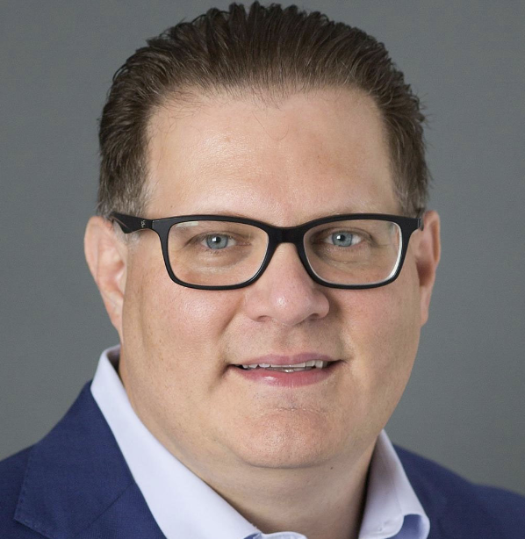
FLORIDA BAR NUMBER: 2401175N
PART 4: WEALTH PLANNING STRATEGIES WITH MATH AND BEYOND
Saturday, February 3, 2024
From 11:00 AM to 12:00 PM EST
(60 minutes)
Presented By:
Chris Roe, CPA, PFS
croe@rxwealthadvisors.com
Alan Gassman, JD, LL.M. (Taxation), AEP® (Distinguished)
agassman@gassmanpa.com
1245 Court Street
Clearwater, FL 33756

Slide 2
Please Note:
This presentation Qualifies for Continuing Education Credits for Florida ONLY.
Today’s PowerPoint slides are available in the “Handouts” section of your GoToWebinar side panel.
Within 3-5 hours after the webinar, all registrants will receive a follow-up email with today’s recording and PowerPoint materials.

Slide 3
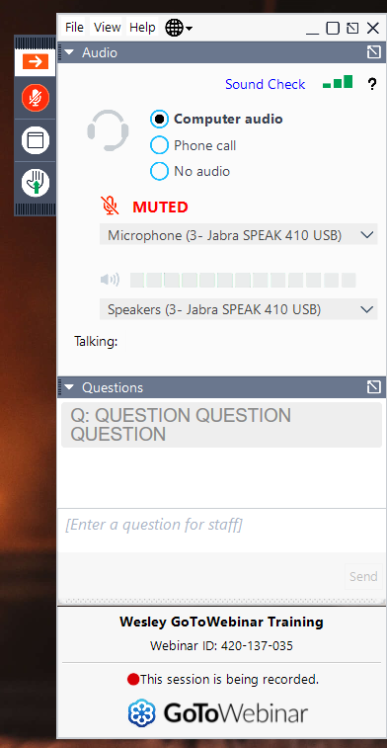
How Do I Ask A Question?
STEP 1:
Click Red Arrow to open Control Panel
STEP 2: Open Drop Down Arrow to Question Section; Type and send your question.

Slide 4
ALAN GASSMAN’S FREE SATURDAY WEBINAR SERIES
Past Video Recordings Are Available In Alan Gassman’s YouTube Library.

Slide 5
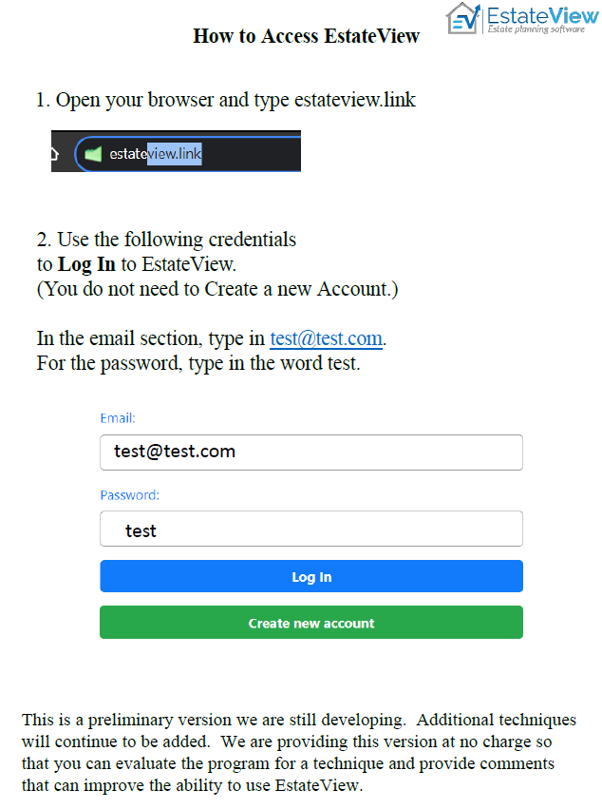

Slide 6
PREVIOUS SLIDES
PART 1: THE CPA’S GUIDE TO DESIGNING AND BUILDING A FAMILY’S COMPLEX WEALTH STRUCTURE
Saturday, October 28, 2023
From 11:00 AM to 12:00 PM EST
(60 minutes)
Presented By:
Chris Roe, CPA, PFS
croe@rxwealthadvisors.com
Alan Gassman, JD, LL.M. (Taxation), AEP® (Distinguished)
agassman@gassmanpa.com
1245 Court Street
Clearwater, FL 33756

Slide 7
Where Do We Start
Our “Purpose”
To compile a complete picture of the family’s current wealth structure
Identify risks the family faces and opportunities they have available to enhance their wealth based on their priorities.
To meet our purpose, we need “DATA” & information from many sources and the cooperation of the family’s current advisors
We sort through and analyze the data to organize & build a complete picture of the family’s current wealth structure

Slide 8
Where Do We Start
Understand and address the family’s needs in the following areas:
Family Tree
Current Assets & Liabilities
Current Cash Flow
Income, Gift & Estate Taxes
Businesses
Asset Protection
Insurances – Life, Property & Casualty and Diability
Estate Plan
Philanthropy & Philanthropic Structures
Children’s finances
Investments

Slide 9
Understand & Refine Family’s Priorities
Wealthy families have “Priorities”, not “Goals”
We seek to understand the family’s current priorities regarding:
Themselves
Their Children & Grandchildren
Their Business
Their Community
Priorities change over time.
These priorities set the framework and benchmark by which all family financial decisions are made.

Slide 10
Approach to Designing a Family’s Wealth Structure
Understand the Family’s priorities.
Evaluate and mitigate all risks the family face; be it with legal structures, insurance, behavioral counseling or diversification.
By mitigating risks, family can now focus on compounding their wealth over time without fear of a large risk loss.
Educate family to help with better decision making going forward.
Educate family and help make decisions with respect to who will be on the team.

Slide 11
Risks Wealthy Families Face
Inflation
Spending
Income & Estate Taxes
Family Division
Variance Drain
Investment Costs
Bad Decision Making
2nd Marriages & Children Spouses
In-Laws becoming Out-Laws (Divorce)
Lawsuits
Cybercrimes
Reputation

Slide 12
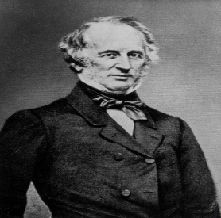
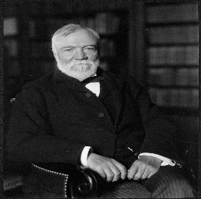
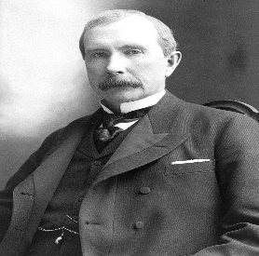
Inflation

Slide 13
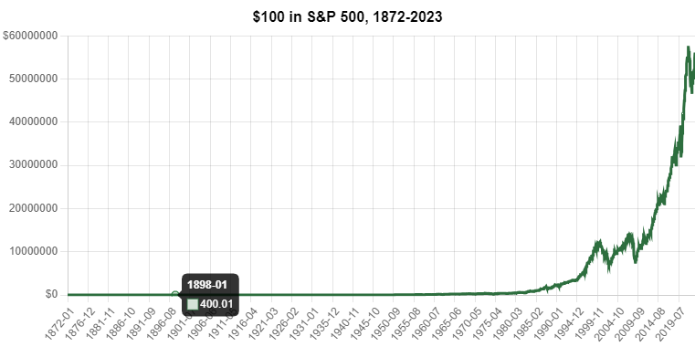
Inflation & Investment Returns
Source: https://www.officialdata.org/us/stocks/s-p-500/1872?amount=100&endYear=2023
The nominal investment return on $100 is $56m, or 56m%. In 2023, the family would have $56m. Avg Return = 9.13% over 151 years.
The avg. inflation rate of 7.75% per Advisor Perspective Chart, means the real return over this time was just 1.38%. Or purchasing power in inflation adjusted $s is $1.38m.
Does not account for any taxes paid along the way which interrupts compounding.

Slide 14
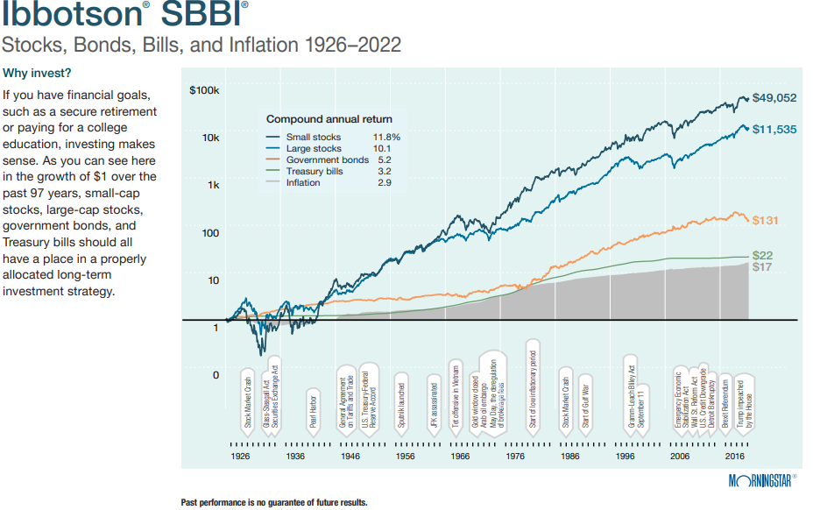
Inflation & Investment Returns

Slide 15
Spending/Divorce, Bad Decision
More family’s wealth is lost to overspending, bad behavior & divorce than to market losses, overpaying your advisor or investment costs or not earning enough investment return.
“If only we can make a higher return“, says the family. Investment returns can not be controlled; spending, decision making, and behavior can.
Do not operate your family’s decision making & spending like:

Slide 16
Taxes - Income & Estate
Each year, the family’s earnings from wages, business and investments are subject to income, sales tax and other taxes. Can be as high as 40.8% for income tax.
Families do not operate as a foundation or non-profit.
The wealth accumulated gets taxed on your way out of this world @ 40%

Slide 17
Family Division
Patriarch& Matriarch
Child 1
Child 2
Grandchild 3
Grandchild 4
Grandchild 1
Grandchild 2
Grandchild 5

Slide 18
Volatility & Draw Down Risk
Investment Return Variance - Owing investments are inherently price volatile and will profoundly impact a family's terminal wealth. This is often referred to as the “Volatility Tax” or Sequence of Return Risk.
Drawdown Risk – When a family funds lifestyle from investments, having a portfolio with potentially large drawdowns magnifies portfolio losses

Slide 19
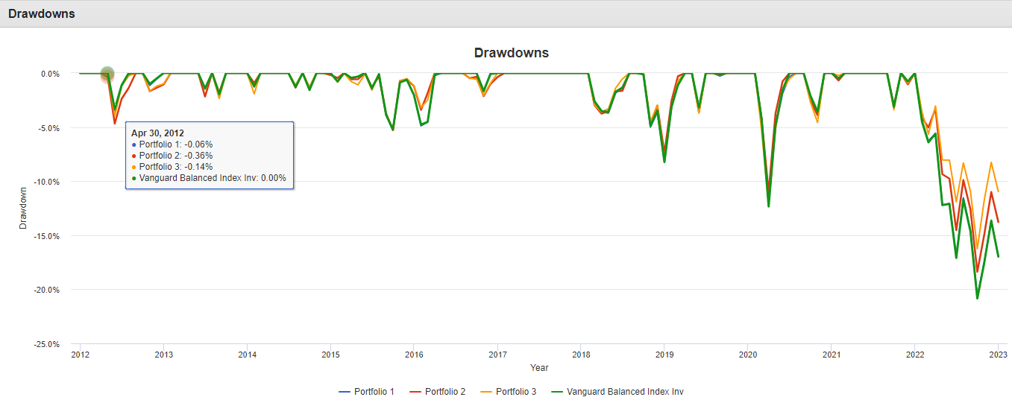
Volatility & Draw Down Risk (Continue)
Investment Return Variance & Draw Down Risk
Hypothetical Example (Past performance in not indicative of future results)
From Jan 1, 2012 to December 31, 2022: P(1), 60%/40% VTI/AGG, P(2) 60% VTI, 20% AGG, 20% Gold, 20% Commodities, P(3) 70% VTI, 5% AGG, 5% Gold, 5% Commodities; 5% Uncorrelated Diversifying Strategy. Includes Fee Withdrawal quarterly at .25%.

Slide 20
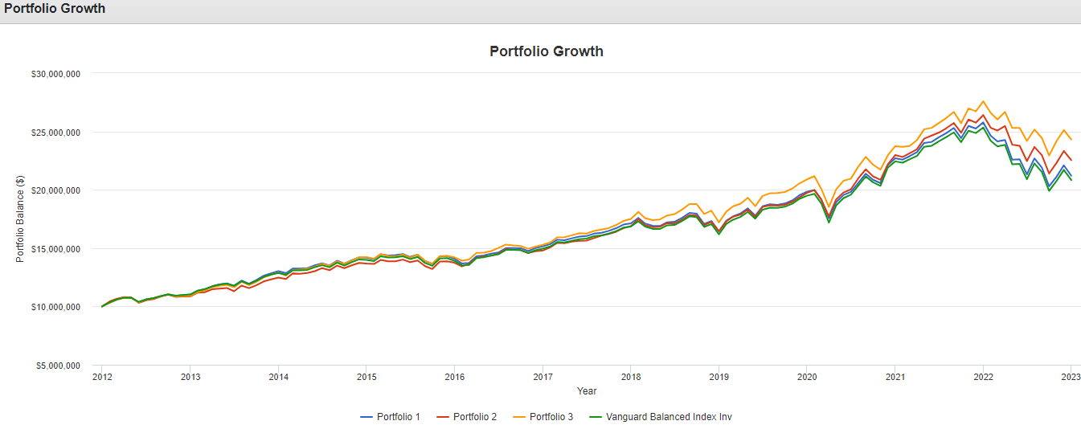
Investment Costs
Source: https://www.sec.gov/investor/alerts/ib_fees_expenses.pdf

Slide 21
Investment Costs
What are the family’s overall investment costs?
Are they paying too much for investment “Beta”?
Are their private investments appropriately priced? Or are they paying to much for “Access”?
Where do they own their investments? Are they tax efficient?

Slide 22
Risk & Opportunities Assessment
We prepare through the Lense of the family’s current priorities.
Our memo addresses the risks present in the family’s current wealth structure and provides current opportunities available to meet or enhance the family’s current priorities.
This the “Roadmap” to building the family’s wealth structure.

Slide 23
What Are We Looking For In Our Assessment
Net Worth
Business
Cash Flow
Asset Protection
Investments
Children
THE FAMILY
Taxes
Insurances
Estate Planning
Philanthropy

Slide 24
What to Look For In an Assessment (Part 1)
Net Worth
What are the assets & who owns them? What are the liabilities? What are the terms around the liabilities (i.e., interest rate, payments, etc.)? Any contingent liabilities to consider?
Account types (non-qualified or qualified) – Roth accounts?
Where is real estate located?
Businesses owned and percentage owned? How are they valued?
List of all toys, collectibles and other non-financial assets?
Current Cash Flow
Where is it coming from and how much does the family need each year to maintain lifestyle? Is it consistent or lumpy?
What is the percentage of cash flow taxable and non-taxable?

Slide 25
What to look for in an assessment (Part 2)
Insurances
Property and Casualty
Are all risks covered? Who is listed as the insured? Are all property owners listed? (For example, if a revocable trust owns the residence)
Is the property’s value adequately insured for full replacement cost
Are the autos, toys covered for their agreed value? IS OME (original manufacturer equipment) standard replacement?
Any excess liability coverage? Does it include underinsured/uninsured motorist? Does it extend across all assets?
Cyber risks? Collectibles coverage? Wind/Storm Damage?
Deductibles?
Life Insurance – Review all current policies and answer the following questions
Owner & Insured? Are the insured still in the same or better health?
Insurance’s Original purpose?
Is family still paying premiums? For how long?
What are the guarantees in the policies? (Get in force illustrations)
What is the rate of return on death benefit to life expectancy and 5 & 10 years beyond.
Term policies – What is the remaining length, what is the conversion feature?

Slide 26
What We Look For In Our Assessment (Part 3)
Insurances (Continue)
Disability Insurance
What is the annual premium?
What is the monthly benefit? What is definition of disability? Own Occupation?
Is this even needed?
Estate Plan – Review all estate documents and answer the following questions
What is their current exposure to Federal estate tax?
When were they executed and who serves in the fiduciary capacity?
What happens in the documents? Is this still the client’s wish?
What trusts do they have in place and what are the terms and who are the trustees?
Do their current trusts meet their current and future needs?
Are there other estate planning techniques they should be considering given their priorities?

Slide 27
What we look for in our assessment (Part 4)
Investments – Review their current investment holdings, allocation and location
Understanding their overall allocation, investment vehicles being used and the overall investment costs?
Where are the assets held (IRAs, Charitable Trusts or Foundations, Taxable Accounts, Their Children’s name)
What is the estimated after-tax return experienced?
What return is needed, post tax, inflation and lifestyle spending to grow assets?
How is each investment holder allocated relating to the objective and tax nature? For example, a non-grantor trust vs a charitable lead trust.
Income & Estate Taxes
Current tax bracket – ordinary income and capital gains? Will they remain in the same bracket for foreseeable future?
Capital loss or passive loss carryforward? Any charitable carry forwards. Are they getting the full impact of their charitable giving?
Are their parents and children in lower tax brackets? Are they be utilized for tax savings?
How much lifetime exemption have they used? How much GST have they sued?
Are they taking advantage of qualified plans?

Slide 28
What We Look For In Our Assessment (Part 5)
Children
Understand their current finances
Do they have estate documents?
What is their tax bracket?
Married? Prenuptials?
Philanthropy
Do they have a foundation or donor fund?
How do they give?
Are they planning any large gifts? Do they want to leave money upon their deaths?
Business
What is the current financial health?
Do they have adequate agreements in place? Are their entity documents up to date?
Is there a succession plan in place, if owner dies or becomes disability?

Slide 29
What We Look For In Our Assessment (Part 6)
Asset Protection
How to they own title to assets?
What risks are they facing?
Is there a prenuptial or post nuptial agreement? Should they or their children have one?
What state does the family domicile?
Do they operate domestic or internationally?
How considered are they with asset protection? How concerned should they be?
Are there ways to better protect their business and other assets?
What are the most litigious assets the client owns? Can they be isolated or insured to pass risk?
Philanthropy
Do they have a foundation or donor fund?
How do they give?
Are they planning any large gifts? Do they want to leave money upon their deaths?
Business
What is the current financial health?
Do they have adequate agreements in place? Are their entity documents up to date?
Is there a succession plan in place, if owner dies or becomes disability?

Slide 30
Design Deliverables
Deliverables
Family Tree
Current Net Worth Statement
Estate Tax Exposure
Income Tax Exposure
Summary of All Insurances
Flowchart of all entities
Summary of current estate plan, estate documents and fiduciaries
Asset allocation and location
Risk & Opportunities Memo
Strategy meeting to review and determine what recommendations will be implemented and when.
Next Step is we begin to Building Our Recommended Wealth Structure to address the risks and opportunities in the family’s current situation.

Slide 31
Disclosure
Rx Wealth Advisors, LLC (“[Rx Wealth]”) is a registered investment advisor offering advisory services in the State[s] of Pennsylvania & New Mexico and in other jurisdictions where exempted. Registration does not imply a certain level of skill or training.
This presentation is for informational, educational purposes only and is not intended as tax, accounting or legal advice, as an offer or solicitation of an offer to buy or sell, or as an endorsement of any company, security, fund, or other securities or non-securities offering. This communication should not be relied upon as the sole factor in an investment or financial plan making decision. Any user should consult their financial, tax or legal advisor before taking any action on behalf of themselves or their clients.
Past performance is no indication of future results. Investment in securities involves significant risk and has the potential for partial or complete loss of funds invested. It should not be assumed that any recommendations made will be profitable or equal the performance noted in this publication.
The information herein is provided “AS IS” and without warranties of any kind either express or implied. To the fullest extent permissible pursuant to applicable laws, [Rx Wealth Advisors, LLC(referred to as “Rx Wealth”) disclaims all warranties, express or implied, including, but not limited to, implied warranties of merchantability, non-infringement, and suitability for a particular purpose.
All opinions and estimates constitute Chris J. Roe, CPA/PFS & Rx Wealth’s judgement as of the date of this communication and are subject to change without notice. Rx Wealth does not warrant that the information will be free from error. The information should not be relied upon for purposes of transacting securities or other investments. Your use of the information is at your sole risk.
Under no circumstances shall Chris J. Roe, CPA/PFS or Rx Wealth be liable for any direct, indirect, special or consequential damages that result from the use of, or the inability to use, the information provided herein, even if Rx Wealth or a Rx Wealth’s authorized representative has been advised of the possibility of such damages. Information contained herein should not be considered a solicitation to buy, an offer to sell, or a recommendation of any security or planning idea in any jurisdiction where such offer, solicitation, or recommendation would be unlawful or unauthorized.

Slide 32
PREVIOUS SLIDES
PART 2: IMPLEMENTING A FAMILY’S COMPLEX WEALTH STRUCTURE
Saturday, December 2, 2023
From 11:00 AM to 12:00 PM EST
(60 minutes)
Presented By:
Chris Roe, CPA, PFS
croe@rxwealthadvisors.com
Alan Gassman, JD, LL.M. (Taxation), AEP® (Distinguished)
agassman@gassmanpa.com
1245 Court Street
Clearwater, FL 33756

Slide 33
Risks Wealthy Families Face
Bad Decision Making
2nd Marriages & Children Spouses
In-Laws becoming Out-Laws (Divorce)
Lawsuits
Cybercrimes
Reputation
Inflation
Spending
Income & Estate Taxes
Family Division
Variance Drain
Investment Costs

Slide 34
Inflation

Slide 35
Inflation & Investment Returns
Source: https://www.officialdata.org/us/stocks/s-p-500/1872?amount=100&endYear=2023
The nominal investment return on $100 is $56m, or 56m%. In 2023, the family would have $56m. Avg Return = 9.13% over 151 years.
The avg. inflation rate of 7.75% per Advisor Perspective Chart, means the real return over this time was just 1.38%. Or purchasing power in inflation adjusted $s is $1.38m.
Does not account for any taxes paid along the way which interrupts compounding.

Slide 36
Inflation & Investment Returns

Slide 37
Spending/Divorce, Bad Decision
More family’s wealth is lost to overspending, bad behavior & divorce than to market losses, overpaying your advisor or investment costs or not earning enough investment return.
“If only we can make a higher return“, says the family. Investment returns can not be controlled; spending, decision making, and behavior can.
Do not operate your family’s decision making & spending like:

Slide 38
Taxes - Income & Estate
Each year, the family’s earnings from wages, business and investments are subject to income, sales tax and other taxes. Can be as high as 40.8% for income tax.
Families do not operate as a foundation or non-profit.
The wealth accumulated gets taxed on your way out of this world @ 40%

Slide 39
Family Division
Patriarch& Matriarch
Child 1
Child 2
Grandchild 3
Grandchild 4
Grandchild 1
Grandchild 2
Grandchild 5

Slide 40
Volatility & Draw Down Risk
Investment Return Variance - Owning investments are inherently price volatile and will profoundly impact a family's terminal wealth. This is often referred to as the “Volatility Tax” or Sequence of Return Risk.
Drawdown Risk – When a family funds lifestyle from investments, having a portfolio with potentially large drawdowns magnifies portfolio losses

Slide 41
Volatility & Draw Down Risk (Continue)
Investment Return Variance & Draw Down Risk
Hypothetical Example (Past performance in not indicative of future results)
From Jan 1, 2012 to December 31, 2022: P(1), 60%/40% VTI/AGG, P(2) 60% VTI, 20% AGG, 10% Gold, 10% Commodities, P(3) 70% VTI, 15% AGG, 5% Gold, 5% Commodities; 5% Uncorrelated Diversifying Strategy. Includes Fee Withdrawal quarterly at .25%.

Slide 42
Volatility & Draw Down Risk (Continue)
Investment Return Variance & Draw Down Risk
Hypothetical Example Continues (Past performance in not indicative of future results) - From March 2006 through October 2023

Slide 43
Volatility & Draw Down Risk (Continue)
Investment Return Variance & Draw Down Risk
Hypothetical Example Continues (Past performance in not indicative of future results) – From March 2006 through October 2023

Slide 44
Investment Costs
Source: https://www.sec.gov/investor/alerts/ib_fees_expenses.pdf

Slide 45
Investment Costs
What are the family’s overall investment costs?
Are they paying too much for investment “Beta”?
Are their private investments appropriately priced? Or are they paying to much for “Access”?
Where do they own their investments? Are they tax efficient?

Slide 46
Risk & Opportunities Assessment
We prepare through the Lense of the family’s current priorities.
Our memo addresses the risks present in the family’s current wealth structure and provides current opportunities available to meet or enhance the family’s current priorities.
This the “Roadmap” to building the family’s wealth structure.

Slide 47
What are we look for in our assessment
Net Worth
Business
Cash Flow
Asset Protection
Investments
Children
THE FAMILY
Taxes
Insurances
Estate Planning
Philanthropy

Slide 48
What We Look For In Our Assessment (Part 1)
Net Worth
What are the assets & who owns them? What are the liabilities? What are the terms around the liabilities (i.e., interest rate, payments, etc.)? Any contingent liabilities to consider?
Account types (non-qualified or qualified) – Roth accounts?
Where is real estate located?
Businesses owned and percentage owned? How are they valued?
List of all toys, collectibles and other non-financial assets?
Current Cash Flow
How much does the family need each year to maintain lifestyle? Where is it coming from? Is it consistent or lumpy?
What is the percentage of cash flow that is taxable and non-taxable?

Slide 49
What We Look For In Our Assessment (Part 2)
Insurances
Property and Casualty
Are all risks covered? Who is listed as the insured? Are all property owners listed? (For example, if a revocable trust owns the residence)
Is the property’s value adequately insured for full replacement cost
Are the autos, toys covered for their agreed value? IS OME (original manufacturer equipment) standard replacement?
Any excess liability coverage? Does it include underinsured/uninsured motorist? Does it extend across all assets?
Cyber risks? Collectibles coverage? Wind/Storm Damage?
Deductibles?
Life Insurance – Review all current policies and answer the following questions
Owner & Insured? Are the insured still in the same or better health?
Insurance’s Original purpose?
Is family still paying premiums? For how long?
What are the guarantees in the policies? (Get in force illustrations)
What is the rate of return on death benefit to life expectancy and 5 & 10 years beyond.
Term policies – What is the remaining length, what is the conversion feature?

Slide 50
What We Look For In Our Assessment (Part 3)
Insurances (Continue)
Disability Insurance
What is the annual premium?
What is the monthly benefit? What is definition of disability? Own Occupation?
Is this even needed?
Estate Plan – Review all estate documents and answer the following questions
What is their current exposure to Federal estate tax?
When were they executed and who serves in the fiduciary capacity?
What happens in the documents? Is this still the client’s wish?
What trusts do they have in place and what are the terms and who are the trustees?
Do their current trusts meet their current and future needs?
Are there other estate planning techniques they should be considering given their priorities?

Slide 51
What We Look For In Our Assessment (Part 4)
Investments – Review their current investment holdings, allocation and location
Understanding their overall allocation, investment vehicles being used and the overall investment costs?
Where are the assets held (IRAs, Charitable Trusts or Foundations, Taxable Accounts, Their Children’s name)
What is the estimated after-tax return experienced?
What return is needed, post tax, inflation and lifestyle spending to grow assets?
How is each investment holder allocated relating to the objective and tax nature? For example, a non-grantor trust vs a charitable lead trust.
Income & Estate Taxes
Current tax bracket – ordinary income and capital gains? Will they remain in the same bracket for foreseeable future?
Capital loss or passive loss carryforward? Any charitable carry forwards? Are they getting the full impact of their charitable giving?
Are their parents and children in lower tax brackets? Are they be utilized for tax savings?
How much lifetime exemption have they used? How much GST have they used?
Are they taking advantage of qualified plans?

Slide 52
What We Look For In Our Assessment (Part 5)
Asset Protection
How to they own title to assets?
What risks are they facing?
Is there a prenuptial or post nuptial agreement? Should they or their children have one?
What state does the family domicile?
Do they operate domestically, internationally or both?
How concerned are they with asset protection? How concerned should they be?
Are there ways to better protect their business and other assets?
What are the most litigious assets the client owns? Can they be isolated or insured to pass risk?

Slide 53
What We Look For In Our Assessment (Part 6)
Children
Understand their current finances
Do they have estate documents?
What is their tax bracket?
Married? Prenuptials?
Philanthropy
Do they have a foundation or donor fund?
How do they give?
Are they planning any large gifts? Do they want to leave money upon their deaths?
Business
What is the current financial health?
Do they have adequate agreements in place? Are their entity documents up to date?
Is there a succession plan in place, if owner dies or becomes disability?

Slide 54
Design Deliverables
Deliverables
Family Tree
Current Net Worth Statement
Estate Tax Exposure
Income Tax Exposure
Summary of All Insurances
Flowchart of all entities
Summary of current estate plan, estate documents and fiduciaries
Asset allocation and location
Risk & Opportunities Memo (Road Map)
Strategy meeting to review and determine what recommendations will be implemented and when.
Next Step is we begin to Build Our Recommended Wealth Structure based on the developed Road Map.

Slide 55
Assembling the Client’s Team
Family Wealth Advisor (the “Chief of Staff”)
Attorneys – Not only estate but for other legal issues a family may have
Accountant
Insurance Brokers
Investment Managers
Other Advisors
Concierge Services – Planes, Trains & Automobiles

Slide 56
Building Strategies & Structures
Based on the Road Map & the Family’s Priorities
Address risks a family faces & the opportunities to enhance their priorities.
Evaluate enhanced opportunities in the following areas:
Family Communication and Priorities
Assets & Liabilities
Investments
Estate Plan
Asset Custody
Consolidation of assets for simplification
Adequate Cash Reserves & Placement
Risk Management & Asset Protection

Slide 57
Reporting & Monitoring
How do we collect & share Family Data
Design the Reporting Structure
Family Priorities & Accomplishments
Family Snapshot – What is important to family
Net Worth
Estate Planning & Business Entities
Accounting & Cash Flow
Taxes
Investment Reporting on Liquid & Illiquid Investments
Reporting across generations

Slide 58
Goal of Designing A Family Wealth Structure
Coordinate – Every aspect of the family’s financial life with team members.
Consolidate – Minimum number of entities, accounts and paperwork necessary to meet the client’s priorities and protect their wealth
Comprehensive – We work on all aspects of their finances
Simplify – To reduce the burden placed on the family in managing their finances so they can focus on what is truly important to them
Accountability – Provide accountability amongst the team to provide the best advice to the family

Slide 59
Goal of Designing A Family Wealth Structure
While most families do not grow their wealth or even maintain it over the generations, they just watch it disappear before their eyes.
To grow wealth, it takes patience, sacrifice, time, hard slogging and paying attention to the minuet details.
We believe a coordinate approach to managing a family’s complex wealth and paying attention to the small stuff gives them the best opportunity to grow their wealth.

Slide 60
FLORIDA BAR COURSE NUMBER: 2312050N
PART 3: MANAGING A FAMILY’S COMPLEX WEALTH STRUCTURE
Saturday, December 16, 2023
From 11:00 AM to 12:00 PM EST
(60 minutes)
Presented By:
Chris Roe, CPA, PFS
croe@rxwealthadvisors.com
Alan Gassman, JD, LL.M. (Taxation), AEP® (Distinguished)
agassman@gassmanpa.com
1245 Court Street
Clearwater, FL 33756

Slide 61
INTRODUCTION
EstateView is designed to be an educational tool to assist new and accomplished professionals in understanding and designing techniques.
It is also designed to provide all important calculations and illustrations that a planner may want to use to determine how to best plan an estate, and how to educate and illustrate clients and others.

Slide 62
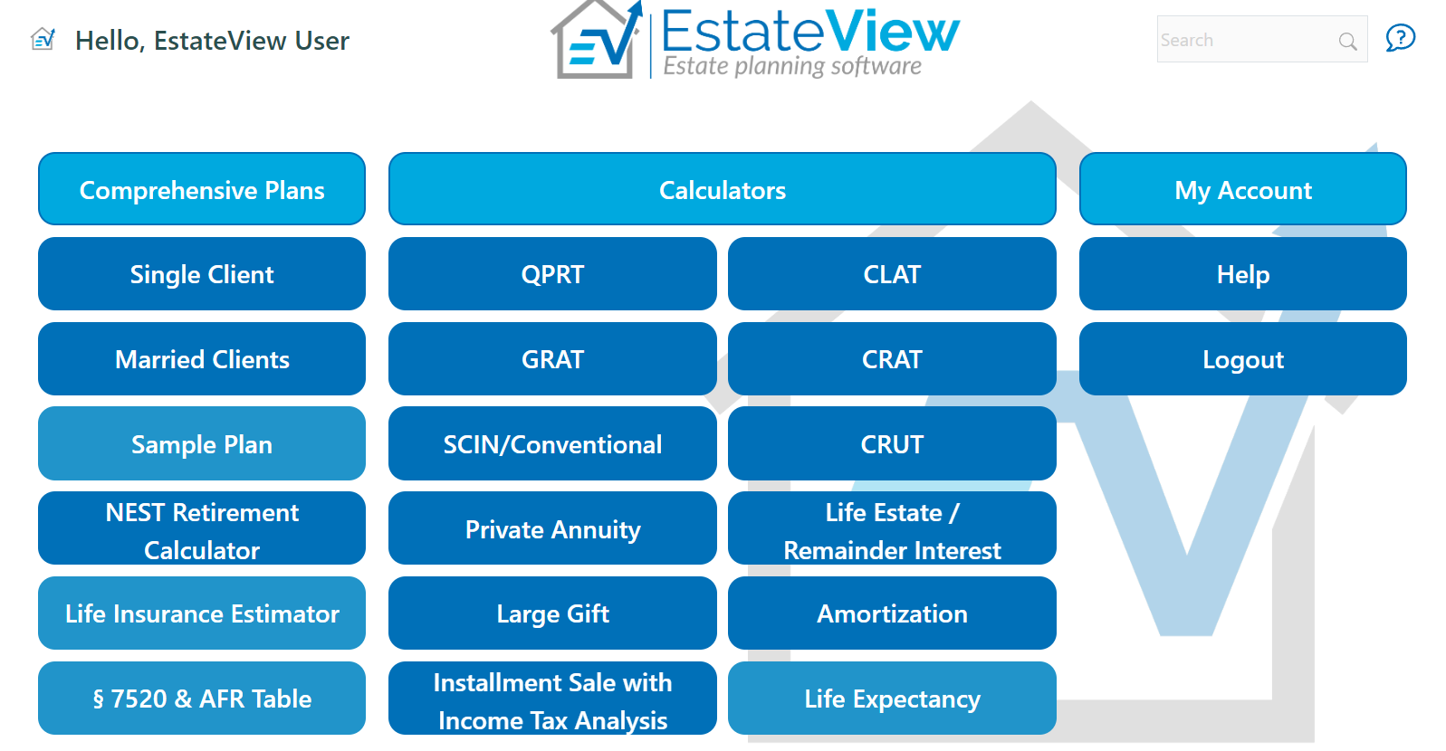

Slide 63
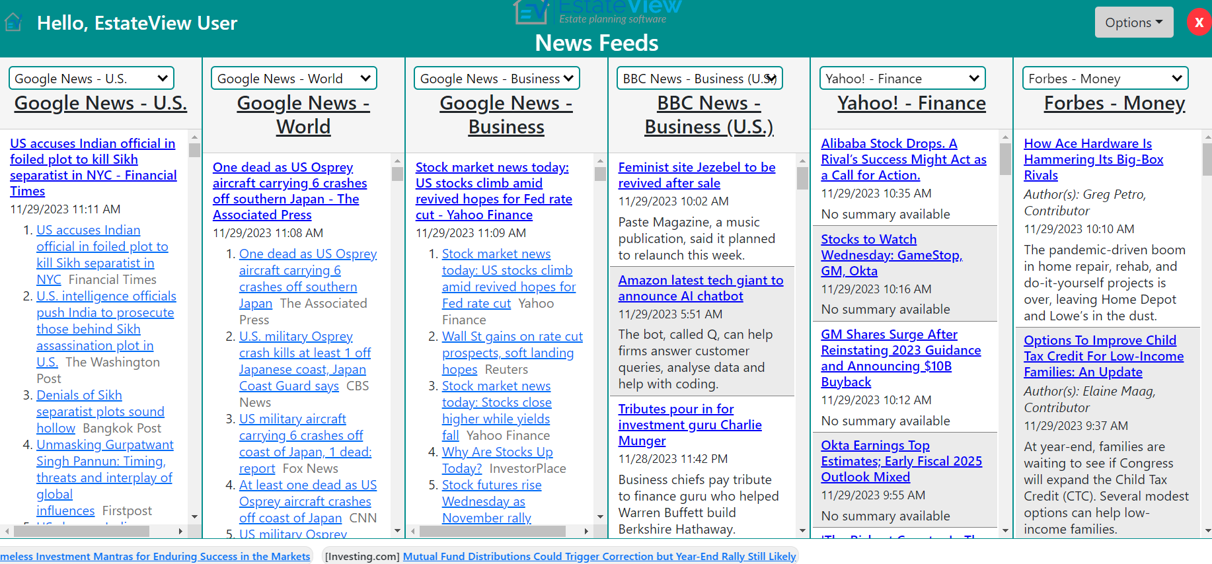

Slide 64
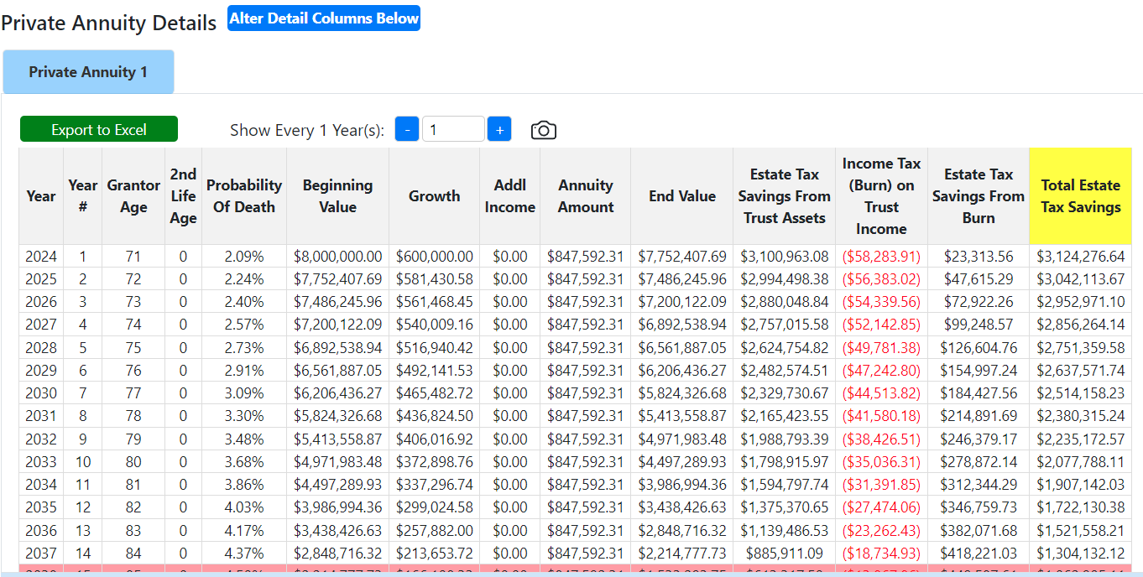

Slide 65
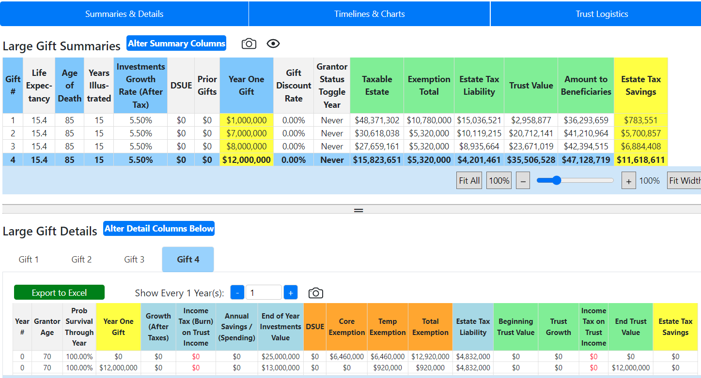

Slide 66
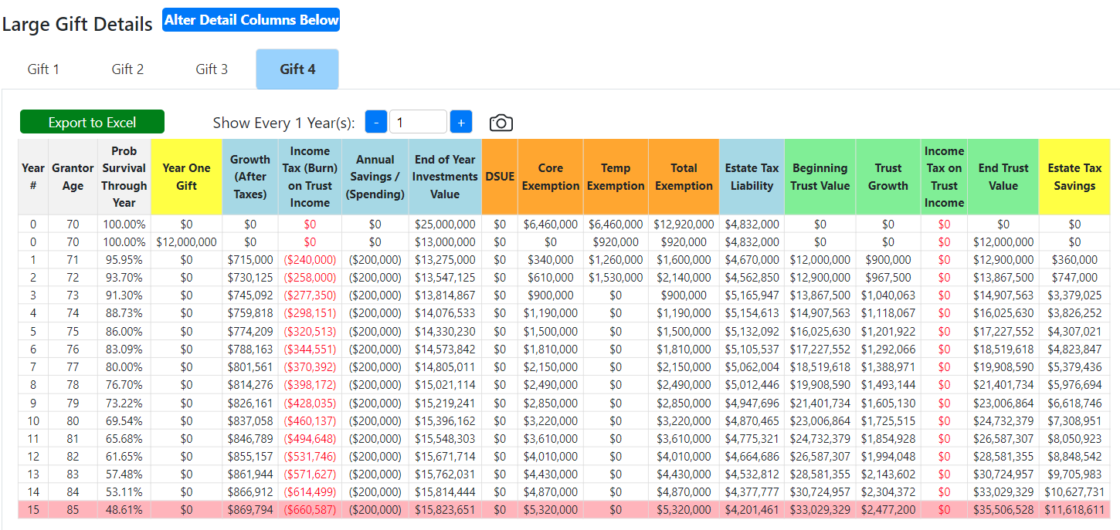

Slide 67
INTRODUCTION
University course curriculum – being used in one or more LL.M. programs as part of their curriculum, with free student use during the LL.M. program and for one year thereafter. Designed to be a great team training tool!

Slide 68
IMPORTANT FEATURES
1) Easy dial-up and down controls/dashboards.

Slide 69
IMPORTANT FEATURES
2) Easy "side by side" comparisons of outcomes by variable.

Slide 70
IMPORTANT FEATURES
3) Provides instructional videos prepared by experienced estate tax lawyers and other professionals. Will qualify for CPA credit at CPAAcademy.org.
COMMENTS:
These will be provided by January 8, 2024. Working on national legal CLE credit for videos.

Slide 71
IMPORTANT FEATURES
4) Usable by PCs, Apple computers, iPads, and some smart phones.

Slide 72
IMPORTANT FEATURES
5) Shows the impact of the "burn" - Grantor pays tax on Trust income until toggled off.

Slide 74
IMPORTANT FEATURES
6) Calculates SCIN premiums for balloon payments beyond Table 2010 life expectancy.

Slide 75
IMPORTANT FEATURES
7) Calculates Charitable Remainder Trust 5% and 10% tests using pro-rated first-year payments as required under Treasury Regulation.
COMMENTS:
By December 31, 2024.

Slide 76
IMPORTANT FEATURES
8) Shows discounted present values for CLAT remainder and charitable interests.

Slide 77
IMPORTANT FEATURES
9) Shows impact of rent payments after QPRT term, or impact of QPRT SLAT with surviving spouse paying no rent.
COMMENTS:
In comprehensive planning module.

Slide 78
IMPORTANT FEATURES
10) Generates customizable and exportable spreadsheets for each chosen technique application that automatically transfers to a PowerPoint.
COMMENTS:
Separate PowerPoint per spreadsheet will be operational by December 12.

Slide 79
IMPORTANT FEATURES
11) Provides client-specific PowerPoint illustrations, general explanations, checklists by technique and sample language.

Slide 80
IMPORTANT FEATURES
12) Will generate a client-specific net worth and savings spreadsheet that can be used by financial planners to illustrate possible retirement scenarios and amounts of life insurance needed when primary earner dies prematurely.
COMMENTS:
The exportable spreadsheet can be sent to the client’s financial planner to request input and guidance, with a separate column for each major item of income and expenditure by December 10, 2023.

Slide 81
IMPORTANT FEATURES
13) Provides typical life insurance rates by age and sex for standard and preferred non-smokers - 10, 20 and 30 yr. term and lifetime universal.
COMMENTS:
Will include 10-Year Term and Guaranteed Universal Life (GUL) by December 31, 2023.

Slide 82
IMPORTANT FEATURES
14) Life insurance planning includes1 ability to enter details of each policy now existing and as will exist in the future, with and without ILITs, can calculate and summarize results for an infinite number of policies. Recognizes the 3-year rule.
COMMENTS:
Will recognize 3-year rule by December 10, 2023.

Slide 83
IMPORTANT FEATURES
15) Large gift module has columns for DSUE, temporary exemption, and permanent exemption to demonstrate savings from gifting more than DSUE and permanent exemption before 2026 – also permits gift splitting and shows “the burn.”

Slide 84
IMPORTANT FEATURES
16) Will include the following videos for each calculator:
a) A client-friendly explanation.
b) How to use the software for the calculator.
c) A technical tax discussion with illustrations.

Slide 85
IMPORTANT FEATURES
17) Maintained by Alan Gassman under the direction of Jerry Hesch and others.

Slide 86
IMPORTANT FEATURES
18) Shows simultaneous use (with the results provided by each use) of a combination of up to 9 techniques in the following order from the following strategies:
a) Bypass/Credit Shelter Trust.
b) Use or loss of DSUE.
c) Exemption going to half in 2026 or not.

Slide 87
IMPORTANT FEATURES
d) Annual gifting to Crummey Trust and/or descendants.
e) Above annual gifting of discounted assets.
f) One or two QPRT's - SLAT QTIP.
g) Life insurance before and after planning for each spouse and second to die.
h) Installment Sale and/or large gift to Grantor Trust, including for “exploding value assets.”
i) Testamentary charitable or CLAT disposition.
j) Comprehensive modules also prepare a detailed letter to the client.

Slide 88
IMPORTANT FEATURES
19) Email illustrations and calculator with a link and security password to clients and colleagues to enable them to change variables and use software for up to 14 days by simple e-mail of link.
COMMENTS:
Many clients like to receive a customized video of their planner using and explaining their situation on the software – with the opportunity to use it themselves by December 10, 2023.

Slide 89
IMPORTANT FEATURES
20) Clearly informs the user of when to use the closest calendar age versus the last birthday for each technique.

Slide 90
IMPORTANT FEATURES
21) Clearly tells the user whether they can use the present 7520 rate or the lowest of this month or the previous two months.

Slide 91
IMPORTANT FEATURES
22) Provides warnings when settings may violate reasonable practices such as:
a) When the probability of exhaustion test may be violated for a private annuity arrangement.
b) When any valuation discount exceeds 40%.
c) When a valuation discount for an LLC used in a GRAT or CLAT with a short payout (under 10 years) exceeds a 20% discount.

Slide 92
IMPORTANT FEATURES
d) When a SCIN Term Exceeds the 2010 Mortality Life Expectancy Table (which may be permissible).
e) Whether the latest birth date age or closest to calendar year age is to be used.
f) When a seed capital gift is less than 10% of an installment sale or SCIN sale amount.
g) Where a SCIN interest rate exceeds or approaches a usury rate (18%).

Slide 93
IMPORTANT FEATURES
h) When a QPRT term exceeds the Grantor having a 70% chance of surviving the term under Table 2010.
COMMENTS:
Most of these are in place – will all be in place by November 10, 2023.

Slide 94
IMPORTANT FEATURES
23) The software automatically selects:
a) The lowest available AFR for the month of a sale and the 2 preceding months.
b) The lowest available AFR for a non-sale loan.
c) The best available 7520 rate for a Charitable Remainder Trust or Charitable Lead Trust is the best of the month of funding or the preceding 2 months.

Slide 95
IMPORTANT FEATURES
d) The maximum credit shelter trust that can be funded at a future date based upon the anticipated chained inflation rate and other techniques being used.
e) The amortization calculator allows the user to solve for any of the following 4 items by providing the other 3:
i) Payment amount.
ii) Principal loaned.
iii) Interest rate.
iv) Frequency and length of term.

Slide 96
IMPORTANT FEATURES
24) Our simple "SWIFT PLAN MODE" mode defines primary terms and significant traps for the unwary on the same screen that shows the planning numbers outcomes.
COMMENTS:
Traps for the unwary will be completed by November 7, 2023.

Slide 97
IMPORTANT FEATURES
25) Absolutely free until April 1, 2024.
COMMENTS:
Traps for the unwary will be completed by November 7, 2023.

Slide 98
IMPORTANT FEATURES
26) Expected pricing:
a) Professional will include most items provided by competitors, plus side by side comparisons and comprehensive modules ($199.95 per year).
b) Professional PRO will include PowerPoints and comprehensive letters ($349.95 per year).
c) Professional PRO Elite version will include all features. ($499.95 per year)

Slide 99
IMPORTANT FEATURES
Those who commit to purchase before April 1, 2024 will receive guaranteed no increased pricing for 24 calendar months.
This will be for 36 calendar months for those who sign up on or before January 12, 2024.
Updates at pro-rata pricing will be available during the year.

Slide 100
IMPORTANT FEATURES
27) Select newsfeed with 30-minute updates feature.

Slide 101
IMPORTANT FEATURES
28) Chat function and room moderated by a tax and estate planning lawyer, accessible only to subscribers.
COMMENTS:
Please volunteer to be a monitor.

Slide 102
IMPORTANT FEATURES
29) Estate Plans of the Week Award - and discussion - a weekly email and video showing one or more examples of how our subscribers have used EstateView for their clients.

Slide 103
IMPORTANT FEATURES
30) Almost 24/7 customer service - Monday through Saturday - by four tax lawyers and law students at Gassman, Crotty & Denicolo, P.A. during normal business hours EST and technical assistance "almost 24/7" by our full-time programmer, and U.S. and Philippine-based lawyers and legal assistants employed by Gassman, Crotty & Denicolo, P.A.
COMMENTS:
Competitors do offer notable service by well-qualified tax professionals.

Slide 104
Please Note:
This presentation Qualifies for Continuing Education Credits for Florida ONLY.
Today’s PowerPoint slides are available in the “Handouts” section of your GoToWebinar side panel.
Within 3-5 hours after the webinar, all registrants will receive a follow-up email with today’s recording and PowerPoint materials.

Slide 105
How Do I Ask A Question?
STEP 1:
Click Red Arrow to open Control Panel
STEP 2: Open Drop Down Arrow to Question Section; Type and send your question.

Slide 106
ALAN GASSMAN’S FREE SATURDAY WEBINAR SERIES
Past Video Recordings Are Available In Alan Gassman’s YouTube Library.

Slide 108
FLORIDA BAR NUMBER: 2401175N
PART 4: WEALTH PLANNING STRATEGIES WITH MATH AND BEYOND
THANK YOU FOR PARTICIPATING!
Saturday, February 3, 2024
From 11:00 AM to 12:00 PM EST
(60 minutes)
Presented By:
Chris Roe, CPA, PFS
croe@rxwealthadvisors.com
Alan Gassman, JD, LL.M. (Taxation), AEP® (Distinguished)
agassman@gassmanpa.com
1245 Court Street
Clearwater, FL 33756

