Slide 1




THE BUSINESS OF MEDICINE: LEGAL STRUCTURES AND TAXATION
Saturday, January 6, 2024
From 11:00 AM to 12:00 PM EST
(60 minutes)
Presented By:
Alan Gassman, JD, LL.M. (Taxation), AEP® (Distinguished)
agassman@gassmanpa.com
Lynda Dilts-Benson, RN, CCM, LHRM, CRC
Pariksith Singh, M.D.
1245 Court Street
Clearwater, FL 33756

Slide 2
Please Note:
This presentation does not qualify for Continuing Education Credits.
Today’s PowerPoint slides are available in the “Handouts” section of your GoToWebinar side panel.
Within 3-5 hours after the webinar, all registrants will receive a follow-up email with today’s recording and PowerPoint materials.

Slide 3
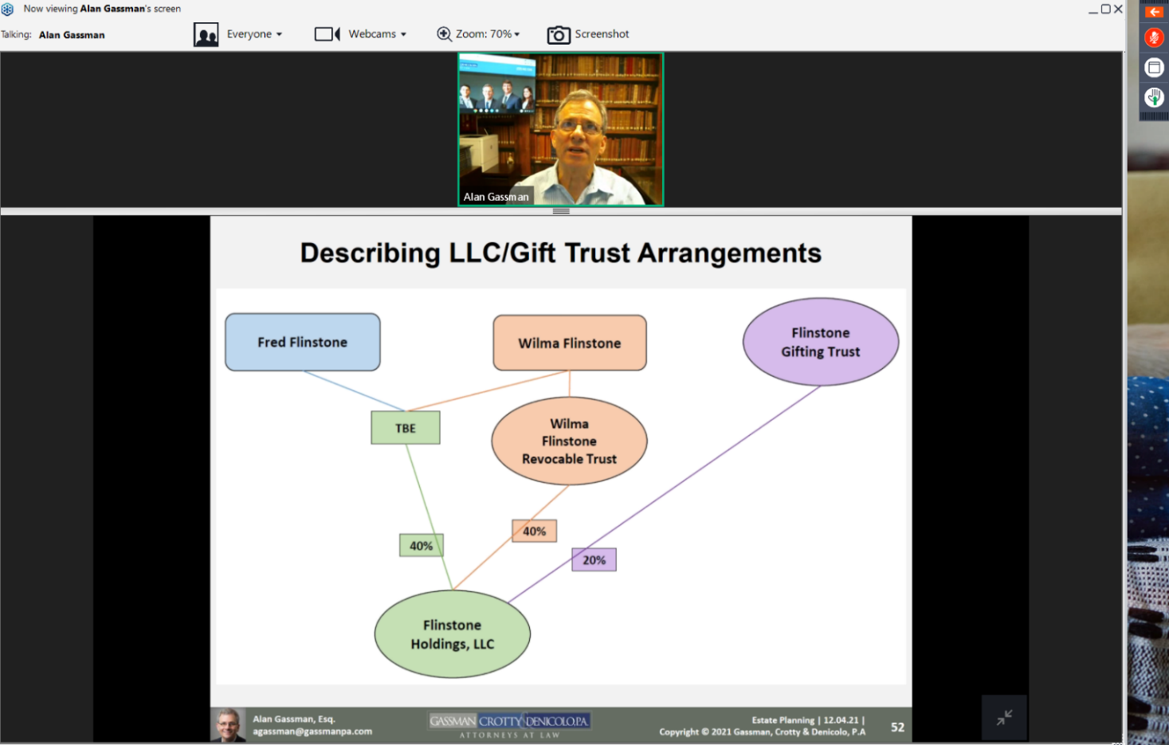

How Do I Ask A Question?
STEP 1:
Click Red Arrow to open Control Panel
STEP 2: Open Drop Down Arrow to Question Section; Type and send your question.

Slide 4


ALAN GASSMAN’S FREE SATURDAY WEBINAR SERIES
Past Video Recordings Are Available In Alan Gassman’s YouTube Library.

Slide 5





Email info@gassmanpa.com if you would like to subscribe to the Thursday Report.

Slide 6



When will the 58th Annual Heckerling Institute on Estate Planning be held?
The 58th Annual Heckerling Institute on Estate Planning will be held in Orlando, FL on January 8-12, 2024.
Come Visit us at Interactive Legal’s Booth
Click here to view

Slide 7



Slide 8


Slide 9
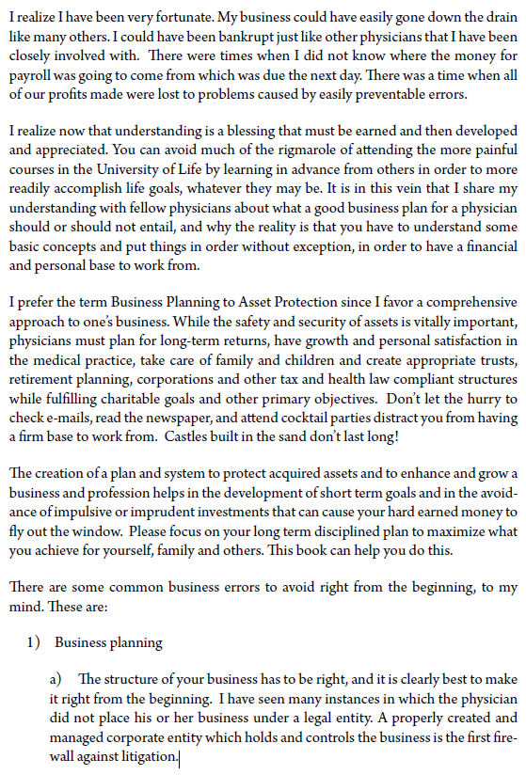

Slide 10
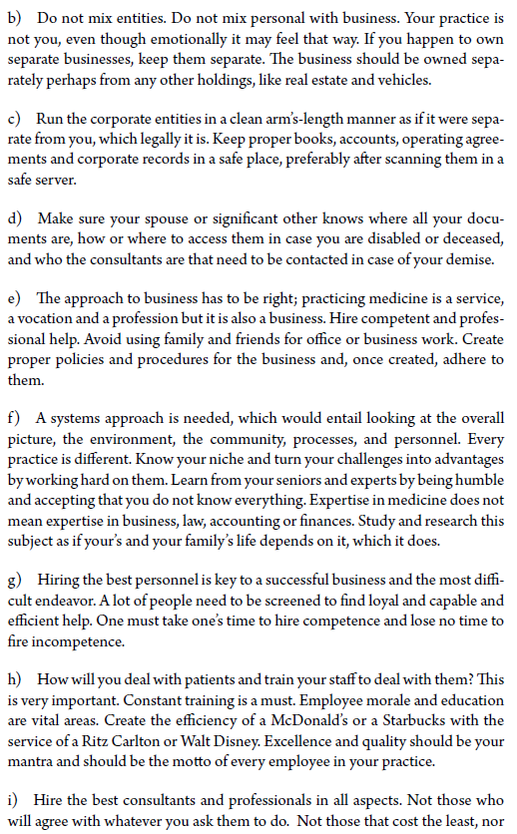

Slide 11
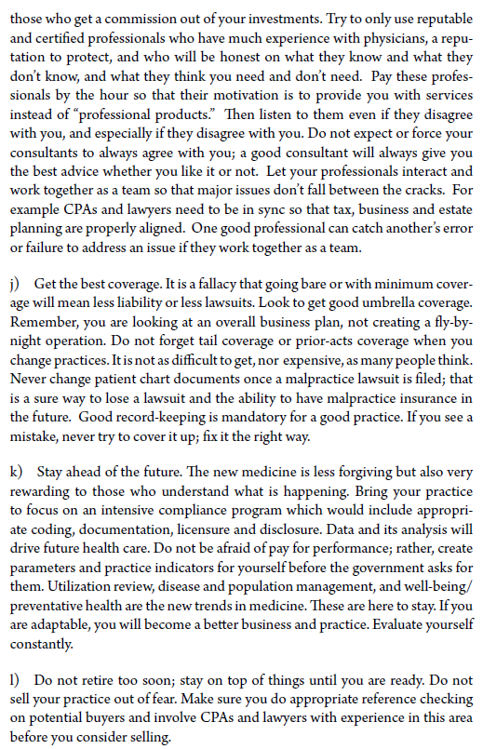

Slide 12
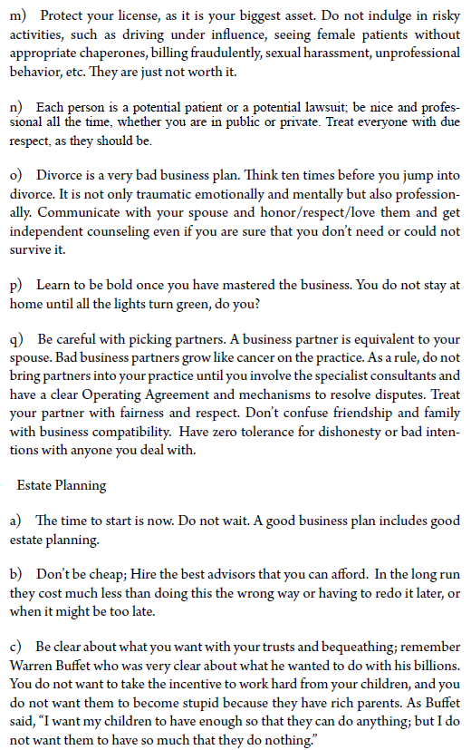

Slide 13
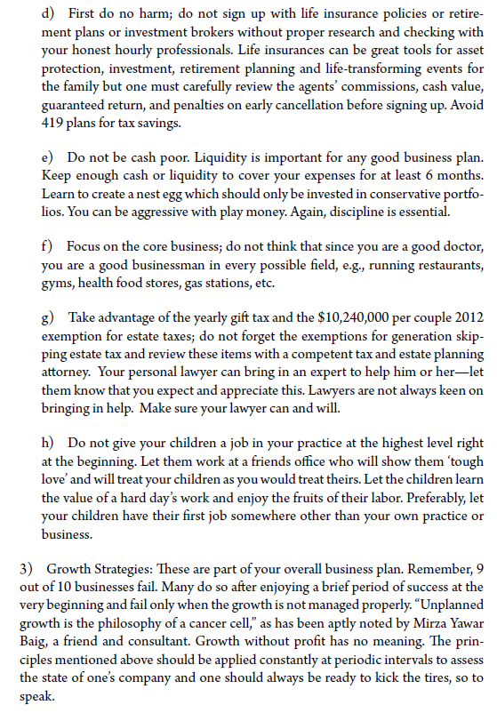

Slide 14
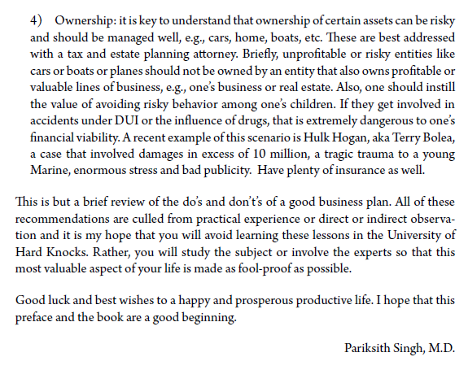

Slide 15


Slide 16


Slide 17
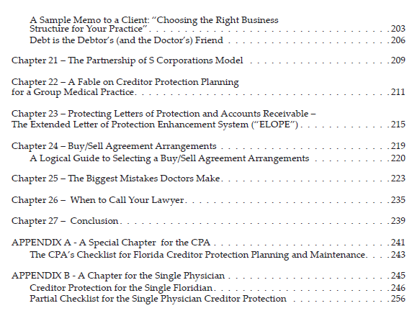

Slide 18
Definitions
S Corporation: a corporation or limited liability company (LLC) that affirmatively elects to be treated as an S corporation for federal income tax purposes by filing Form 2553
C Corporation: a corporation that does not make an S election, including a LLC that affirmatively elects to be treated as a C corporation for income tax purposes by filing Form 8832

Slide 19
Definitions
Partnership: an entity, which may include an LLC or a limited partnership (LP), formed under state law that is treated as a partnership for federal income tax purposes
  Entities taxed as partnerships do not pay any federal income taxes—somewhat like an S corporation, the income and deductions of the entity flow through to its partners
Limited liability company: an entity that may be taxed as an S corporation, C corporation, partnership, or “disregarded”

Slide 20
Definitions
Disregarded LLC: the income and deductions of the disregarded LLC go directly onto the income tax return of its 100% owner—that may be the Schedule C (for a business or a medical practice) or Schedule E (for a rental activity) on the IRS Form 1040

Slide 21
Basic Income Tax Operations
Shareholder
(Dividends are taxed)
Shareholder
(Dividends are not taxed)
Partners
(Individuals, S corporations or otherwise) (Distributions are not taxed)
C CORP
TAXED ENTITY
S CORP
TAXED ENTITY
PARTNERSHIP TAXED ENTITY
PROPRIETORSHIP (DISREGARDED ENTITY)
C CORPORATIONS
Entity is taxed for income at 21%; shareholders taxed for dividends and distributions.
Corporate level tax–revenues minus deductible expenses
Contribution of appreciated assets can trigger tax unless the 80% rule is followed under IRC Section 351.
Income is triggered if an appreciated asset or accounts receivable are transferred from the C corporation to shareholders unless it is deductible compensation.
Dividends are not deductible expenses.
May deduct healthcare and disability insurance expenses under certain circumstances.
In the highest individual tax bracket on the first dollar of income if this is a personal service company.
S CORPORATIONS
Owners are taxed at individual rates for salary and income of the company.
Income and deductions are computed and then go on income tax returns of owners by K-1 reporting.
Contribution of appreciated assets can trigger tax unless the 80% rule is followed under IRC § 351.
Income is triggered if an appreciated asset or accounts receivable are transferred from the S corporation to shareholders unless it is deductible compensation.
Special rules apply if an S corporation used to be a C corporation. This can cause double tax.
Shareholder might be afforded the benefit of the 20% § 199A deduction.
PARTNERSHIPS
Income and deductions are computed and then go on income tax returns of owners by K-1 reporting – no entity level tax.
Distributions to partners are usually subject to employment taxes
Compensation paid to partners is often called “guaranteed payments” and reduces partnership income
Typically no income tax is triggered when appreciated assets are contributed to the partnership in exchange for a partnership interest
Typically no gain is triggered when the partnership transfers appreciated assets to its partners to redeem their ownership interests.
Partner might be afforded the benefit of the 20% Section 199A deduction.
PROPRIETORSHIP
All income and deductions are shown on individual’s Form 1040 Schedule C – subject to employment taxes of 12.4% on the first $137,700 of income, plus the 2.9% Medicare tax, making for a 15.3% tax thereon, plus the 2.9% Medicare tax on income from $137,700 and an additional 0.9% Medicare tax to the extent of self-employment income that exceeds $200,000 for a single taxpayer and $250,000 for a married taxpayer.
Owner might be afforded the benefit of the 20% Section 199A deduction.

Slide 23
SMART OWNERSHIP OF A MEDICAL PRACTICE
ONE OWNER DOCTOR & SPOUSE – MORE PROTECTIVE
DOCTOR OR
DOCTOR/SPOUSE ONLY
GIFTING TRUST FOR CHILDREN
100%
LLC
(S Corp)
2%
98%
100%
100%
100%
100%
BUILDING LLC
LLC
(Disregarded w/ EIN)
EQUIPMENT LLC
VEHICLE LLC
ACCOUNTS RECEIVABLE / FACTORING LLC
(20 year lease)
MEDICAL OFFICE BUILDING
MEDICAL PRACTICE
COMPANY VEHICLES

Slide 24
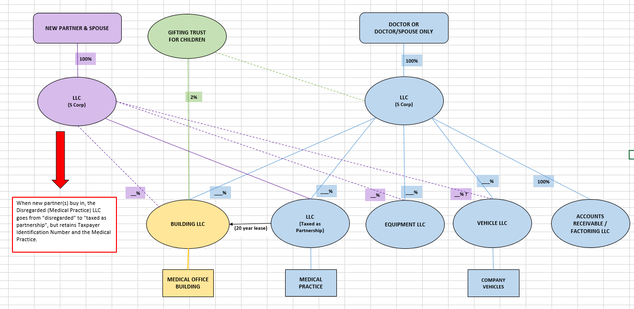
SMART OWNERSHIP OF A MEDICAL PRACTICE
AFTER NEW DOCTOR & SPOUSE ARE ADDED TO PREVIOUS SLIDE (#3) SITUATION

Slide 26
Confer with a Good Actuary
OPTIMIZE QUALIFIED PLAN CONTRIBUTIONS
Quite often clients are underserved with respect to retirement planning. This is often the result of product or general brokerage houses and banks that sponsor simple retirement plans without extensively trained planned design and maintenance personnel.
One example is the possible use of a 401(k) plan that uses the 3% safe harbor. Such a plan can be set up so that the 3% contribution is not required. The client can decide before the end of each year whether the safe harbor contribution will be made for the year, and must give notice to all participants by the end of November stating whether or not the 3% contribution will be made. This is often known as the “flexible safe harbor” or “maybe safe harbor” or “wait and see safe harbor plan.” Many physician groups should be checking with their pension advisors to see if their plan has the flexible safe harbor feature. A plan with a required safe harbor match cannot be managed on a flexible basis.
Appropriate pension planning can also include cross-testing and defined benefit planning.

Slide 27

Employee Census

Slide 28
Optimize Qualified Plan Contributions
(courtesy of Jim Feutz, Suncoast Pension & Benefits Group, Inc.)
On the following page, we have an example of an allocation of benefits as between a physician, his spouse who is the office manager for the practice, and 4 employees, using a flexible 401(k) plan.
This client had been told that “all that they could do economically” was a SIMPLE IRA Plan because the client has four other full time employees.
As shown on the following page, the physician and his wife would benefit from 89% of the plan contributions, with the four other employees sharing 11%, part of which is subject to vesting requirements of 20% per year over 5 years. Most physician groups would not be aware of this type of opportunity.

Slide 29
Optimize Qualified Plan Contributions
(courtesy of Jim Feutz, Suncoast Pension & Benefits Group, Inc.)
Flexible 401(k) Plan for Charles Allen, M.D., P.A.
Name | Position | Earnings | Age | Employee Deferrals | Profit Sharing | Total to Employee | Employer Cost | % of Total
Charles Allen | Owner | 250,000 | 46 | 17,000 | 33,000 | 50,000 | 50,000 | 62.7
Ann Allen | Mgr | 82,000 | 46 | 17,000 | 4,100 | 21,100 | 21,100 | 26.5
Sub-Total |  | 332,000 |  | 34,000 | 37,100 | 71,100 | 71,100 | 89.2
Jan Brown | Staff | 76,267 | 47 | 763 | 3,813 | 4,576 | 3,813 | 4.8
Mindy Garcia | Staff | 24,980 | 43 | 250 | 1,249 | 1,499 | 1,249 | 1.6
Alice Jenkins | Staff | 39,503 | 29 | 395 | 1,975 | 2,370 | 1,975 | 2.5
Sue Mayfair | Staff | 18,960 | 40 | 190 | 1,555 | 1,745 | 1,555 | 1.9
Sub-Total |  | 159,710 |  | 1,598 | 8,592 | 10,190 | 8,592 | 10.8
Total |  | 491,710 |  | 35,598 | 45,692 | 81,290 | 79,692 | 100.0

Slide 30
Optimize Qualified Plan Contributions
(courtesy of Jim Feutz, Suncoast Pension & Benefits Group, Inc.)
The following page is an example where the owner employs her son. Note that the physician is able to get the maximum $55,500 (since she is over 50) even though she only takes compensation of $130,000.
The plan also covers Ann Mitchell, a highly compensated assistant, who is not an owner. If desired the plan could totally exclude Mitchell which would reduce the contribution by $3,630.

Slide 31
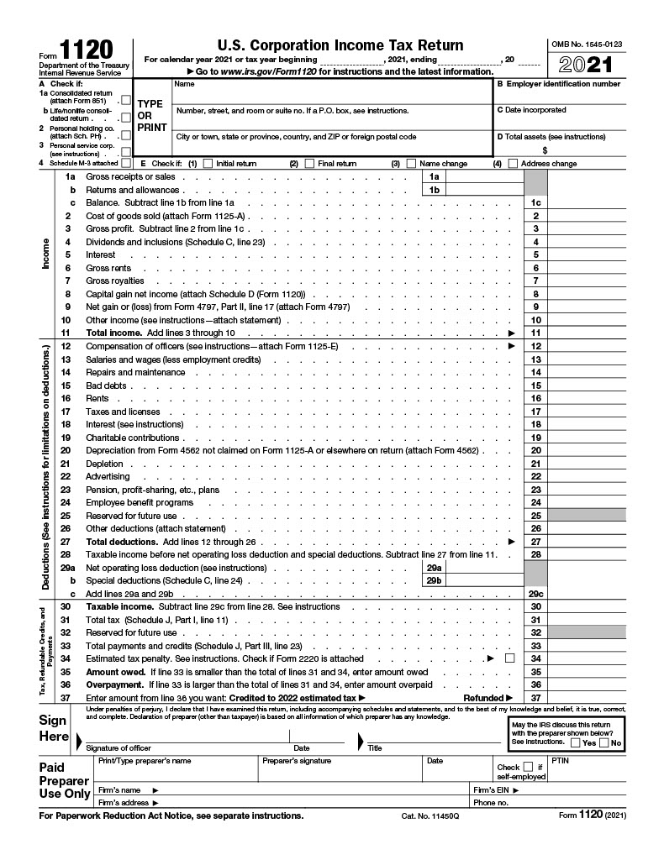
IRS Form 1120 for a C Corporation
Page 1 of 6

Slide 32
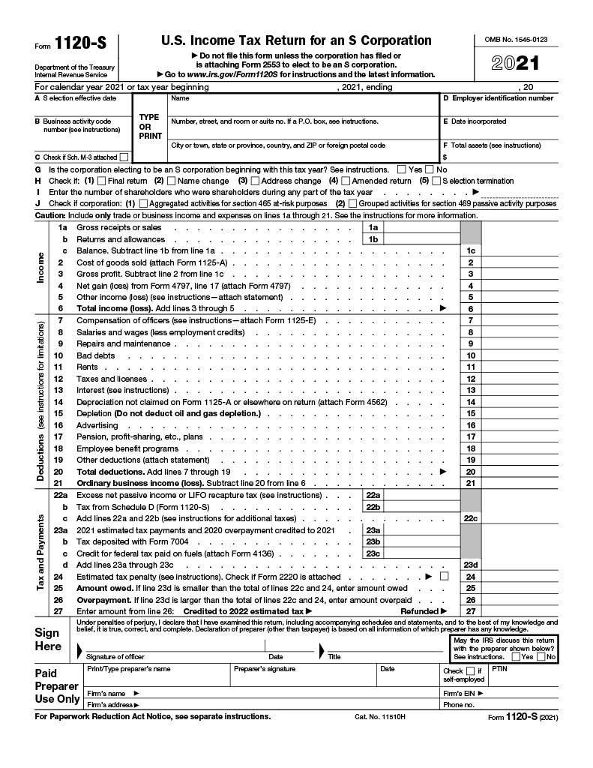
IRS Form 1120-S for an S Corporation
Page 1 of 5

Slide 33
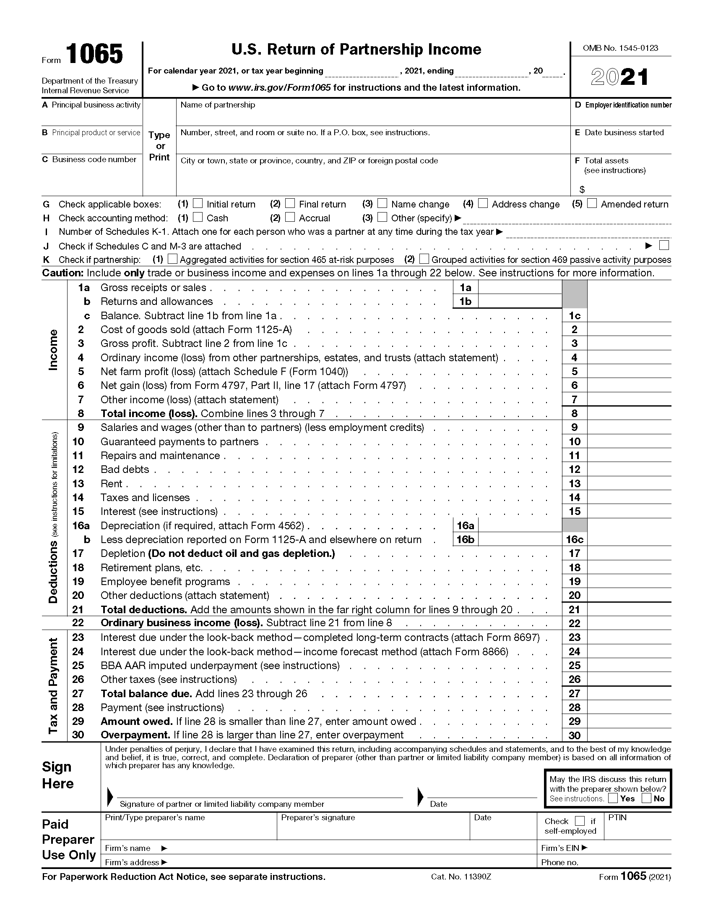
IRS Form 1065 for Partnerships
Page 1 of 5

Slide 34
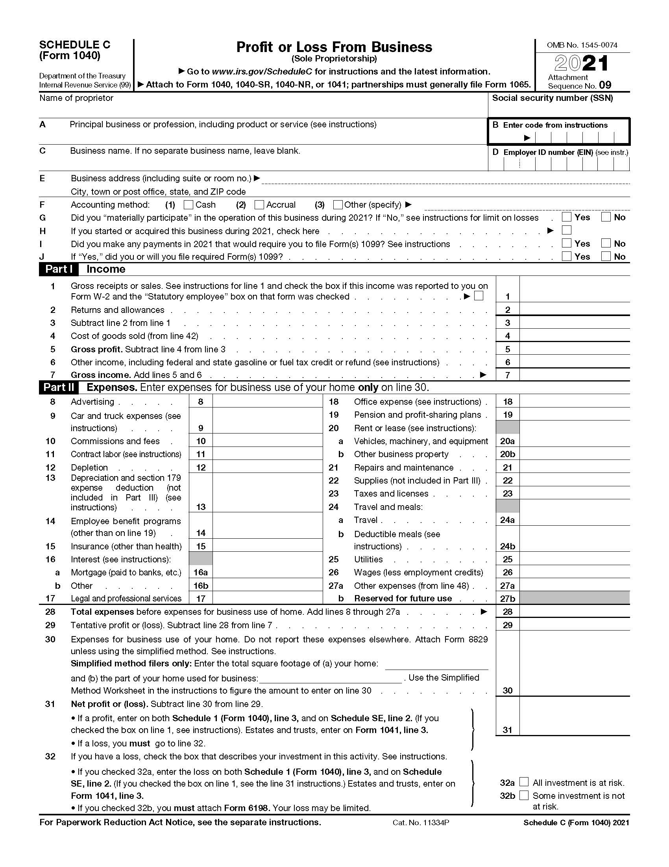
IRS Form 1040 Schedule C for Individuals
Page 1 of 2

Slide 35
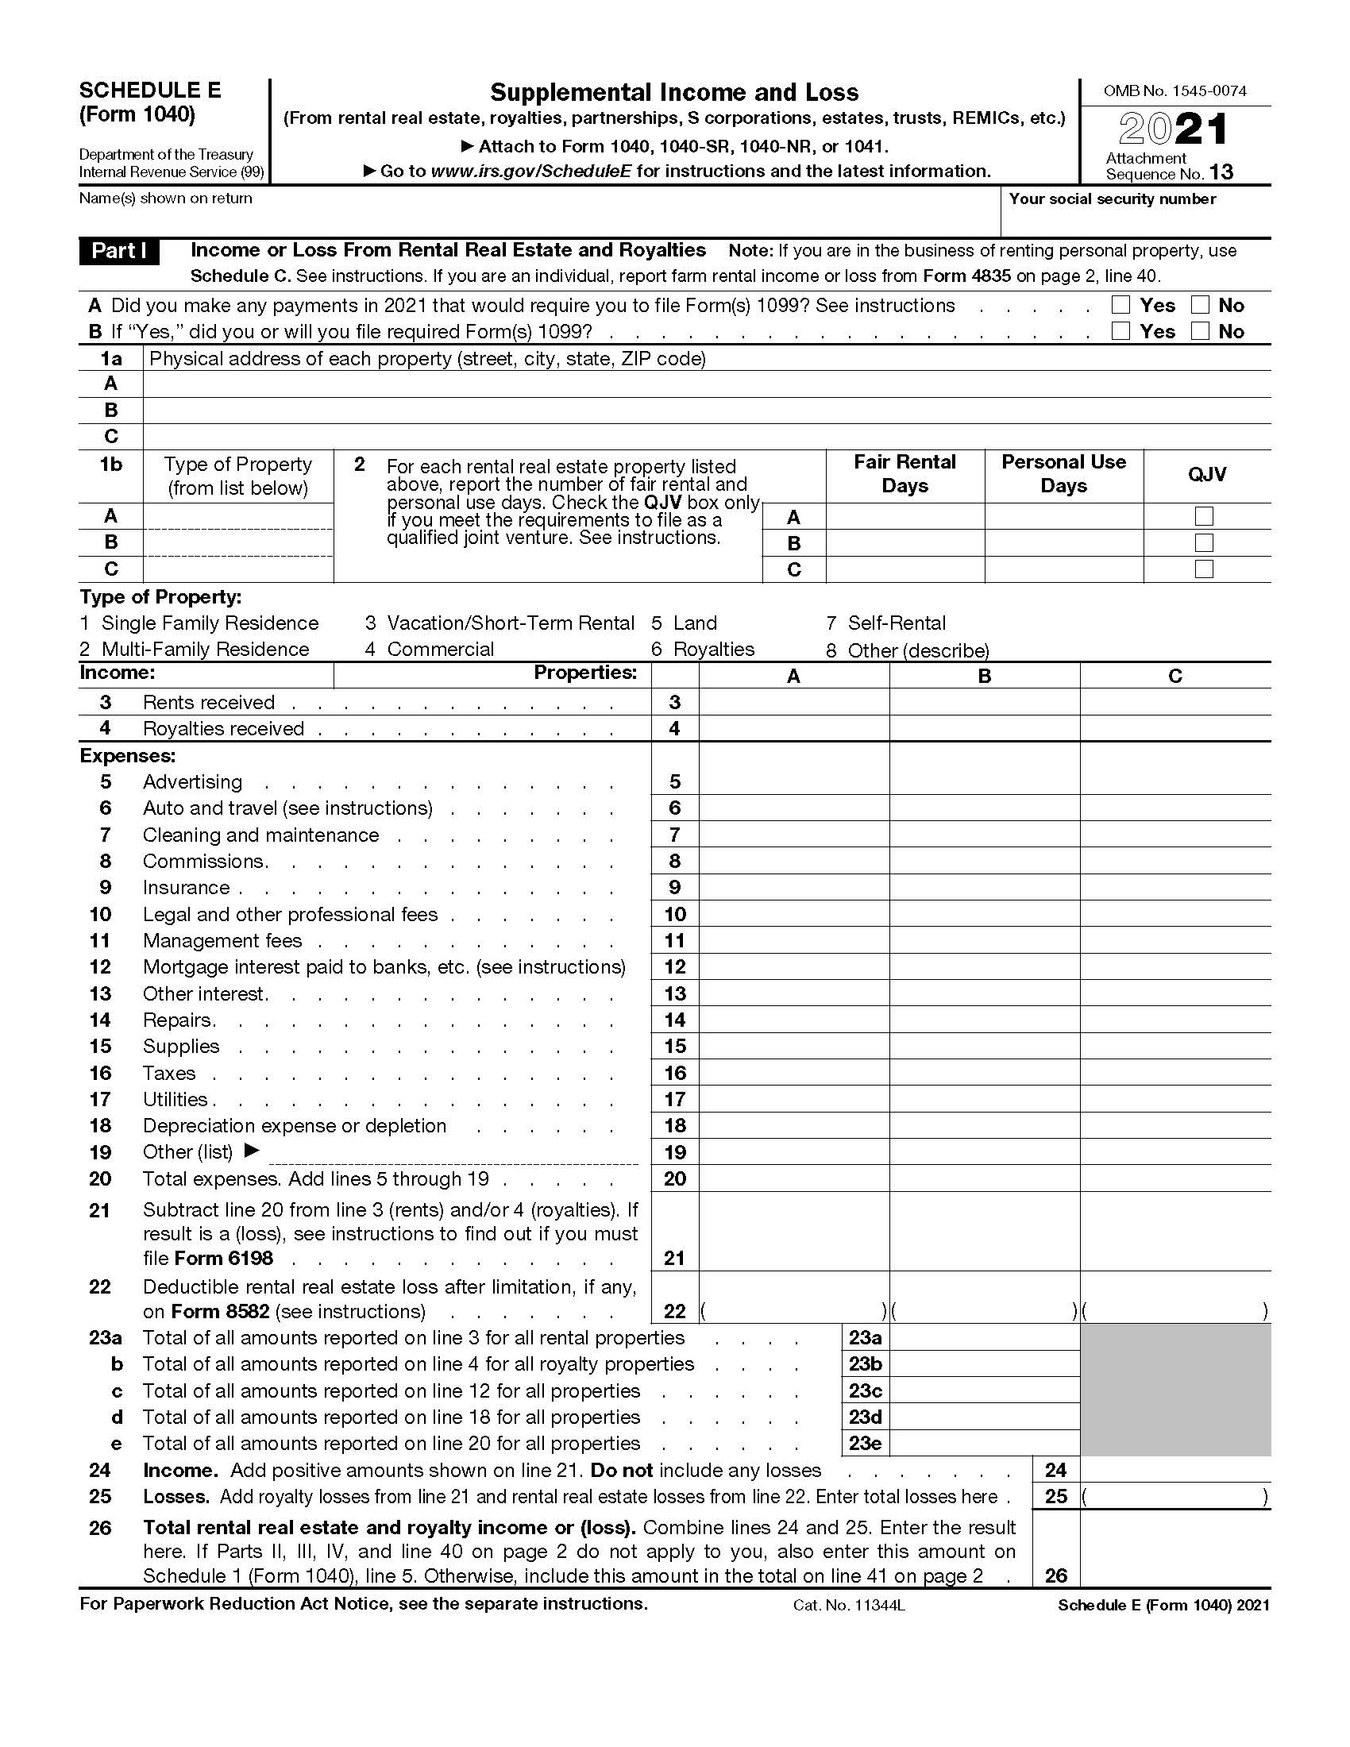
IRS Form 1040 Schedule E for Individuals
Page 1 of 2

Slide 36
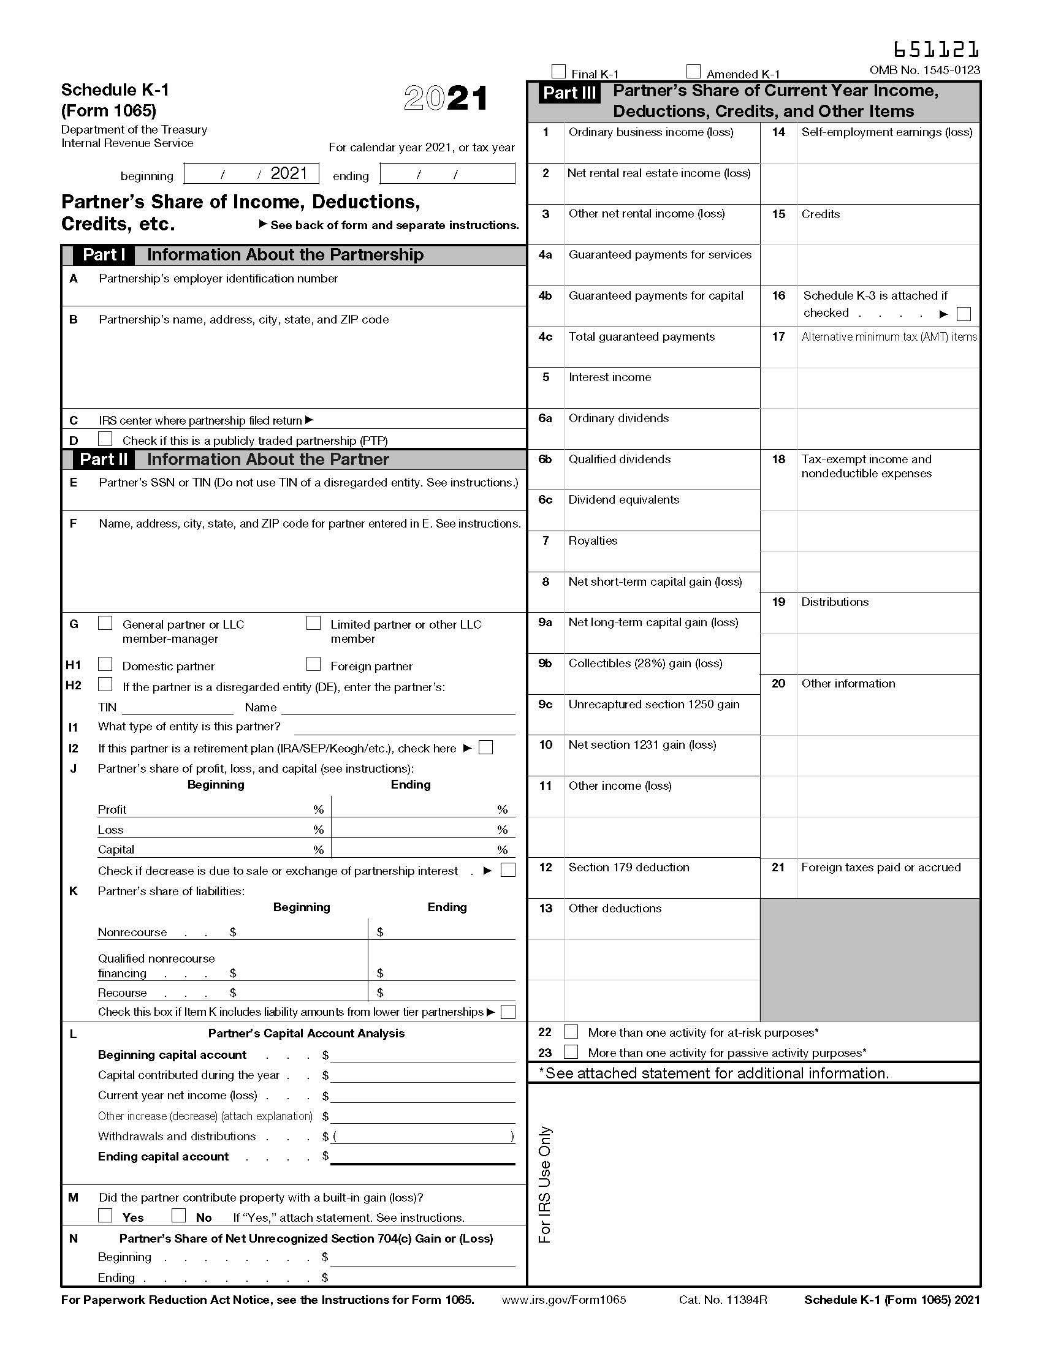
IRS Form 1065 Schedule K-1
Page 1 of 1

Slide 37
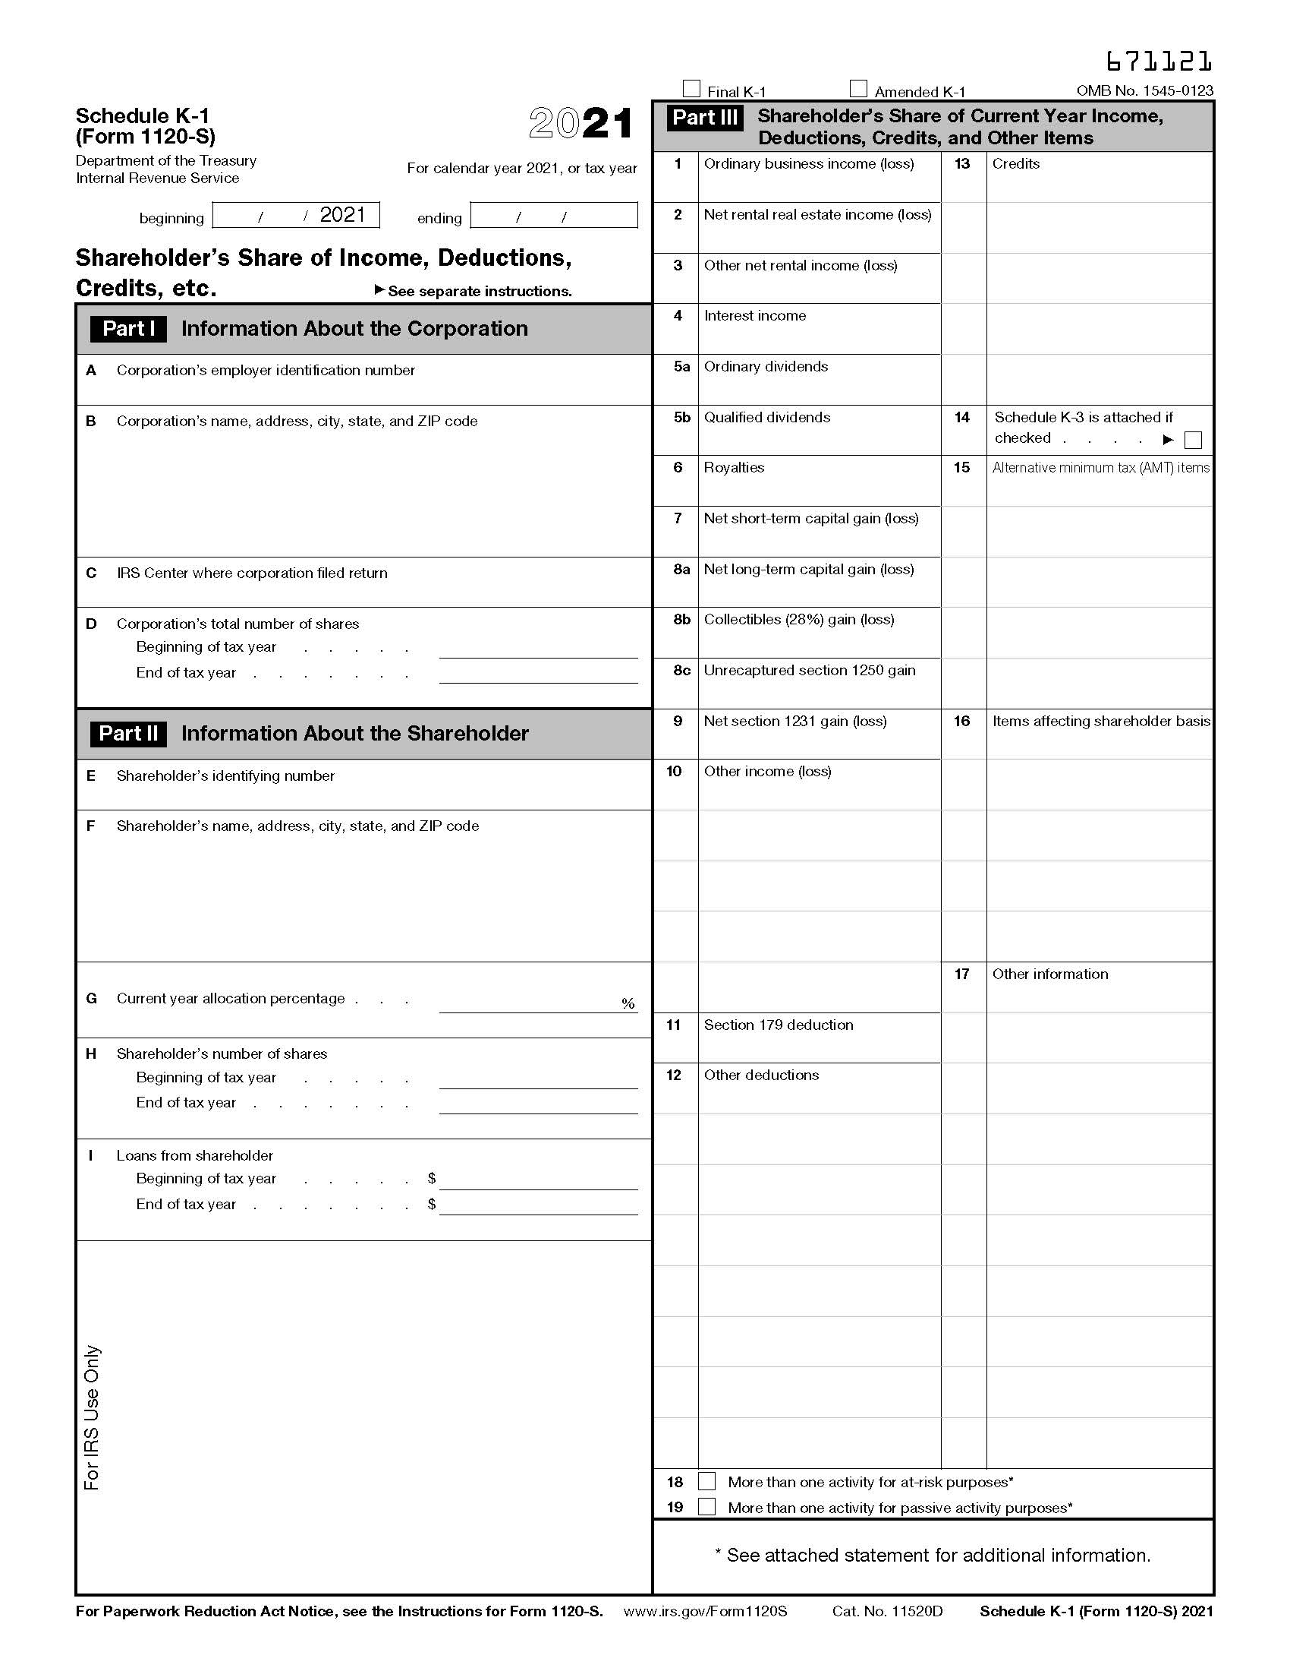
IRS Form 1120-S Schedule K-1
Page 1 of 1

Slide 38
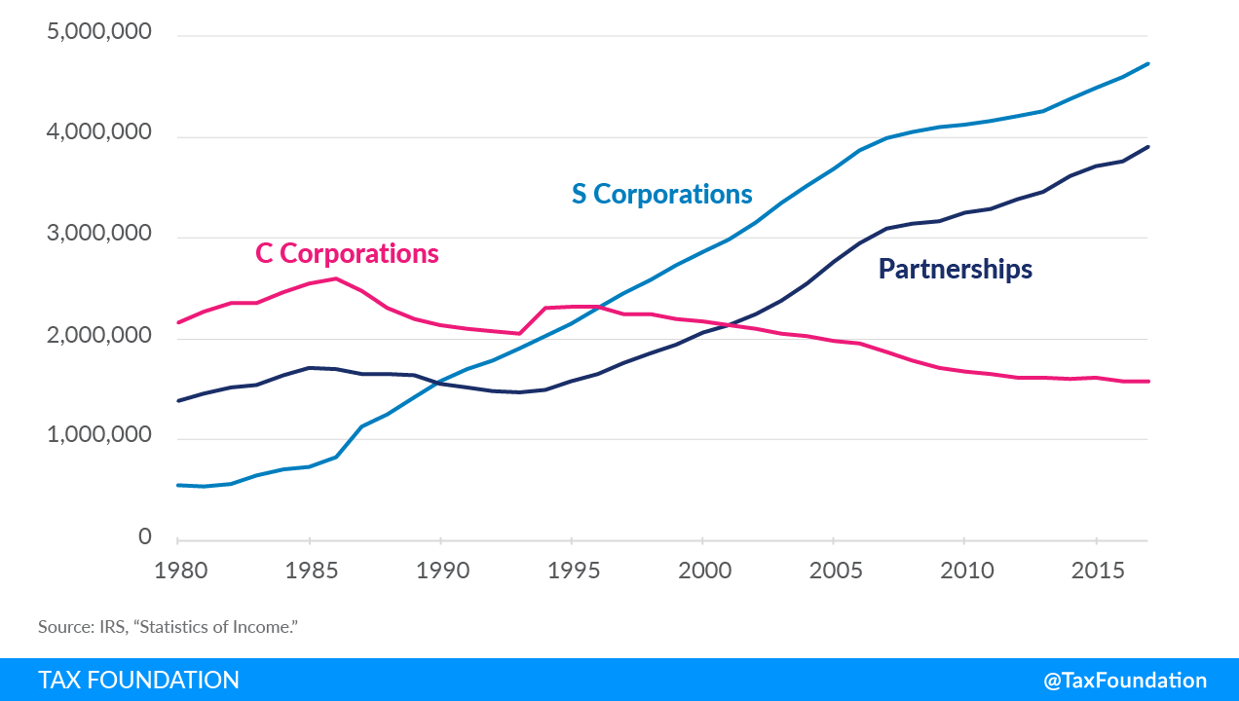
Number of Firms by Entity Type, 1980 to 2017

Slide 39
Corporations Generally
Both C corporations and S corporations are “corporations” under the Internal Revenue Code for federal income tax purposes.
A corporation is a legal entity separate from its shareholders that exists perpetually until it is dissolved.
The risk to the shareholder is limited to the risk of losing their investment. Corporate shareholders are not personally liable for the debts of the corporation.
The shareholder’s ownership interest in the corporation is represented by freely transferrable shares.
Corporations are managed by a board of directors that are elected by the shareholders. The board of directors appoints the corporation’s officers.

Slide 40
Corporate Formation: Nonrecognition Under IRC § 351
Contributions to a corporation are tax-free only if they meet the 80% of control test set forth under Internal Revenue Code Section 351.
This test requires that the contributors own at least 80% of the total combined voting power of all classes of stock entitled to vote and at least 80% of the total number of shares of all other classes of stock immediately after the contribution.

Slide 41
Taxation of C Corporations
C corporations are taxed under a firm-taxation, also known as “double taxation,” model:
  The corporation is taxed on its income.
  Shareholders are taxed separately on any distributions that they receive.
Because the C corporation is considered an entity separate from its shareholders, the C corporation must compute its own annual gross income and deductions, pay corporate taxes, and file its own annual return (Form 1120).

Slide 42
Taxation of C Corporations
Under certain circumstances, if a C corporation accumulates its earnings, it may be subject to penalty taxes in addition to corporate income taxes.

Slide 43
Historic U.S. Corporate Tax Rates
Year | Max Tax Rate | President | Comments
1909 | 1 | Taft
1916 | 2 | Wilson | Reduced tariffs and raised corporate
1917 | 6 |  | U .S. entered WWI
1918 | 12 |  | Taxes raised to finance WWI
1919 | 10 |  | WWI ended
1922 | 12.5 | Harding | Lowered income tax and raised corporate
1925 | 13 | Coolidge | Reduced income tax, raised corporate
1926 | 13.5 |  | Recession
1928 | 12 |  | Recession ended
1929 | 11 | Hoover | Tax cut triggered stock market crash
1930 | 12 |  | Dust Bowl started
1932 | 13.8 |  | Tax hikes to stop speculation worsened depression.
1936 | 15 | FDR | Hike revived depression
1938 | 19 |  | Dust Bowl ended
1940 | 24 |  | Hike to finance WWII
1941 | 31 |  | Pearl Harbor
1942 | 40 |  | Hikes to pay for WWII
1950 | 38 | Truman | Cut to fight recession
1951 | 50.75 |  | Hike to fund Korean War
1952 | 52 | Eisenhower | No cuts, despite 1953 and 1957 recessions.
1964 | 50 | LBJ | Implemented JFK's tax cut
1965 | 48 |  | Cut boosted economy
1968 | 52.8 |  | Hikes paid for Great Society and Vietnam War
1970 | 49.2 | Nixon | Recession
1971 | 48 |  | Cut to fight recession
1979 | 46 | Carter | Cut to offset high interest rates
1987 | 40 | Reagan | Tax Reform Act
1988 | 34 |  | Cut to fight recession.
1993 | 35 | Clinton | Omnibus Budget Reconciliation Act
2018 | 21 | Trump | Tax Act goes into effect
Source: IRS; Table: The Balance, https://www.thebalance.com/corporate-income-tax-definition-history-effective-rate-3306024

Slide 44
Fringe Benefits
Fringe benefits are benefits offered by an employer to their employees in addition to wages and salaries.
Some fringe benefits are taxable, while others are not.
Tax advantaged C corporation fringe benefit plans, as used in the Internal Revenue Code, include:
  Group-term life insurance purchased for employees
  Amounts received under accident and health plans
  Contributions by employer to accident and health plans
  Cafeteria plans
  Educational assistance programs
  Dependent care assistance programs
  Adoption assistance programs

Slide 45
C Corp v. S Corp Fringe Benefits
Some fringe benefits provided by C corporations are not considered compensation. The employees are therefore not taxed on the value of those benefits.
Unlike C corporations, however, S corporations are treated like partnerships for fringe benefit purposes. IRC 1372. Any 2% S corporation shareholder is treated as a partner.

Slide 46
IRC § 1372 - Partnership rules to apply for fringe benefit purposes
(a)General rule
For purposes of applying the provisions of this subtitle which relate to employee fringe benefits—
(1)the S corporation shall be treated as a partnership, and
(2)any 2-percent shareholder of the S corporation shall be treated as a partner of such partnership.
(b)2-percent shareholder defined
For purposes of this section, the term “2-percent shareholder” means any person who owns (or is considered as owning within the meaning of section 318) on any day during the taxable year of the S corporation more than 2 percent of the outstanding stock of such corporation or stock possessing more than 2 percent of the total combined voting power of all stock of such corporation.

Slide 47
Health Insurance Non-Discrimination Rules
Is a C corporation permitted to provide health insurance to some employees but not others (for example: an executive but not the executive’s secretary)?
  Yes, unless the health insurance qualifies as a “self-insured medical reimbursement plan.”
  IRC 105(h)(6) defines “self-insured medical reimbursement plan” as, “a plan of an employer to reimburse employees for [medical] expenses . . . for which reimbursement is not provided under a policy of accident and health insurance.”
  If the plan qualifies as a “self-insured medical reimbursement plan” and certain non-discrimination rules are not met (I.R.C. § 105(h)(3)(A)), highly compensated individuals must include “excessive reimbursements” as gross income.

Slide 48
Vehicles
If a corporation provides a vehicle to an employee to use, the employee’s use of the vehicle may qualify as a fringe benefit to that employee.
Under IRC 132, however, the value of the employee’s business use of the vehicle is excluded from the employee’s gross income.
The value of the employee’s personal use of the vehicle is a compensation expense to the employer.

Slide 49


The Guzzler Award
The following vehicles are among those that qualify for a 80% write-off upon acquisition under certain circumstances/over 6,000 pounds:
Audi Q7
BMW X5, X6
Buick Enclave
Cadillac XT5, XT6, Escalade
Chevrolet Silverado, Suburban, Tahoe, Traverse
Chrysler Pacifica
Dodge Durango, Grand Caravan
Ford Expedition, Explorer, F-150 and larger
GMC Acadia, Sierra, Yukon
Honda Pilot 4WD, Odyssey
Infiniti QX80, QX56
Jeep Grand Cherokee
Land Rover Range Rover, Discovery
Lexus GX460, LX570
Lincoln MKT AWD, Navigator
Mercedes-Benz G550, GLS, GLE, Metris, Sprinter
Nissan Armada, NV 1500, NVP 3500, Titan
Porsche Cayenne
Tesla Model X
Toyota 4Runner, Landcruiser, Sequoia, Tundra
Notes:
https://www.taxfyle.com/blog/list-of-vehicles-over-6000-lbs

Slide 50
Consolidated Groups
Affiliated Group: At least 80% of the stock of Corporation A is owned by Corporation B
Corporations in an affiliated group can file a consolidated tax return.
Any transactions between members of the consolidated group will be canceled out on the return.
  Intercorporate sales of goods/services
  Offset losses

Slide 51
Consolidated Groups
If Corporation A’s stock is then acquired by Corporation C from Corporation B, the acquiring Corporation C is able to make an election under IRC 338 that steps up the basis of Corporation A’s assets.
The IRC 338 election is considered a sale of A’s assets. The sale is taxable to Corporation A. This tax will not be paid on the consolidated return but on A’s separate tax return.
IRC 338 then allows Corporation C to take gain on the sale as income. The basis of Corporation C’s stock in Corporation A is then stepped up by the amount of the gain.

Slide 52
Consolidated Groups
Essentially, the 338(h)(10) election operates as though Corporation A was liquidated and its assets were sold by Corporation C.
IRC 338(h)(10) Elective recognition of gain or loss by target corporation, together with nonrecognition of gain or loss on stock sold by selling consolidated group
  (A)In general: Under regulations prescribed by the Secretary, an election may be made under which if—
    (i)the target corporation was, before the transaction, a member of the selling consolidated group, and
    (ii)the target corporation recognizes gain or loss with respect to the transaction as if it sold all of its assets in a single transaction,
  then the target corporation shall be treated as a member of the selling consolidated group with respect to such sale, and (to the extent provided in regulations) no gain or loss will be recognized on stock sold or exchanged in the transaction by members of the selling consolidated group.

Slide 53
Section 1202 Corporations
Section 1202 of the Code permits the shareholder of a qualifying C corporation that meets certain requirements to sell stock held for more than five years without paying capital gains tax on the sale.
A shareholder who has held Section 1202 qualifying stock for less than five years can reinvest the monies received from the sale of such stock to buy other Section 1202 qualifying stock on a tax-deferred basis. The holding period will be tacked to the holding period of the previously held Section 1202 stock, so that the sale of the subsequently acquired Section 1202 stock can be tax-free after a five-year combined holding period if the requirements discussed below are met.
There are many requirements that must be satisfied to qualify for Section 1202 status. These include having the company engaged in an active trade or business that is not one of the “Specified Service Trades or Businesses” enumerated in the Statute and having at least 80% of the corporate assets being used or needed in the business or businesses of the company.
A Section 1202 company may perform management, marketing, billing, or associated services for a related entity, and may invest its profits in one or more other businesses. Another aspect of Section 1202 planning is that the liquidation of the company or distribution of assets to the shareholders after five years will still be subject to tax. The only way to avoid the tax is to sell the ownership of the company.

Slide 54
Section 1202 companies are not permitted to engage in the following trades or businesses:
Health,
Law,
Accounting,
Actuarial science,
Performing Arts,
Consulting,
Athletics,
Financial Services,
Brokerage Services,
Investing, Trading, or Dealing in Securities, Partnership Interest, or Commodities,
Any business where the principal asset is the reputation or skill of one or more of its employees,
Engineering,
Architecture,
Oil and Gas,
Hotels and motels,
Restaurants,
Businesses similar to hotels, motels or restaurants.

Slide 55
General Requirements to Qualify for Section 1202 Gain Exclusion
Must be stock of a C corporation acquired after 1993.
Stock must have been acquired at original issue in exchange for money or other property, or as compensation for services performed for the corporation.
The Corporation must be a “qualified small business” immediately before and immediately after the issuance of stock.
During substantially all of the taxpayer’s holding period, the Corporation meets the active trade or business requirements of Section 1202(e).
The qualifying stock must be held for more than five years.

Slide 56
Taxation of S Corporations
Subchapter S of the Internal Revenue Code permits qualifying corporations to elect to be taxed under a flow-through taxation model:
  The S corporation is not taxed. (Exception: Under certain circumstances, an S corporation that was previously a C corporation will be taxed on earnings and profits from when it was a C corporation.)
  The corporation’s income, expenses, gains, and losses “flow-through” to the shareholders when it is earned by the S corporation, regardless of whether any distributions are made to the shareholders.

Slide 57
IRC § 1374 Unrecognized Built-In Gain Rules
If a C corporation converts to a S corporation, all of the C corporation’s “hot” assets (those with unrecognized built-in gain) will be taxed at the corporate level if they are disposed of within 5 years of making the § 1374 election.

Slide 58
IRC Section 1374
(a)General rule
If for any taxable year beginning in the recognition period an S corporation has a net recognized built-in gain, there is hereby imposed a tax (computed under subsection (b)) on the income of such corporation for such taxable year.
(b)Amount of tax(1)In general
The amount of the tax imposed by subsection (a) shall be computed by applying the highest rate of tax specified in section 11(b) to the net recognized built-in gain of the S corporation for the taxable year.
(2)Net operating loss carryforwards from C years allowed
Notwithstanding section 1371(b)(1), any net operating loss carryforward arising in a taxable year for which the corporation was a C corporation shall be allowed for purposes of this section as a deduction against the net recognized built-in gain of the S corporation for the taxable year. For purposes of determining the amount of any such loss which may be carried to subsequent taxable years, the amount of the net recognized built-in gain shall be treated as taxable income. Rules similar to the rules of the preceding sentences of this paragraph shall apply in the case of a capital loss carryforward arising in a taxable year for which the corporation was a C corporation.
(3)Credits
(A)In general
Except as provided in subparagraph (B), no credit shall be allowable under part IV of subchapter A of this chapter (other than under section 34) against the tax imposed by subsection (a).
(B)Business credit carryforwards from C years allowed
Notwithstanding section 1371(b)(1), any business credit carryforward under section 39 arising in a taxable year for which the corporation was a C corporation shall be allowed as a credit against the tax imposed by subsection (a) in the same manner as if it were imposed by section 11.
(c)Limitations
(1)Corporations which were always S corporations
Subsection (a) shall not apply to any corporation if an election under section 1362(a) has been in effect with respect to such corporation for each of its taxable years. Except as provided in regulations, an S corporation and any predecessor corporation shall be treated as 1 corporation for purposes of the preceding sentence.
(2)Limitation on amount of net recognized built-in gain
The amount of the net recognized built-in gain taken into account under this section for any taxable year shall not exceed the excess (if any) of—
(A)the net unrealized built-in gain, over
(B)the net recognized built-in gain for prior taxable years beginning in the recognition period.
(d)Definitions and special rules
For purposes of this section—
(1)Net unrealized built-in gain
The term “net unrealized built-in gain” means the amount (if any) by which—
(A)the fair market value of the assets of the S corporation as of the beginning of its 1st taxable year for which an election under section 1362(a) is in effect, exceeds
(B)the aggregate adjusted bases of such assets at such time.
(2)Net recognized built-in gain
(A)In general
The term “net recognized built-in gain” means, with respect to any taxable year in the recognition period, the lesser of—
(i)the amount which would be the taxable income of the S corporation for such taxable year if only recognized built-in gains and recognized built-in losses were taken into account, or
(ii)such corporation’s taxable income for such taxable year (determined as provided in section 1375(b)(1)(B)).
(B)Carryover
If, for any taxable year described in subparagraph (A), the amount referred to in clause (i) of subparagraph (A) exceeds the amount referred to in clause (ii) of subparagraph (A), such excess shall be treated as a recognized built-in gain in the succeeding taxable year.
(3)Recognized built-in gain
The term “recognized built-in gain” means any gain recognized during the recognition period on the disposition of any asset except to the extent that the S corporation establishes that—
(A)such asset was not held by the S corporation as of the beginning of the 1st taxable year for which it was an S corporation, or
(B)such gain exceeds the excess (if any) of—
(i)the fair market value of such asset as of the beginning of such 1st taxable year, over
(ii)the adjusted basis of the asset as of such time.
(4)Recognized built-in losses
The term “recognized built-in loss” means any loss recognized during the recognition period on the disposition of any asset to the extent that the S corporation establishes that—
(A)such asset was held by the S corporation as of the beginning of the 1st taxable year referred to in paragraph (3), and
(B)such loss does not exceed the excess of—
(i)the adjusted basis of such asset as of the beginning of such 1st taxable year, over
(ii)the fair market value of such asset as of such time.
(5)Treatment of certain built-in items
(A)Income items
Any item of income which is properly taken into account during the recognition period but which is attributable to periods before the 1st taxable year for which the corporation was an S corporation shall be treated as a recognized built-in gain for the taxable year in which it is properly taken into account.
(B)Deduction items
Any amount which is allowable as a deduction during the recognition period (determined without regard to any carryover) but which is attributable to periods before the 1st taxable year referred to in subparagraph (A) shall be treated as a recognized built-in loss for the taxable year for which it is allowable as a deduction.
(C)Adjustment to net unrealized built-in gain
The amount of the net unrealized built-in gain shall be properly adjusted for amounts which would be treated as recognized built-in gains or losses under this paragraph if such amounts were properly taken into account (or allowable as a deduction) during the recognition period.
(6)Treatment of certain property
If the adjusted basis of any asset is determined (in whole or in part) by reference to the adjusted basis of any other asset held by the S corporation as of the beginning of the 1st taxable year referred to in paragraph (3)—
(A)such asset shall be treated as held by the S corporation as of the beginning of such 1st taxable year, and
(B)any determination under paragraph (3)(B) or (4)(B) with respect to such asset shall be made by reference to the fair market value and adjusted basis of such other asset as of the beginning of such 1st taxable year.
(7)Recognition period
(A)In general
The term “recognition period” means the 5-year period beginning with the 1st day of the 1st taxable year for which the corporation was an S corporation. For purposes of applying this section to any amount includible in income by reason of distributions to shareholders pursuant to section 593(e), the preceding sentence shall be applied without regard to the phrase “5-year”.
(B)Installment sales
If an S corporation sells an asset and reports the income from the sale using the installment method under section 453, the treatment of all payments received shall be governed by the provisions of this paragraph applicable to the taxable year in which such sale was made.
(8)Treatment of transfer of assets from C corporation to S corporation
(A)In general
Except to the extent provided in regulations, if—
(i)an S corporation acquires any asset, and
(ii)the S corporation’s basis in such asset is determined (in whole or in part) by reference to the basis of such asset (or any other property) in the hands of a C corporation,
then a tax is hereby imposed on any net recognized built-in gain attributable to any such assets for any taxable year beginning in the recognition period. The amount of such tax shall be determined under the rules of this section as modified by subparagraph (B).
(B)Modifications
For purposes of this paragraph, the modifications of this subparagraph are as follows:
(i)In general
The preceding paragraphs of this subsection shall be applied by taking into account the day on which the assets were acquired by the S corporation in lieu of the beginning of the 1st taxable year for which the corporation was an S corporation.
(ii)Subsection (c)
(1) not to apply
Subsection (c)(1) shall not apply.
(9)Reference to 1st taxable year
Any reference in this section to the 1st taxable year for which the corporation was an S corporation shall be treated as a reference to the 1st taxable year for which the corporation was an S corporation pursuant to its most recent election under section 1362.
(e)Regulations
The Secretary shall prescribe such regulations as may be necessary to carry out the purposes of this section including regulations providing for the appropriate treatment of successor corporations.

Slide 59
State Income Tax
C corporations are subject to state income tax on a state-by-state basis.
Some states impose an income tax on S corporations, but others do not.

Slide 60
Top Marginal Corporate and Individual Income Tax Rates of 10 Most Populous States
State | Corporate Income Tax Rate | Highest Individual Income Tax Rate and Bracket
California | 8.84% | 13.30% > $1,000,000
Texas | N/A | N/A
Florida | 5.50% | N/A
New York | 7.25% | 10.90% > $25,000,000
Pennsylvania | 9.99% | 3.07% > $0
Illinois | 9.50% | 4.95% > $0
Ohio | N/A | 3.99% > $110,650
Georgia | 5.75% | 5.75% > $7,000
North Carolina | 2.50% | 4.99% > $0
Michigan | 6.00% | 4.25% > $0

Slide 61
S Corporation Election Requirements
Requirements to qualify to be taxed as an S corporation:
  Fewer than 100 shareholders;
  All shareholders must be individuals (with the exception of certain trusts, disregarded limited liability companies, and tax exempt organizations);
  Shareholders may not be nonresident aliens;
  A single class of stock; and
  Must not have previously made an S corporation election and revoked such election within the last 5 years, unless consent is received from the IRS.
The election is made by filing Form 2553 with the IRS.

Slide 62
Partnership v. S Corporation
Which is Better to Hold Real Estate?
PARTNERSHIP | S CORPORATION
Advantages and Disadvantages
Partners receive basis for indebtedness incurred by the partnership | DOI income insolvency exclusion is determined at the corporate level.
On the death of a partner, the partnership’s (inside) tax basis of its assets can receive a step-up in income tax basis, if a Section 754 election is in place for the partnership | No similar basis adjustment mechanism applies to S corporations.
When a new partner buys into a partnership corporation, their depreciation write-off and underlying basis in their partnership interest will be based upon the price that they pay. | When a new shareholder buys into an S corporation, their depreciation write-off and underlying basis if and when the real estate is ever sold has to be based upon the historic basis and depreciation taken, versus being based upon the price they pay.
Appreciated real property can generally be distributed from the partnership tax-free to the partners. | Distributions of appreciated real property to the shareholders are treated as if the property was sold at its fair market value to the shareholders.
No restrictions apply as to who can own partnership interests. | S corporations can only be owned by certain individuals and trusts, and cannot be owned non-resident aliens, corporations or partnerships
Partnerships can have more than one class of stock, and income and distribution preferences can be drafted in virtually any manner, so long as they have substantial economic effect | S corporations cannot have a “second class of stock,” and income allocation and distribution rights must be pro rata to ownership
DOI income insolvency exclusion is determined at each partner’s level. | Shareholders do not receive basis for indebtedness incurred by the corporate, unless the loan is made by such shareholder.
Have capital accounts for all partners. | Generally, do not have capital accounts for shareholders.

Slide 63
Reasonable Compensation Rules
S corporations are required to pay reasonable wages to shareholders/owners who render valuable services.
Form 1120-S, U.S. Income Tax Return for an S Corporation, states, "Distributions and other payments by an S corporation to a corporate officer must be treated as wages to the extent the amounts are reasonable compensation for services rendered to the corporation."

Slide 64
S Corporations and
C Corporations Compared
Issue/Factor | S Corporation | C Corporation
Tax Rates | Owners are taxed at individual rates for salary and income of the company | Entity taxed for income at 21%; shareholders taxed for dividends and distributions
Double Taxation | Not subject | Dividends or distributions taxed separately
Availability of Section 199A deduction | Available (depending on limitations) | Cannot qualify for Section 199A
Accumulated Earnings | Taxed to owner as reported on their Form K-1, regardless of whether distributions are made | Taxed at 21% corporate rate; beware of accumulated earning tax issues
Guaranteed payments | N/A | N/A

Slide 65
S Corporations and
C Corporations Compared
Issue/Factor | S Corporation | C Corporation
Owner provides services (reasonable compensation issues) | W-2 Wages; excluded from QBI and subject to reasonable compensation rules | W-2 Wages; subject to reasonable compensation rules
Business is a Specified Service Trade or Business | Eligible if owner’s taxable income is under lower-income thresholds; Limited if in between lower- and higher-income thresholds; Lost if taxable income is greater than higher-income thresholds | N/A
High Income earner as owner | May be limited if Wage/Property Hurdle is not met | N/A

Slide 66
S Corporations and
C Corporations Compared
Issue/Factor | S Corporation | C Corporation
Employees (W-2 Wages) | Consider impact on Wage/Property Limitation, adjust if necessary | N/A
Independent contractors | Hurts in application of Wage/Property Hurdle; Compensation not considered W-2 wages | N/A
Qualified property basis | Consider impact on Wage/Property Hurdle, adjust if necessary | N/A
State and local tax deductions | Deduction Limited | Fully Deductible
Medical expenses and plans deductions | N/A | Premiums and medical reimbursement plans are deductible

Slide 67
Some Advantages of Partnerships Over S Corporations
Partnerships do not have the single class of stock requirement, allowing both common and preferred stock.
Partnerships can have foreign owners.
When you die, you get a new income tax basis on underlying assets under IRC § 754.

Slide 68
Some Advantages of S Corporations Over Partnerships
Avoidance of employment taxes and Medicare taxes on net income of the S corporation
Less complicated than partnerships

Slide 69
Refresher on Types of Entities That Can Hold S-Corporation Stock
Single Person, owns 100% of LLC
Complex Electing Small Business Trust “ESBT”
(Non-Resident Alien as beneficiary-ok)
Beneficiary Defective Trust (aka BDIT or 678 Trust)
Grantor Trust
Disregarded LLC
(May not be safe with non-community spouse married couples)
501(c)(3) Organization
Qualified Subchapter S Trust “QSST”
Varieties of Grantor Trusts:
1. GRATs
2. Grantor SLATs
3. Grantor CLATs
Can make protective ESBT Election.
ABC COMPANY
(Taxed as S-Corporation
The following entities will not qualify to own S corp stock:
1. Non-Resident Aliens
2. Partnerships
3. Charitable Remainder Trusts (CRATs and CRUTS)
4. IRS or pensions
5. Off-Shore Trusts
6. Elvis the dog
S-Corporation
(Electing to treat Subsidiary as
Q-SUB)

Slide 70
A Partnership of S Corporations
This is a very good way to own a medical practice because each S corp. receives its share of the LLC’s profits and each doctor can decide how much comes out of each S corp. as compensation and dividends.
Doctor 1
Doctor 2
Doctor 3
(and spouse as joint owners?)
S Corporation 1
S Corporation 2
Disregarded or Partnership or S Corporation
3
Management Fee
LLC taxed as a Partnership
Medical Director Fee

Slide 71
New Parent F Reorganization
A new S corporation is formed with the same owners as the parent S corporation.
The parent S corporation can elect for the subsidiary to be treated as a Qualified Subchapter S Subsidiary (QSub) and convey the parent corporation to the new subsidiary corporation in a tax-free transaction.
Appreciated assets, such as equipment or real estate, can be conveyed from the QSub to the parent or to brother-sister companies without triggering income tax and for creditor protection purposes.

Slide 72
New Parent F Reorganization for a Medical Practice

Slide 73
The Extended Letter of Protection Enhancement System (“ELOPE”)
© 2007 Gassman, Crotty & Denicolo, P.A.
The Extended Letter of Protection Enhancement (ELOPE) System is a term and technique developed by our firm in 2007 that is especially useful for physicians who do injury victim work and are owed monies under Letters of Protection that are typically significant and are not paid for a number of years.
Many orthopedic surgeons, spine surgeons, and podiatrists have significant “personal injury” medical practices. Oftentimes, these doctors accept Letters of Protection for their services.
A Letter of Protection is a promise that the physician will be paid if and when the personal injury claim is settled. The law firm issuing the Letter of Protection basically agrees that the settlement or jury verdict judgment monies that would otherwise go to the plaintiff/patient will be paid to the doctor, to the extent delineated in the Letter of Protection.
Typically, the Letter of Protection charges are significantly higher than medical insurance, HMOs, or Medicare pay, which takes into account that the doctor has to wait a long time to be paid, and cannot be certain if or when he or she will be paid.
There is, therefore, a significant “Financial Leverage” occurring, as the doctor finances his practice while waiting to be paid sometimes as long as 2-3 years on average.

Slide 74
The Extended Letter of Protection Enhancement System (“ELOPE”)
The ELOPE System is designed to allow affiliated family entities, which may be owned by or for children, grandchildren, and other family members in lower tax brackets, to realize reasonable profits that would otherwise be taxed at the highest bracket possible, while also protecting the Letters of Protection from potential creditors of the medical practice and the physician.
It would make sense to immediately transfer Letters of Protection outside of the medical practice to an affiliated entity, but if the medical practice is taxed as a corporation, whether a regular corporation or an S corporation, the transfer of such Letters of Protection out to the doctor or any other entity affiliated with him or her will normally trigger taxable income on the value of the Letter of Protection at such time.
Therefore, the common idea of having a family limited partnership or other affiliated entity factor or purchase the Letters of Protection from the medical practice is typically not a popular one.
The solution under the ELOPE system is to have a factoring company established as a brother/sister company to the medical practice.

Slide 75
The Extended Letter of Protection Enhancement System (“ELOPE”)
It is simple and inexpensive to establish a “New Parent S Corporation” to own 100% of the stock of the medical practice company and 100% of the stock of the factoring company. This new S corporation can be a Limited Liability Company that might be owned by the physician, the physician’s spouse, or by the physician and the physician’s spouse as Tenants by the Entireties.
The medical practice entity does not need to change its name, its taxpayer identification number, or any other significant aspect of its operations as a result of this “F Reorganization.” Under the tax law it will be known as a Qualified Sub-Chapter S subsidiary (“Q-Sub”).
One business purpose of this arrangement is to allow the affiliated family entity to be reasonably assured that the Letters of Protection that it finances the purchase of will not be lost to a malpractice claimant of the medical practice.
The monies received by the medical practice for the Letters of Protection may be held by the parent company for long term capital needs under an investment account. Unless or until the monies are paid out from the parent company, there should be no income tax thereon. The income from the Letters of Protection will therefore not have to be recognized until the ultimate payor (the patient or the insurance carrier) pays the Factoring Company for the Letter of Protection.

Slide 76
The Extended Letter of Protection Enhancement System ( “ELOPE”)
The Factoring Company may be administered by a separate S corporation that might be owned and run by the doctor’s children. In that event, the Factoring Company would pay a reasonable management fee to the management S corporation, then the children might earn sufficient funds to fund their IRAs, and they also receive dividends to the extent that computer systems, policy and procedure manuals, and other physical and intangible assets of the management company cause income to be received.
The purpose accomplished from the point of view of the medical practice company and doctor is that income tax will not be triggered when the Letters of Protection are transferred
to the Factoring Company, because transfers between a brother and sister company that are commonly owned by an S corporation parent can be disregarded for income tax purposes.
NOT E : A subsidiary company can elect to be treated as QSST (Qualified Sub-Chapter S Subsidiary). A new entity may elect to be treated as a Q-Sub or as a disregarded entity L.L.C., but may have a separate tax identification number. Each separate subsidiary should have separate financial statements, bank accounts, and fiscal conduct.

Slide 77
The Extended Letter of Protection Enhancement System (“ELOPE”)
All income and deductions of the subsidiaries will go onto a single S corporation tax return for the parent company. However, it is crucial to keep separate books and records for each subsidiary, in order to maintain its independence and to avoid having a creditor of the medical practice assert that the Letter of Protection entity is an “alter ego” or “partner” of the medical practice.
In our example, the Factoring Company would purchase Letters of Protection as they are received by the medical practice. At the end of each calendar month, the Letters of Protection received by the medical practice could be assigned to the Factoring Company, in exchange for which the Factoring Company could give the medical practice cash.
In order to allow an affiliated family entity to provide financial assistance to the medical practice and be paid reasonable compensation for such assistance, the applicable family limited partnership, S corporation, or trust established in whole or in part for the doctor’s children, grandchildren, or other family members may have assets that can be pledged or otherwise collateralized to finance the Factoring Company. An example would be a family limited partnership with a $1,000,000 investment portfolio, which borrows money on margin from the brokerage firm at 6.8% interest and advances this money to the subsidiary Factoring Company. The Factoring Company then uses this money to purchase the pre-existing Letters of Protection that the medical practice owns, which may be valued at $400,000, based upon industry standards. The Letters of Protection may have a face amount of $1,000,000.

Slide 78
The Extended Letter of Protection Enhancement System (“ELOPE”)
The market value of the Letters of Protection may be established by having arm’s-length Factoring Companies review and make offers for the purchase or financing thereof. The Factoring Company can agree to pay a fairly high interest rate to the affiliated family company for the use of the money. The affiliated family company may be paying its broker- age firm 6.8% interest on the margin loan, and it may be receiving 15% interest back from the Factoring Company. Some companies in this industry charge the highest percentage permitted by Florida law, which is 25% when the borrower is a corporation and the loan is in excess of $500,000. Where the loan is under $500,000, the usury rate under Florida Law is 18%. See Florida Statute 687.03.

Slide 79
199A Rules
The following slides are taken from a presentation presented by Alan Gassman entitled, “Planning With 199A, 678 Trusts And Complex Trusts.” A video recording of the presentation and the complete slide deck is available at https://www.youtube.com/watch?v=lA8owRLPrYo.

Slide 80
EXCERPT FROM “PLANNING WITH 199A, 678 TRUSTS AND COMPLEX TRUSTS”
Deduction Is Provided For Qualified Business Income
Qualified business income is “active trade or business income,” and must come only from one of the following five places:
1. S corporation K-1 income (includes income from LLCs taxed as S corporations).
2. Partnership K-1 income (includes income from LLCs taxed as partnerships).
3. Trade or Business income reported on Schedule C of a taxpayer’s Form 1040 (includes income from single member LLC that is disregarded for income tax purposes).
4. Net rental income reported on Schedule E of Form 1040, from an “active trade or business.”
Farm income reported on Schedule F of Form 1040.
Section 501(c)(3) organizations receiving Unrelated Business Taxable Income (“UBTI”) may qualify. IRS indicated in Preamble to Final Regulations that they are continuing to study this issue.
Note - For most taxpayers, K-1 income is cash based, but pension deductions are commonly accrued - you have until December 31st to put new pension plans into place that may be funded next year for 199A and other planning.
Trap for Unwary - Don’t make contributions to a SEP-IRA or 401k before determining what plans the client will want for the year – once contributions are made, plans cannot be changed.

Slide 81
EXCERPT FROM “PLANNING WITH 199A, 678 TRUSTS AND COMPLEX TRUSTS”
Important Definitions You Need To Know
Qualified Business Income (“QBI”) – Active trade or business income from flow through entities such as S corporations, entities taxed as partnerships, LLCs, disregarded entities, and Schedule C entities such as sole proprietorships effectively connected to a US trade or business. This does not include monies earned as wages, reasonable compensation, or “guaranteed payments” from entities taxed as partnerships.
Specified Service Trades or Businesses (“SSTB”) - Categories of businesses or activities which will not qualify for the flow-through deduction if the individual taxpayer reporting QBI has taxable income exceeding the levels described in slide 10.
Unadjusted Basis Immediately After Acquisition of Qualified Property (“UBIA”) – Cost basis of physical assets, including real estate, furniture and equipment owned by a flow-through entity at the end of the taxable year which has not reached the date that is the later of (a) the end of the depreciable life; or (b) ten years from acquisition.
W-2 Wages - Compensation paid to employees of a flow-through entity (including pension contributions and other elective deferrals), which does not include (1) wages earned by an individual taxpayer from sources other than a flow- through entity; (2) compensation paid to independent contractors; or (3) income that is subject to self-employment taxes, if not paid and treated as wages paid to an employee.
Effectively Connected Income – Income that is derived from assets used in or held for use in the US, and the activities of the US business were a material factor in the realization of such income. Puerto Rico based income will also qualify.
Guaranteed Payments – Payments made by a partnership to partners without regard to the partnership’s income, which are not considered wages under applicable wage and partnership law.
IRS Notice 2019-7 – Providing the 250 hour safe harbor test for non-triple net lease rental activities to be considered as an active trade or business.

Slide 82
EXCERPT FROM “PLANNING WITH 199A, 678 TRUSTS AND COMPLEX TRUSTS”
Two Main Rules To Know (Besides that taxpayers below the threshold can typically take the deduction, most of the time.)
 |  |  | Situation | Result
1 | Specified Service Trade or Business (“SSTB”) | A | Taxpayer's Taxable Income is under $315,000 for Taxpayers married filing jointly, or $157,500 for single filers ($170,050 and $340,100 for 2022) | No Limitation applies
 |  | B | Taxpayer's Taxable Income is between $315,000-$415,000 for Taxpayers married filing jointly or $157,500-$207,500 for single filers | Limitation is phased in by the amount Taxable Income exceeds threshold amount Example – Married with Taxable Income of $365,000. Deduction is equal to 10% of QBI (50% ((365-315)/100) * 20% Deduction.
 |  | C | Taxpayer's Taxable Income exceeds $440,100 for Taxpayers married filing jointly or $220,050 for single filers | No Deduction
2 | Wage and Qualified Property Test | A | Taxpayer's Taxable Income is under $340,100 if married filing jointly, or $175,050 for single filers | No Limitation applies
 |  | B | Taxpayer's Taxable Income is between $340,100-$440,100 if married filing jointly or $175,050-$220,050 for single filers | Limitation is phased in by the amount Taxable Income exceeds threshold amount
 |  | C | Taxpayer's Taxable Income Exceeds $440,100 if married filing jointly or $220,050 for single filers | Limitation applies unless 50% of Wages, or 25% of Wages plus 2.5% of Qualified Property, are met at the entity level

Slide 83
Items Relating To: Individual Taxpayers Qualified Business Income (Section 199A)
EXCERPT FROM “PLANNING WITH 199A, 678 TRUSTS AND COMPLEX TRUSTS”
Filing Status | Tax Year 2022 | Tax Year 2023 | Tax Year 2024
Single | $170,050 | $182,100 | $191,950
Married Jointly | $340,100 | $364,200 | $383,900
Head of Household | $170,050 | $182,100 | $191,950
2024 Phase-out
Married Filing Jointly - $383,900 - 483,900
Single/Head of Household - $191,950 - 241,950
QBI INCREASED BY STANDARD DEDUCTION
Filing Status | Tax Year 2022 | Tax Year 2023 | Tax Year 2024
Single | $170,050 + $12,950 = $183,000 | $182,100 + $13,850 = $195,950 | $191,950 + $14,600 = $206,550
Married Jointly | $340,100 + $25,900 = $366,000 | $364,200 + $27,700 = $391,900 | $383,900+ $29,200 = $413,100
Head of Household | $170,050+ $19,400 = $189,450 | $182,100 + $20,800 = $202,900 | $191,950 + $21,900 = $213,850
$206,550 x 7.4% = $15,285
3.8% of $206,550 is $7,849
$15,285 + $7,849 = $23,134
Notes:
https://taxfoundation.org/data/all/federal/2024-tax-brackets/

Slide 84
EXCERPT FROM “PLANNING WITH 199A, 678 TRUSTS AND COMPLEX TRUSTS”
Kiddie Tax And Trust Tax Rates
The Kiddie Tax was modified by the 2017 TCJA and taxed a child’s unearned investment income over a certain threshold if the child is under 18, or over 18 but under 24 if a “full-time student” without significant earned income. Under prior law, unearned income of the child was taxed at the parents’ rates. Under the 2017 Tax Act, unearned income was taxed using the trust tax rates, which are as follows:
Ordinary Taxable Income (2022) | Ordinary Taxable Income (2023) | Ordinary Taxable Income (2024) | Ordinary Income Tax Rate
$0 - $2,750 | $0 - $2,900 | $0 - $3,100 | 10%
$2,751 - $9,850 | $2,901 - $10,550 | $3,100 - $11,150 | 24%
$9,851 - $13,450 | $10,551 - $14,450 | $11,150 - $15,200 | 35%
$13,451 + | $14,451 + | $15,200 + | 37%
The lower trust brackets save $3,659 in income taxes on the first $15,200 of income. This increases to $5,624 if the 3.8% Net Investment Income Tax is also saved (additional savings of $5,624-$3,659=$1,965).
Capital Gain Income (2022) | Capital Gain Income (2023) | Capital Gain Income (2024) | Capital Gain Tax Rate
$0 - $2,800 | $0 - $3,000 | $0 - $3,150 | 0%
$2,801 - $13,700 | $3,000 - $14,649 | $3,150 - $15,450 | 15%
$13,701 + | $14,650 + | $15,450 + | 20%
A student is “full-time” if enrolled on the first day of at least five calendar months in the year.
Notes:
https://smartasset.com/taxes/trust-tax-rates

Slide 85
Potential Section 199A Savings
EXCERPT FROM “PLANNING WITH 199A, 678 TRUSTS AND COMPLEX TRUSTS”
High Income Taxpayer with No Section 199A Deduction
Total Taxes on $609,350 of Income at 40.8% (37% + 3.8%) = $248,614 of Income Taxes
Low Income Taxpayer with No Section 199A Deduction
$191,950 of Income for Single Taxpayer = $39,106 of Income Taxes
(20.37% Effective Rate)
Savings From Income Tax Rate Brackets and Medicare Tax
(Assuming No Section 199A Deduction) = $39,210
Low Income Taxpayer with Section 199A Deduction
$ 191,950 of Income for Single Taxpayer = $37,219 of Income Taxes
(19.38% Effective Rate)
Additional Section 199A Savings = $9,436
Total Savings if Kiddie Tax and 3.8% NIIT Avoided = $48,660
Notes:
https://taxfoundation.org/data/all/federal/2024-tax-brackets/

Slide 86
EXCERPT FROM “PLANNING WITH 199A, 678 TRUSTS AND COMPLEX TRUSTS”
Opportunity 1

Slide 87
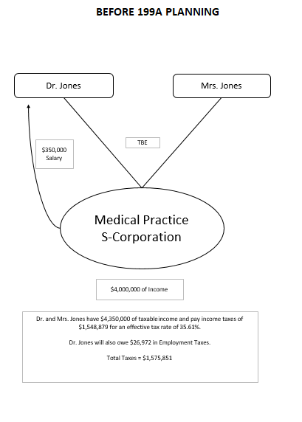
EXCERPT FROM “PLANNING WITH 199A, 678 TRUSTS AND COMPLEX TRUSTS”
Opportunity 7

Slide 88
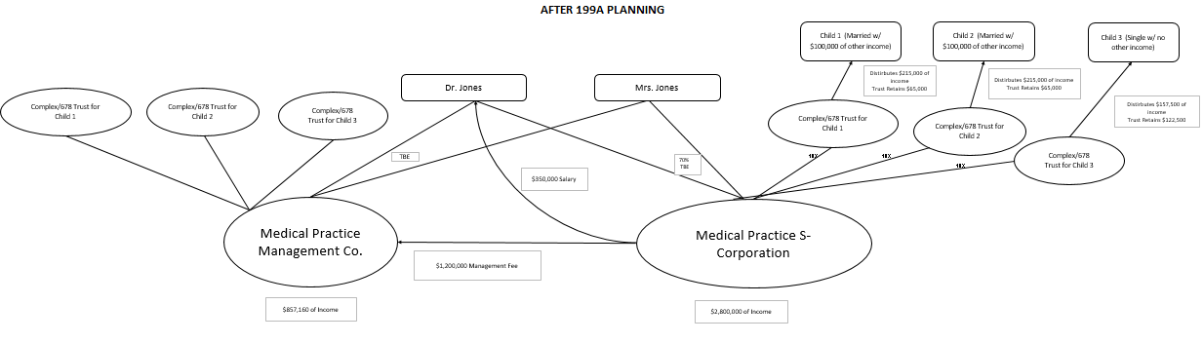
EXCERPT FROM “PLANNING WITH 199A, 678 TRUSTS AND COMPLEX TRUSTS”
Chart is zoomed in on next two slides.
Opportunity 7
A
B

Slide 89

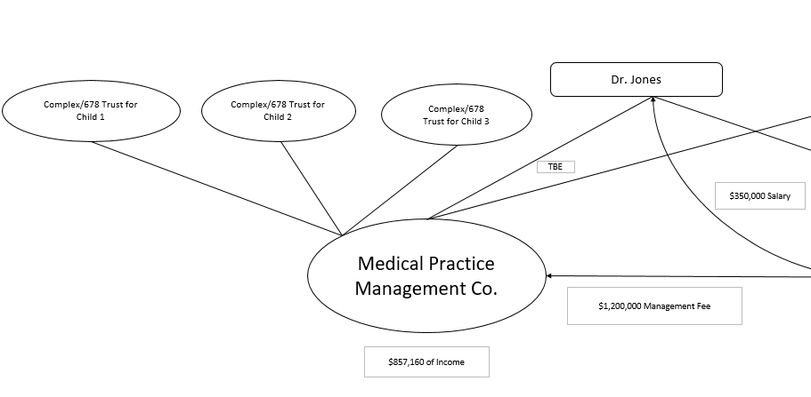
EXCERPT FROM “PLANNING WITH 199A, 678 TRUSTS AND COMPLEX TRUSTS”
Opportunity 7
A

Slide 90
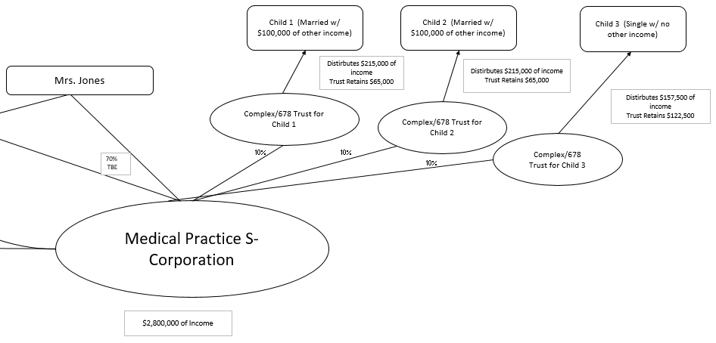
EXCERPT FROM “PLANNING WITH 199A, 678 TRUSTS AND COMPLEX TRUSTS”
Opportunity 7
B

Slide 91
EXCERPT FROM “PLANNING WITH 199A, 678 TRUSTS AND COMPLEX TRUSTS”
Opportunity 7

Slide 92
EXCERPT FROM “PLANNING WITH 199A, 678 TRUSTS AND COMPLEX TRUSTS”
Use of Management Company and Related Arrangements
Excerpt from LISI Income Tax Planning Newsletter #136, Published March 12, 2018
Planning for Section 199A could be problematic and challenged by the Service under the face of Section 269A where the company primarily performs services for one other company or other entity. Consider the following:
• Substantially all of the services of a PSC are performed for (or on behalf of) one other corporation, partnership, or other entity.
• While the principal purpose for forming the PSC is not the avoidance or evasion of Federal income tax by securing the benefit of a deduction (e.g., under Section 199A), which would not otherwise be available because the PSC pre-existed, a new entity (division, subsidiary or brother-sister entity) would have in fact been formed for this purpose.
• It may be argued that the new division or entity providing non-SSB services should not be a PSC, as its principal activity is not the performance of personal services, caution should be exercised as the Section 269A and 199A definitions of personal services are not the same.
• Most worrisome, perhaps, is that Section 269A permits the IRS to treat all related persons (within the meaning of Section 144(a)(3)) as one entity. Might that be interpreted to negate the bifurcation of non-SSB and SSB revenue sources? But if the future Regulations indicate that separate entities are not required and that accounting for non-SSB and SSB revenue sources internally under one entity will be sufficient then, perhaps, Section 269A has no bearing on the ultimate Section 199A tax result?

Slide 93

EXCERPT FROM “PLANNING WITH 199A, 678 TRUSTS AND COMPLEX TRUSTS”
Coordination Of Buildings And Businesses
Debt on building may protect assets of business equity.
Lease obligation to landlord company provides further protection.
SPOUSE 1
SPOUSE 2
COMPLEX
TRUST
TBE
95%
5%
95%
5%
BUSINESS ENTITY
BUILDING
ENTITY
(20 year lease)
(Guarantees mortgage and pledges assets as collateral)
UCC Filing
(mortgage)
TBE and charging order protection, along with cross-collateralization to protect a married couple's business and investment assets, and reduce federal estate tax.

Slide 94
EXCERPT FROM “PLANNING WITH 199A, 678 TRUSTS AND COMPLEX TRUSTS”
Section 199A Strategies
Let’s talk now about strategies as opposed to the 199 technical points that we could spend the rest of our time reviewing.
These strategies are “take it back to the office and apply it” items that can save solid tax dollars for your clients, and give you a useful checklist for what your law firm or CPA firm can do to help clients qualify for the strategy.
Taking into account that single taxpayers with under $157,500 in taxable income and married taxpayers with under $315,000 can take the deduction for any specified trade or business, and without reference to whether wages or qualified property levels apply:
a. Don’t Use S Corporations for Low Income Taxpayers.
Do not use an S corporation for these clients, unless you have to have wages to justify a pension plan or can put part ownership under someone other than the taxpayer or the taxpayer's spouse that files a joint return with the taxpayer.
      If there is no significant pension plan, and a married contractor can earn $315,000 as a Schedule C taxpayer, do so without going into an S corporation, so that she does not have to pay herself reasonable wages under Revenue Ruling 74-44 and the long line of case law requiring S corporation shareholders to pay themselves reasonable compensation because the wages do not qualify for the Section 199A deduction.
Opportunity 9

Slide 95
EXCERPT FROM “PLANNING WITH 199A, 678 TRUSTS AND COMPLEX TRUSTS”
Section 199A Strategies, Continued
b. Use S Corporations for High Income Taxpayers.
If your client is well over the $217,500, or $415,000 if married, threshold, then the business is probably best suited to be an S corporation to avoid employment taxes and to enable the person to pay himself or herself sufficient wages to qualify.
Opportunity 9
c. Minimize or Eliminate Guaranteed Payments From Partnerships.
Your clients who derive income from entities taxed as partnerships should minimize guaranteed payments that they receive, because this income does not qualify for the Section 199A deduction.
      If your client is receiving a guaranteed payment that needs to be wages, then convey the partnership interest to the S corporation if debt does not exceed basis, and the compensation paid to the individual owner of the S corporation does not have to be classified as a guaranteed payment.
      Remember that hot assets (ordinary income assets) from the sale of a partnership interest qualify for the 199A deduction.
d. Asset Sales Yielding Ordinary Income Can Qualify Under Section 199A.
The Final Regulations specifically confirm this for situations where a partner’s sale of a partnership interest triggers “hot asset” income (from accounts receivable and appreciable items).
This should also apply where there is a sale of assets and ordinary income form the sale of accounts receivable, and depreciation recapture. Section 1231 business property that qualifies for capital gains will not qualify for the 199A deduction.
Opportunity 1

Slide 96
EXCERPT FROM “PLANNING WITH 199A, 678 TRUSTS AND COMPLEX TRUSTS”
Section 199A Strategies, Continued
Opportunity 3
e. Reduce Income.
Do whatever you can to get the individual or married couple income below the $315,000/$157,500 levels if this will save considerable taxes:
Defined benefit or cash balance pension planning.
199A asset acquisitions.
Shelter capital gains in Charitable Remainder Unitrusts or by using deferred exchanges under 1031, which now only applies to investment or business real estate.
Oil and gas investments (100% deduction for individual’s intangible drilling costs (IDC).
Conservation easements.
Put other family members to work and on the payroll to reduce taxpayer’s income and increase wages.
Pay past due and prior earned amounts to others in 2018.
Defer sale of capital gain asset to next year if sale will increase income above the threshold levels.

Slide 97
EXCERPT FROM “PLANNING WITH 199A, 678 TRUSTS AND COMPLEX TRUSTS”
Section 199A Strategies, Continued
f. Establish Arm’s-Length Compensation and Sales Arrangements.
A specified trade or business owned by a high-earner taxpayer may pay arm’s-length management, marketing, billing and factoring fees to a separate company whose income will not be Specified Trade or Service Business income until the Final Regulations come out.
      When the Final Regulations come out, the separate company can be owned by children and/or 678 Trusts which are considered as owned by the beneficiary who had a withdrawal right over all assets. Google Gassman Forbes 678 to see an article on this.
      The ownership can be under complex trusts, which should receive a $157,500 threshold at both the trust level and at the level of each beneficiary until the Final Regulations come out.
      If the Final Regulations restrict use of complex trusts convert the complex trust into a 678 trust, so for each young child, you will have $157,500 times 7% savings.
      g. Plan for Wages.
      Remember that the wages need to be 28.57% of what the income without wages would otherwise be, and include not only wages themselves, but also pension contributions and employer paid health benefits.
      You may, therefore, already have significant “wages” but may not know it.
Opportunity 4
Mistake 3

Slide 98
EXCERPT FROM “PLANNING WITH 199A, 678 TRUSTS AND COMPLEX TRUSTS”
Section 199A Strategies, Continued
h. Decide what income to aggregate between related companies and what you can do to prevent aggregation in later years. Remember you can’t aggregate SSTBs.
i. Separate life insurance agency income from investment advisory and annuity sales income.
j. Restructure celebrities and well known professionals so that their earnings come from business operations and not from royalties or endorsements.
k. Make real estate rentals and other “passive” activities active in order to qualify such activities for the Section 199A deduction.
Mistake 5
Mistake 1
Opportunity 10

Slide 99
EXCERPT FROM “PLANNING WITH 199A, 678 TRUSTS AND COMPLEX TRUSTS”
Section 199A Strategies, Continued
l. Pay off loans to eliminate interest expenses to qualify for a larger deduction, or maintain debt if interest expense will reduce income below the high earner thresholds.
Taxpayers who have made debt decisions based in part upon the deducibility of interest may wish to reconsider normal assumptions, given that the interest deduction attributable to a trade or business that generates income qualifying for the Section 199A deduction will be saving income tax at a lower bracket.
For example, a 37% bracket taxpayer who has an active business that pays $100,000 a year of interest on debt will be saving $29,600 in income taxes instead of $37,000 in income taxes as the result of the interest paid.
If the same taxpayer has a separate trade or business or investment arrangement that is taxed in the 37% bracket, why not pay down the debt owed on the business that qualifies under Section 199A to receive an additional $7,000 in tax savings from the interest deduction?
Under the 2017 Tax Cuts and Jobs Act, businesses with more than $25 million in average annual gross receipts for three preceding tax years cannot deduct interest expenses to the extent that such expenses exceed 30% of their adjusted taxable income.
m. Remember that 1231 property income – capital gains income from the sale of business property – will not qualify, but losses will reduce 199A income. (See Section 1231 Summary Chart on next slide.)
The Section 1239 rules also apply.

Slide 100
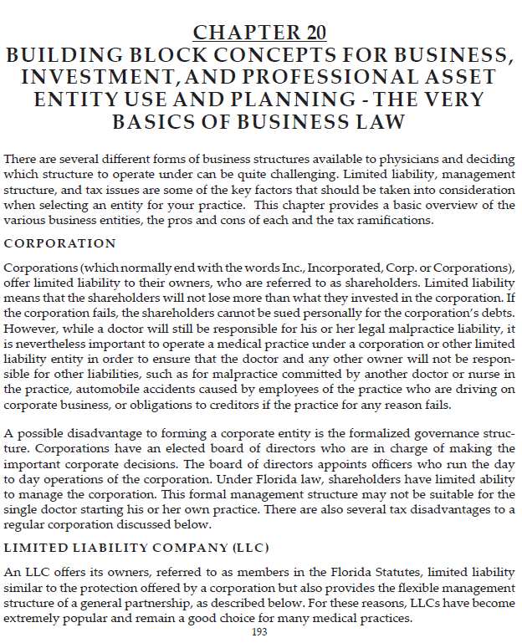

Slide 101
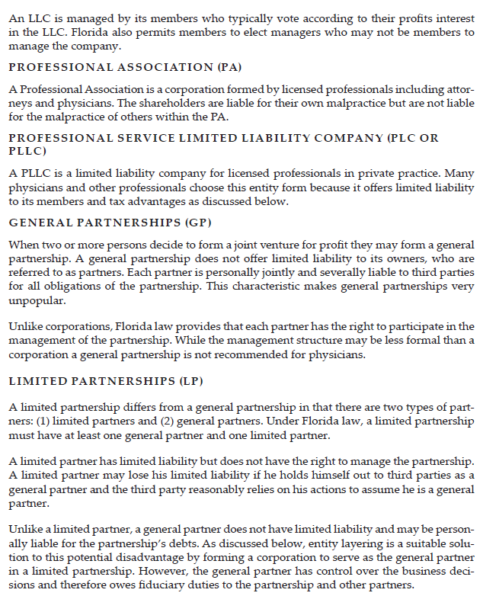

Slide 102
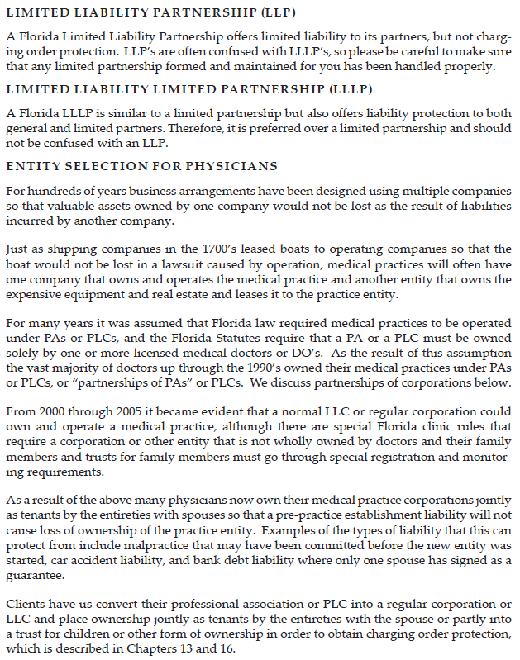

Slide 103
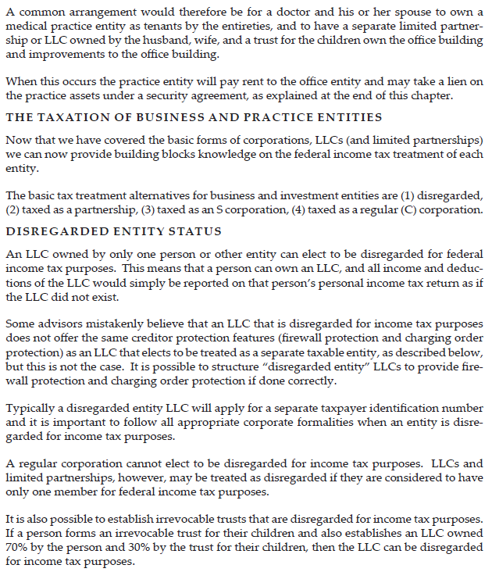

Slide 104
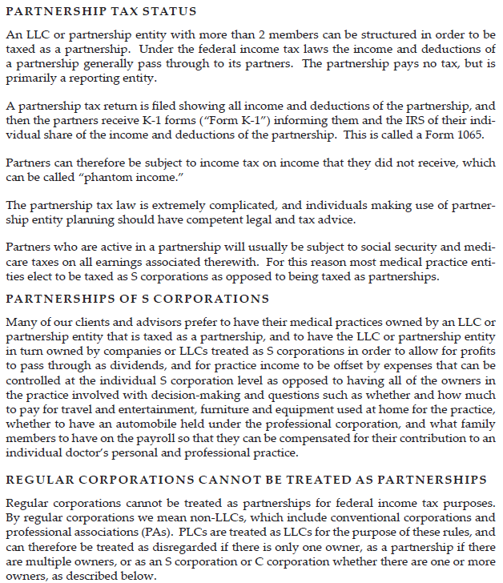

Slide 105
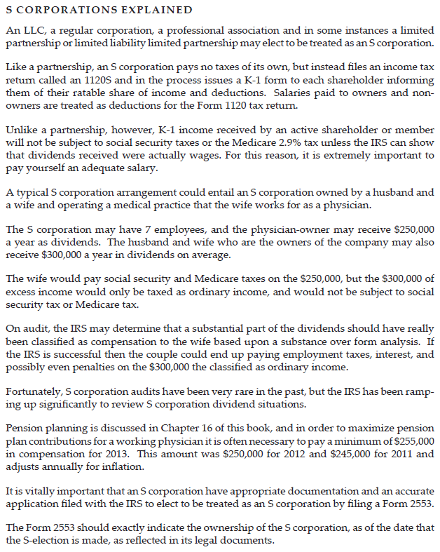

Slide 106
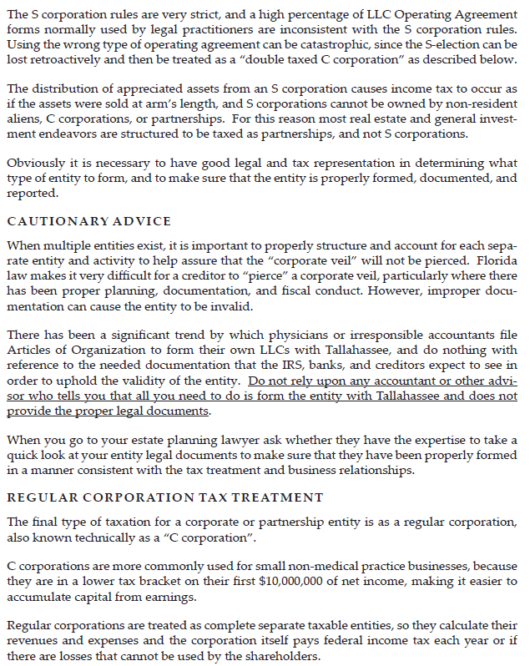

Slide 107
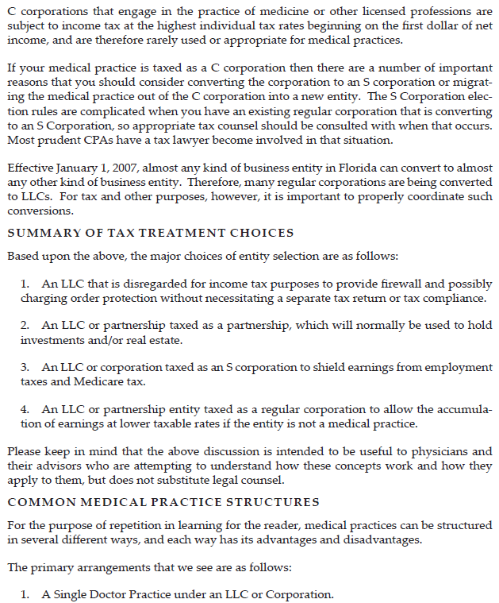

Slide 108
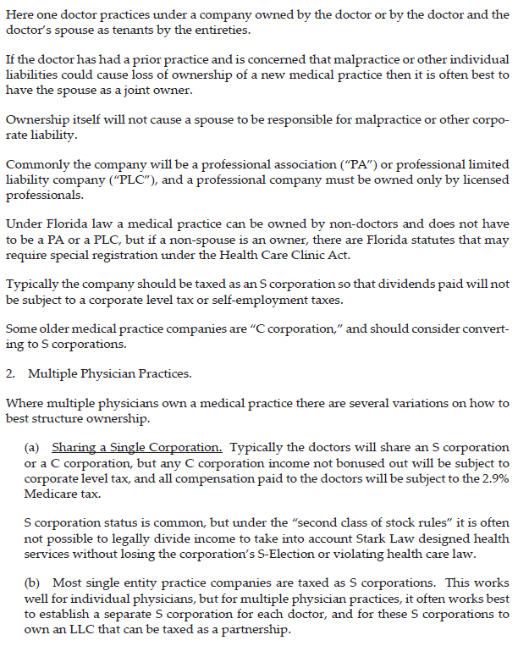

Slide 109
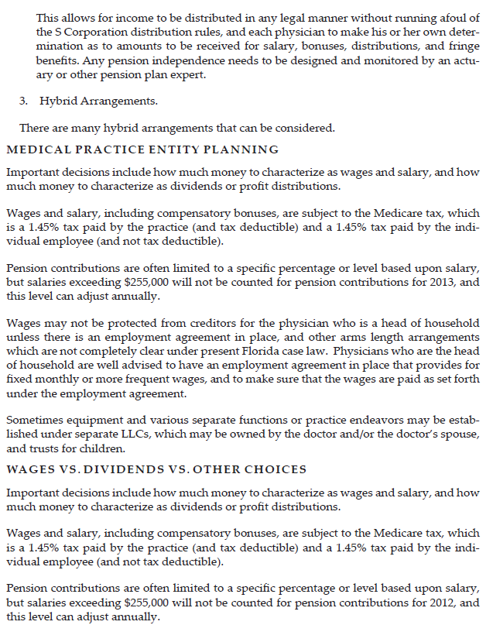

Slide 110
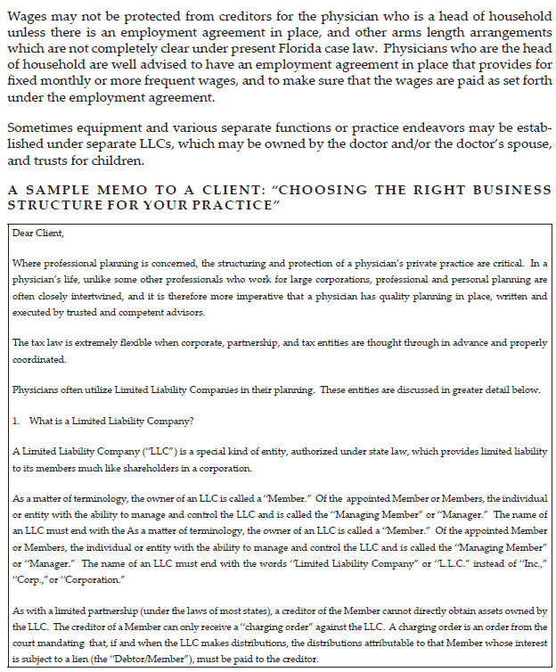

Slide 111
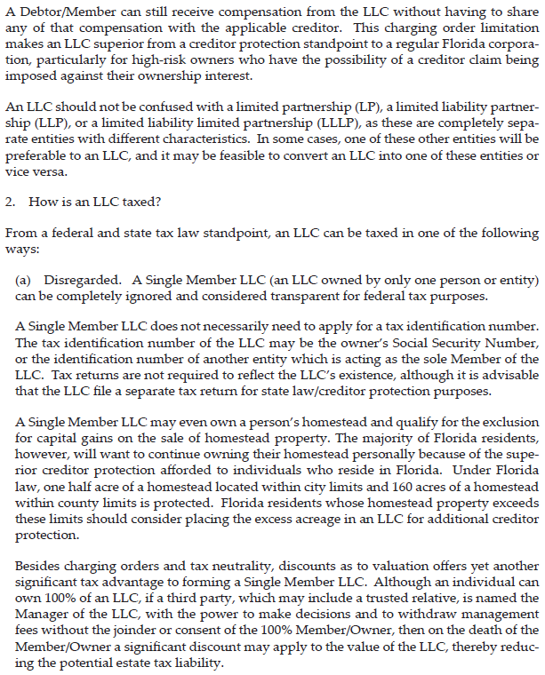

Slide 112
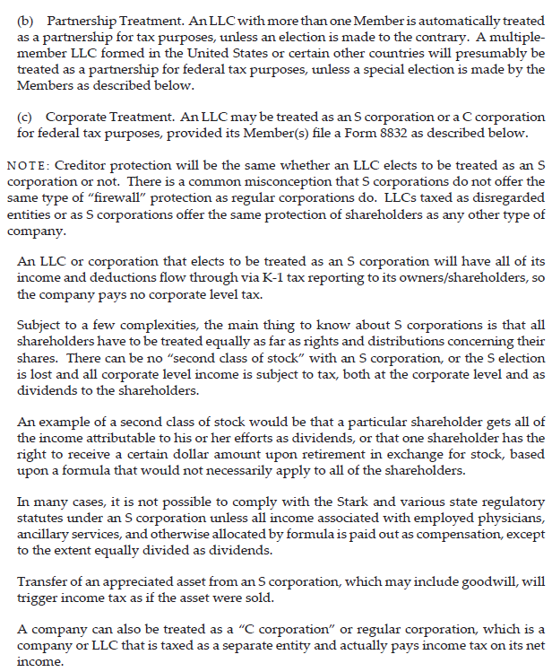

Slide 113
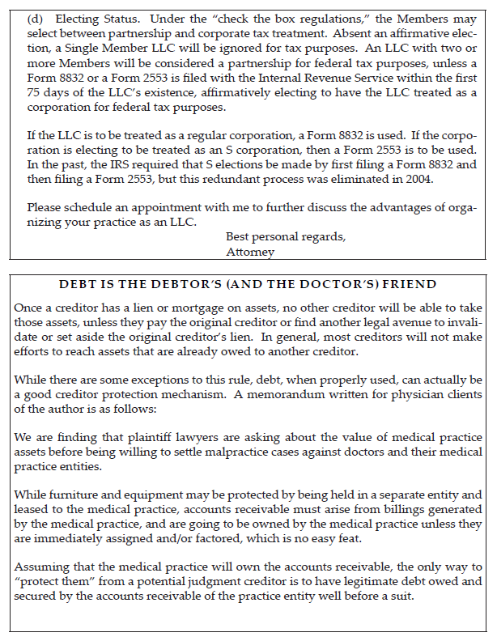

Slide 114
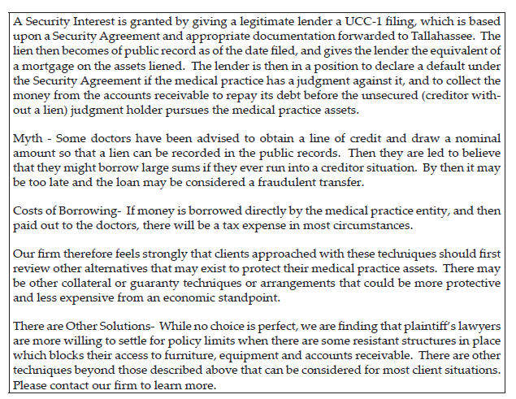

Slide 115
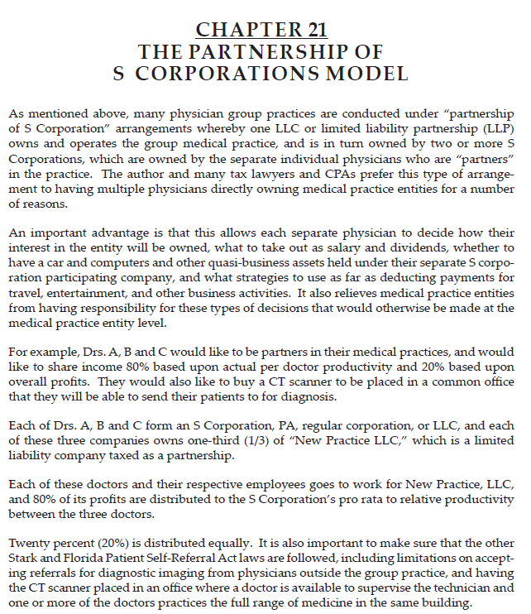

Slide 116
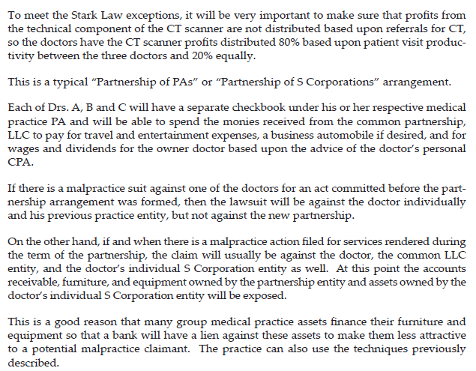

Slide 117
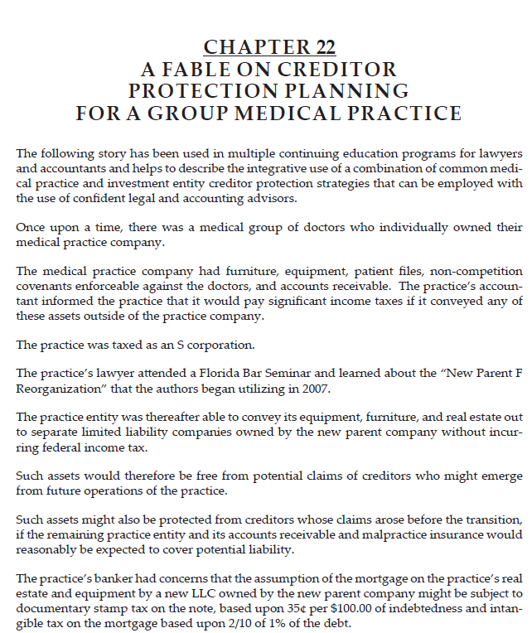

Slide 118
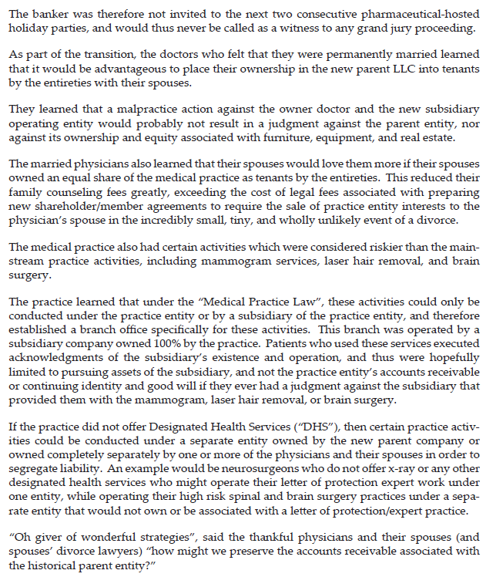

Slide 119
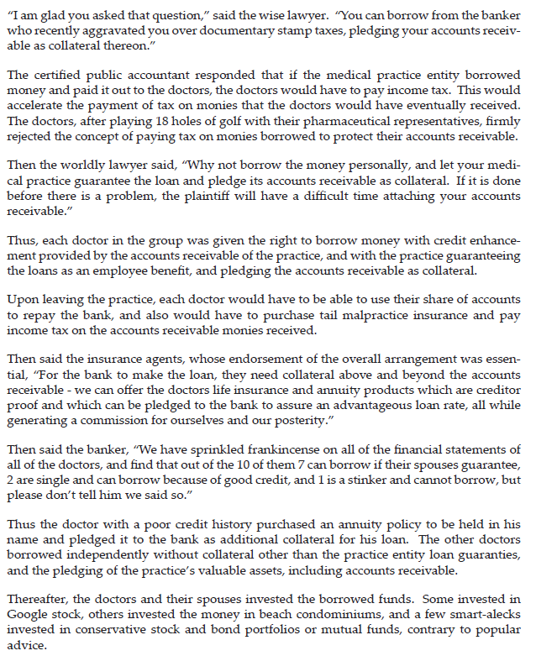

Slide 120
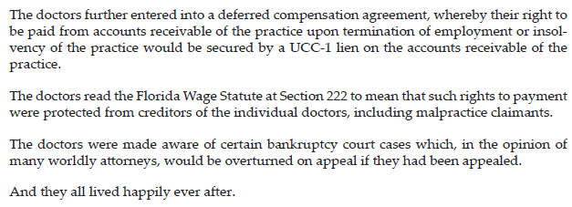

Slide 121
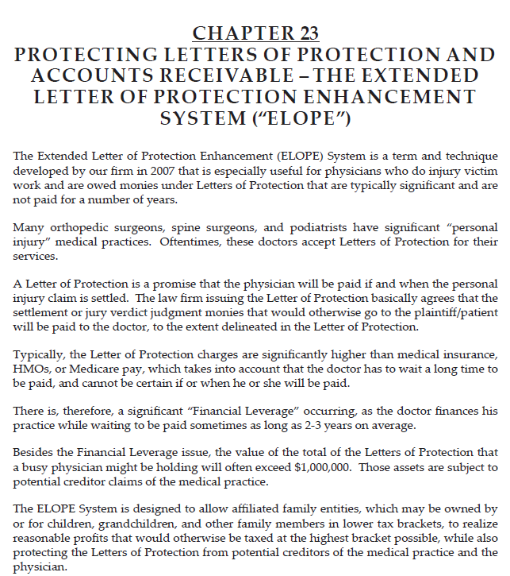

Slide 122
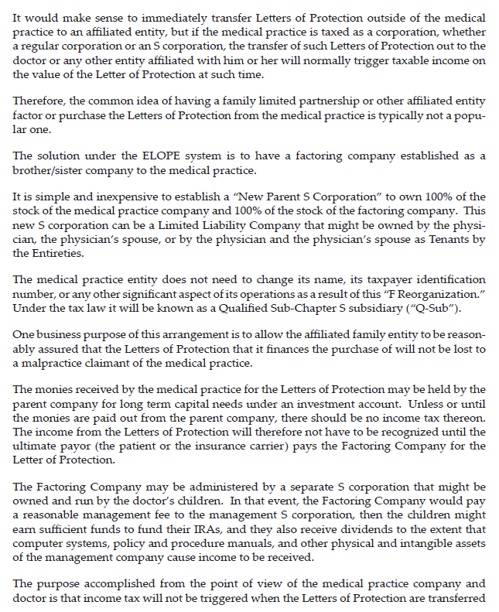

Slide 123
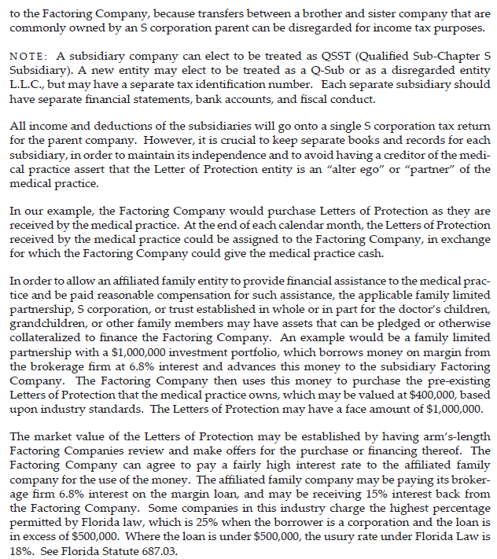

Slide 124
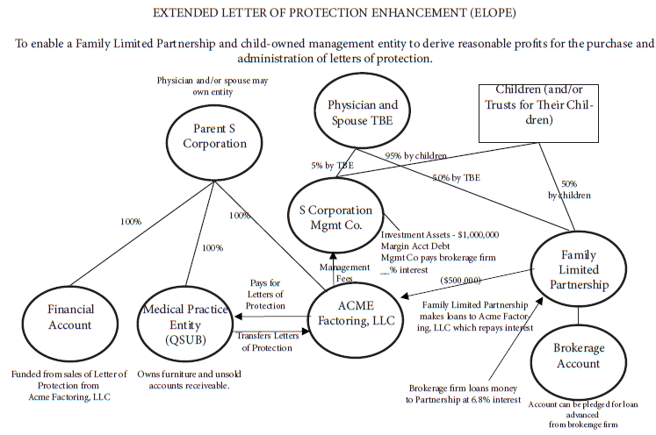

Slide 125
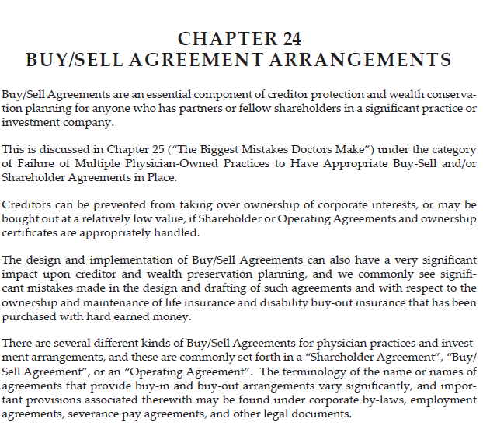

Slide 126
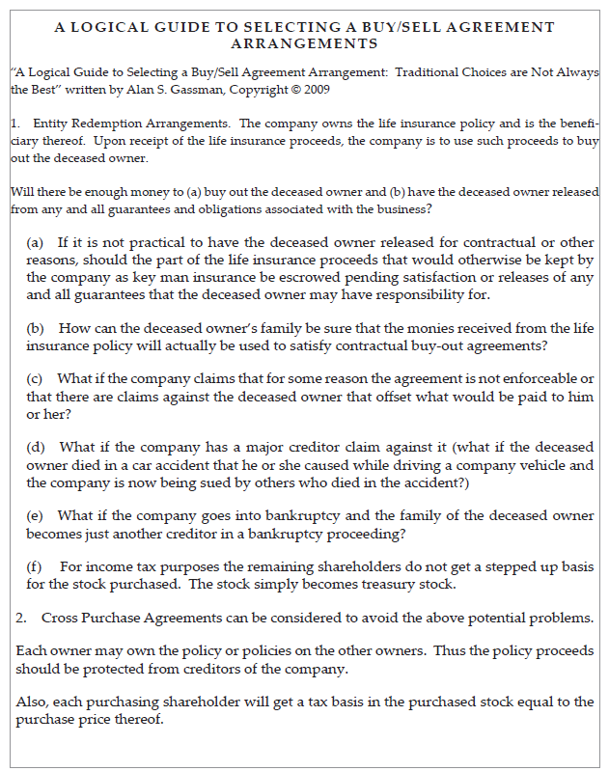

Slide 127
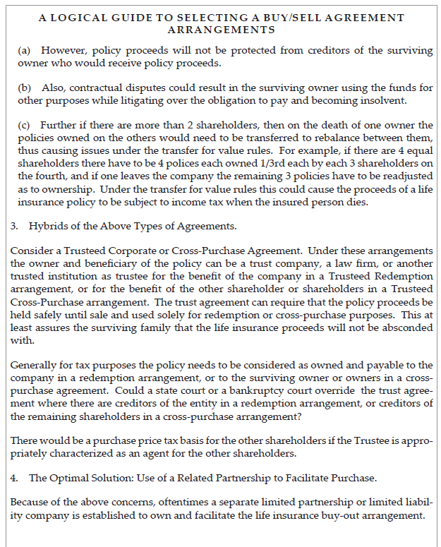

Slide 128
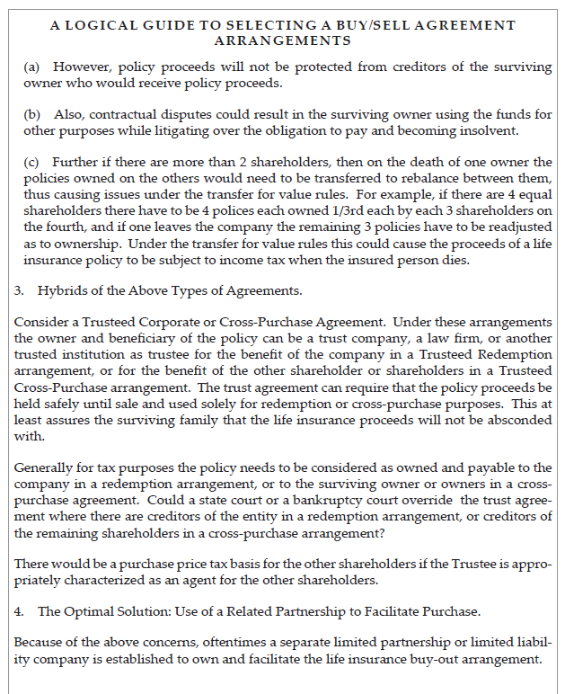

Slide 129


Slide 130


Slide 131


Slide 132


Slide 133


Slide 134


Slide 135


Slide 136


Slide 137


Slide 138


Slide 139


Slide 140
THE BUSINESS OF MEDICINE: LEGAL STRUCTURES AND TAXATION
Saturday, January 6, 2024
From 11:00 AM to 12:00 PM EST
(60 minutes)
Presented By:
Alan Gassman, JD, LL.M. (Taxation), AEP® (Distinguished)
agassman@gassmanpa.com
Lynda Dilts-Benson, RN, CCM, LHRM, CRC
Pariksith Singh, M.D.
1245 Court Street
Clearwater, FL 33756

Slide 141
THE BIGGEST MISTAKES THAT DOCTORS MAKE WITH
RESPECT TO MANAGING THEIR MEDICAL PRACTICES AND INVESTMENTS
By Alan S. Gassman, J.D., LL.M.
As published in Leimberg Information Services, Inc. (LISI) Estate Planning Newsletter #1465 (May 20, 2009) Copyright 2009.
Alan Gassman, a partner in Gassman, Bates & Associates, P.A., and a frequent LISI commentator, has represented several hundred medical practices through the years. Alan practices business, estate planning and tax law in Clearwater, Florida.
A thriving and successful medical practice can quickly be pulled under by one catastrophic incident that destroys its financial solvency, its credibility, or both. How and why do such catastrophes occur, and what are their most common forms?
EXECUTIVE SUMMARY:
This commentary reviews ten avoidable mistakes that can be the cause of fatal errors for medical practices and investment portfolios.
COMMENT:
While different physicians and groups of physicians tend to make more mistakes in one area than another, each common mistake area should be reviewed and understood with appropriate advisors. These common errors, which are described in more detail below, are as follows:
1. Failure to Maintain and Appropriately Use Independent Professional Advisors.
2. Failure to Maintain Medical Law Compliance.
3. Failure to Maintain Proper Malpractice Insurance.
4. Failure of Multiple Physician-Owned Practices to Have Appropriate Buy-Sell and/or Shareholder Agreements in place.
5. Failure to Procure and Maintain Proper Insurances.
6. Failure to Make the Medical Practice and Doctor Judgment-Proof.
7. Failure to Theft-Proof the Practice's Monies and Accounts Receivable.
8. Using Greedy Investment Advisors.
9. Unbalanced Investment Portfolio.
10. Doing Business With the Wrong People.
11. Failure to Have Anyone in the Practice Pay Attention to Contracts with Third Parties.

Slide 142
1. Failure to Maintain and Appropriately Use Independent Professional Advisors. Many of the calamities described below will be avoided if a medical practice has experienced advisors on board. The practice should consult with its advisors when making major practice decisions, and also periodically confirm that appropriate procedures and safeguards are in place.
(a) CPA: Quite often the quarterback of the advisor team will be a good, caring Certified Public Accountant who does extensive medical practice work. CPA's are often well versed in investments, business matters, and methods of theft- proofing a medical practice from a financial standpoint.
CPAs should prepare quarterly or monthly financial statements for the medical practice; these statements should involve a review of accounts receivable, cash flow and general practice financial information.
(b) Attorney: An experienced lawyer who represents a number of medical practices should have sufficient experience to help physicians avoid terrible problems before they occur.
Just as physicians advise patients to have an annual check-up, and may wisely require this before prescriptions are renewed beyond 12 months, a medical practice client should confer with its lawyer on a periodic basis. Commonly the primary lawyer for the practice will refer matters to appropriate sub-specialist attorneys in a number of different areas. Often this happens in conjunction with a CPA meeting.
(c) Other Advisors: Other advisors commonly and appropriately used by a medical practice group will include (i) a qualified pension plan advisor, who is also preferably an actuary, as well as (ii) a banker who is knowledgeable as to practical business expense and loan-associated planning, and (iii) a reputable and conservative financial advisor or advisors who assist with pension planning, various insurances, and other practice-associated financial instruments.
Good advisors should be honest and always let the physician and the rest of the team know about questions, concerns, or the need to bring in additional experts to handle any particular matter or situation. Advisors who show up to sell a single product or scheme commonly cause problems, as described in below.
2. Failure to Maintain Medical Law Compliance. A great many physicians are annihilated financially when Medicare and/or private insurance carriers request hundreds of thousands of dollars in refunds because the physician has used inappropriate billing practices or financial arrangements with third parties. In many cases these problems are reported to the government by employees who can earn a 15% "whistle-blower fee."

Slide 143
Many physician clients simply do not realize that they use improper coding, do not maintain sufficient patient file back-up, or bill for items that are inappropriately unbundled or altogether un-billable.
Several years ago, the concept of a "medical practice compliance audit" was in vogue, and many professionals, in the opinion of the author, significantly over-charged physician groups for "practice audits." Such audits extended far beyond a reasonable review of billing, patient file documentation, and third-party financial arrangement review.
Reasonable and periodic practice maintenance and reviewed by trusted medical consultant advisors eliminates the need for such a costly venture. In the author's experience, most medical practices benefit from hiring an independent consultant to come into the practice, perhaps annually, to spend a day randomly reviewing patient charts and the billing and collection processes associated therewith.
Quite often a good consultant can spot billing opportunities where the practice is undercharging or not knowing to charge for certain services. An independent consultant can also be a tactful go-between to let certain members of a medical practice know that their file documentation is not sufficient. Such corrections are best conveyed by a neutral third party.
Consultants should be hired by a lawyer on behalf of the medical practice so that any problems they may discover can stay confidential under the attorney-client privilege to the extent possible.
If and when the government criticizes a medical practice's coding, file documentation or other billing procedures, it is very helpful to be able to show that the practice conscientiously hired and followed the advice of a reputable billing and coding consultant on a periodic basis.
Many physician groups are also unfamiliar with or intentionally disregard rules relating to arms length leases, compensation arrangements, and also the ability to refer tests within a group medical practice only if certain rules are followed. The author has had law-abiding and well-meaning physician clients arrested in their lobbies by the FBI as a result of being in business with the wrong people at the wrong time.
Doctors can rest assured that any "scoundrel" that they have legitimate or questionable business relationships with will turn them in to get amnesty if and when approached by law enforcement, even if the doctor did nothing wrong. When law enforcement comes knocking the doctor should immediately have appropriate sub-specialty lawyers contact law enforcement on his or her behalf. Neither the doctor nor his or her staff should directly speak with any law enforcement officers at any time on any topic.

Slide 144
3. Failure to Maintain Proper Malpractice Insurance. While malpractice insurance is not inexpensive, it is necessary in order to protect physicians from the significant legal fees, expert witness costs, and liability exposure associated with defending lawsuits. The proliferation of the personal injury lawyer industry shows no sign of slowing down, and a sympathetic jury system, coupled with experts willing to testify that a doctor committed malpractice under complicated circumstances that a jury can never understand provides good cause for maintaining appropriate malpractice insurance coverage.
Many advisors and clients believe that a practice need only maintain the lowest limits of liability coverage because "they will always settle for your limits," but the author has found that in many cases plaintiffs will not settle for low limits of medical malpractice insurance liability where there are other significant assets exposed. Physician clients will sleep better and have a greater sense of financial security, as well as significantly less personal exposure, when they have higher levels of liability insurance than the legally required minimum.
Many physicians will obtain malpractice insurance coverage from low-cost carriers that turn out to be infirm and go bankrupt, leaving doctors high and dry to defend their own claims and without any coverage whatsoever for legal and expert expenses.
Any opportunity to pay significantly less than the going rate for malpractice coverage should be reviewed carefully with the above concerns in mind.
Also, the income tax laws permit a medical group to form its own "captive insurance carrier" and deduct premiums paid to the carrier company. Under the tax law the carrier company may not have to include premiums received as income unless or until it is determined what portion of the premiums will be used to pay claims as expenses and what portion of the premiums will be profits. Profits taken out later may be taxed at favorable capital gains rates.
Nevertheless, there is a significant economic risk taken since the carrier could "go under" if there are extensive claims, and when there are multiple doctors being insured by the carrier, one or two doctors who make a lot of mistakes could cost all of the equity for the other doctors.
Further, unlike conventional malpractice insurance, which requires a carrier to offer tail malpractice insurance coverage at the request of each doctor, captive insurance carrier reinsurance contracts will commonly not bind the reinsurance company to even renew the coverage, let alone provide a tail policy on termination, leaving an entire group of doctors without any coverage whatsoever. Successor carriers will not provide tail coverage for periods of time that no other carrier is on the hook for.

Slide 145
The laws of most states require that malpractice insurance be provided by a state-registered carrier. Doctors who have malpractice insurance furnished by an unregistered carrier may be considered to be "going bare" under state law, and may therefore have to notify patients that the doctor is "bare." A possible loss of license can occur if a doctor cannot satisfy a claim by reason of not having malpractice insurance or the financial wherewithal to pay a claim.
Many doctors are not aware that for a small additional premium they can have a separate "corporate" malpractice insurance policy issued by the same carrier that provides individual policies that covers the medical practice company in order to effectively double the limits of malpractice insurance that would be available to pay on a claim, and to assure that the company will have coverage if one of the doctors leaves and refuses to buy tail malpractice insurance.
Also, nurse practitioners and registered nurses can often qualify for insurance with high limits of liability for very low cost. Many physicians will not treat certain types of high-risk patients unless they at all times have a nurse practitioner in the room with them to make sure that there is plenty of coverage, witnesses to what is said, and appropriate follow-up.
4. Failure of Multiple Physician-Owned Practices to Have Appropriate Buy-Sell and/or Shareholder Agreements in Place. Many successful medical practices are run on a handshake or a long-forgotten and now archaic agreement, but when problems or changes in circumstances arise the results can be catastrophic- and quite lucrative for the legal profession.
For the sake of example, assume that Doctor A and Doctor B are lifelong friends who have practiced together 25 years and share 50% each ownership of a medical practice without current legal agreements. Their spouses have also been best friends.
They have always worked approximately the same and have always been paid the same. A couple of years ago they were offered $3,000,000 for the practice, which involved signing 5 year non-competes and 5-year employment agreements. They also own the practice real estate together in a separate company under which they have signed a $2,000,000 mortgage on real estate now worth only $1,500,000.
If Doctor A becomes disabled, they may not be able to agree on how much Doctor B should be paid to administer the practice. Disagreements may also arise regarding the hiring of a replacement doctor or doctors.
They may also not be able to agree on a price or terms for Doctor B to buy Doctor A out.

Slide 146
Often disabled physicians believe they will be returning to work. Meanwhile, their partners see the writing on the wall and take a more skeptical view of their capacity for recovery. The practice can be significantly damaged during this period of time until the disabled physician's status on returning to work is absolutely confirmed.
What if Doctor A becomes a drug addict or begins having an affair with medical practice personnel that could cause obliteration of the practice? How can Doctor B force Doctor A to leave, or to even behave? How can Doctor B protect the practice and himself from responsibility for Doctor A's misconduct?
What if Doctor A dies? Doctor A's widow may believe that the practice is worth $3,000,000 and will be voting Doctor A's stock unless or until she is bought out. How can Doctor B convince Doctor A and her lawyers and valuation experts that the practice has lost significant value because of Doctor A's death? How can Doctor B run the practice if Doctor A's widow will not agree to any significant changes in situations where such changes become necessary?
How can Doctor B attract a new doctor to the practice if he has to disclose that he is not getting along with the 50% widow owner of the practice?
The list of examples goes on and on. It does take time and money to put together an appropriate Buy-Sell/Employment/Shareholder document package. Almost no two are the same as circumstances change. However, it is a valuable investment that every practice should make.
In addition, applicable state law and/or Medicare law often requires that compensation be based upon methods determined in advance that do not take into account the referral of patient services. As mentioned under number 2 above, the referral of a patient within a group practice for certain testing or other "designated health services" under the Stark Law can be a felony unless there is a properly documented method of sharing that qualifies under the Stark Laws. Failure to have this in writing in advance of a particular calendar quarter can constitute a felony offense.
5. Failure to Procure and Maintain Proper Insurances. There are myriad insurances required to appropriately safeguard a medical practices from the normal risks of doing business, particularly in view of the American trial system.
Fortunately most of these risks can be reasonably handled on an affordable basis, assuming that proper coverage is in place.

Slide 147
The most important coverage is clearly malpractice insurance, which is addressed below as a separate section, but other insurances which are essential to the well-being of physicians and their medical practices include:
1) disability insurance,
2) overhead insurance to handle practice expenses during a period of disability or in the event of a natural disaster such as a hurricane or acts of terrorism,
3) liability insurance to cover non-malpractice obligations, such as if patients or others hurt themselves in the parking lot or fall on slippery areas in the office,
4) workers' compensation insurance to protect the practice against state laws that can require lifetime support and/or significant monetary payments to be made to an employee injured in the course of employment, and
5) unowned automobile liability insurance to insure against the liability that occurs to a medical practice if any employee is in an automobile accident while running errands or otherwise working in the course of medical practice business.
Individual automobile liability policies should also be reviewed to ensure that each physician has coverage for medical practice-related driving. Many personal policies will not cover business driving without additional policy riders. The author commonly recommends at least $3,000,000 - $5,000,000 worth of umbrella liability coverage to cover all business and personal driving, and driving by others who might use the doctor's car.
There are thousands of disabled physicians in the United States now living on disability insurance. The author has more than 15 clients who have been able to "retire" on their disability insurance. This explains why the rates are so high to procure such coverage, but also why having good coverage is a necessity rather than a luxury for physicians who do not have adequate retirement savings to support themselves and their families for their remaining lifetimes.
Sometimes individual health insurance policies will not cover on-the-job injuries under the presumption that a doctor will be covered under workers' compensation for on-the-job injuries. Doctors who do not have workers' compensation insurance, which is often waived to save money, should check their health insurance policies to make sure that they are covered for on-the-job injuries.
6. Failure to Make the Medical Malpractice and Doctor Judgment-Proof. There are many ways that a medical practice and a doctor can work to make themselves a less attractive target for a plaintiff's lawyer.
Often the practice incurs debt in its name, and the lender or lenders have liens on practice and personal assets that must be paid before a plaintiff is able to levy upon a doctor or practice. Also, valuable assets like real estate and furniture and equipment can be owned by a separate entity that would lease those assets to the medical practice to make them inaccessible, or at least less accessible, to a malpractice claimant.

Slide 148
It is also important to ensure that each physician in a group has his or her personal creditor protection planning properly in place so that a plaintiff lawyer can be led to settle within policy limits if and when a catastrophic lawsuit occurs.
Because of state and bankruptcy law fraudulent transfer law statutes, it is often crucial that creditor protection planning for the medical practice entity and the doctors occur well before any problems arise.
When a serious lawsuit occurs, the doctors should keep in mind that the lawyer hired by the insurance company does not necessarily have duty of absolute loyalty to the doctor. The malpractice insurance carrier selects and pays the lawyer.
There are often circumstances whereby an independent lawyer should be hired by the doctor to encourage the insurance carrier to settle a claim within policy limits when the opportunity arises, in order not to risk the doctor's personal and practice assets to an "excess verdict." Many states have laws that will require an insurance carrier to be responsible for any excess verdict if proper demand has been made upon the carrier when it had the opportunity to settle within policy limits. These are called the "bad faith" rules.
7. Failure to Theft-Proof the Practice's Monies and Accounts Receivable. The author regularly receives at least one phone call per year from a very upset physician who has had tens of thousands of practice dollars stolen by an employee. This employee has often been with the practice many years, and most of the time is the most trusted person in the practice other than the physicians themselves. As such, the employee is able to obtain physical possession of checks made payable to the practice by one or more payor sources and/or has written checks on the practice accounts for bogus expenses.
Over the years, the author has seen medical practices unwillingly and unwittingly pay credit card expenses, electric company expenses, car payments, and even home mortgage payments for a medical practice employee. When the circumstances are reviewed, they reveal that most of these situations would have been avoidable with proper supervision and use of appropriate safeguards.
Additionally, money is often stolen from practice accounts when large projects such as buildings, construction, or similar matters are administered by a person who signs the checks and/or administers the checks and invoices for a busy physician.
Most of the time the theft is carried out by the most trusted office manager without any assistance from another employee.

Slide 149
It is a very basic accounting system principle that the person or people who physically open the envelopes containing checks payable to the practice record the checks onto a log and ensure that the checks are properly deposited. These deposits are then reported to a separate employee who has the ability to record the payments in the practice's computer system.
It is a fatal error to allow one individual to have physical possession of checks and also the ability enter payments or write-offs onto the practice's billing computer system. Even spouses have been known to steal from medical practices, especially when there are multiple partners.
Many practices use a post office box for checks to eliminate the risk of someone being able to "snatch a few checks from the mail" before they can be posted. Many banks offer check-depositing services and addresses that can be used as well. These are often known as "lock box" arrangements.
Larger practices can have someone from their CPA firm visit the practice on an annual basis without advance notice to the practice personnel. This demonstrates to employees that there is some degree of monitoring going on and can discourage practice theft.
8. Using Greedy Investment Advisors. The number of different investments and life insurance and annuity arrangements that can be sold to doctors and their practices in the financial world. The quality of each particular investment vehicle can vary dramatically in terms of actual financial safety, conservative versus aggressive orientation, likelihood of being acceptable to the IRS in the event of an audit, and as to the amount of commissions paid to advisors who may suggest such arrangements.
Expecting a physician to read a prospectus or to understand a complicated tax maneuver is like expecting a lawyer or a CPA to read an EKG- it is easy to be fooled!
If the advisors are earning a significant portion of the amounts invested as compensation, a degree of manipulation, non-disclosure, exaggeration or outright lying can take place.
In the pension world, actuaries and many CPA firms who practice extensively in the retirement plan arena can yield the great results for clients. Pension and profit-sharing plans are well-protected under applicable creditor laws and well-accepted under the tax law in conventional form.

Slide 150
More aggressive plans such as 419A Welfare Benefit plans and 412i plans should be examined carefully by independent advisors before investing.
The author urges clients to use independent accountants who are not compensated directly or indirectly for the sale of financial products. The author has seen entire fortunes lost to tax shelter deals in the 1970s, leveraged real estate deals in the 1980s, land development deals in the 1990s, and now Madoff and related Ponzi and margined-securities deals in the present decade. Crime often pays, and the victim is the doctor who gets involved in these types of arrangements.
There is rarely a good reason for a pension or profit-sharing plan to own a life insurance or annuity product, except to compensate anyone who may be licensed in life insurance and annuities who has involvement in the pension or profit-sharing
9. Unbalanced Investment Portfolio. Statistical studies show that a diversified portfolio of investments will generally out perform a non-diversified portfolio, with significantly less risk. Many successful clients own investment real estate, mutual funds allocated among the various classes of stock investments, and bond funds or CDs. It almost never makes sense for anyone to put all of their eggs in one basket.
Go For Singles and Doubles, Not Home runs. Time and time again we have seen physicians place significant portions of their financial assets into high risk investments or ventures with the intention of hitting “a home run” under risky circumstances.
There is almost always a direct and opposite correlation between expected rate of return and risk being taken. Many high income professionals recognize this and are nevertheless willing to take risks. Quite often, however, physician investors are assured that an arrangement is “virtually risk free” even though it is expected (or touted) to yield a significant return. If it is too good to be true. . .it probably is.
10. Doing Business with the Wrong People. Unfortunately, crime, and also deceitful or misleading behavior can be lucrative for the "bad or careless actor," and these individuals are often found courting doctors to do business and investment transactions or to provide consulting services.
Since the overwhelming majority of doctors are very honest and do not have formal business training, it is not difficult to market "unique propositions" to doctors and to eventually find a handful of doctors who may succumb to participate in a recommended arrangement.

Slide 151
Commonly these "bad actors" will present themselves through relatives, friends and possibly even misled advisors.
Typically the doctor will be asked to invest in a startup or growing company, to help start a new business, or to be involved in the purchasing or financing of real estate.
Bad actors are often well-dressed, exhibit success in the forms of nice house and cars, and sometimes even jet airplanes, stunning vacations, trophy wives, and impressive club memberships.
A team of advisors can usually sniff out this type of individual or organization by checking references, or the lack thereof, licensing, and with other professionals who have worked with the applicable individual. The author has seen this occur in billing companies, unique invention startups, real estate ventures, medical related companies, ice machines (that did not exist), Ponzi schemes, and other situations.
If it sounds too good to be true it usually is! And do not forget the adage about the experienced businessman and the doctor who become partners. The businessman puts in his experience and the doctor puts in his money. At the end of the day the businessman has the money and the doctor merely has an experience!
Doctors with gamble-holic tendencies are often drawn to elusive schemes where the doctor is told that he or she has earned millions of dollars and should have colleagues put money in so that they can earn millions too, while in reality the "con job" is that the money is being stolen or used to pay debts on assets that will never be worth anything. A junior Madoff may be your next door neighbor or brother-in-law!
Every year the IRS publishes the "Dirty Dozen," a list of tax frauds, including schemes involving the internet, domestic tax crimes, offshore frauds and false claims for refunds. This is done for the benefit of citizens and their awareness of financial predators. The IRS website at http://www.irs.gov/newsroom/article/0,id=206370,00.html says it right: "Taxpayers should be wary of scams to avoid paying taxes that seem too good to be true, especially during these challenging economic times," Commissioner Doug Shulman said. "There is no secret trick that can eliminate a person's tax obligations. People should be wary of anyone peddling any of these scams.“

Slide 152
Don’t be a jerk… or get
involved with jerks

Slide 153
11. Failure to Have Anyone in the Practice Pay Attention to Contracts with Third Parties. Quite often medical practices get into disputes or find themselves stuck in agreements as a result of a trusting nature or lack of attention to details associated with contracts they enter into with third parties. Say, for example, somebody delivers a copier to the medical practice that the office manager has requested on a trial basis. Upon delivery, that person gets the receptionist to sign a contract accepting copier and binding the practice to 48 months of payments.
Another example is when a medical practice has a lease that gives the doctors the right to extend after a certain date, but they forget to give notice of extension by the deadline. The practice gets held up by the landlord for a larger rent payment or has to vacate and find new property.
A third example is when a lease for a large piece of equipment also requires the practice to maintain the equipment with one company only. The company may provide poor service or may not permit the practice to pre-pay the lease or re-finance it from a high rate of interest without paying tens of thousands of dollars in penalties.
Another trap some practices fall into is using an office manager or non-CPA accountant to draft legal documents that employ physicians or to set up companies for the practice, not realizing that the contracts have inappropriate provisions or do not cover essential items that a lawyer or appropriately qualified advisor would have pointed out.
F. Lee Baily said that "anyone who acts as his own lawyer has a fool for a client."
Most successful lawyers hire other lawyers to do work for them personally when it is outside of their area of specialty, or sometimes even when it is within their area of specialty because of this phenomenon.
If lawyers are smart enough not to do legal work for themselves, why aren't doctors and their other advisors?
CITE AS:
LISI Estate Planning Newsletter # 1465 (May 20, 2009) at http://www.leimbergservices.com/ Reproduction in Any Form or Forwarding to Any Person Prohibited – Without Express Permission.

Slide 154
8 COMMON LLC PLANNING ERRORS
By: Alan S. Gassman, J.D., LL.M.
Some of the most common problems we encounter in reviewing LLC arrangements for clients are:
1. Tenancy by the Entireties" Designation that Will not Qualify as Tenancy by the Entireties.
Many married couples in states that protect tenancy by the entireties assets from the creditors of one spouse or the other have their LLC interests titled jointly as tenants by the entireties.
But they don't realize that there are provisions in the operative documents which are inconsistent and would thus annul tenancy by the entireties characterization and protection.
Common examples of this are:
(a) By the rules of tenancy by the entireties, the joint interest must pass outright solely by the surviving spouse in the event of the death of the surviving spouse. Oftentimes an operational document will provide that on the death of a member, the interest of that member must be sold. Agreements are commonly not drafted to explicitly provide that on the death of a spouse, the other spouse will be the owner of the joint interests, without any inconsistent member agreement provisions.
(b) Similarly, provisions under an operative document which restrict transfers may actually be read to prevent one spouse from owning the entire member interest on the death of another spouse.
(c) While the certificate of ownership may be issued to both spouses as tenants by the entireties, oftentimes the Operating Agreements or Articles of Organization will provide for only one spouse or the other to be an owner.
2. Entity Documents can Disqualify S Election.
Limited liability companies may be treated as S Corporations under the federal income tax law if certain very strict requirements are met and an S election is made.
If the S election is made but the S Corporation requirements are not met, then the company will be taxed as a "C Corporation," therefore exposing properties and income to double tax.

