Slide 1
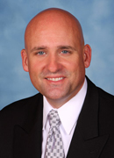

What Mary Poppins Didn’t Know About Umbrellas: Ensure That Your Insurances Will Insure You
Thursday, August 25, 2011
5:30 p.m.
Charles L. Wasson, III, CPCU
Sandy Wasson & Associates Insurance, Inc.
clwasson@wassonandassoc.com
727-392-4400
Alan S. Gassman, J.D., LL.M.
Gassman Law Associates, P.A.
agassman@gassmanpa.com
727-442-1200

Slide 2
Upcoming Webinars
Dentists are Different: The Tax and Business Advisor’s Guide to Representing Dentists in Buy-Sell, Practice Sale, Buy In, Retirement and Planning
Tuesday, August 30, 2011 at 12:30 p.m.
Sponsored by BNA Tax & Accounting
Speakers: Alan Gassman and William Prescott
To register please visit:
http://www.bna.com/dentists-different-tax-w12884903113/
The 15 Minute Guide to the New Florida Power of Attorney Act – Essential Information on Important Changes
Tuesday, August 30, 2011 at 5:30 p.m.
Speaker: Alan Gassman
To register please visit:
https://www2.gotomeeting.com/register/872973338
Riders on the Storm: How To Make Sure Your Insurances Do Not Have Any Catastrophic Exceptions
Monday, September 12, 2011 at 5:30 p.m.
Speakers: Alan Gassman and Chuck Wasson
To register please visit:
https://www2.gotomeeting.com/register/947445370
Special Planning Needs for Doctors Who Are Married To Doctors
Monday, September 19, 2011 at 5:30 p.m.
Speakers: Alan Gassman and Lester Perling
To register please visit:
https://www2.gotomeeting.com/register/739715802
Copyright © 2011

Slide 3

UNDERSTANDING YOUR LIABILITY INSURANCE COVERAGE
The vast majority of carriers will only issue a $250,000 policy on your home, a $250,000 policy on your driving, and a $250,000 policy on your vacation home.
A separate “umbrella carrier” or “carriers” will then issue separate policies for above $250,000, as shown in the example below. Sometimes one carrier will write two or more of the below described policies, but often there will be 3 or more carriers involved and coordination can be a challenge:
$5,000,000 $251,000 | Umbrella Policy #1 Covers claims for home at $300,000 and for cars at $250,000. Must be “drop-down” umbrella if home policy is issued by Citizens or a comparable state agency that does not cover liabilities from pools, pets, or other notable exceptions. |  | Umbrella Policy #2 May need a separate umbrella for out-of-state vacation home, large boats or other items.
$250,000 $0 | Policy #1 – Homeowners | Policy #2 – Car Driver and Owner Policy | Policy #3 – Vacation Home | Policy #4 - Big Boat at Vacation Home
Copyright © 2011 Gassman Law Associates, P.A.

Slide 4
UMBRELLA INSURANCE COVERAGE
Re: UMBRELLA LIABILITY INSURANCE COVERAGE
Dear ________________:
As part of our planning I wanted to reiterate the importance of having an appropriately coordinated and “gap free” liability and casualty insurance program.
I am enclosing a sample letter that some clients use to help assure that they have coverage for common gaps or mistakes made in structuring liability insurance. If you would like assistance in completing this type of letter, please let me know.
The rest of this letter is about umbrella liability insurance coverage. We believe that it is very important to have appropriate limits of liability on automobile and homeowner insurance policies. Typically, the automobile and homeowner policies will be at $500,000 coverage, and then there will be excess coverage under what is called a "personal umbrella policy."
The personal umbrella policy is used in combination with homeowners and auto policies to cover most clients' needs. If it is a true "umbrella" it will provide excess limits above and beyond your primary insurance coverage (such as homeowners, automobile or boat policy), and will also provide coverage for situations excluded or not addressed by underlying coverages. Each individual insurance company will have its own requirement for limits that you must have on your primary policies. You will want to be careful to assure that these policies are coordinated with your umbrella coverage.
Umbrella limits start at $1,000,000 and can go over $10,000,000. Pricing for these policies are based primarily on the number of houses and vehicles to be insured, with each additional $1,000,000 of coverage being less expensive than the preceding. In your situation I would probably have $___________________ of umbrella liability insurance. Also, I would consider placing much of your brokerage account and other assets under a family limited partnership to further insulate you for creditor protection purposes.
Another coverage that is often underutilized by clients is called "uninsured motorist coverage." If you are in an automobile accident caused by someone who does not have enough coverage to pay for your damages, you can pursue your own insurance company to the extent of your "uninsured motorist" coverage. We encourage clients to see what it costs to have $500,000 or more in uninsured motorist coverage to help compensate for catastrophic accidents that can happen.
Some carriers, including citizens and carriers who have assumed policies from citizens do not provide liability coverage for pool and pet or animal related liabilities. In this event the Umbrella liability coverage may or may not apply. This is something that should be discussed with the insurance agency or carrier that provides liability coverage.
If we can provide you with any further information or with assistance concerning your insurances, please let us know.
Very truly yours,
Alan S. Gassman
Copyright © 2011 Gassman Law Associates, P.A.

Slide 5
Dear Liability Insurance Agency and/or Carrier:
I recently met with my estate planning lawyer and wanted to make sure of the following:
1. Please confirm that we have Personal Liability Umbrella insurance covering our automobiles, boats, recreational vehicles, and all properties owned. I would like quotes on the following coverage limits, $1,000,000, $3,000,000 and $5,000,000, with and without Uninsured Motorist coverage.
2. Please confirm that we are covered for animal liability under our primary homeowners insurance and confirm that the Liability Umbrella would also extend to animal liability. We have been told that the primary homeowners may exclude animal liability and that some Liability Umbrella policies will not provide coverage when the primary homeowners insurance excludes same.
3. Please confirm that we are covered for pool related accidents occurring on our property and also confirm that the Personal Liability Umbrella policy will also extend coverage to pool related accidents.
4. Can you please confirm that we are covered for cars being driven by _____________________.
5. Can you please confirm that we are covered for the investment property that we own at ______________________________. It is titled under the name of ______________________________?
6. Can you please confirm that we are covered for our ______________________________ boat, which is ______ foot long and is normally stored at ______________________________. The horsepower is ______________.
Are we also covered for trailering the boat with our trailer?
Also, can you please confirm that we are covered for our waverunner/jet ski which is a _________________ with horsepower of _________________. It is stored at ________________________.
7. You do not handle the coverage for our vacation ______________________________ in ______________________________ or our vacation ____________________________ in ______________________________. Is our potential liability relating to the use of these properties covered under our umbrella, or do we have to obtain a separate umbrella for these properties?
Our ______________________________ and _____________________________ are stored and used up in our ______________________________ ______________________________.
8. ______________________________ drives the car owned by ______________________________ both for personal purposes and with respect to the ______________________________ business. We assume our coverage includes business driving both by ______________________________ and by ______________________________ who occasionally drive the car for the business.
9. Can you please confirm that we are covered for our motorcycle being driven by ___________.
10. Is there anything not mentioned above that comes to mind that we should be aware of?
Please send our lawyer, Alan S. Gassman, a copy of your response to this letter, which has been generated as a part of our estate planning. Alan's email address is AGassman@gassmanpa.com and his street address is 1245 Court Street, Suite 102, Clearwater, Florida 33746. His fax number is (727) 443-5829. Please send us a copy of your response as well.
If you have any further suggestions with respect to our coverages please let us know.
Thank you very much for your assistance herewith.
Best personal regards,
Copyright © 2011 Gassman Law Associates, P.A.

Slide 6
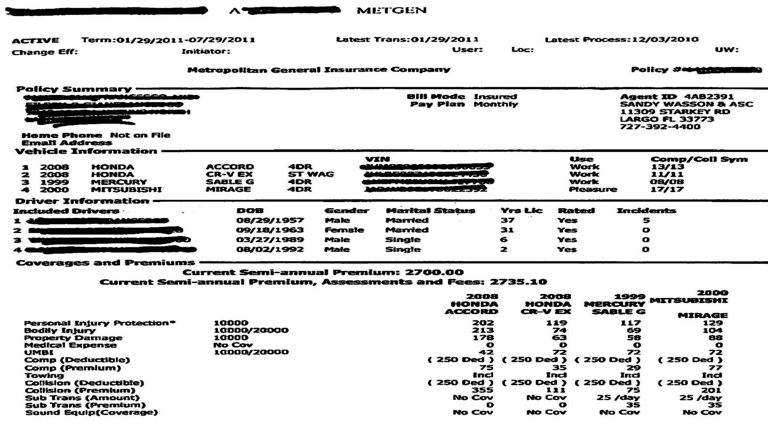
Metropolitan Auto Insurance Declaration Page
Notes:
This is a prime example of an auto insurance policy with extremely low coverage considering there are 2 young men on the policy.
Statistically, young men tend to be involved in more auto accidents than others. By including their children on the policy, this family is more of a liability to the insurance carrier and their insurance premiums will most likely reflect that.
Copyright © 2011 Gassman Law Associates, P.A.
Notes:
This is a prime example of an auto insurance policy with extremely low coverage considering there are 2 young men on the policy.
Statistically, young men tend to be involved in more auto accidents than others. By including their children on the policy, this family is more of a liability to the insurance carrier and their insurance premiums will most likely reflect that.

Slide 7
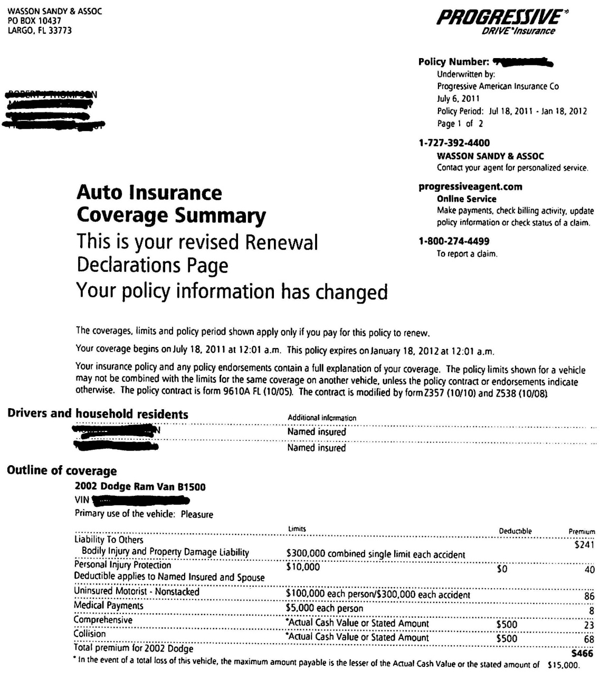
Progressive Auto Insurance Declaration Page
Notes:
It is important to pay attention to the limitations of your policy. This policy shows a $5,000 limit for medical payments for each person. The actual cost of medical care after an auto accident could very easily exceed this limitation.
There are many features that you can add-on to your auto insurance policy that can help keep you better protected in the event of an accident.
Copyright © 2011 Gassman Law Associates, P.A.
Notes:
It is important to pay attention to the limitations of your policy. This policy shows a $5,000 limit for medical payments for each person. The actual cost of medical care after an auto accident could very easily exceed this limitation.
There are many features that you can add-on to your auto insurance policy that can help keep you better protected in the event of an accident.

Slide 8
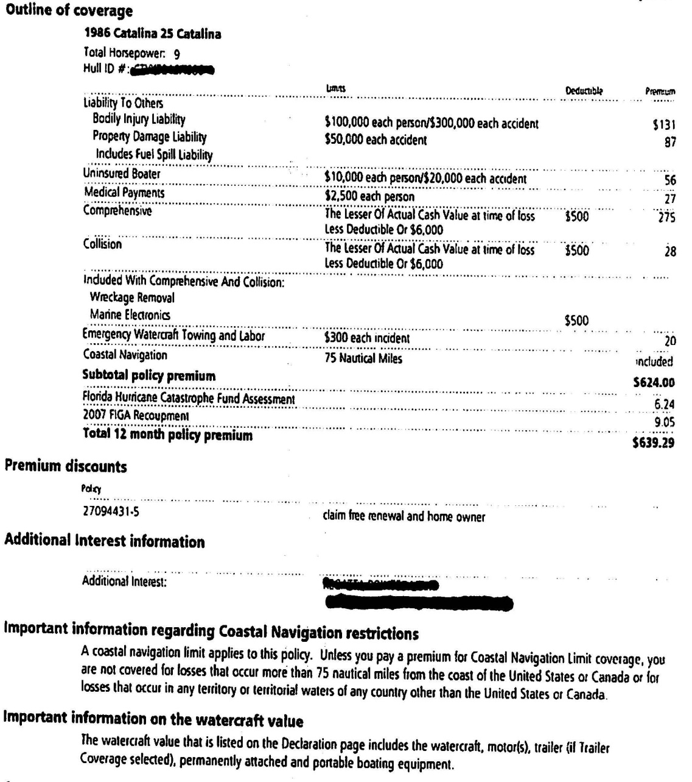
Progressive Boat Insurance Declaration Page
Notes:
An accident can happen just as suddenly on water than on a road. It is very important to make sure that your boat owner’s insurance would be ample to cover enough of the damages that would incur should you ever be in an accident.
Copyright © 2011 Gassman Law Associates, P.A.
Notes:
An accident can happen just as suddenly on water than on a road. It is very important to make sure that your boat owner’s insurance would be ample to cover enough of the damages that would incur should you ever be in an accident.

Slide 9
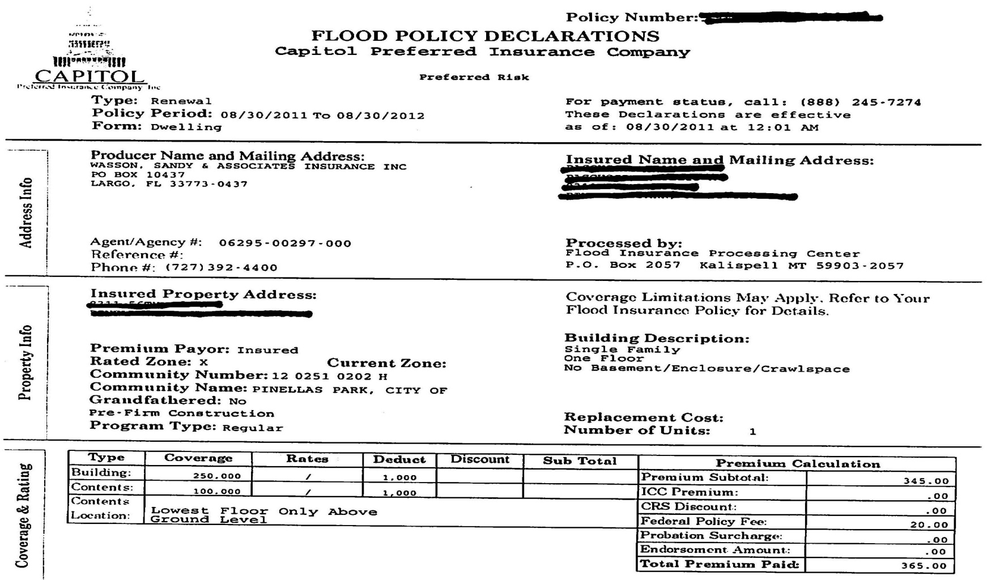
Capitol Flood Insurance Declaration Page
Notes:
With all the thunderstorms and hurricanes, especially during the summer months, Florida is a state where flood insurance is a necessity.
Notice how this policy only carries coverage for the building itself and the possessions inside. There is no liability coverage with this policy.
Copyright © 2011 Gassman Law Associates, P.A.
Notes:
With all the thunderstorms and hurricanes, especially during the summer months, Florida is a state where flood insurance is a necessity.
Notice how this policy only carries coverage for the building itself and the possessions inside. There is no liability coverage with this policy.

Slide 10
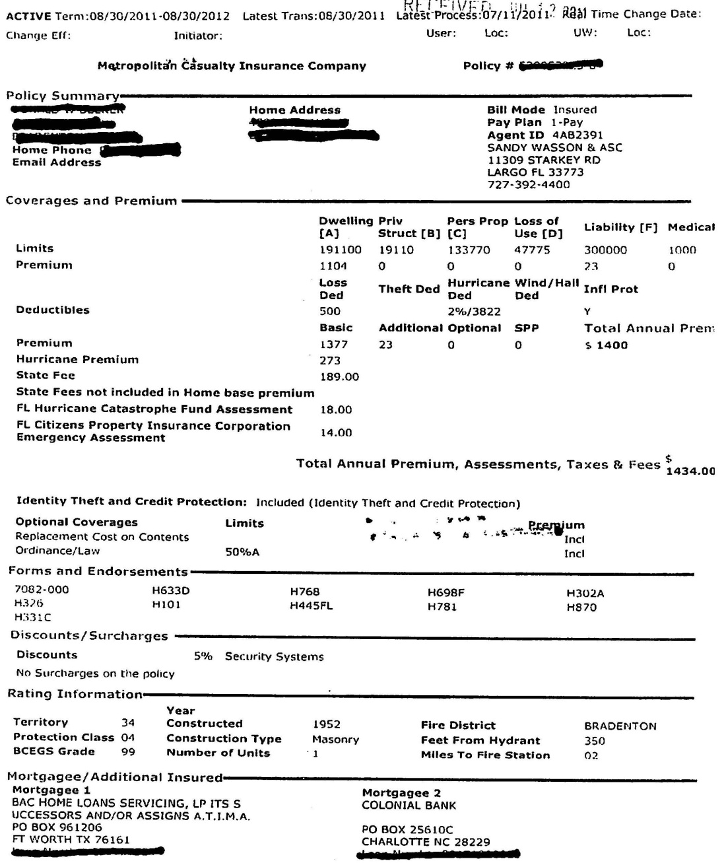
Metropolitan Homeowners Insurance Declaration Page
Notes:
This Declaration Page combines your need-to-know information.
This policy has a $300,000 liability limit. In the event where this insurance would need to be used, that $300,000 would be used up very quickly.
Copyright © 2011 Gassman Law Associates, P.A.

Slide 11
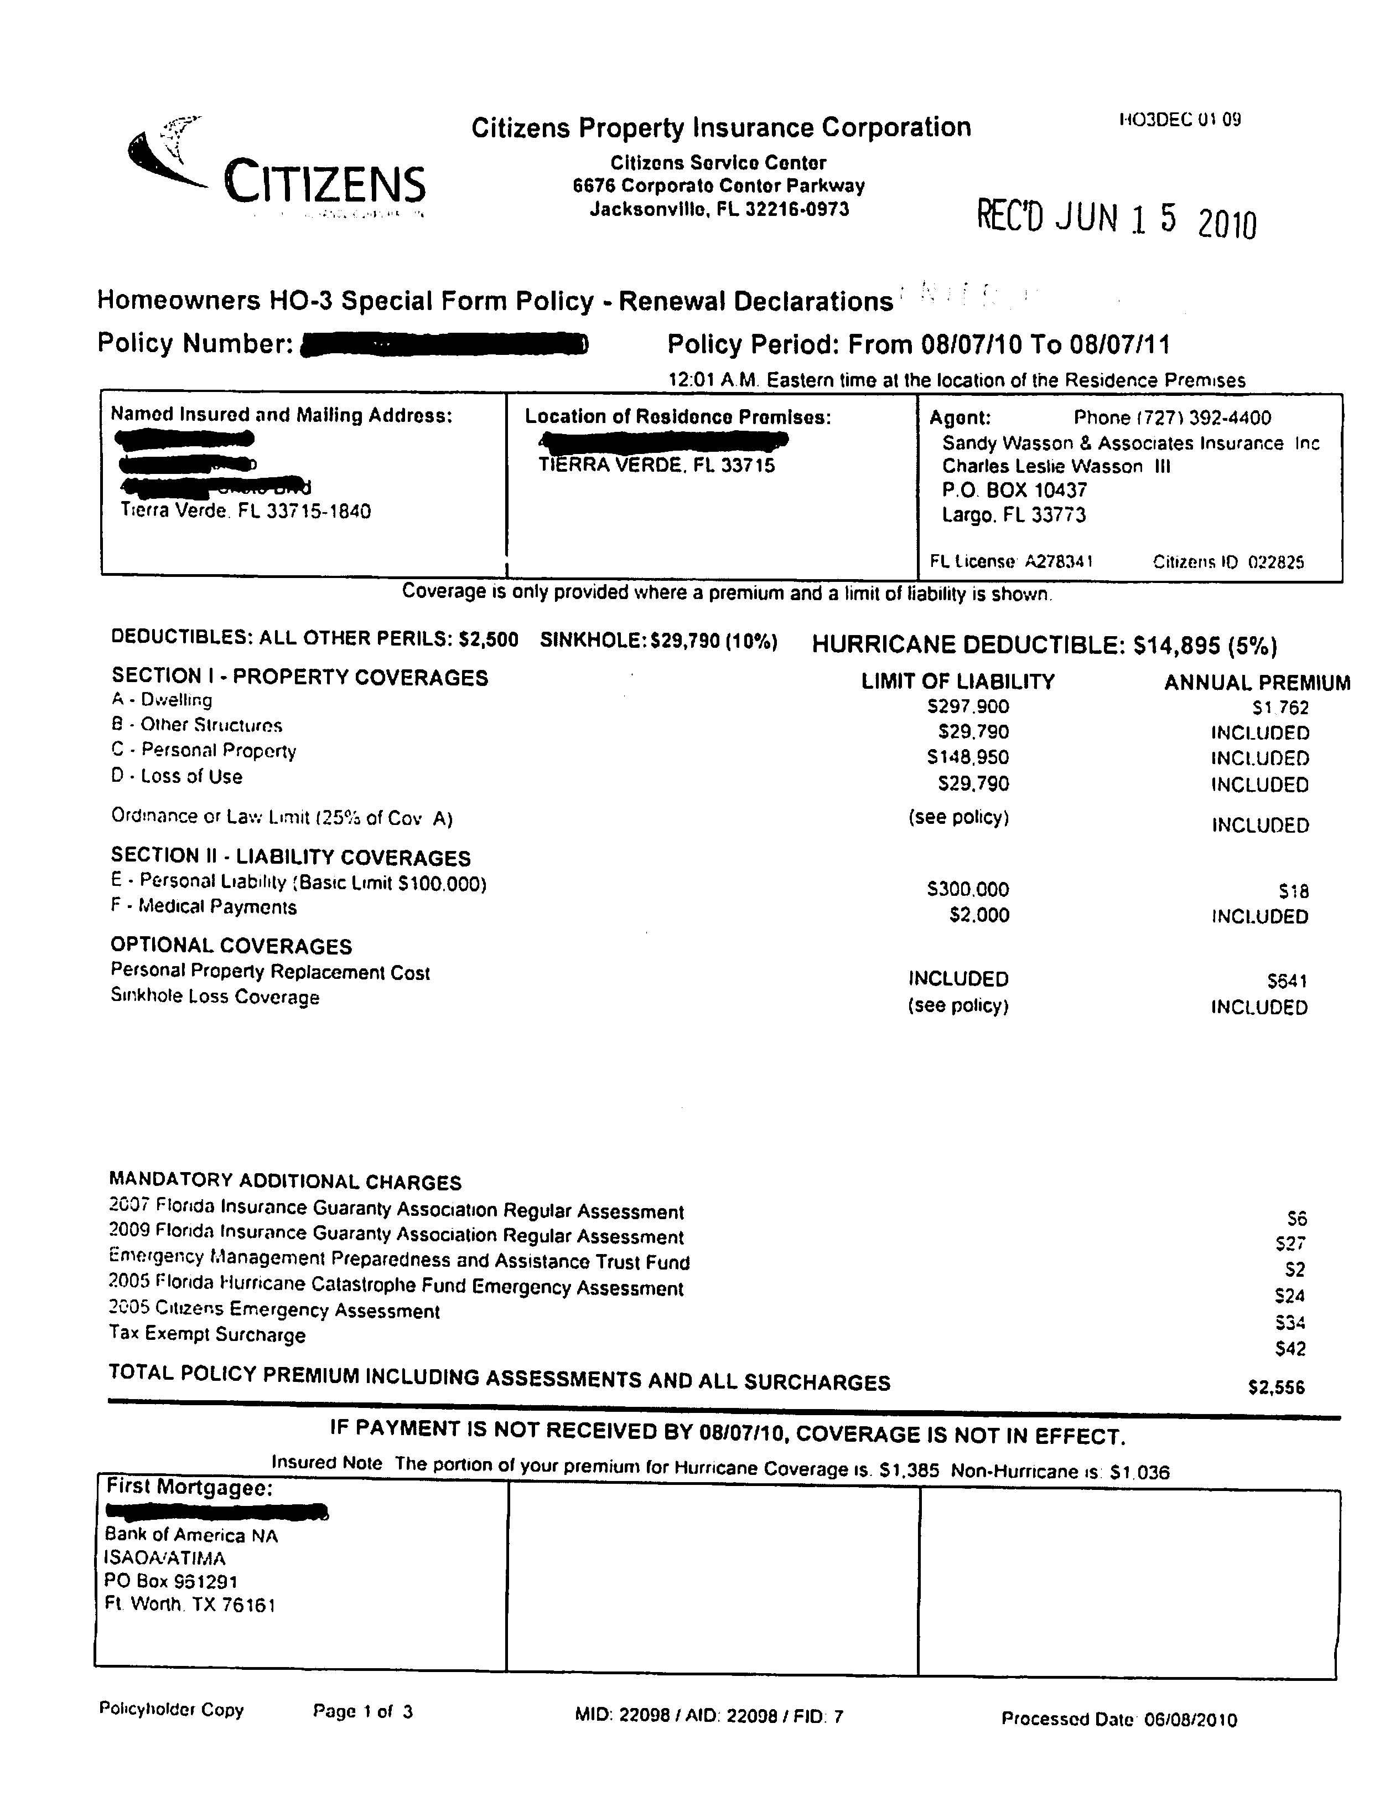
Citizens Homeowners Insurance Declaration Page
Notes:
Your coverage can be multifaceted. This is a sample of a policy that covers various types of properties and liabilities.
The premium breakdown is very important to review. You can use this as a guideline if you are trying to cut costs or looking for areas to add more coverage in.
Copyright © 2011 Gassman Law Associates, P.A.

Slide 12
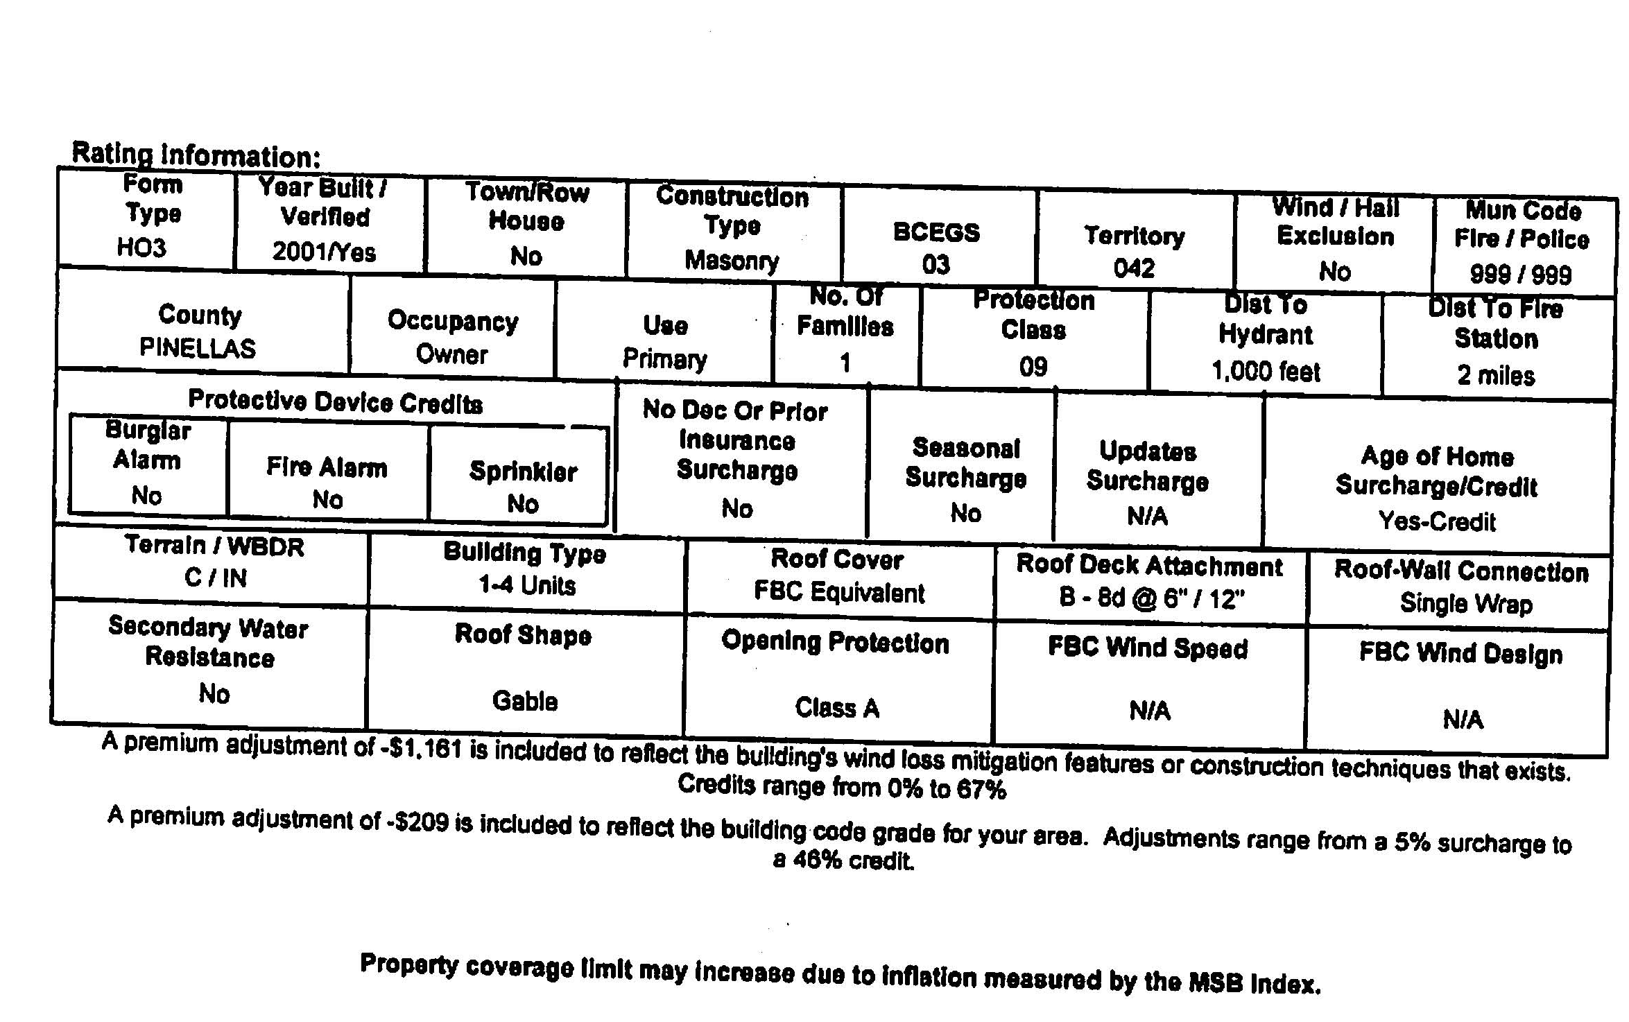
Citizens Homeowners Insurance Rating Information
Notes:
Pay attention to the way that your home is classified.
Upgrading your home security is a great way to better protect your family and also lower your insurance costs. This example shows that this home does not have any of the available “protective device credits” that could help discount policy costs.
Copyright © 2011 Gassman Law Associates, P.A.

Slide 13
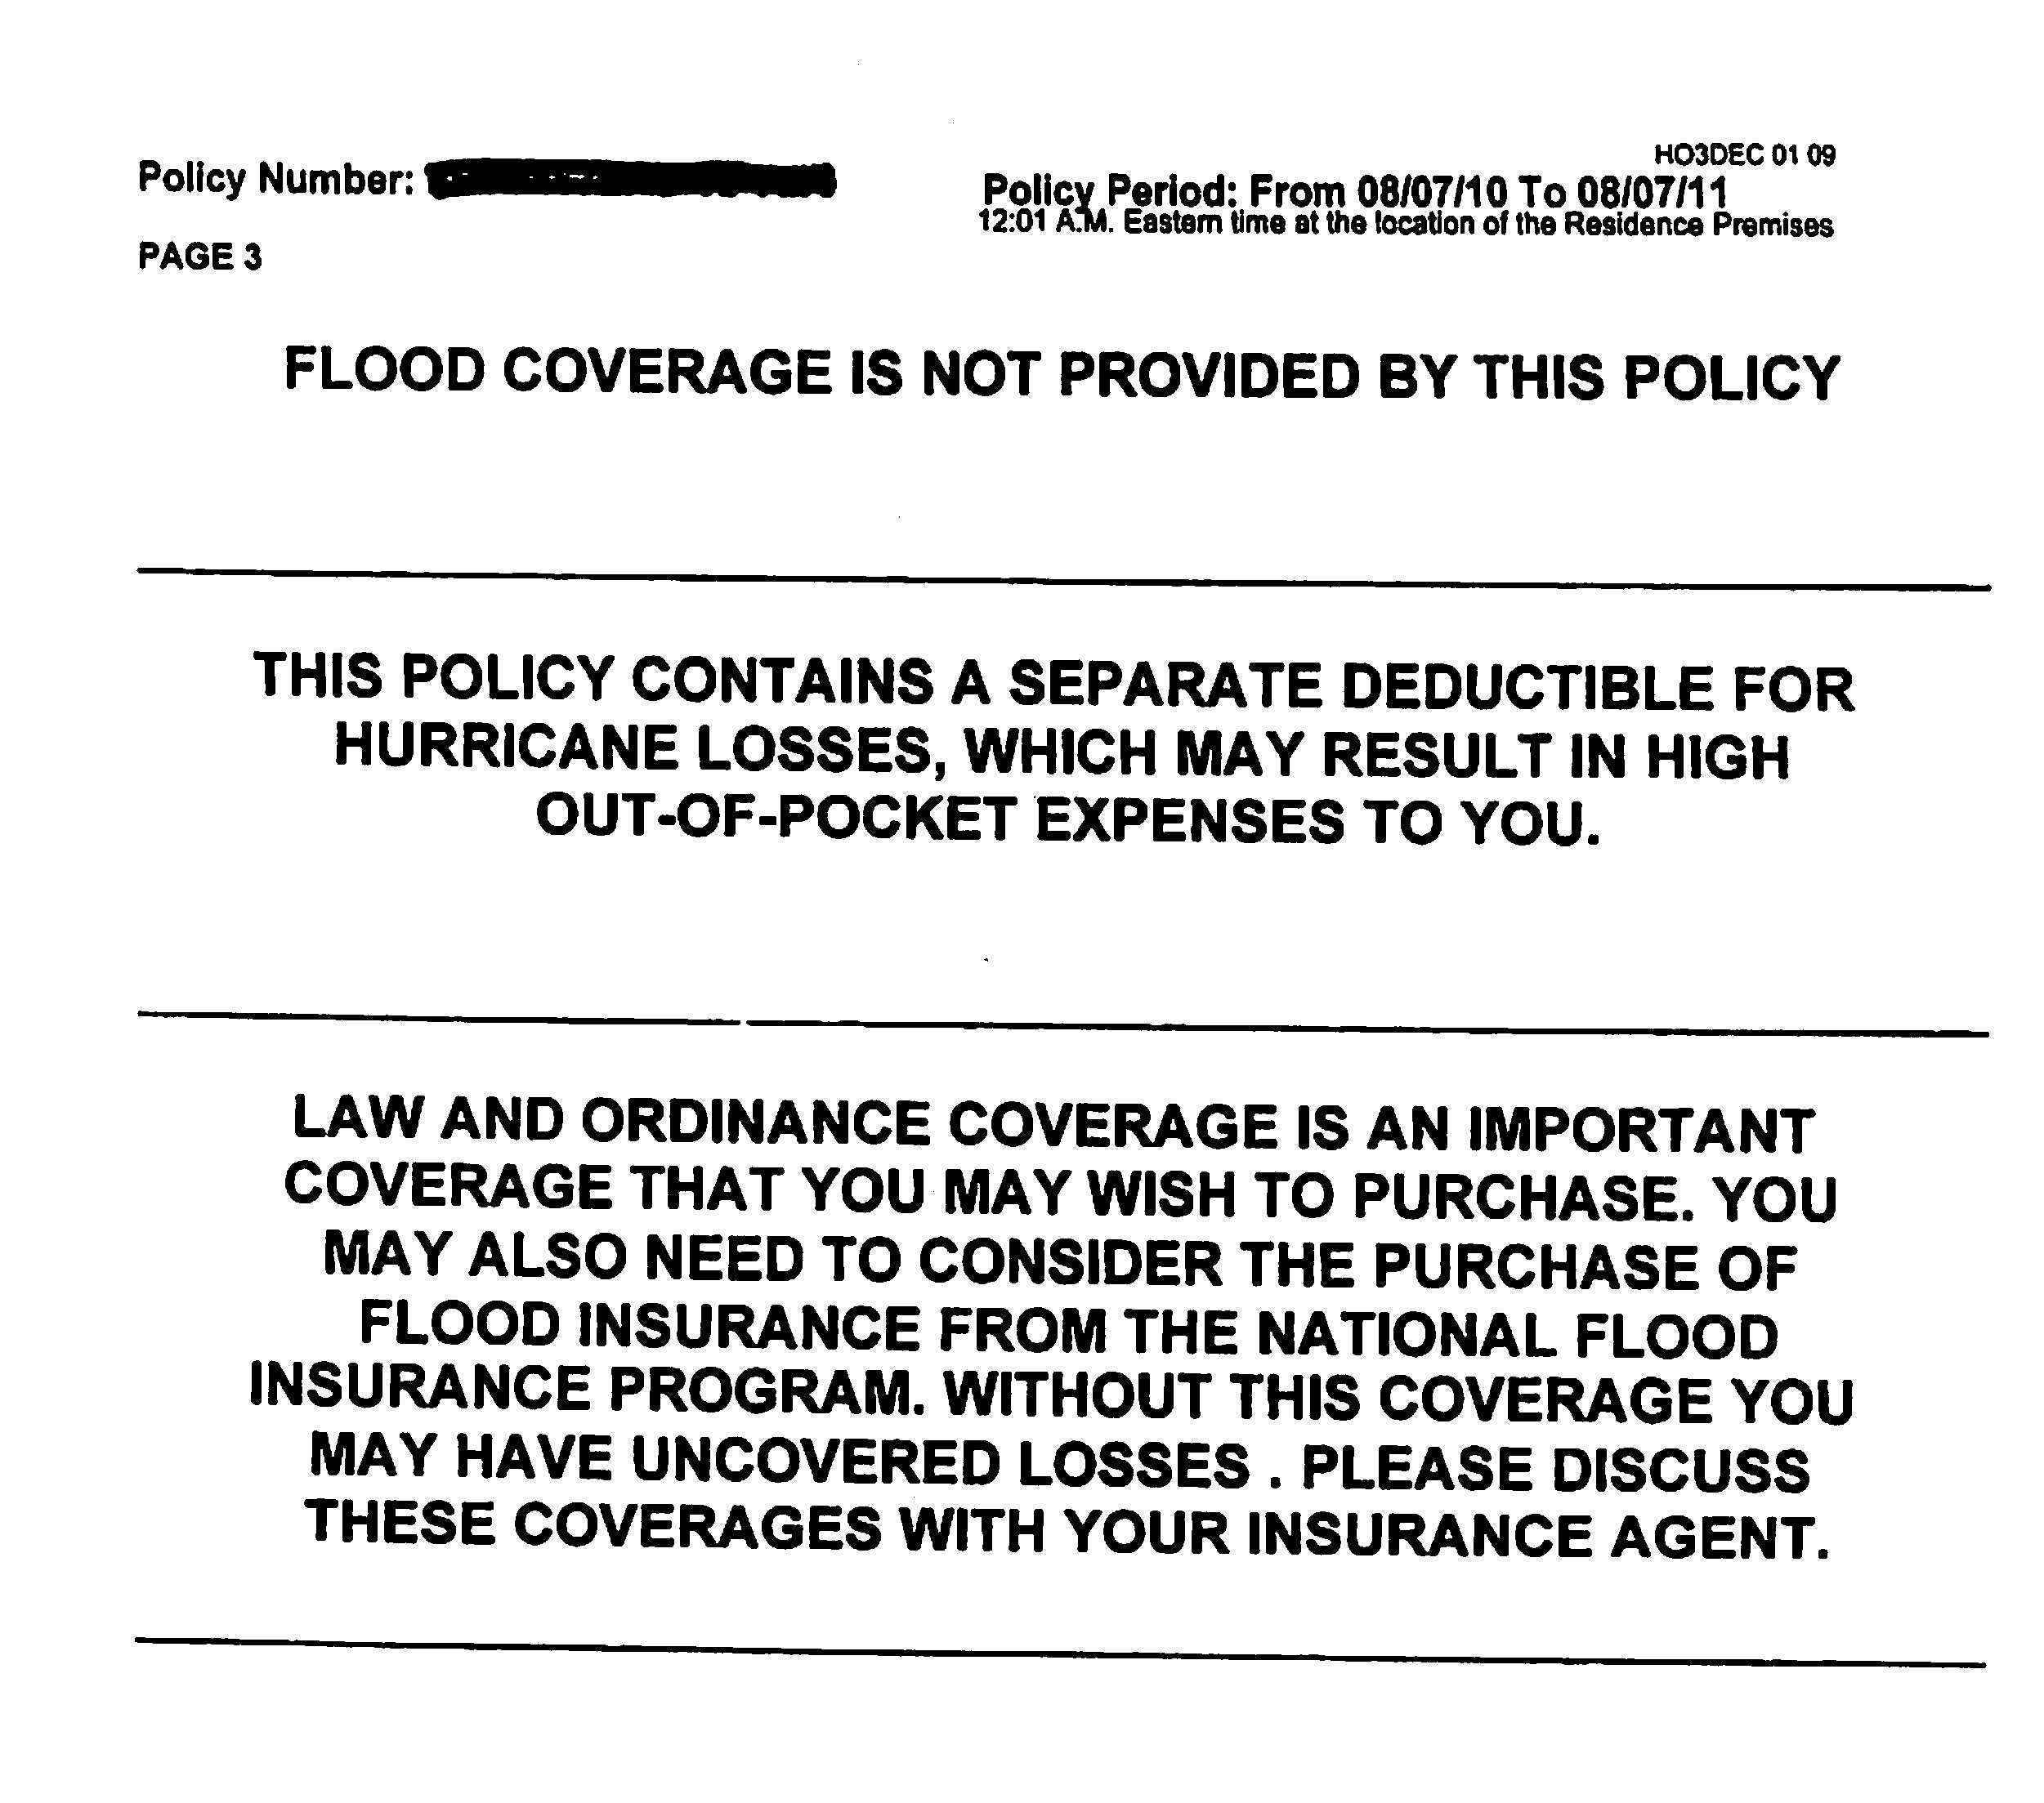
Citizens Homeowners Insurance Disclaimer
Notes:
Having a home in Florida puts you at a higher risk of hurricane damages. This sample shows that an additional hurricane loss deductible can be added to this policy for an additional premium.
Flood coverage is typically not covered under homeowners insurance.
Copyright © 2011 Gassman Law Associates, P.A.

Slide 14
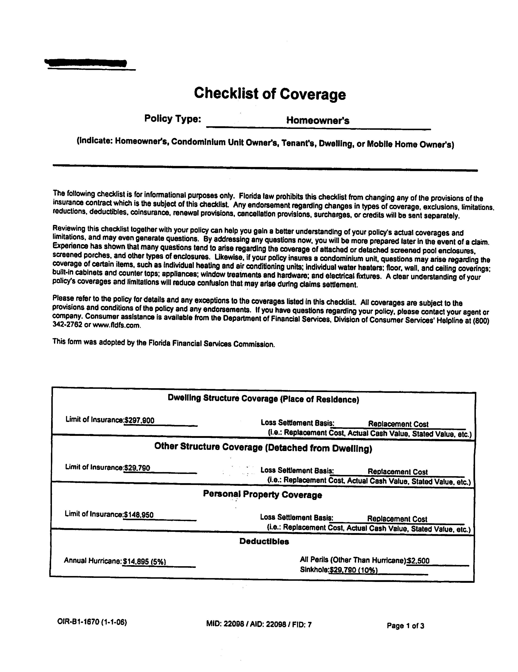
Citizens Homeowners Insurance Checklist of Coverage
Notes:
Always read through the information pertaining to the classification of your home. Being thorough throughout this process will ensure that you are receiving the exact coverage that you are eligible for.
Copyright © 2011 Gassman Law Associates, P.A.

Slide 15
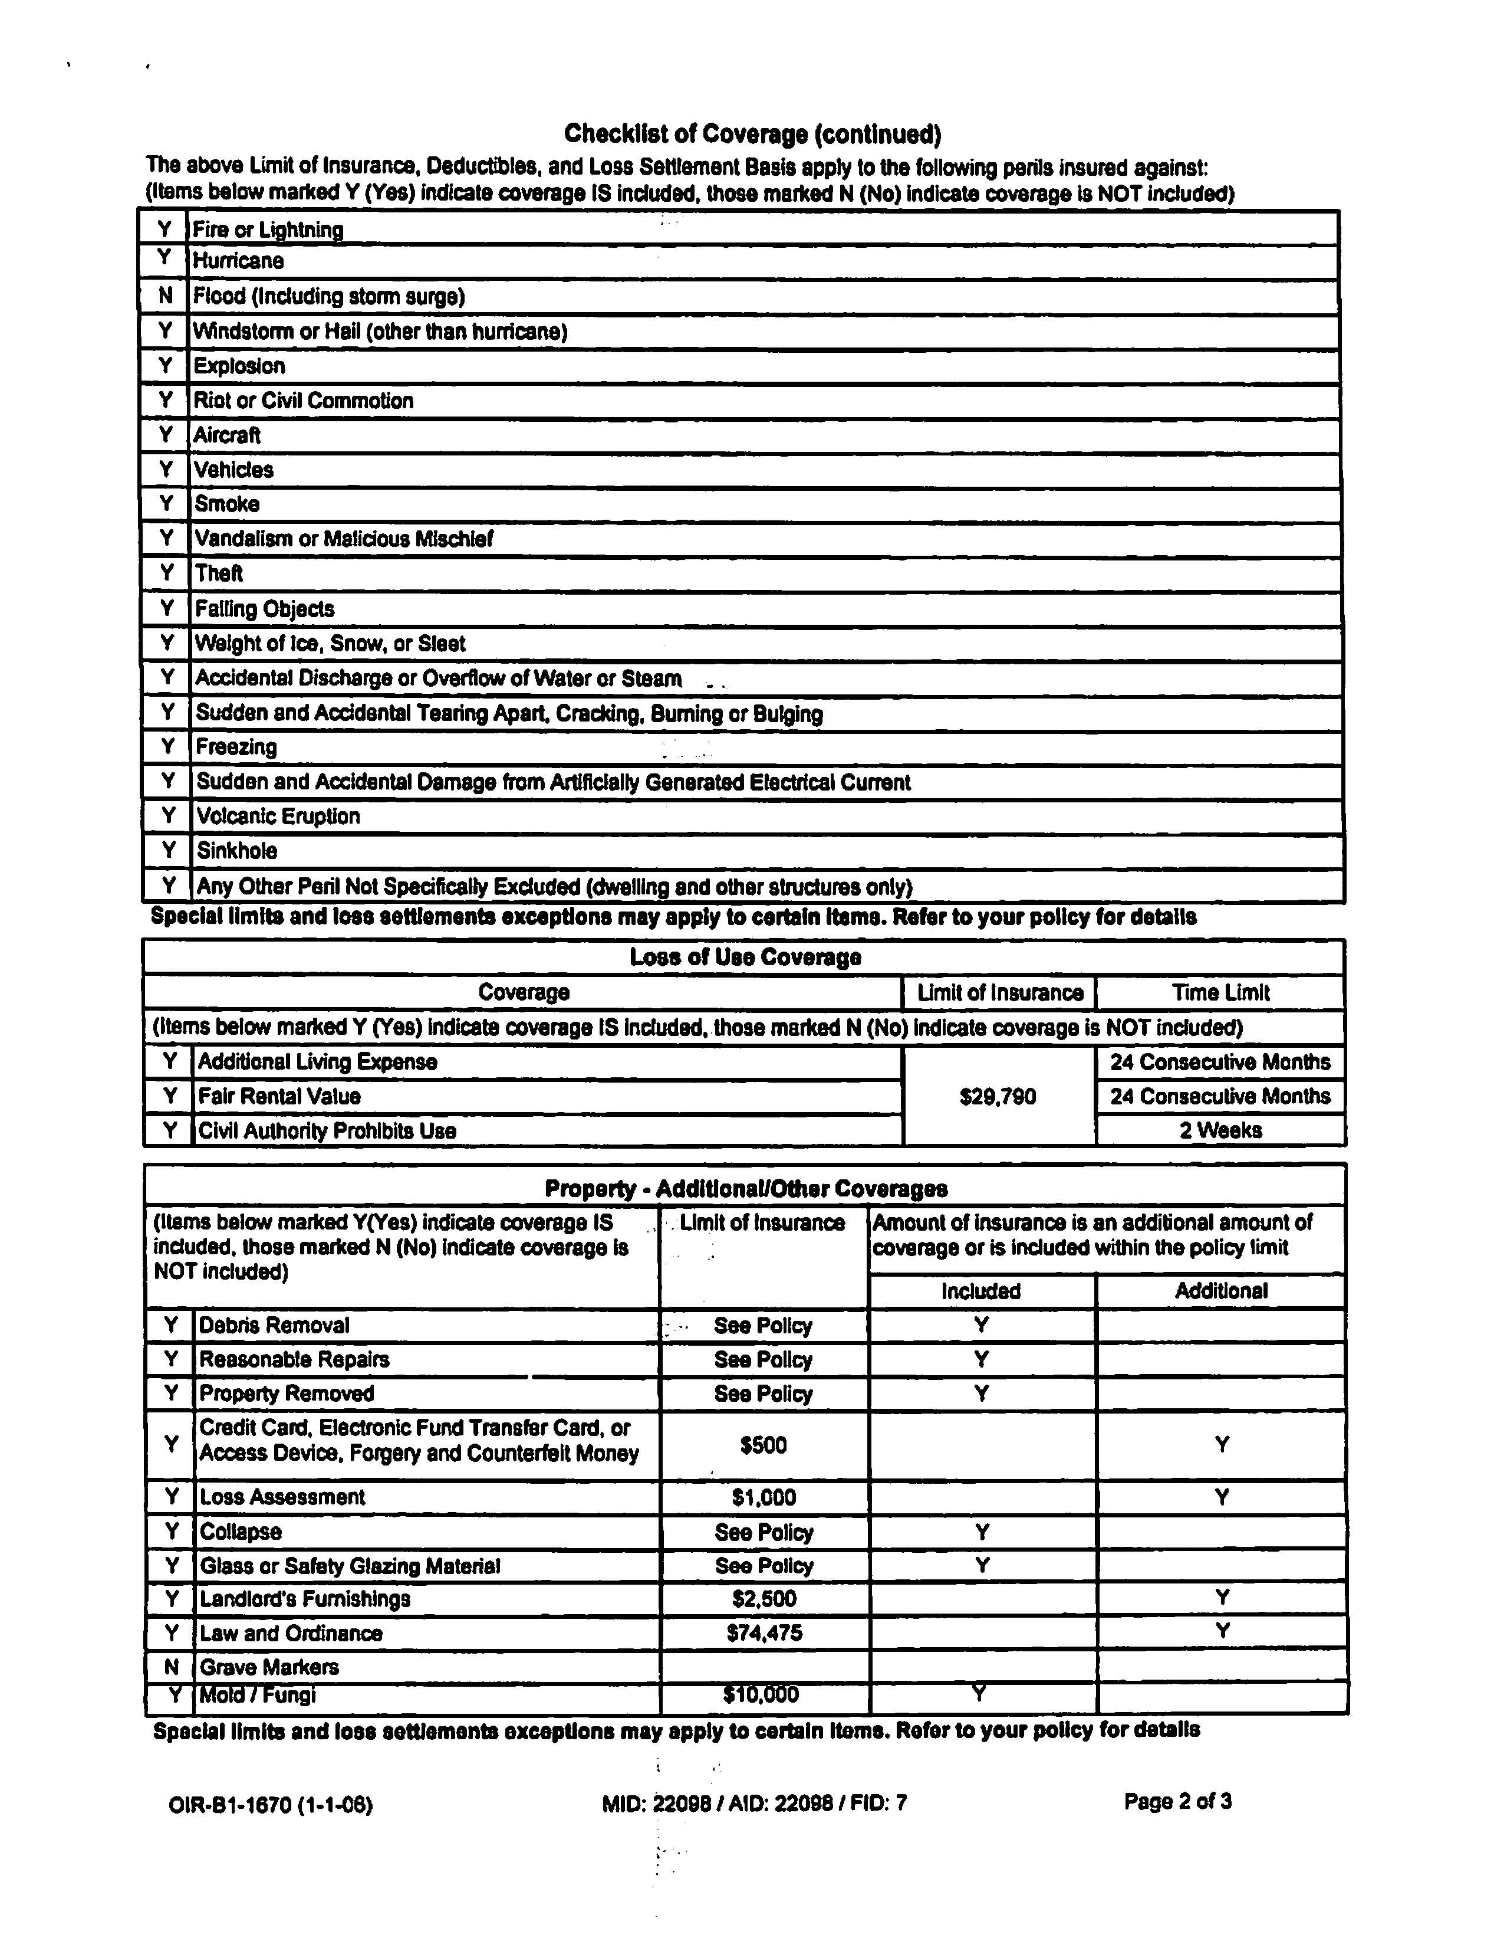
Citizens Homeowners Insurance Checklist of Coverage cont’d…
Notes:
This type of coverage checklist is a great way to evaluate the coverage that your home has.
Copyright © 2011 Gassman Law Associates, P.A.

Slide 16
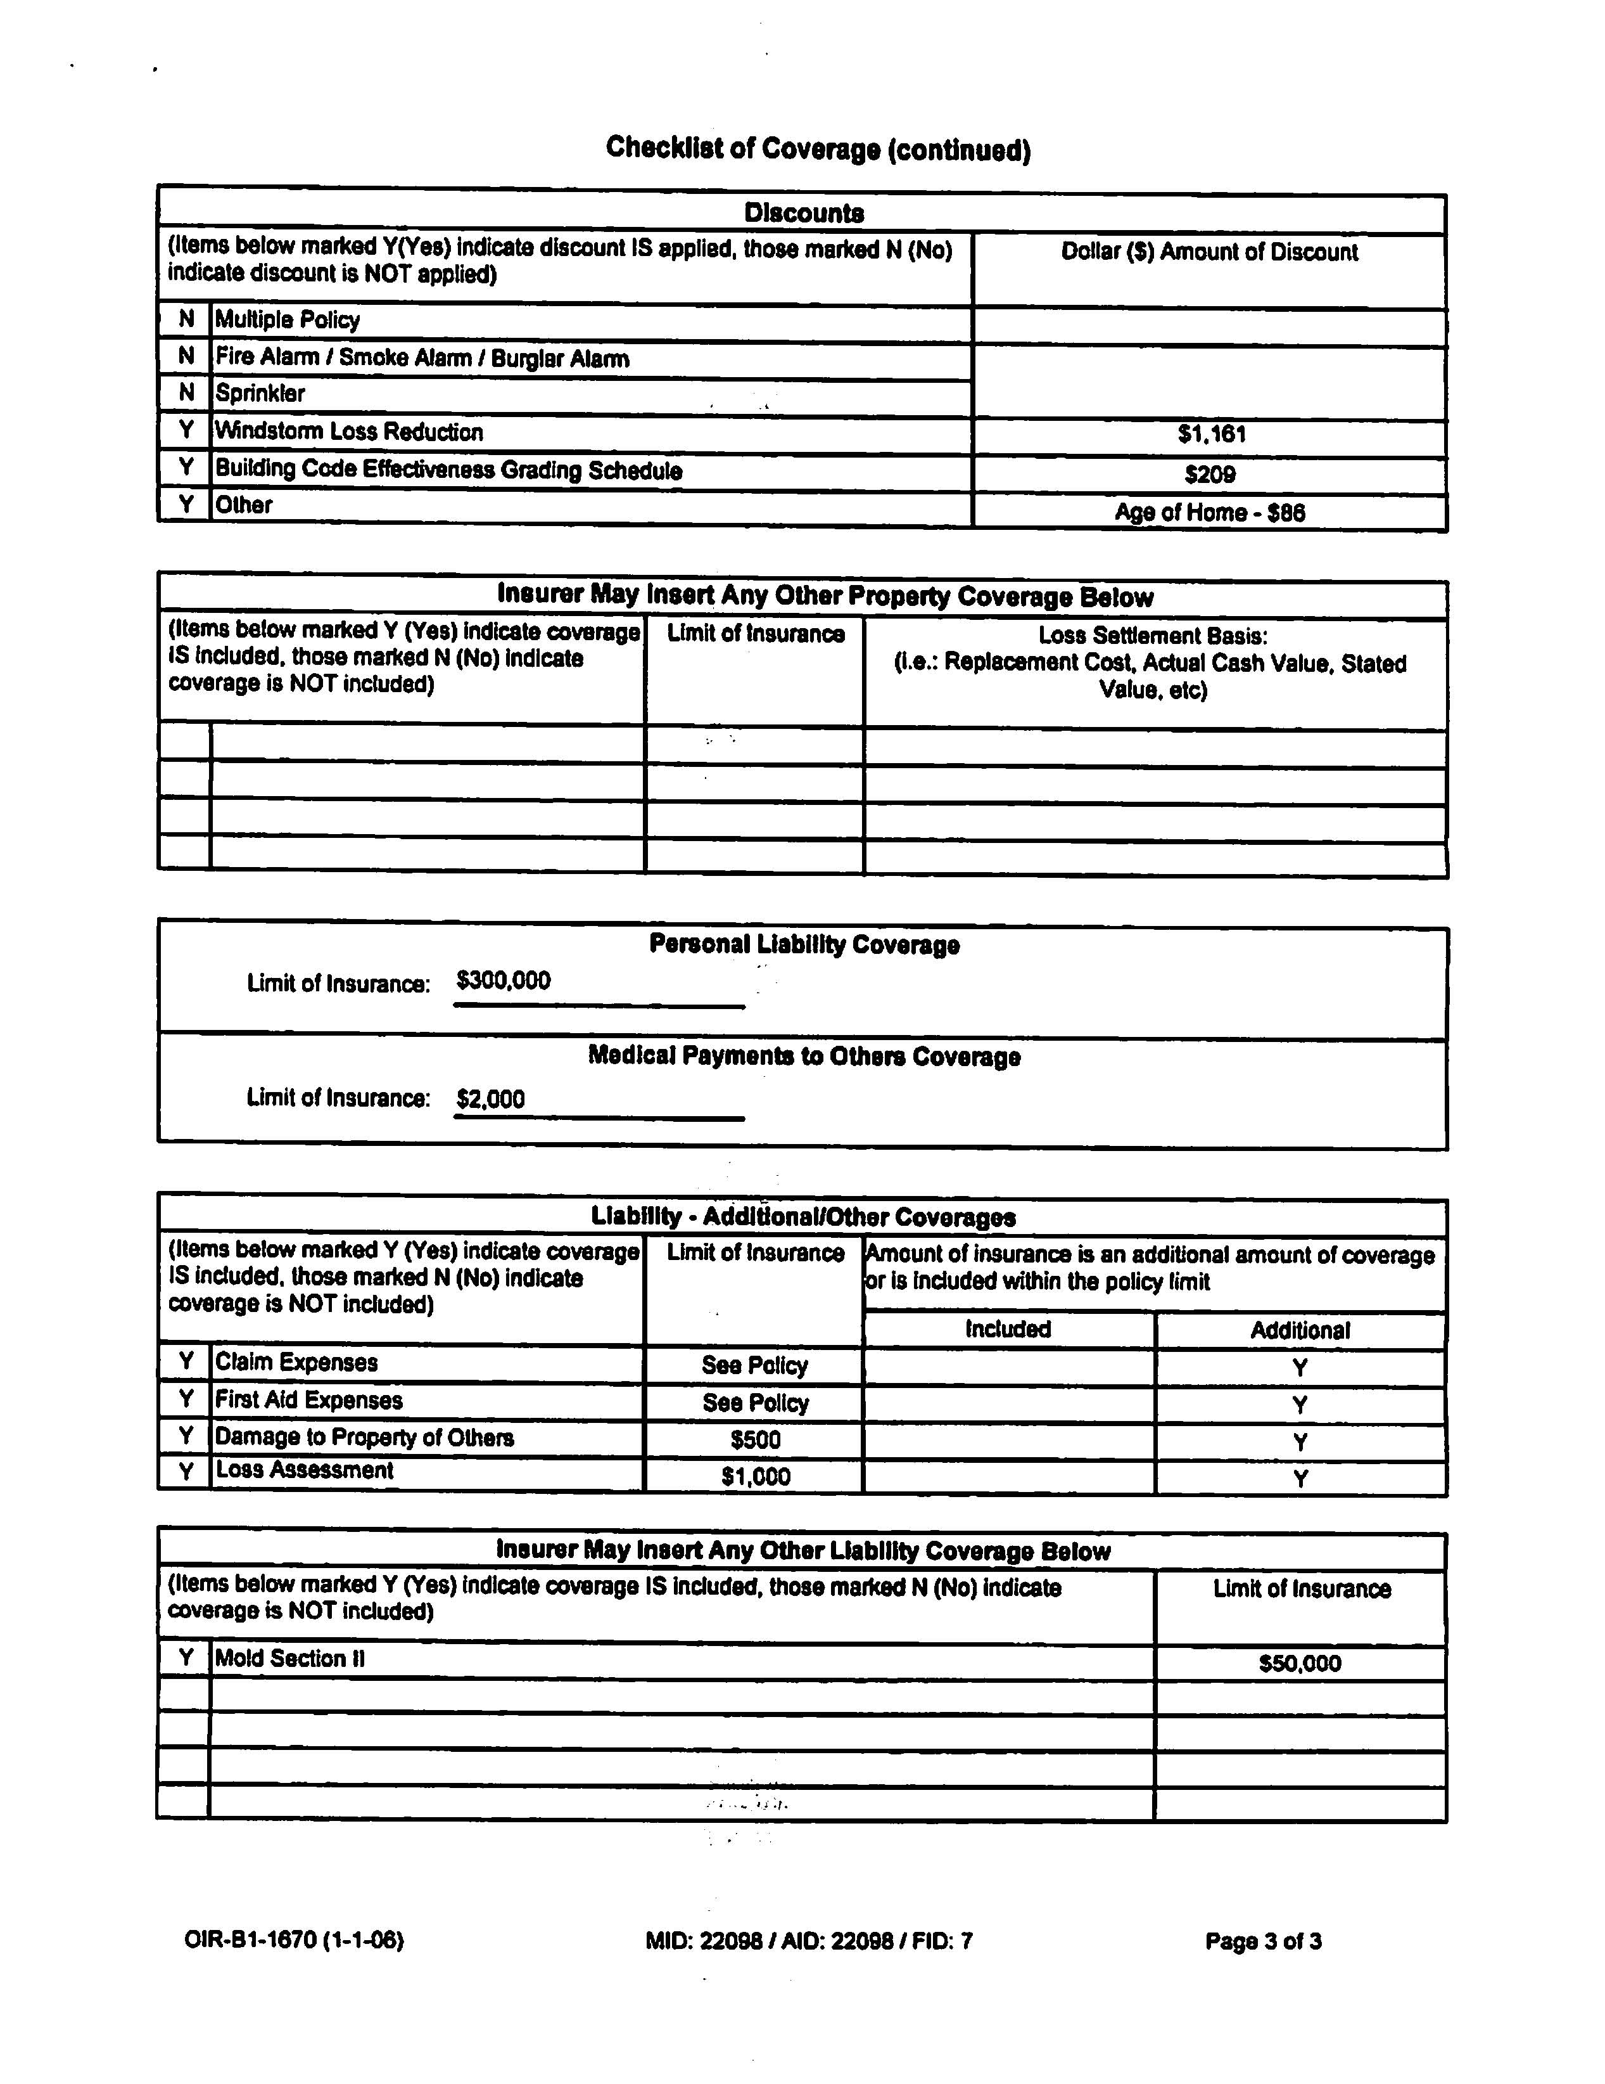
Citizens Homeowners Insurance Checklist of Coverage cont’d…
Notes:
In this example, you can see the types of discounts available to the insured.
Some companies will offer a discount if you hold more than one type of insurance policy with them. If your homeowners insurance company also offers auto or liability insurance, you should inquire about the possibility of multiple policy discounts.
Copyright © 2011 Gassman Law Associates, P.A.

Slide 17
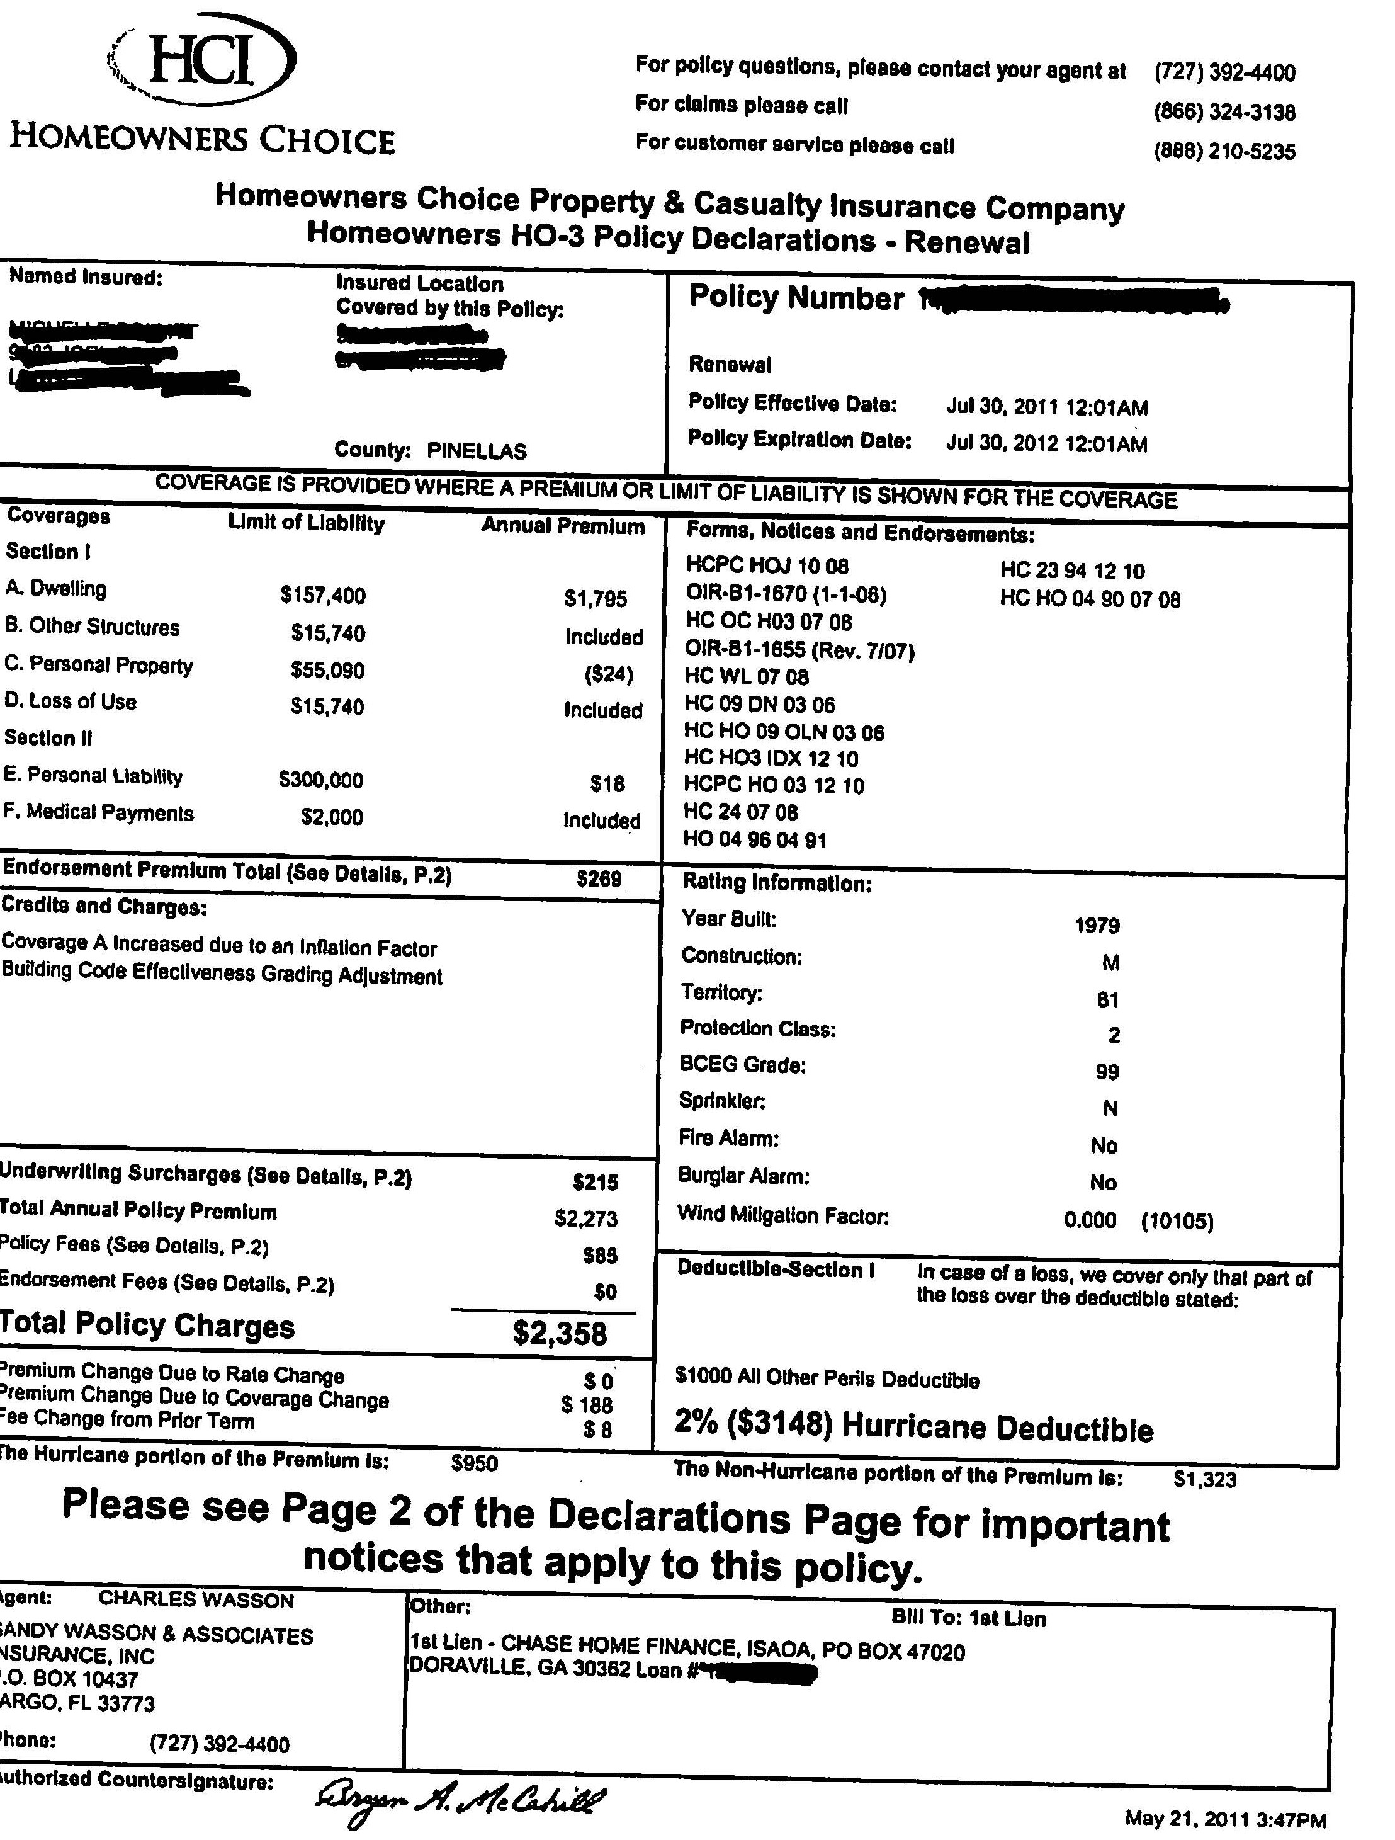
Homeowners Choice Insurance Declaration Page
Notes:
Always read through the information pertaining to the classification of your home. Being thorough throughout this process will ensure that you are receiving the exact coverage that you are eligible for.
Copyright © 2011 Gassman Law Associates, P.A.

Slide 18
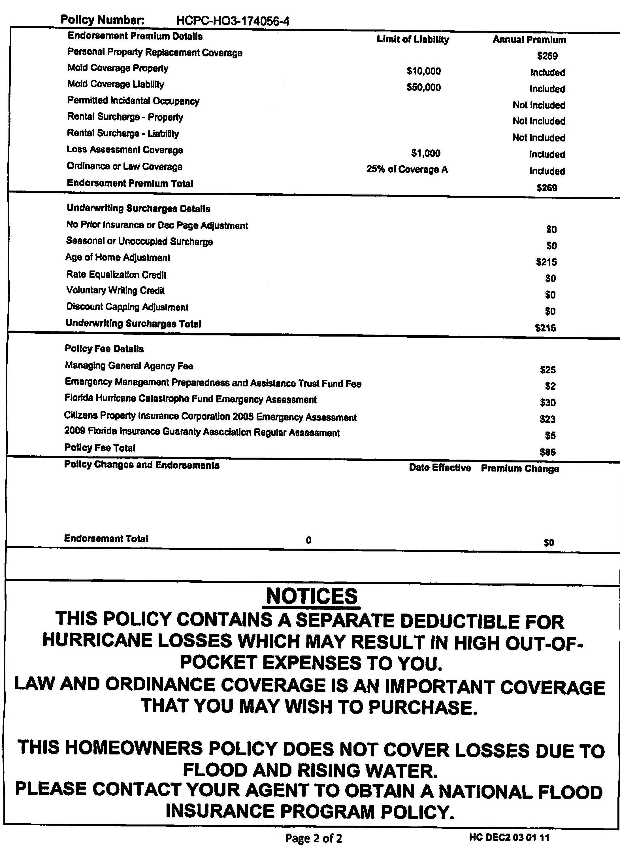
Homeowners Choice Insurance Breakdown of Premium
Notes:
It is always a good idea to know exactly where your money is going. This sample shows what portion of your premium payments goes to surcharges and fees.
This sample also indicates that hurricane loss coverage can be obtained for an additional premium.
Flood and rising water coverage must be purchased as a separate insurance policy.
Copyright © 2011 Gassman Law Associates, P.A.

Slide 19
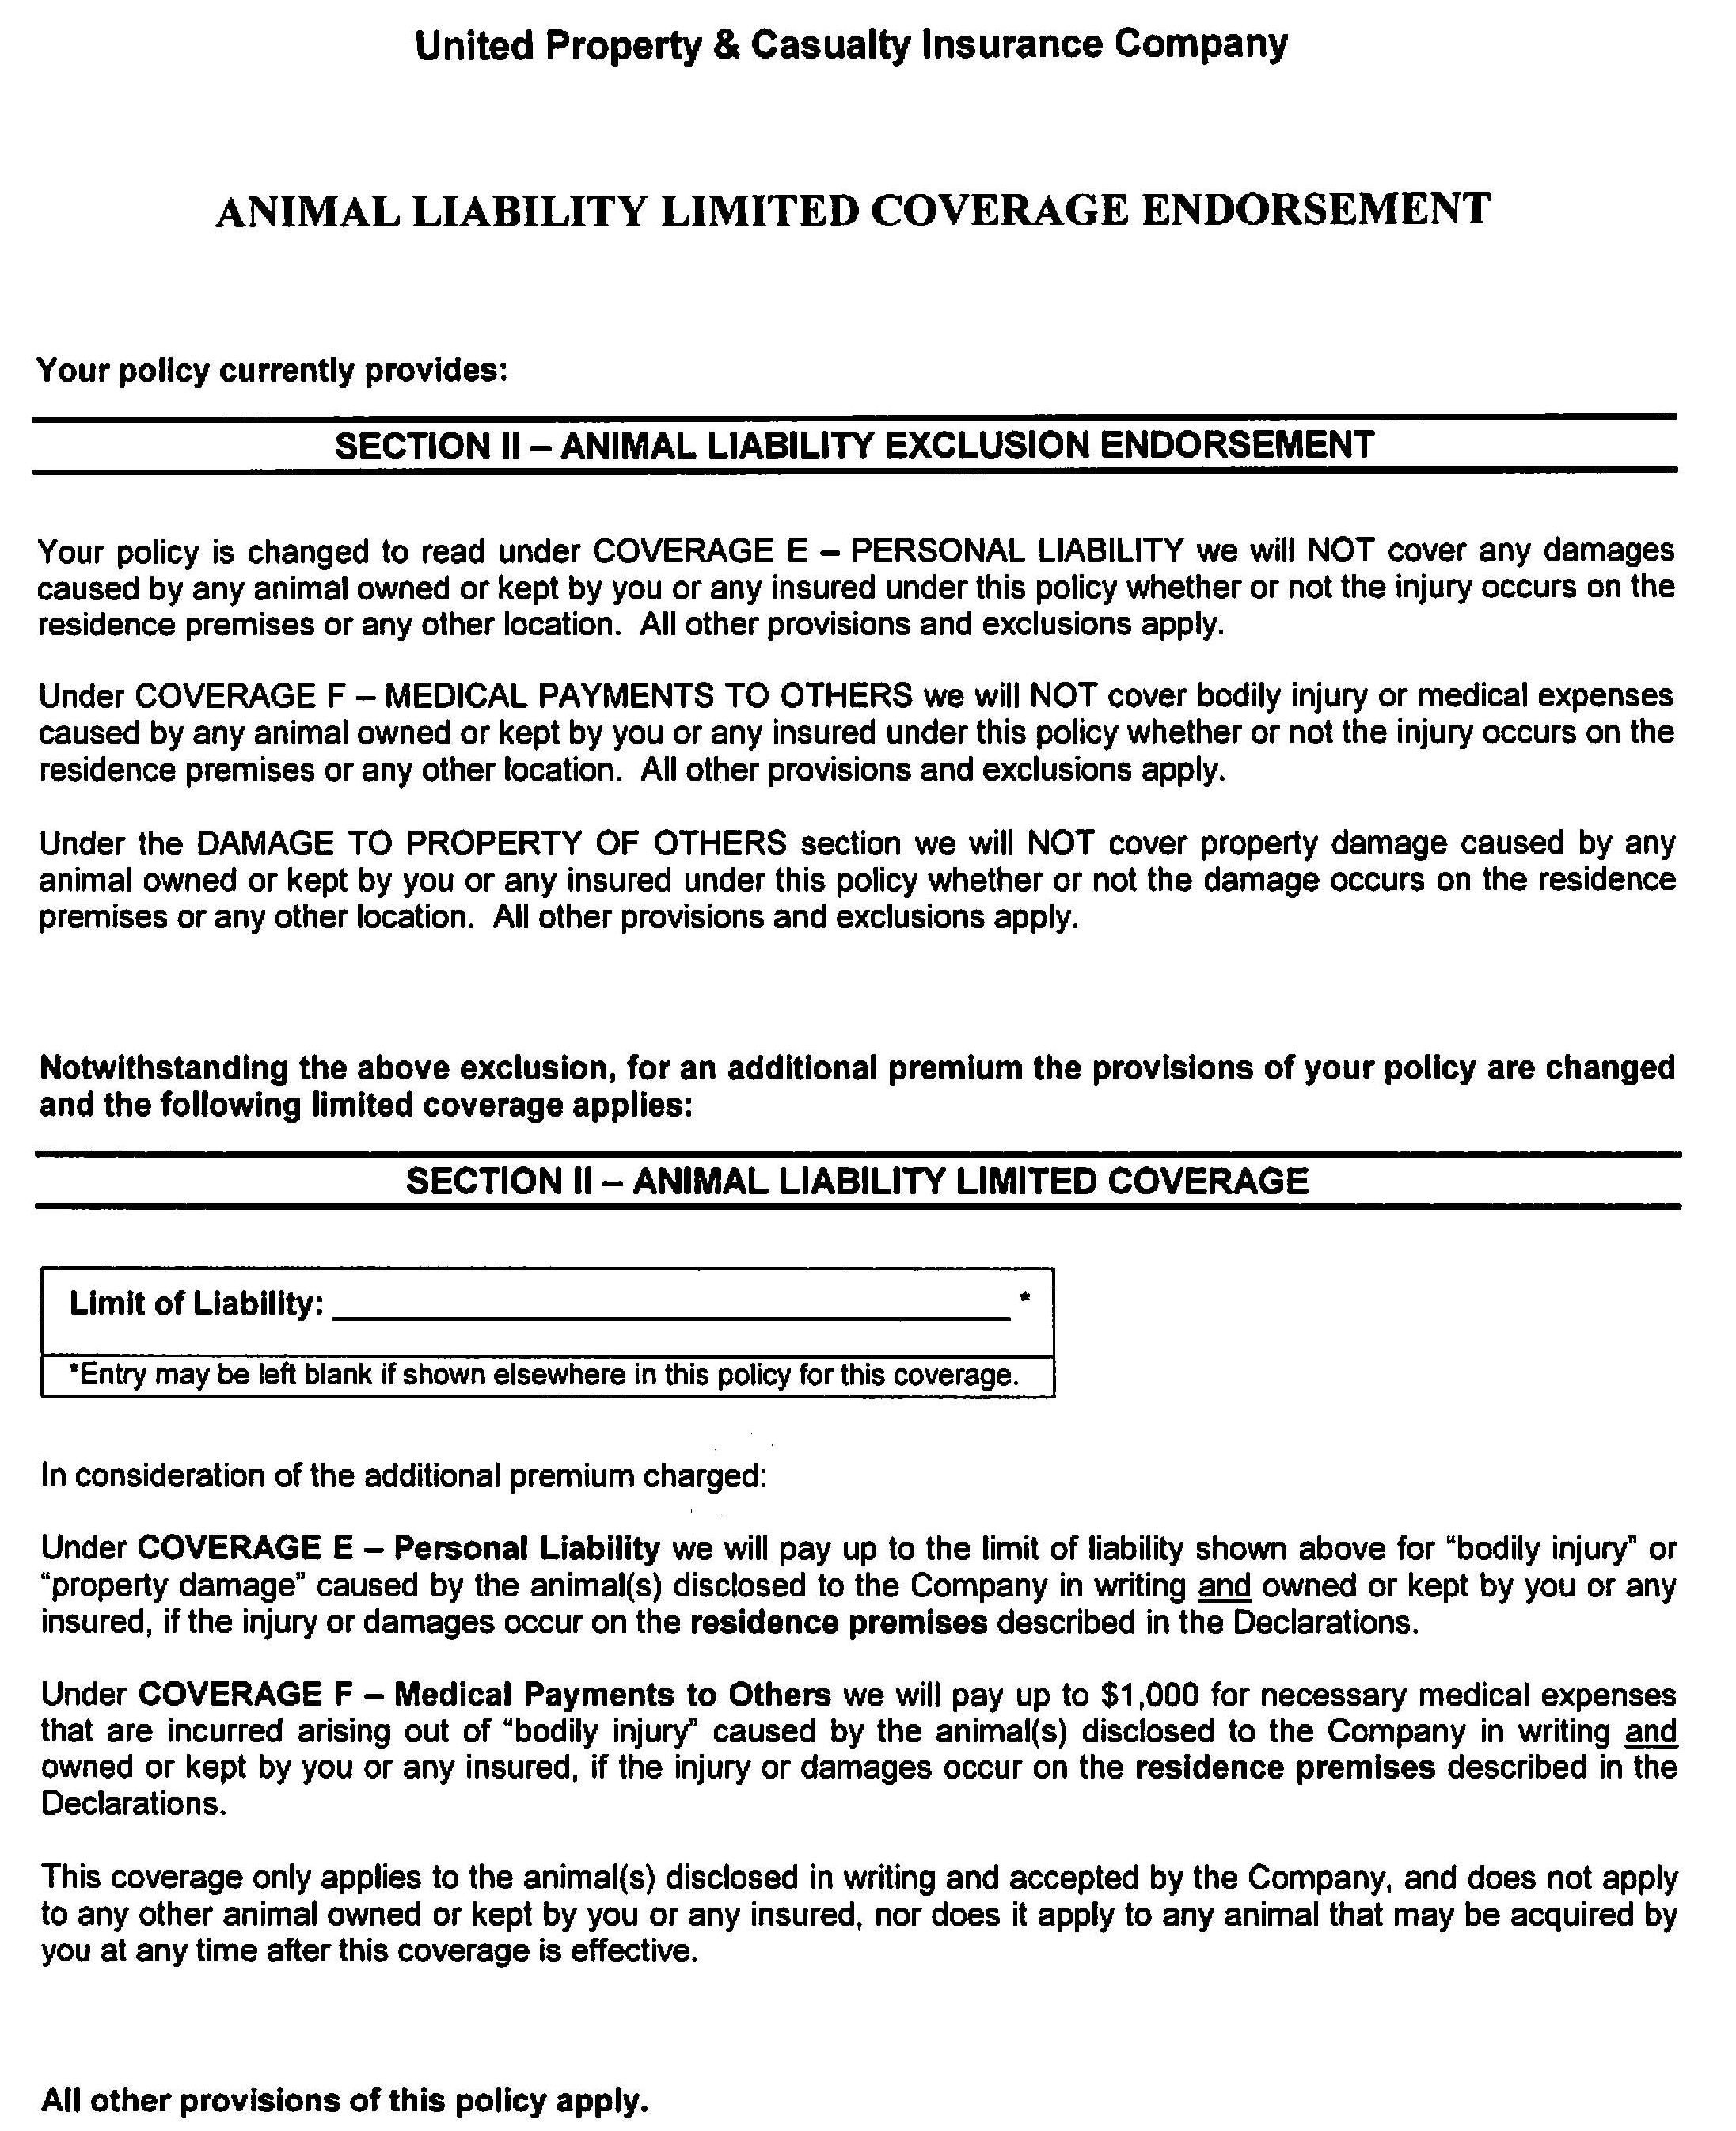
United Animal Liability Coverage
Notes:
United is one of the few companies that will offer animal liability coverage for an additional premium.
Copyright © 2011 Gassman Law Associates, P.A.
Notes:
United is one of the few companies that will offer animal liability coverage for an additional premium.

Slide 20
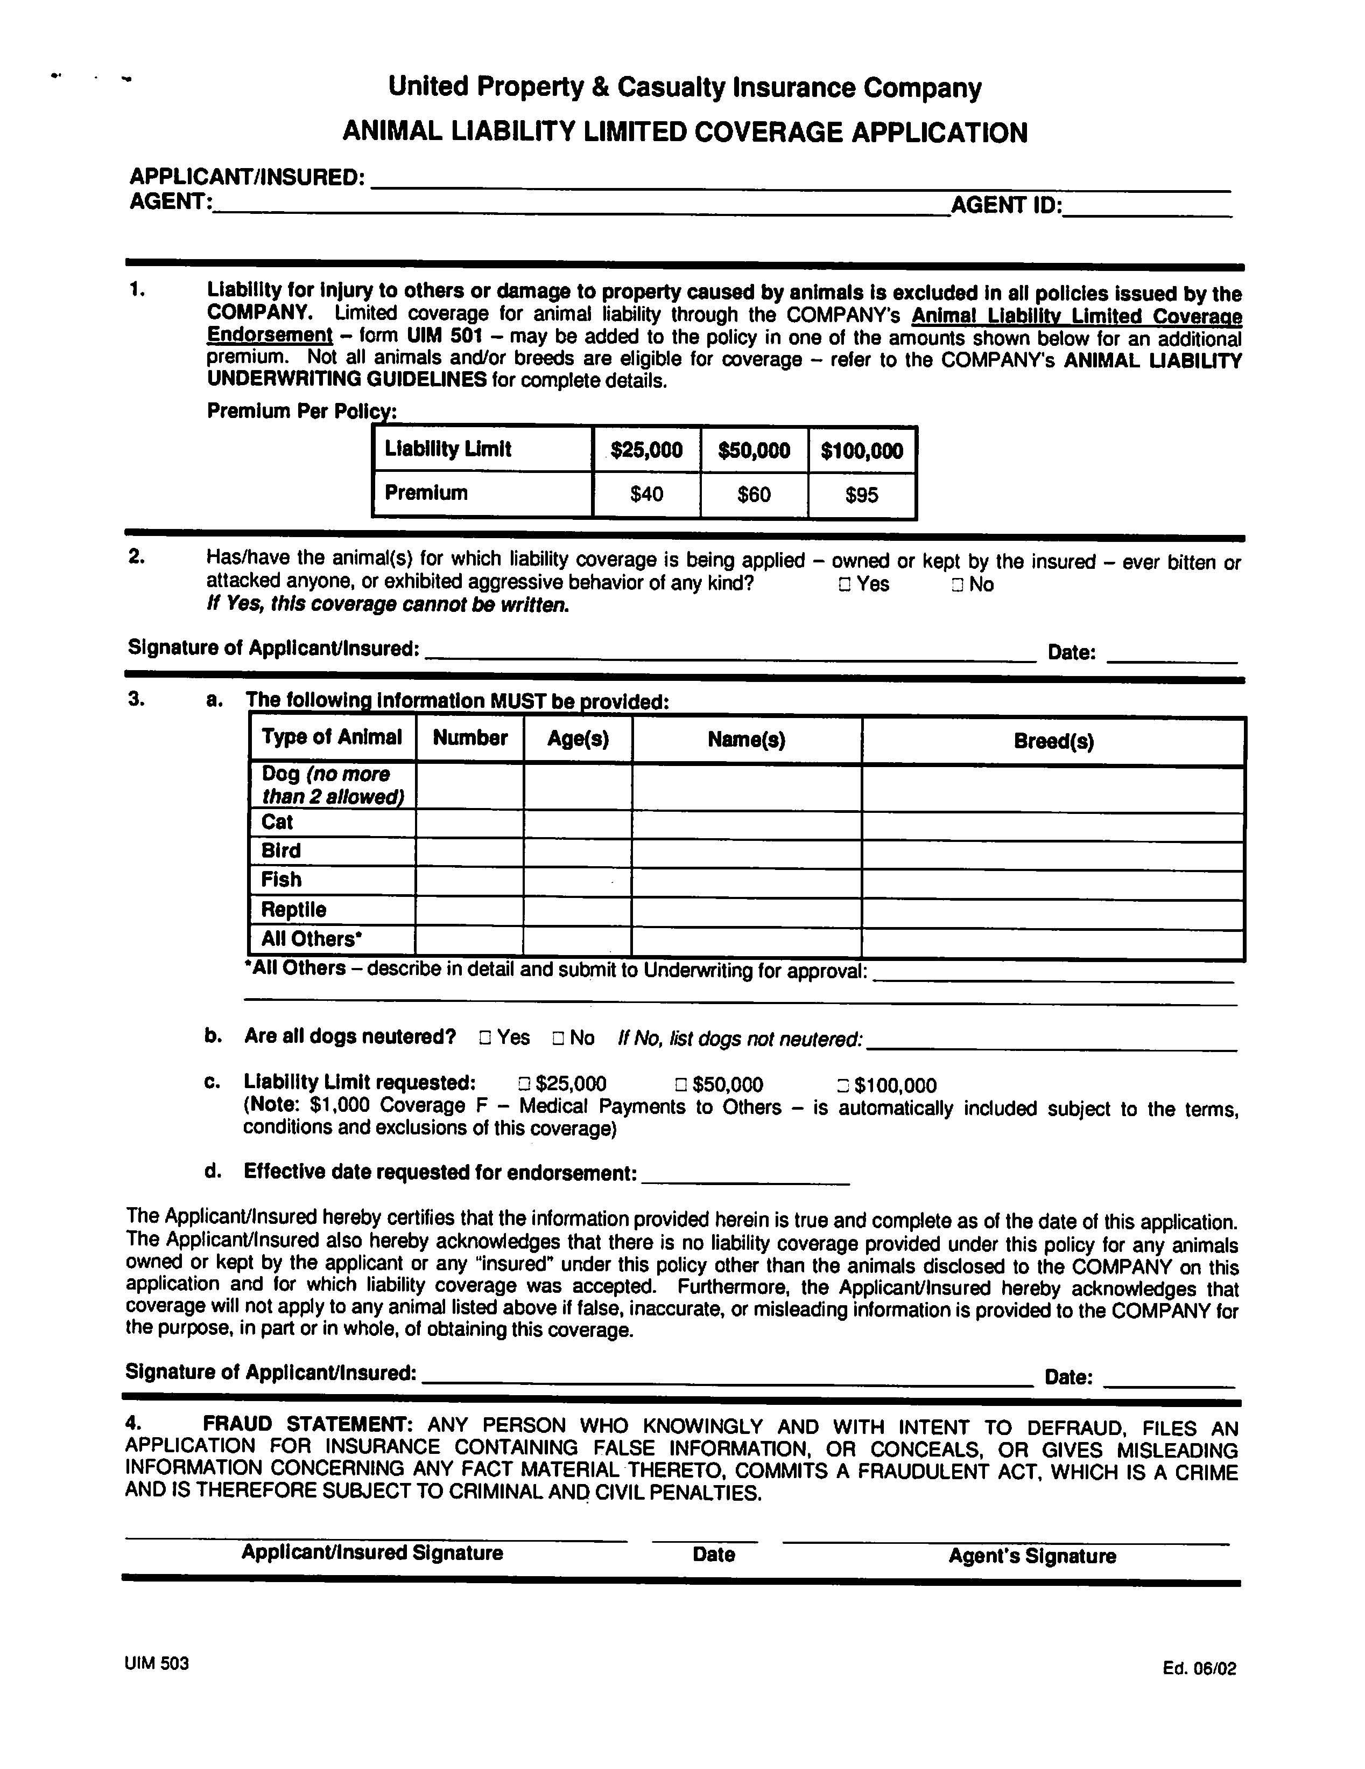
United Animal Liability Coverage Application Page
Notes:
Animal liability coverage usually comes in increments of $25,000, $50,000, or $100,000.
Animals with a history of violence are not insurable.
Animals of certain breeds are not insurable.
Copyright © 2011 Gassman Law Associates, P.A.
Notes:
Animal liability coverage usually comes in increments of $25,000, $50,000, or $100,000.
Animals with a history of violence are not insurable.
Animals of certain breeds are not insurable.

Slide 21
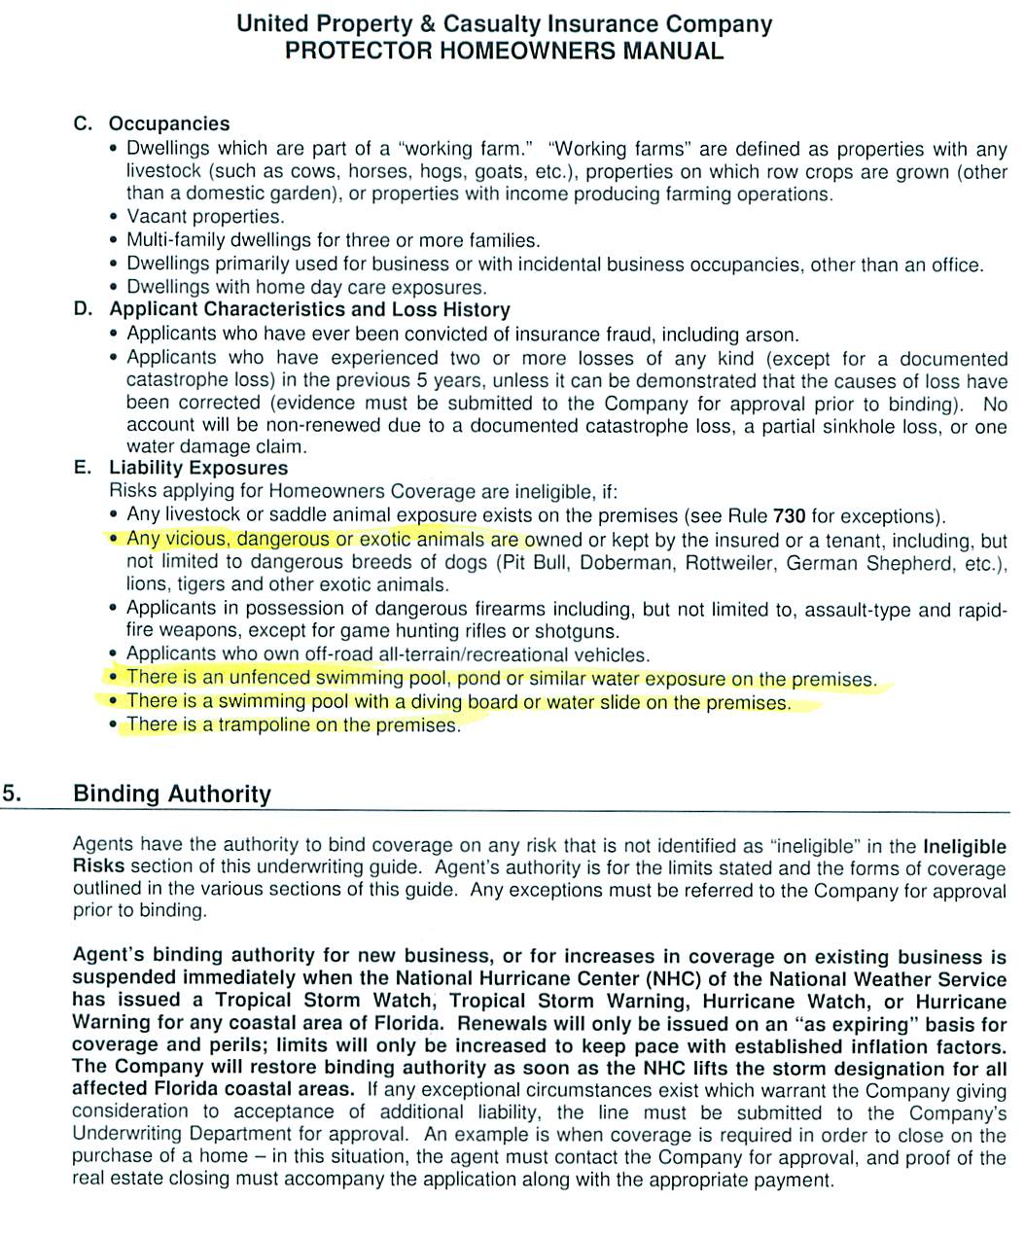
United Liability Ineligibility Language
Notes:
There are many instances that are not covered under liability insurance. You should thoroughly read through your policy to be aware of what exactly it covers.
Vicious, dangerous, or exotic animals are not eligible for animal liability coverage.
Copyright © 2011 Gassman Law Associates, P.A.
Notes:
There are many instances that are not covered under liability insurance.
Vicious, dangerous, or exotic animals are not eligible for animal liability coverage.

Slide 22
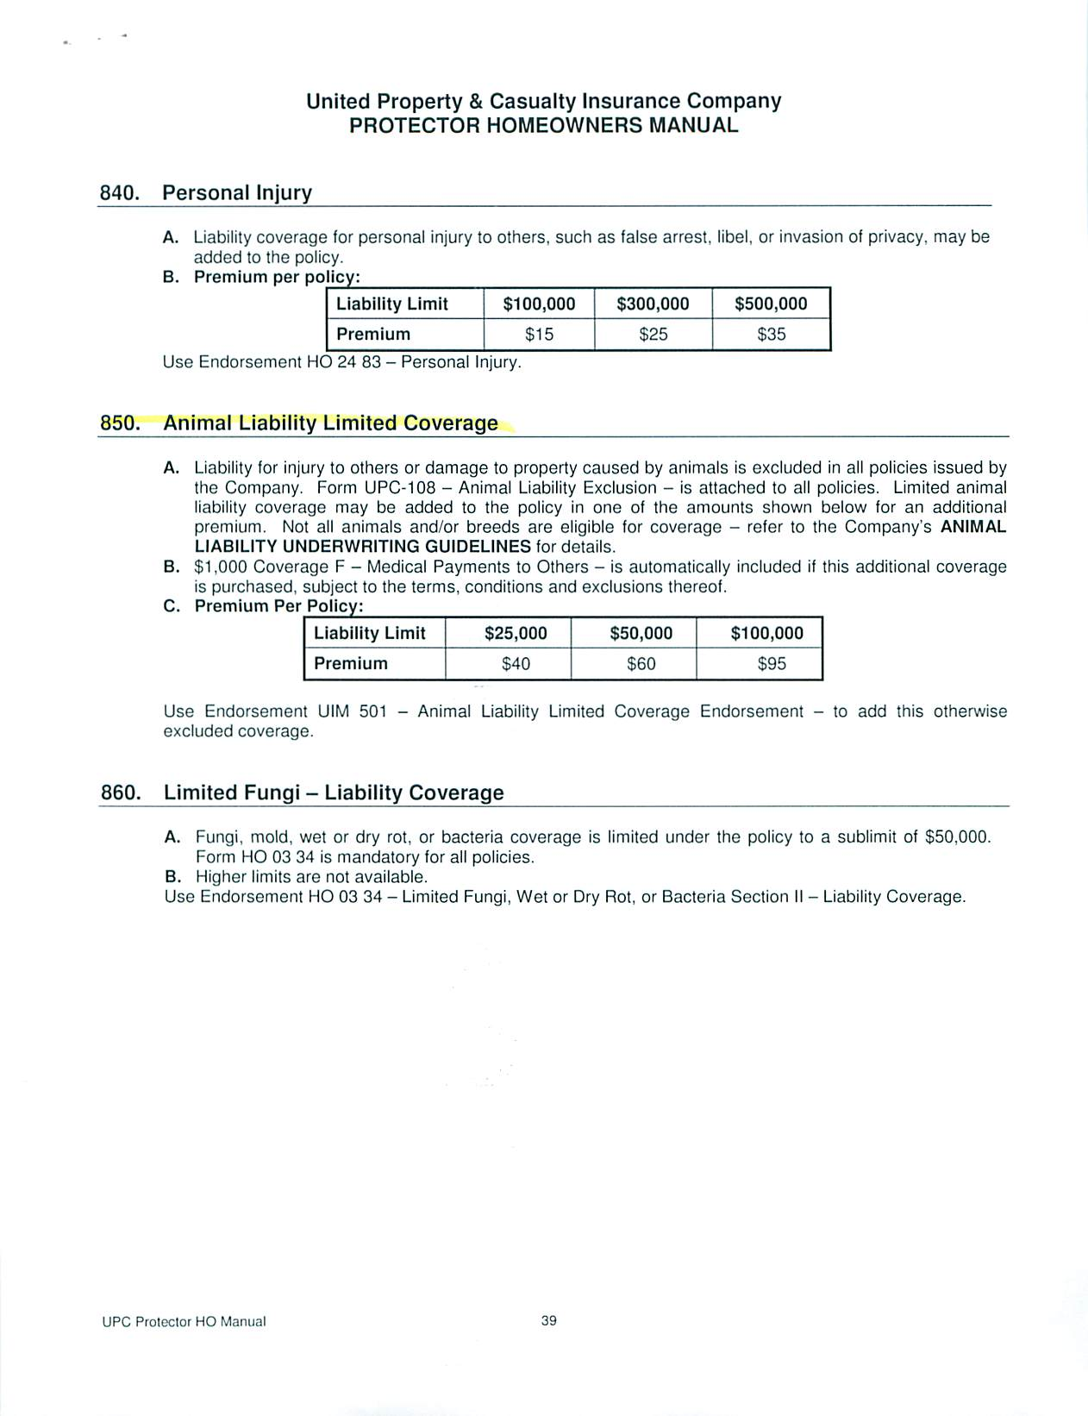
United Animal Liability Limited Coverage
Notes:
Animal Liability Coverage can be added on to some policies. This type of liability coverage will apply to injuries to others or damages to property caused by animals. Not all companies offer this type of coverage. If your insurance company does, they will usually offer a liability limit for an additional monthly premium.
This excerpt from United Property & Casualty states that they will offer $25,000 of animal liability coverage for an additional $40 per month, $50,000 for $60 per month, and $100,000 for $95 per month.
Copyright © 2011 Gassman Law Associates, P.A.

Slide 23
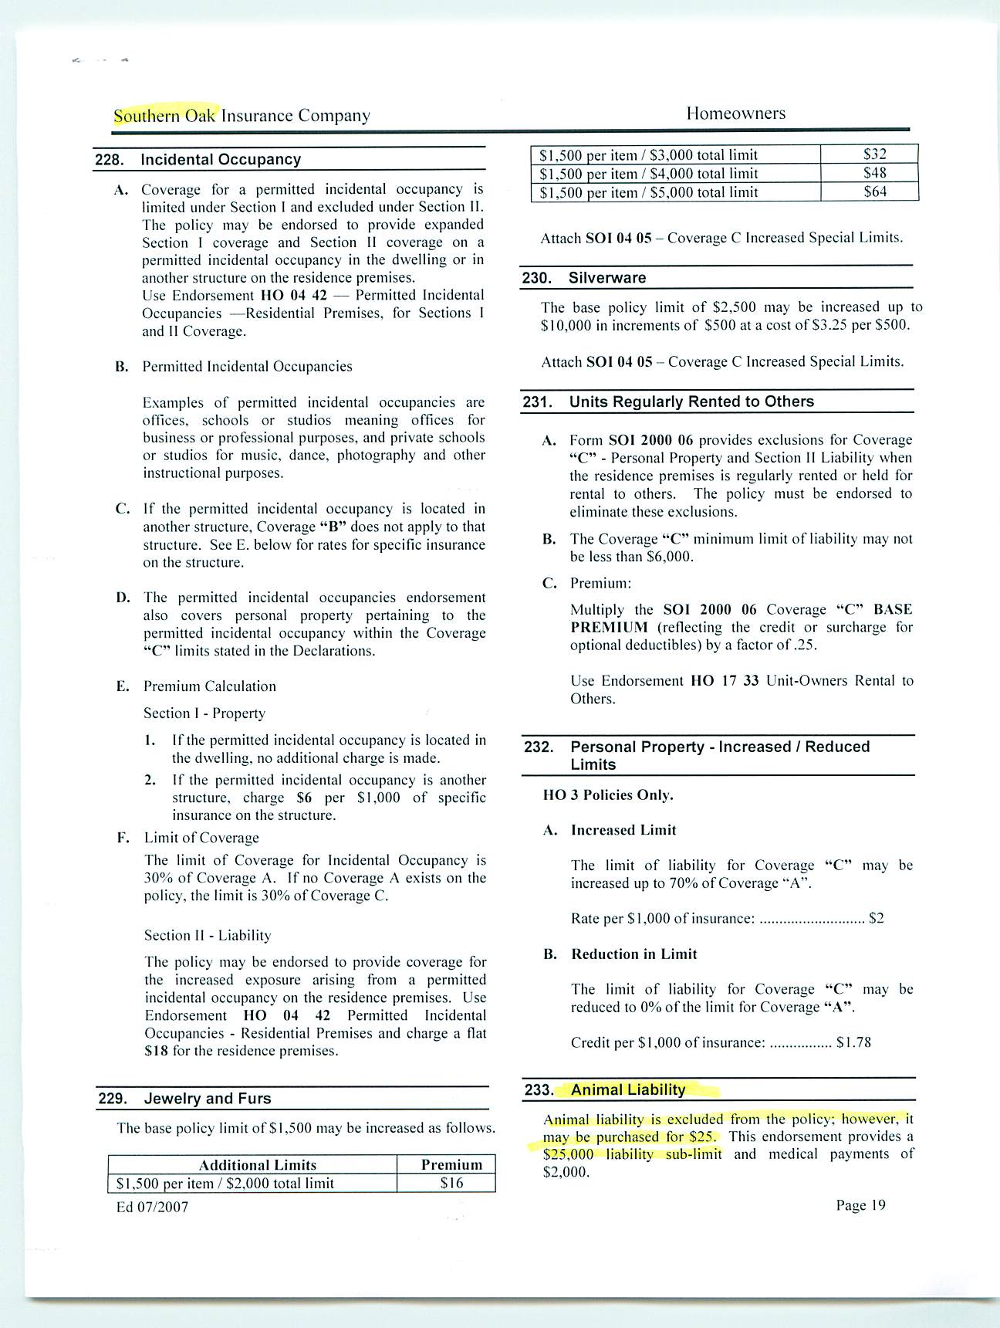
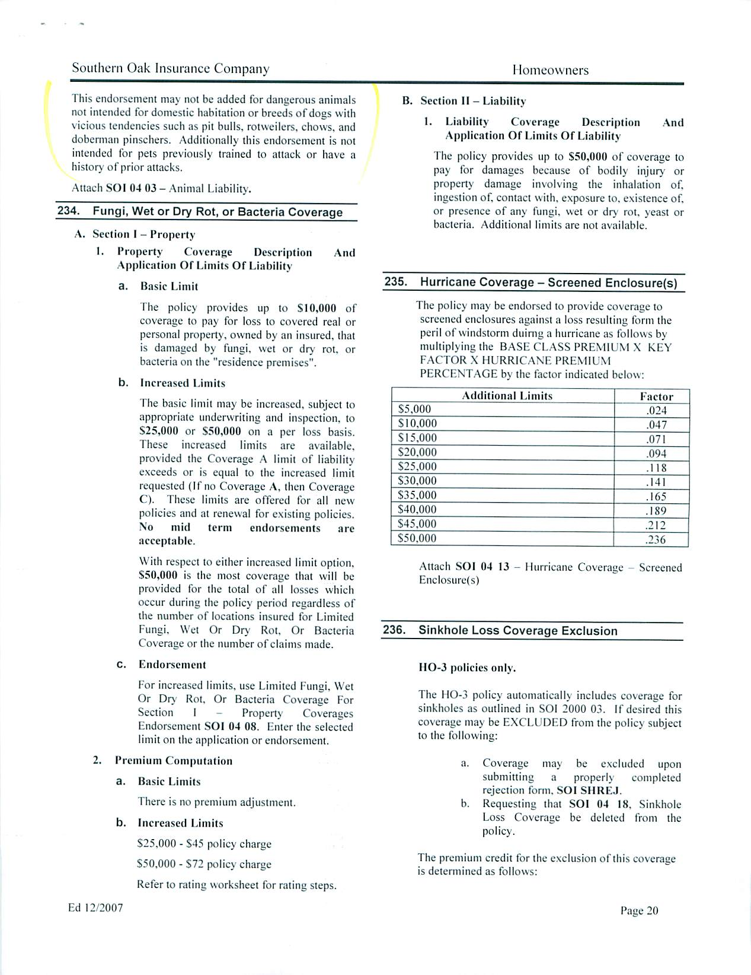
Southern Oak Animal Liability Coverage Wording
Notes:
This sample comes from another insurance company that will offer animal liability coverage. They will add $25,000 of sub-limit liability coverage and $2,000 of medical payment coverage on to a policy for $25 per month.
This company also notes that dangerous animals will not be covered.
Copyright © 2011 Gassman Law Associates, P.A.

Slide 24
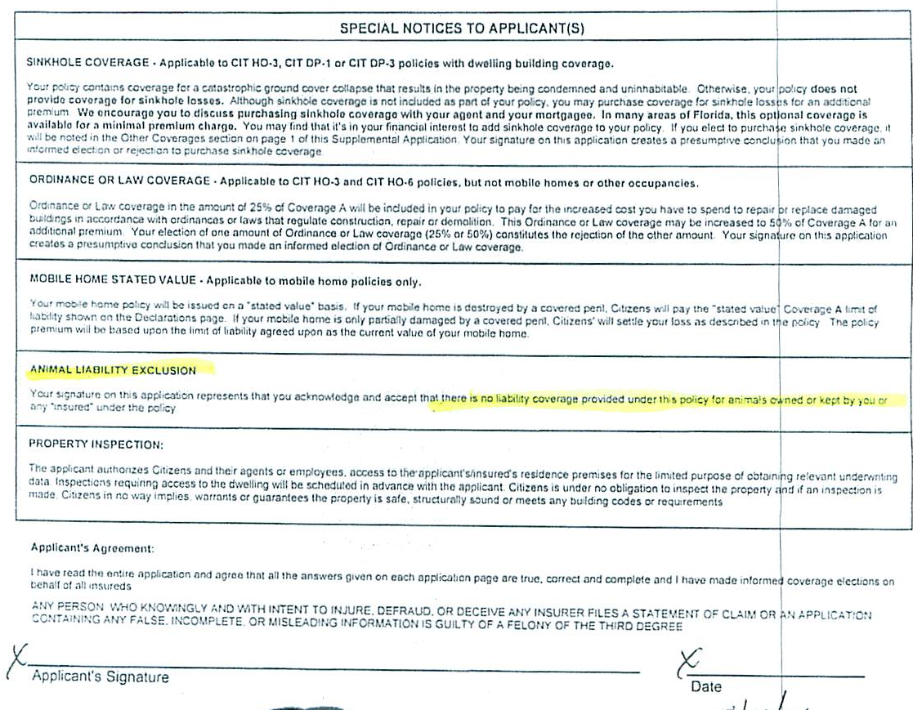
Citizens Animal Liability Exclusion
Notes:
Every one who has Citizens insurance is required to sign this acknowledgement stating that Citizens WILL NOT offer animal liability coverage.
Copyright © 2011 Gassman Law Associates, P.A.
Notes:
Every one who has Citizens insurance is required to sign this acknowledgement stating that Citizens WILL NOT offer animal liability coverage.

Slide 25
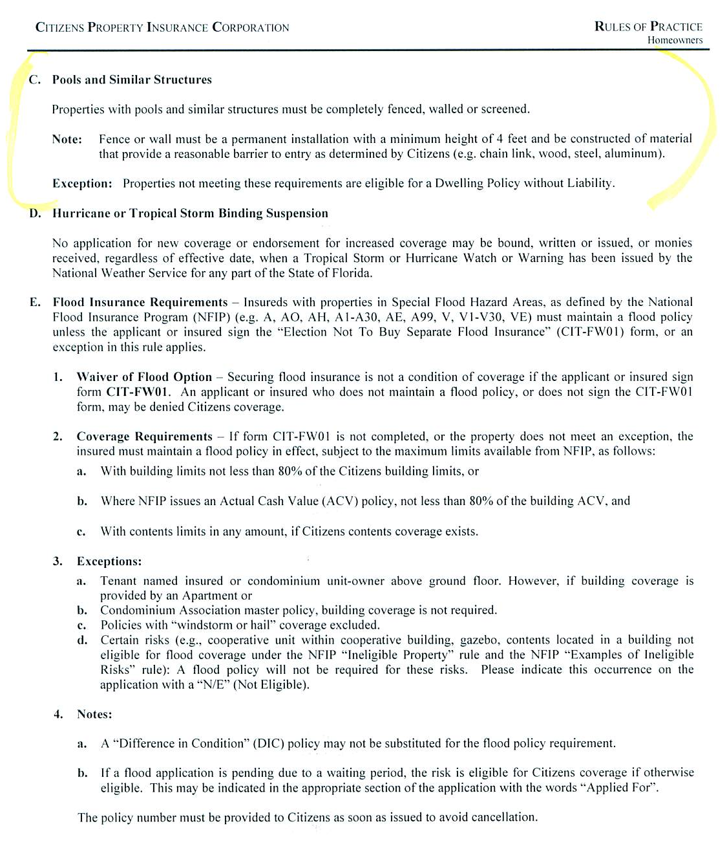
Citizens Property Insurance Eligibility Requirements for a Pool
Notes:
Most insurance companies will want to make sure that what they are insuring meets certain standards and requirements before approving insurability.
This is an example of Citizens insurability requirements for a pool.
Flood insurance requirements are also listed in this example.
Copyright © 2011 Gassman Law Associates, P.A.
Notes:
Most insurance companies will want to make sure that what they are insuring meets certain standards and requirements before approving insurability.
This is an example of Citizens insurability requirements for a pool.
Flood insurance requirements are also listed in this example

Slide 26
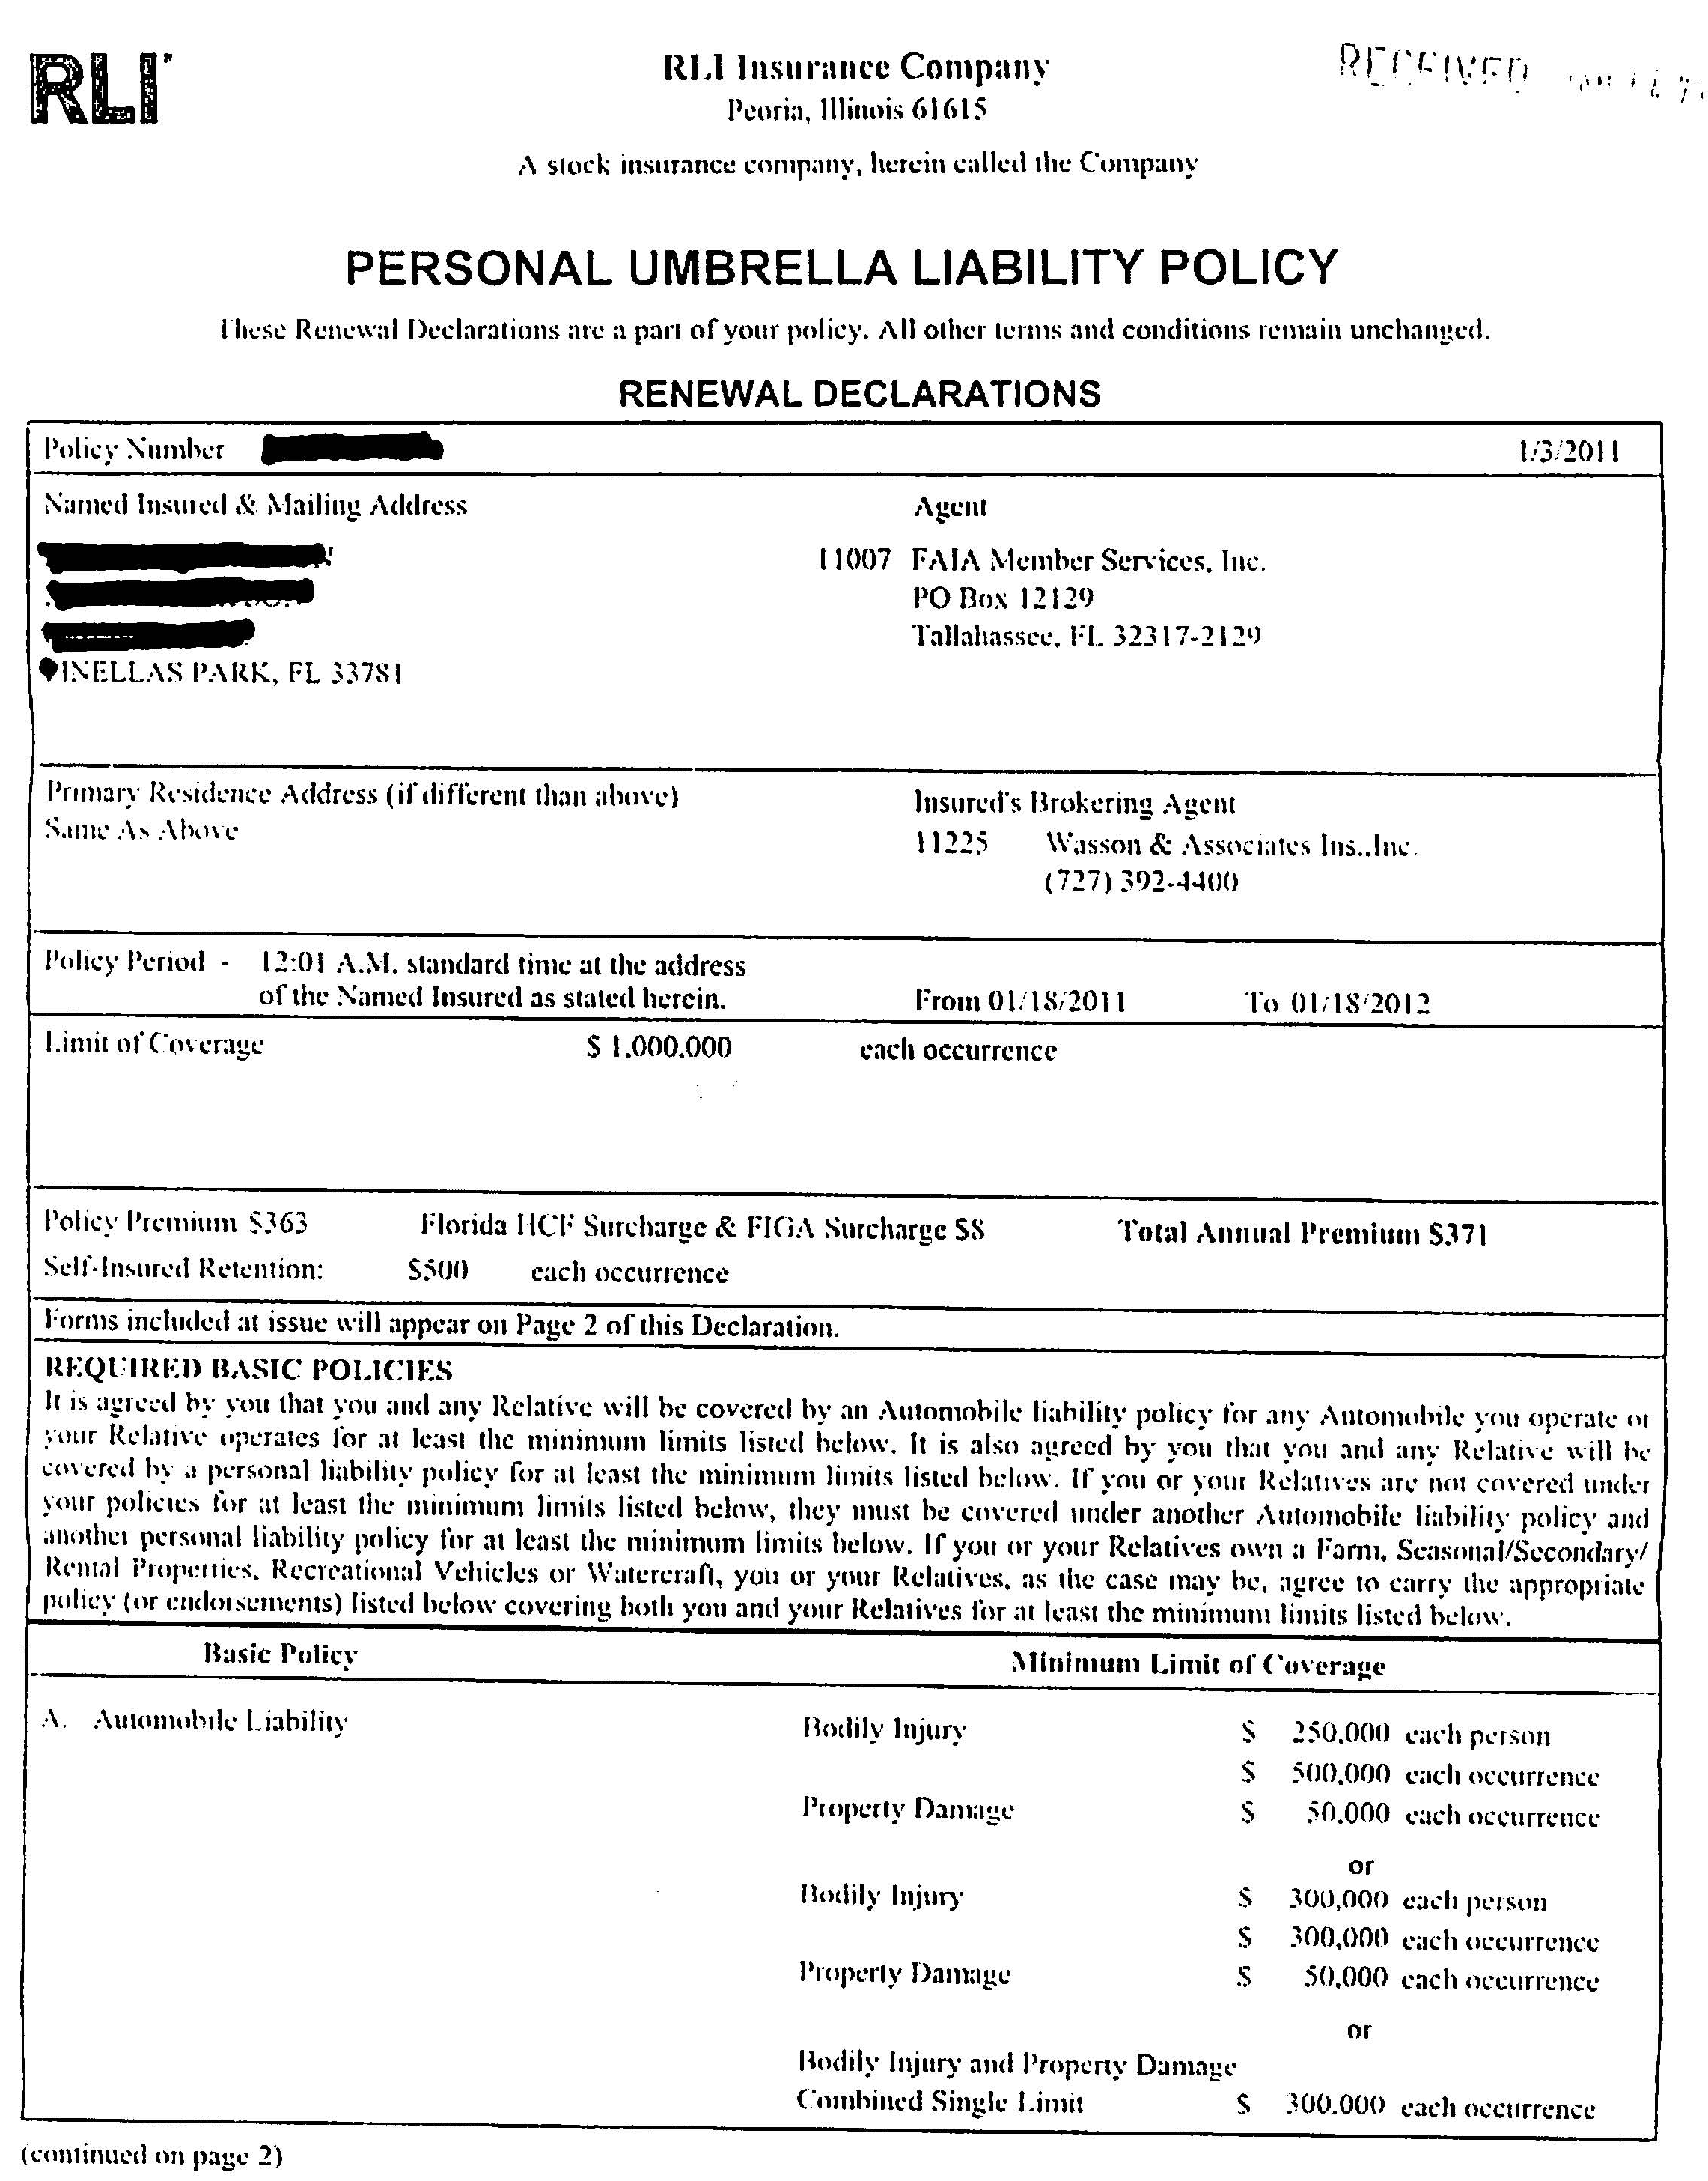
RLI Personal Umbrella Liability
Notes:
RLI will no longer drop down to cover animal liability if the underlying policy does not cover the exposure.
Umbrella insurance is usually very reasonably priced additional liability protection. After other insurance liability limits have been exhausted, the umbrella policy will kick in and cover up to the amount that is insured.
Copyright © 2011 Gassman Law Associates, P.A.
Notes:
RLI will no longer drop down to cover animal liability if the underlying policy does not cover the exposure.

Slide 27
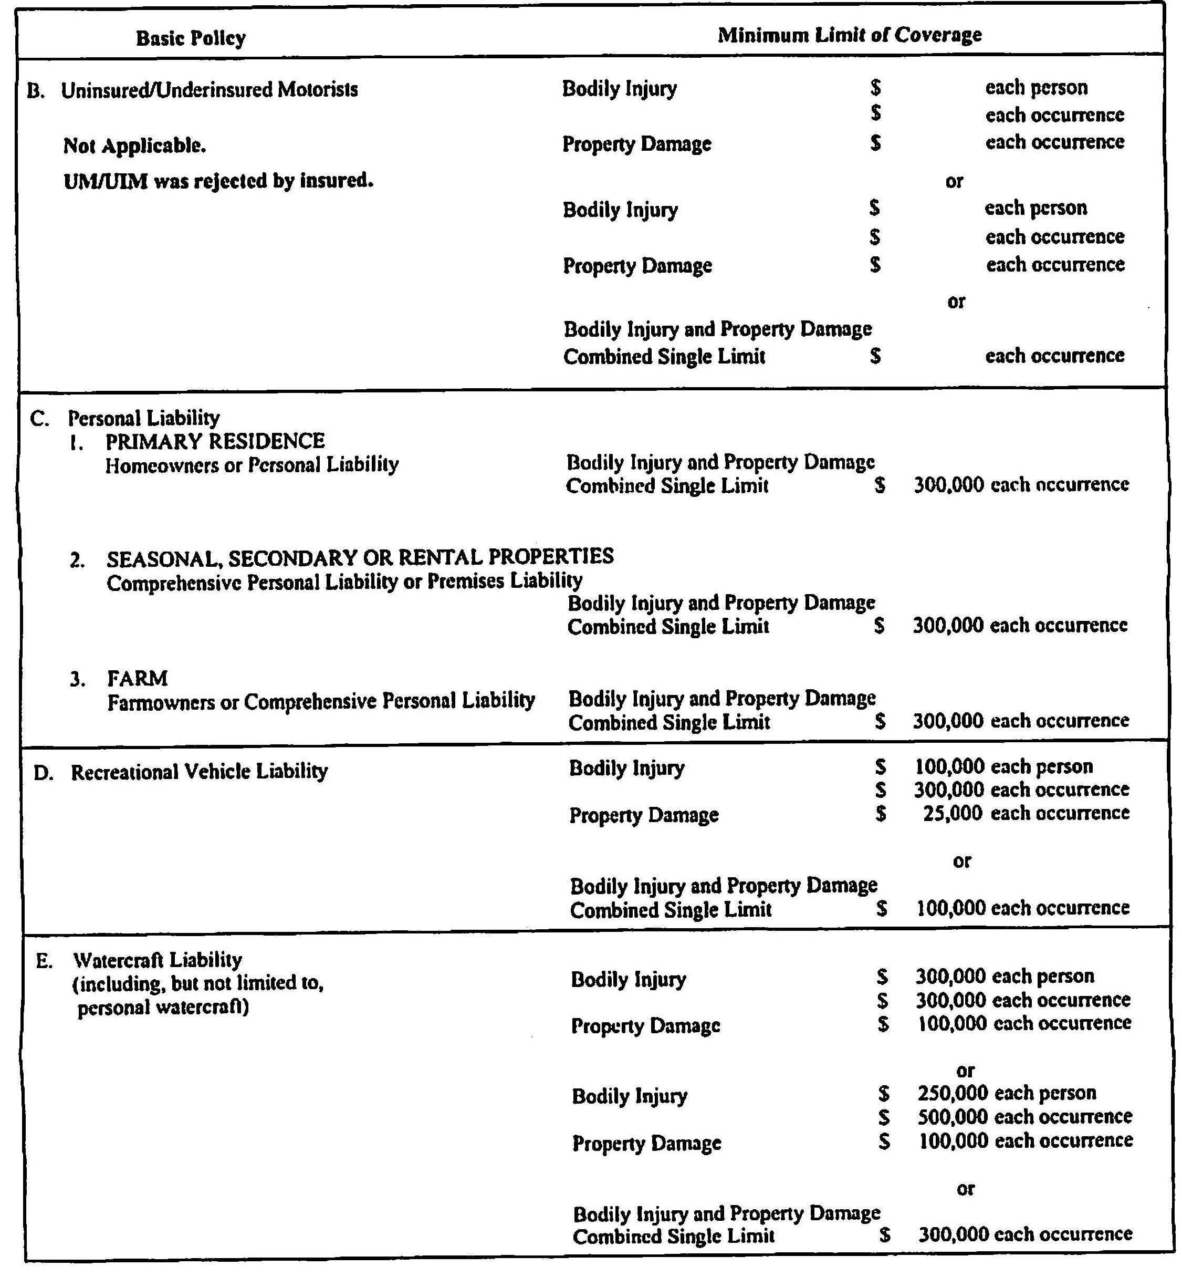
RLI Personal Umbrella Liability
Notes:
Umbrella liability coverage is a way to ensure that your assets will be protected in the event of an accident that wipes out your traditional insurance liability limitations.
For example, this policy owner already has $300,000 of homeowners liability in place.
Copyright © 2011 Gassman Law Associates, P.A.

Slide 28
Author Biographies
Chuck Wasson, President, began working at Sandy Wasson & Associates Insurance in 1992. Prior to that he was an insurance adjuster and spent the last 30 days of his adjusting career in Miami following Hurricane Andrew. After entering the family agency, he began working with physicians which today accounts for the majority of the business at Wasson & Associates. He has a Bachelor of Science degree from the University of Florida and holds the Chartered Property & Casualty Underwriter and the Certified Insurance Counselors designations, both nationally recognized designations within the insurance industry.
Chuck is a past President of the Kiwanis Club of Pinellas Park is married and has two daughters. In his spare time, Chuck enjoys training and racing in Triathlons and completed Ironman Florida in 2004.
Contact Chuck by clwasson@wassonandassoc.com or call 727-392-4400.
Alan S. Gassman, J.D., LL.M. is an attorney practicing in Clearwater, Florida with the firm of Gassman Law Associates, P.A. Mr. Gassman’s primary practice focus over the past 25 years has been the representation of high net worth individuals, physicians and business owners in estate planning, taxation, and business and personal asset structuring.
In 2009 and 2010 Mr. Gassman authored and co-authored the following published articles. “Creditor Rights Under Private Annuities and Grantor-Retained Annuity Trusts in Florida”, The Florida Bar Journal, July/August, 2009. “Unconventional Uses of 529 Plans Should Not Be Ignored By Taxpayers and Their Advisors”, BNA Tax & Accounting, March 11, 2010. “Don’t Overlook the Benefits - Tax and Otherwise - of Private Operating Foundations” Estates, Gifts and Trusts Journal, 11/12/2009. “After Olmstead: Will a Multiple-member LLC Continue to Have Charging Order Protection?”, The Florida Bar Journal, December 2010. “Recent Adventures in Florida Tenancy By The Entirety - Important Developments” Leimberg Information Systems, Inc., June 18, 2009. “One Good Reason Not To Do A Roth IRA Conversion”, Leimberg Information Systems, Inc., September 11, 2010. “Mistakes Doctors Make Managing Their Practices and Investments”, Leimberg Information Systems, Inc., May 20, 2009.
In 2010 Mr. Gassman presented the following Webinars for professionals; Interesting Interest; Minimum and Maximum Interest Rates for Intra-Family Transactions and Applications of the OID Rules to Intra-Family Debt Obligations, BNA Tax & Accounting with Professor Jerry Hesch, August 18, 2009, Individual and Group Medical Practices: Tax, Health Law, and Creditor Protection Planning, BNA Tax & Accounting, March 2, 2010.
Mr. Gassman can be contacted at agassman@gassmanpa.com, or by phone at 727-442-1200. The Gassman Law Associates, P.A. website is www.gassmanlaw.com.

