Slide 1


Riders on the Storm
How To Make Sure Your Insurances Do Not Have Any Catastrophic Exceptions or Gaps
Monday, September 12, 2011, 5:30 PM
Presented By:
Chuck L. Wasson, III, CPCU
Sandy Wasson & Associates Insurance, Inc.
clwasson@wassonandassoc.com
727-392-4400
Alan S. Gassman, J.D., LL.M.
Gassman Law Associates, P.A.
agassman@gassmanpa.com
727-442-1200

Slide 2
Common Gaps
Medical insurance and on-the-job injury normally covered by Worker’s Comp,
Someone running an errand for you in their own car,
Not having enough underlying coverage to allow umbrella insurance to kick in,
Coverage for dog and pool injuries, and
Coverage for assets outside of Florida.

Slide 3

What is a Rider?
Many companies offer policy riders that can add extra protection to your insurance coverage.
If you elect not to purchase certain riders, you may find gaps within your coverage.
Additional riders may raise your premiums.
Some riders can also help by reducing coverage to make a policy more affordable.
Companies will often include “complimentary” riders.
Make sure that the cost of the rider is worth the benefit before you add it!

Slide 4

Riders Affecting…
Your Life Insurance

Slide 5

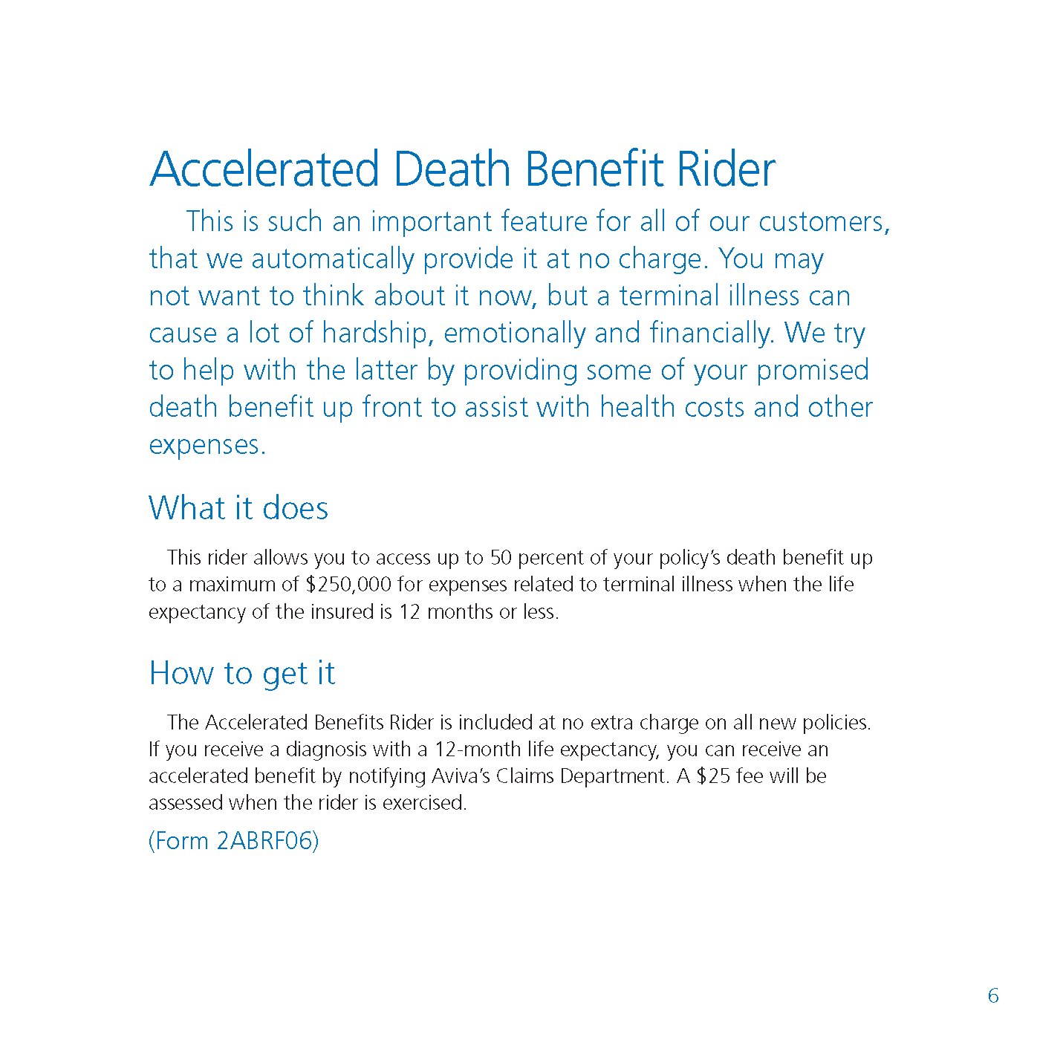
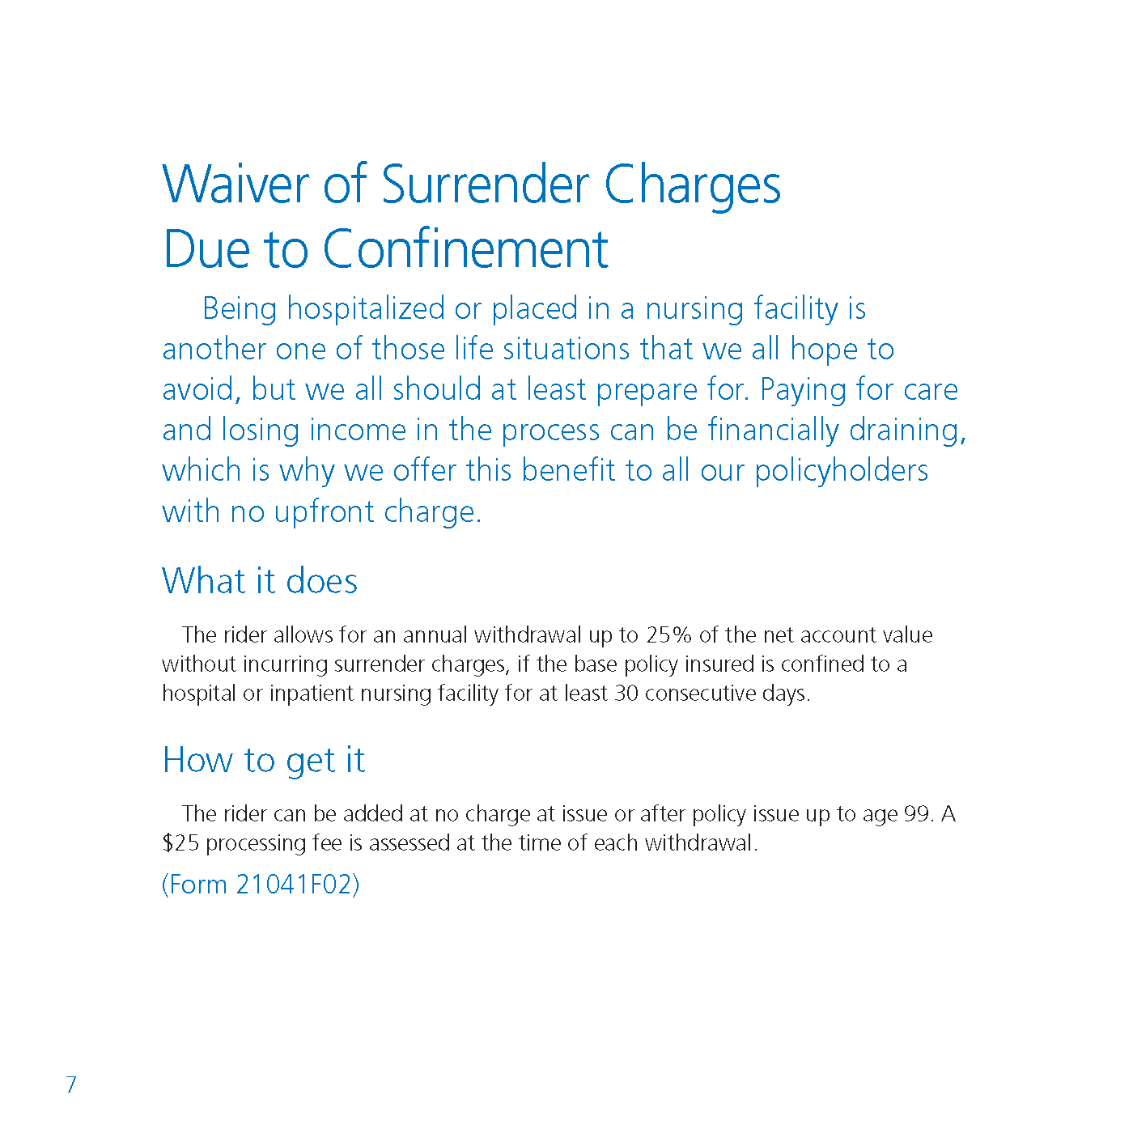
Complimentary Riders from
Aviva Life Insurance
Here are examples of common policy riders that Aviva Life Insurance offers. They may be considered “complimentary” riders, but you can see that the Accelerated Death Benefit Rider and the Waiver of Surrender Charges Due to Confinement Rider have $25 processing fees if you exercise them.

Slide 6


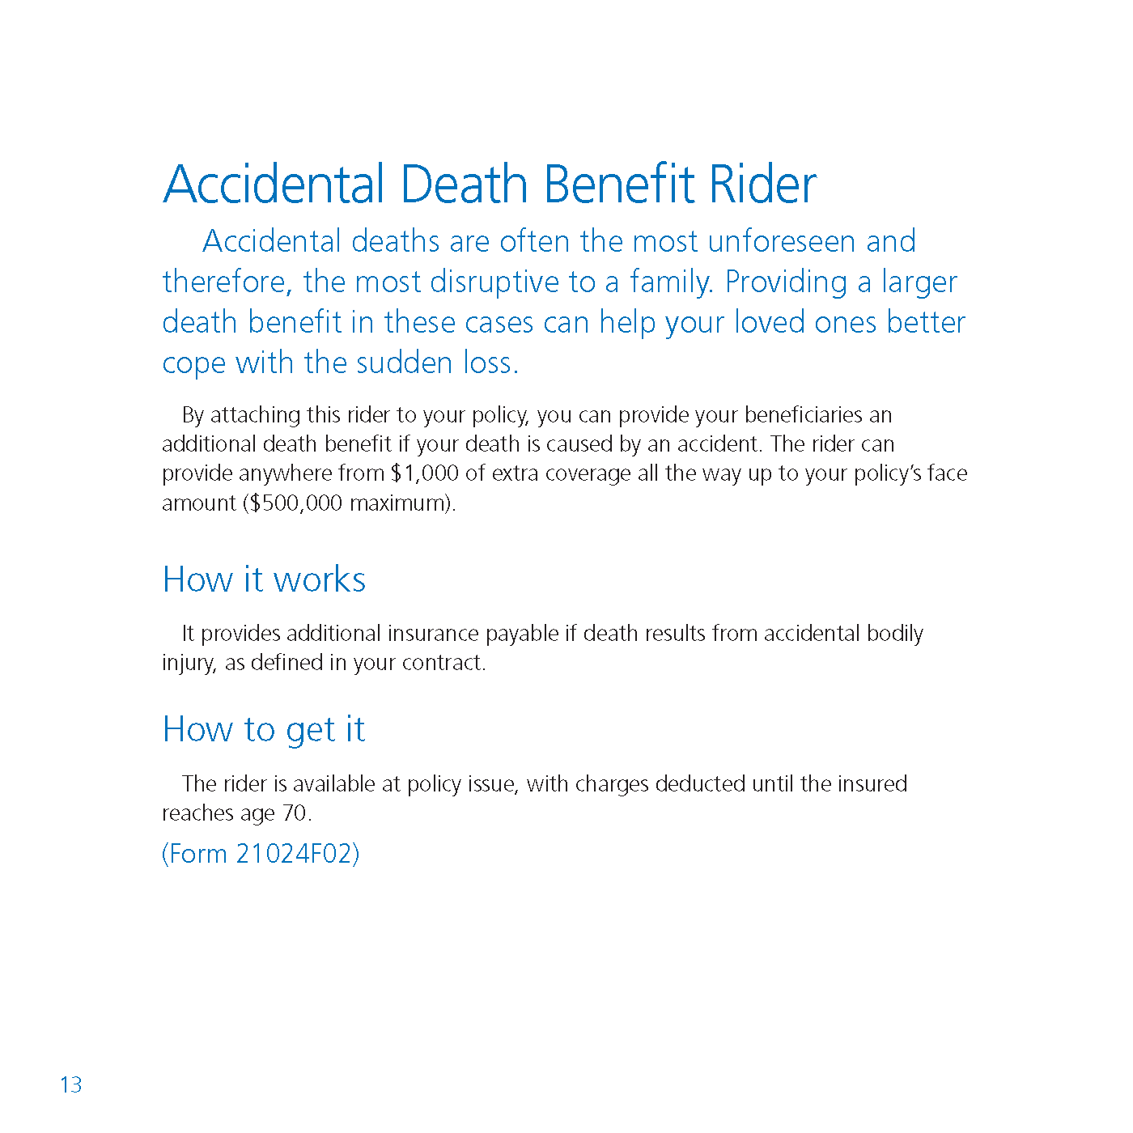
Additional Coverage Riders from Aviva
These rider examples show different types of additional coverage available through Aviva Life Insurance.
Additional coverage comes with additional premium costs. Make sure that you are aware of the cost of any rider that you are considering.
Also note that without the Guaranteed Purchase Option Rider, if you wanted to purchase more insurance down the road, you would most likely be required to have another health examination. Based upon the results of your examination, your request for more insurance could be denied. With this rider, you would be guaranteed the option to purchase additional amounts of coverage at specified future dates. If this option is important to you, you may want to consider a policy rider similar to this one.

Slide 7
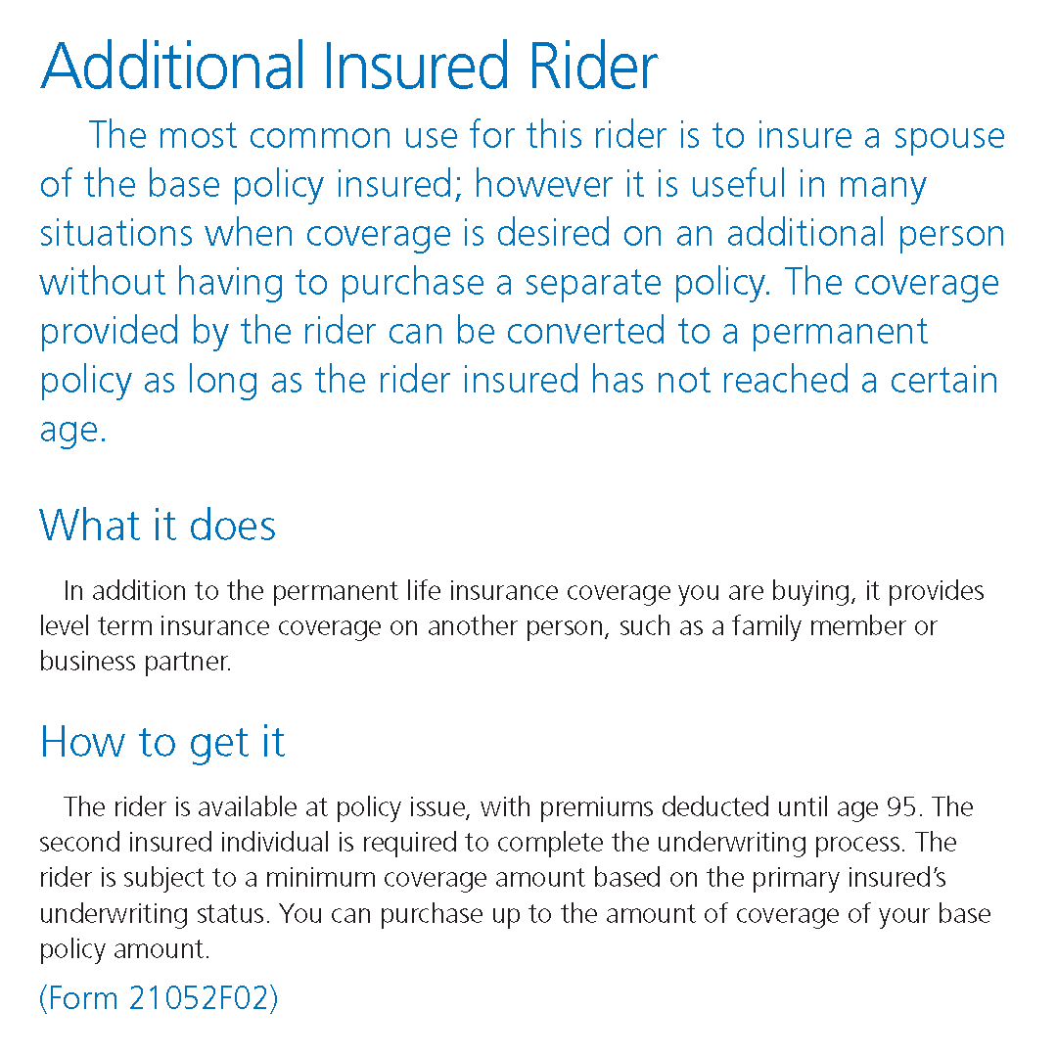
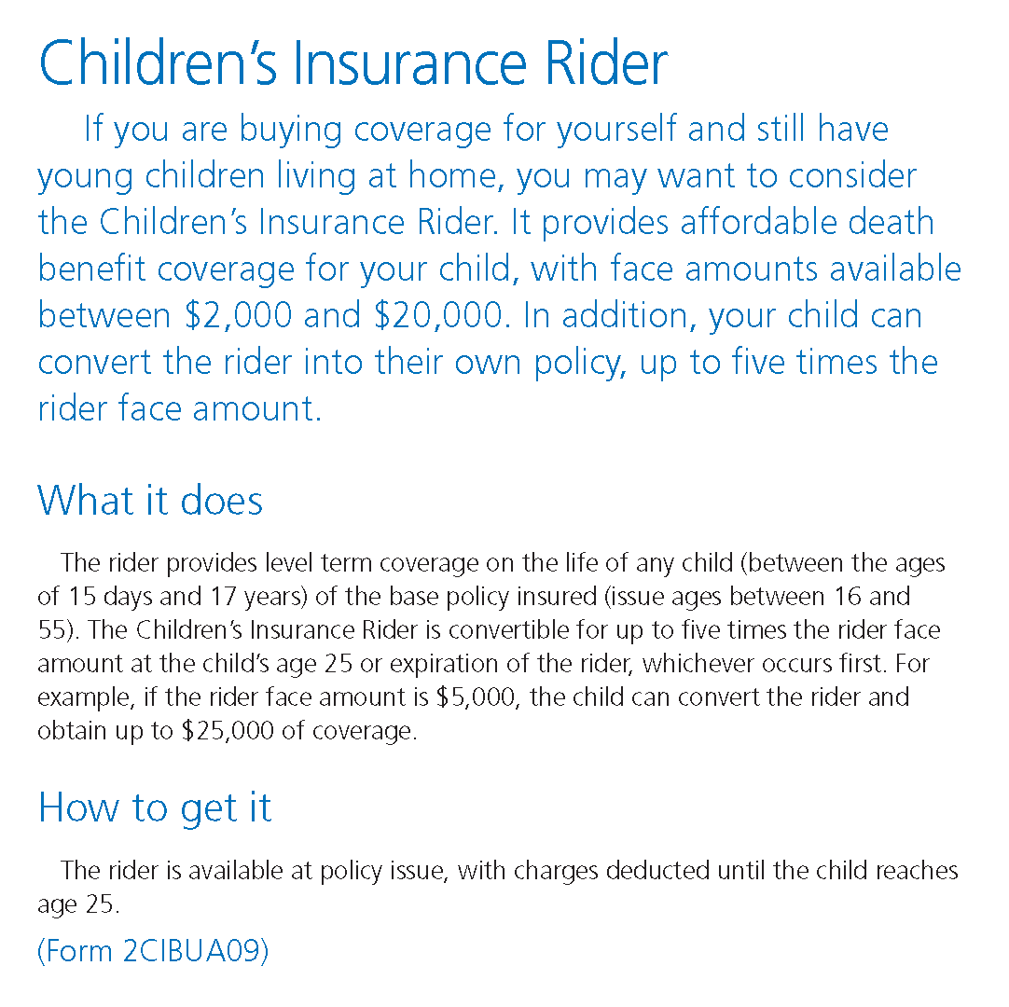
Additional Coverage Riders from Aviva
These riders are great ways to provide coverage for your spouse or children without having to establish a new, separate policy for them.

Slide 8
Riders Affecting…
Your Disability Insurance

Slide 9

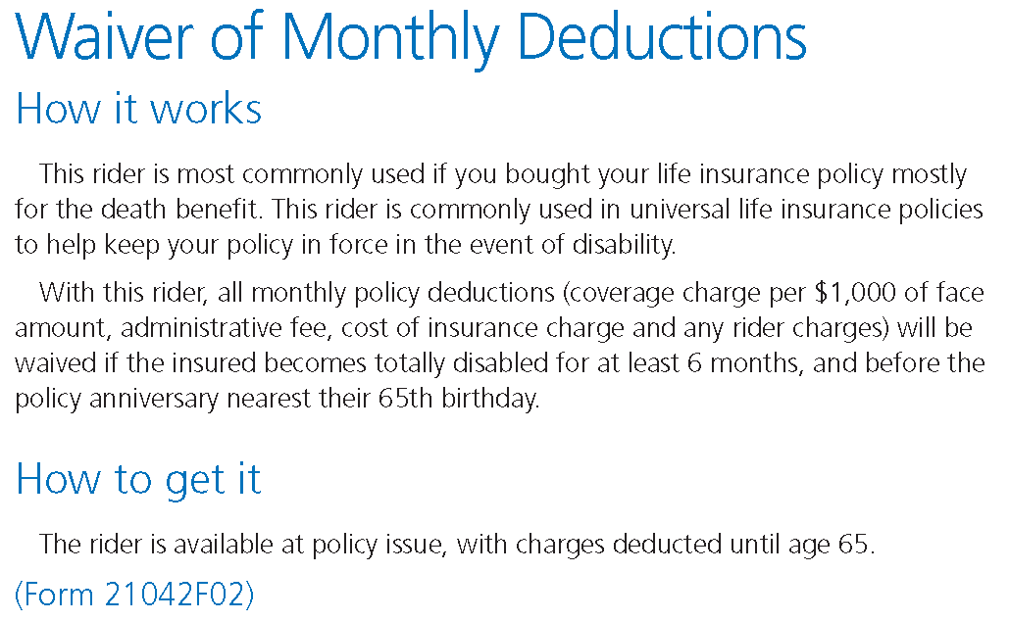
Disability Riders on Life Insurance
The Social Security Administration claims that nearly 1/3 of workers become disabled before retirement.
These example riders come from Aviva Life Insurance. Most companies have riders that provide similar coverage.
These riders are intended to protect your life insurance policy in the event of disability.
For example, without a rider like the Waiver of Monthly Deductions, in the event of disability, you would still be responsible to pay your premiums. If you could not pay the premiums, your policy could lapse.
With this rider, your premiums would be waived if you were to become disabled for at least 6 months.
These riders should not replace disability insurance.

Slide 10
Disability Insurance Riders
“Own Occupation or Regular Occupation”: The inability to perform the substantial and material duties of your occupation.
“Your Occupation or Own Occupation Not Engaged”: The inability to perform the substantial and material duties of your occupation and not working.
Residual: Usually added by rider, this feature allows the insured to collect benefits while residually disabled and working. The definition usually reads due to injury or sickness the insured is unable to perform one or more of the substantial or material duties of their occupation, is working and is suffering a loss of income of at least 20%. If the insured has a loss of income of 75% the insured is deemed totally disabled and receives full benefit.

Slide 11
Disability Insurance Riders
COLA (“Cost of Living Adjustment”): This benefit increases the benefit payable on claim every year to help fight inflation. Normally the first increase is on the policy anniversary after having been on claim at least one year.
FIO, APB, GIO, Benefit Update or Guaranteed Insurability: The ability to increase your monthly benefit on specified anniversaries without evidence of medical insurability. Financial verification will be necessary when exercising the option.
Catastrophic Disability Rider: This rider pays an additional monthly benefit for catastrophic disabilities, e.g. the loss of two of five or six activities of daily living and cognitive impairment. The exact definition varies by company.

Slide 12

Riders Affecting…
Your Home and Assets

Slide 13
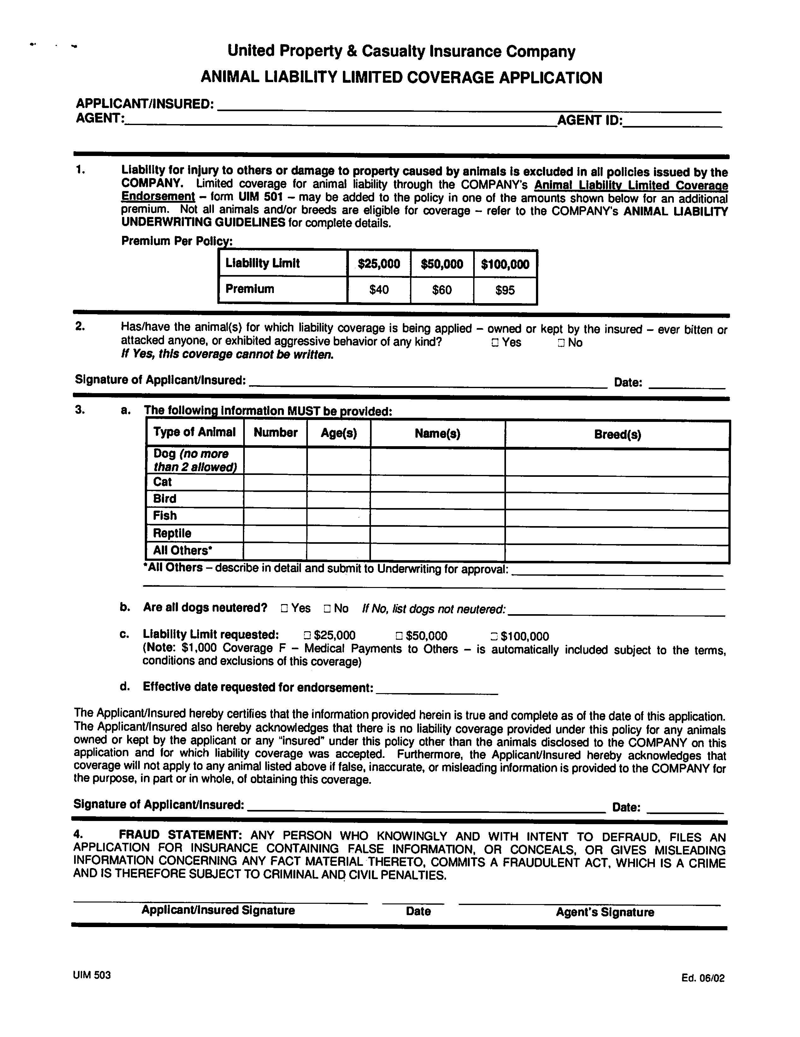
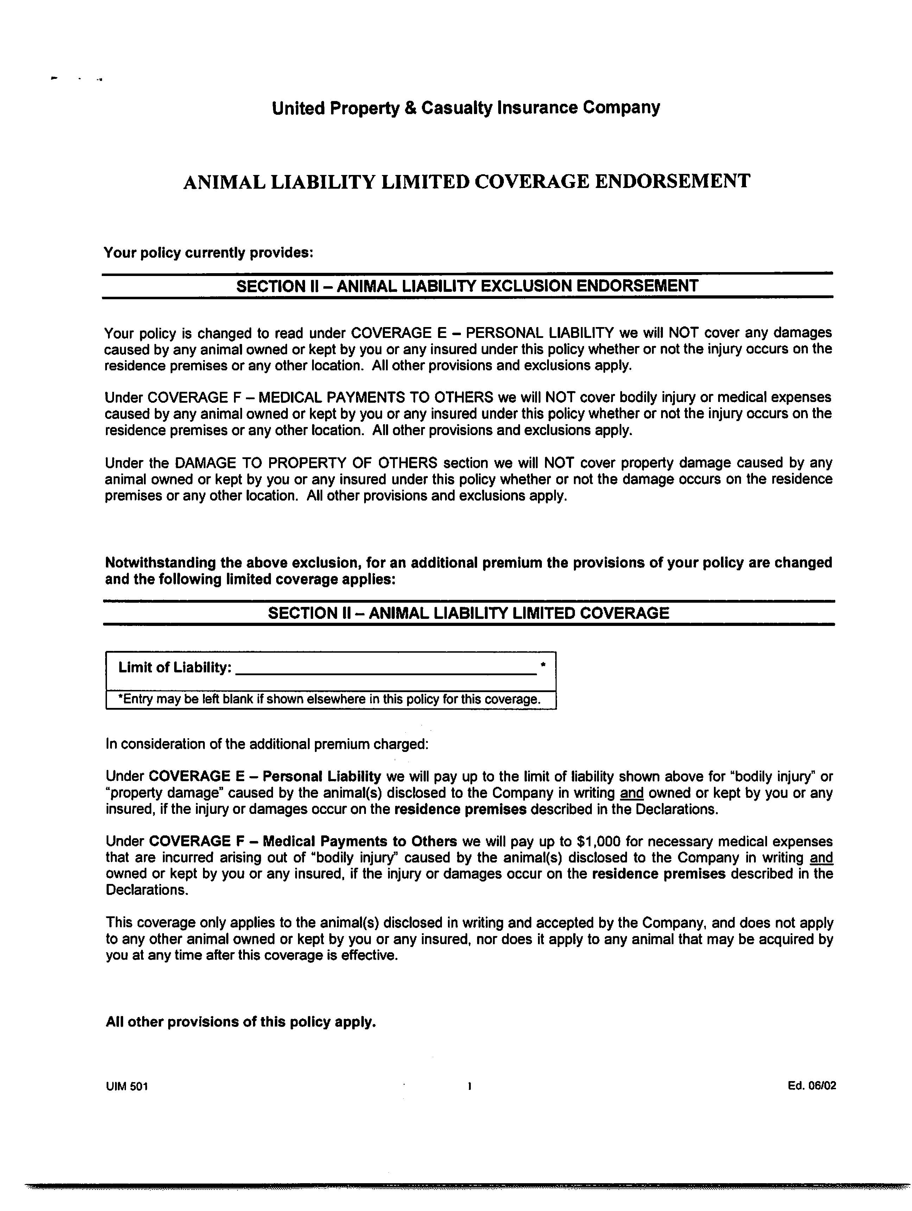
Homeowner’s Insurance
Animal Liability Insurance Rider
United is one of the few companies that will offer animal liability coverage for an additional premium.
Animal liability coverage usually comes in increments of $25,000, $50,000, or $100,000.
Animals Not Covered:
History of violence,
Certain breeds, and
Vicious, dangerous, or exotic animals.

Slide 14
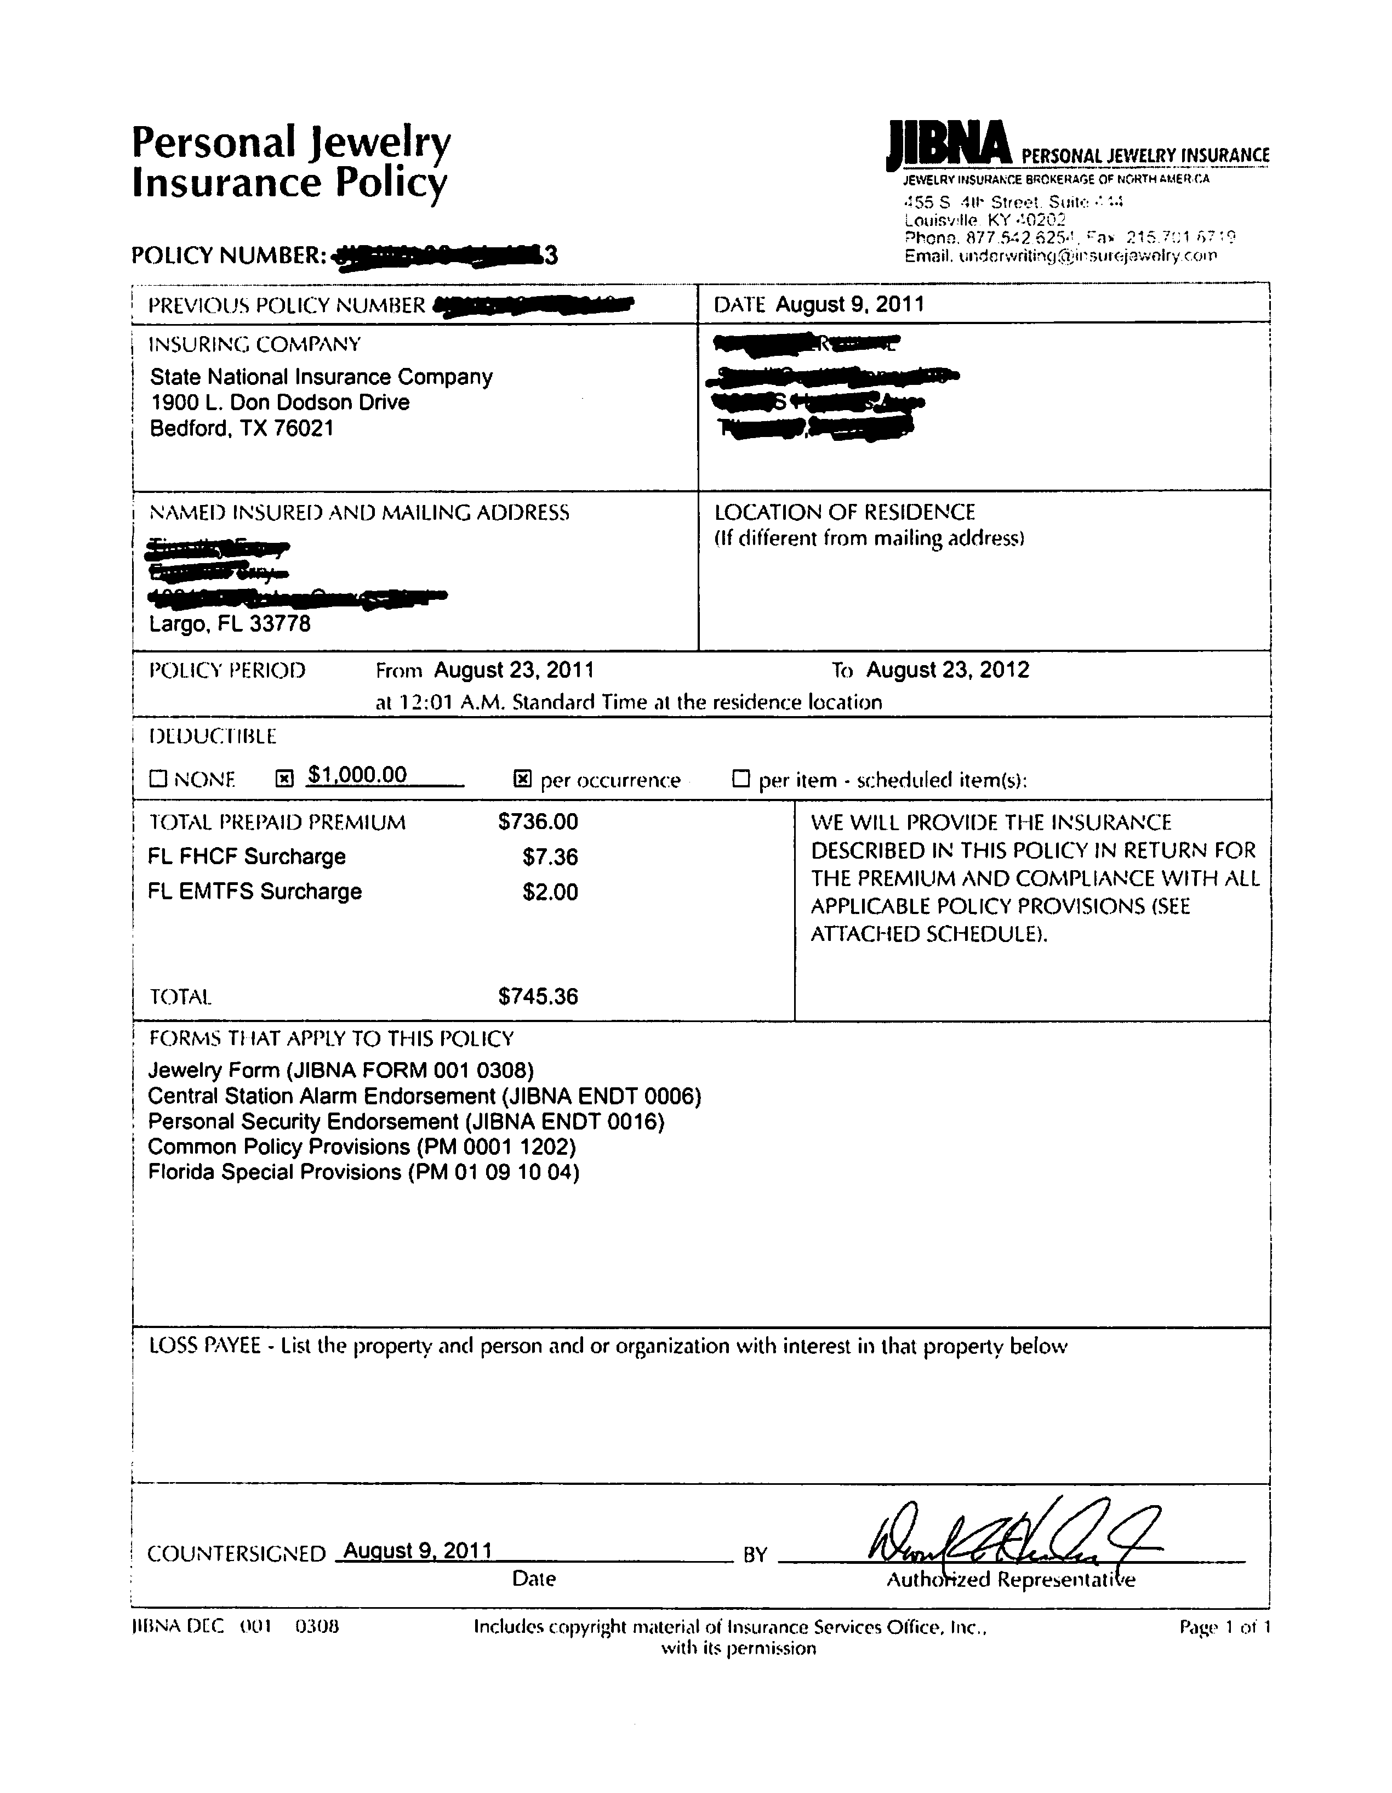
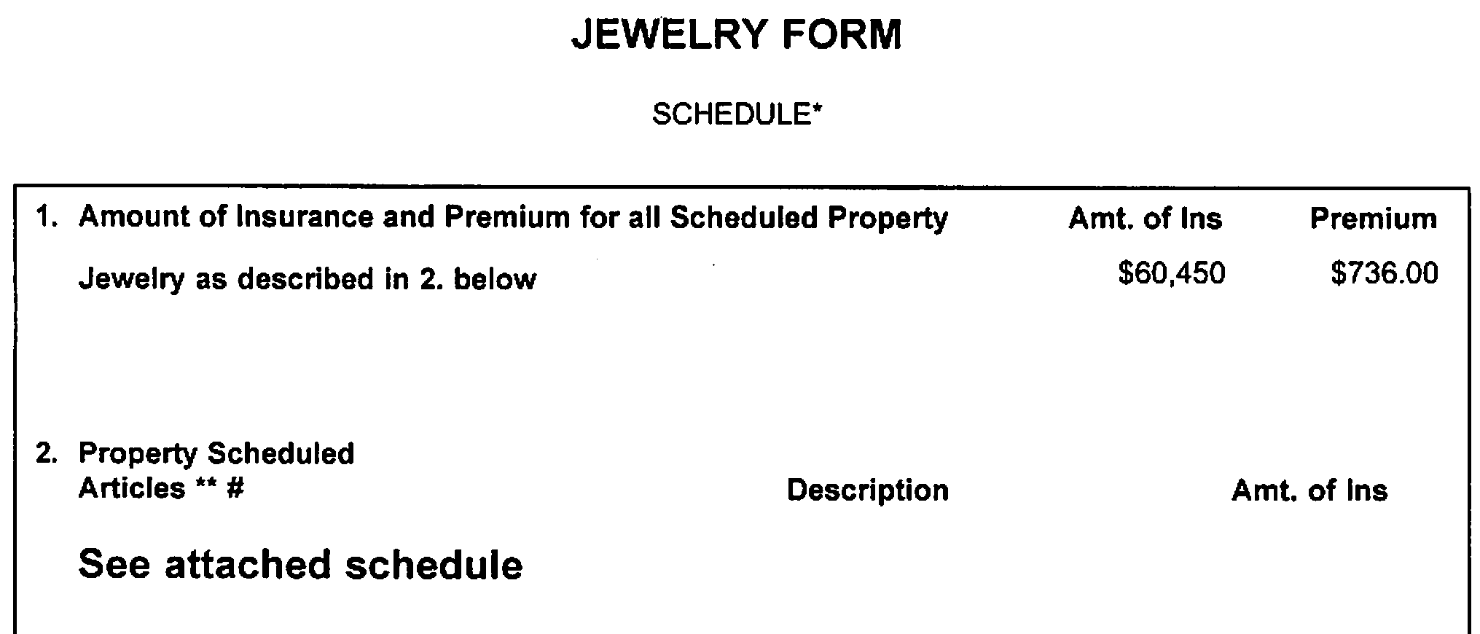
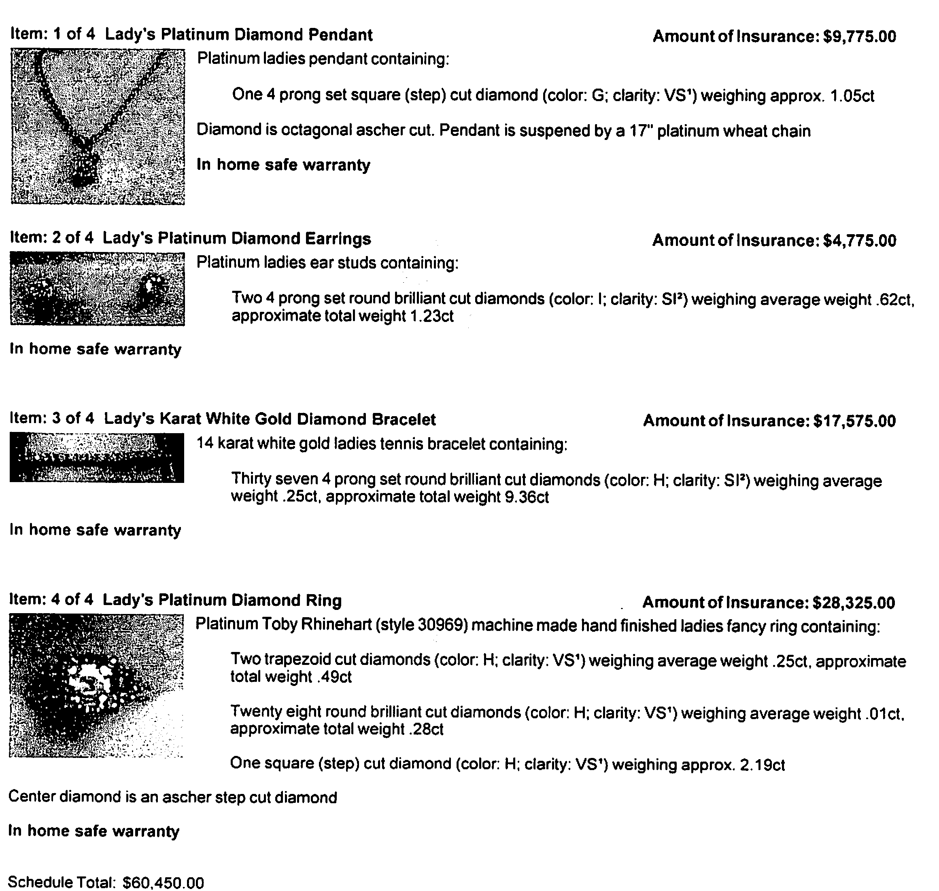
Personal Jewelry Insurance
Personal jewelry is covered to a certain extent by homeowner’s insurance, but oftentimes, the value of the jewelry exceeds the value of the coverage.
Additional jewelry insurance, or “scheduled jewelry insurance,” can be purchased from separate insurers. It is often not offered as a homeowner’s insurance rider.

Slide 15
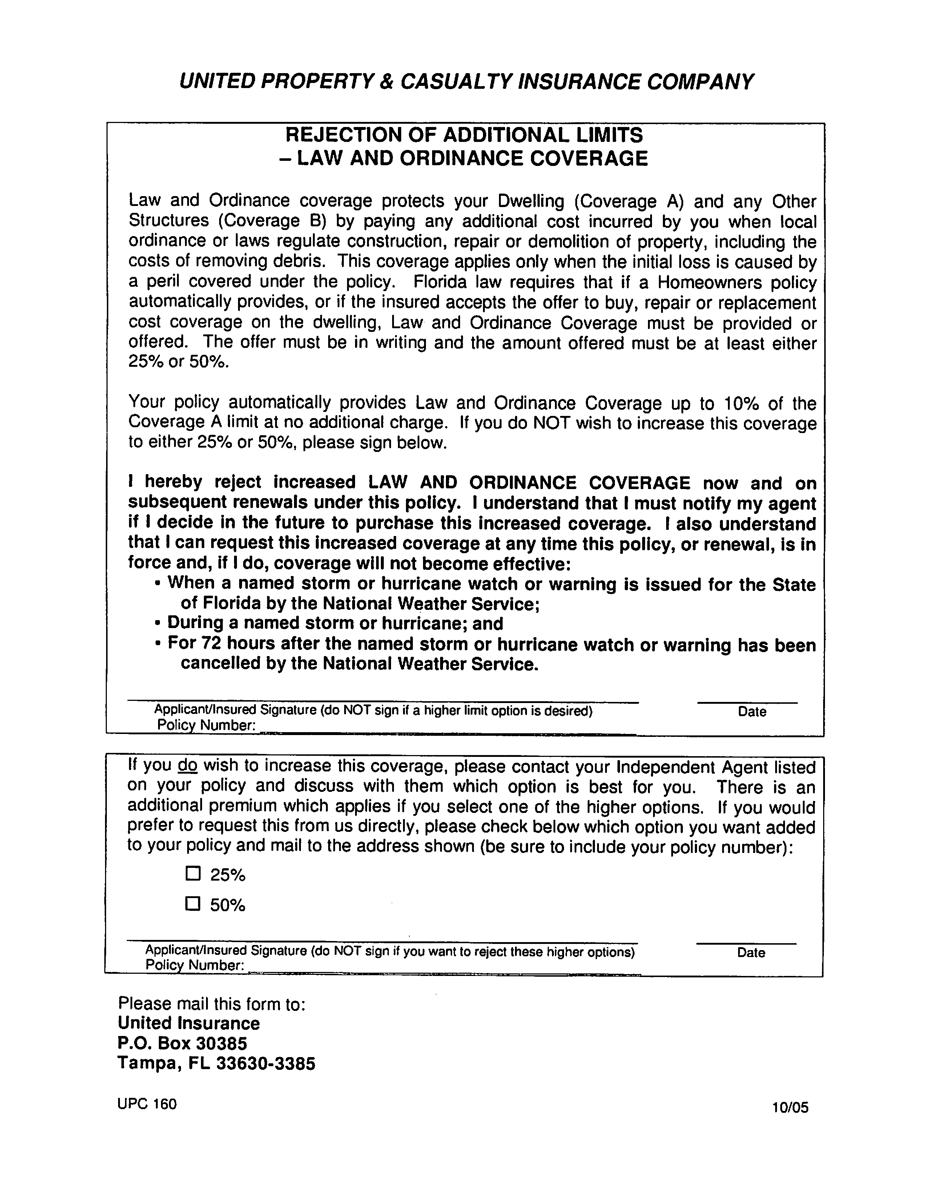
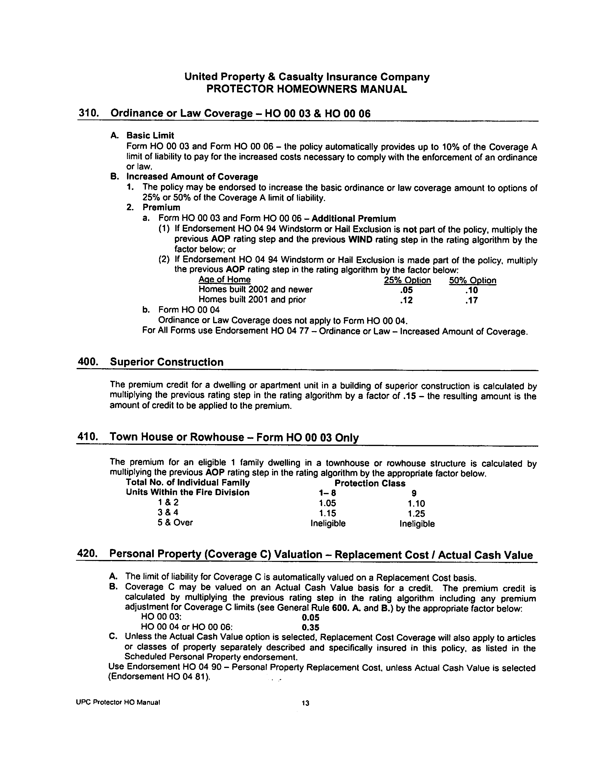
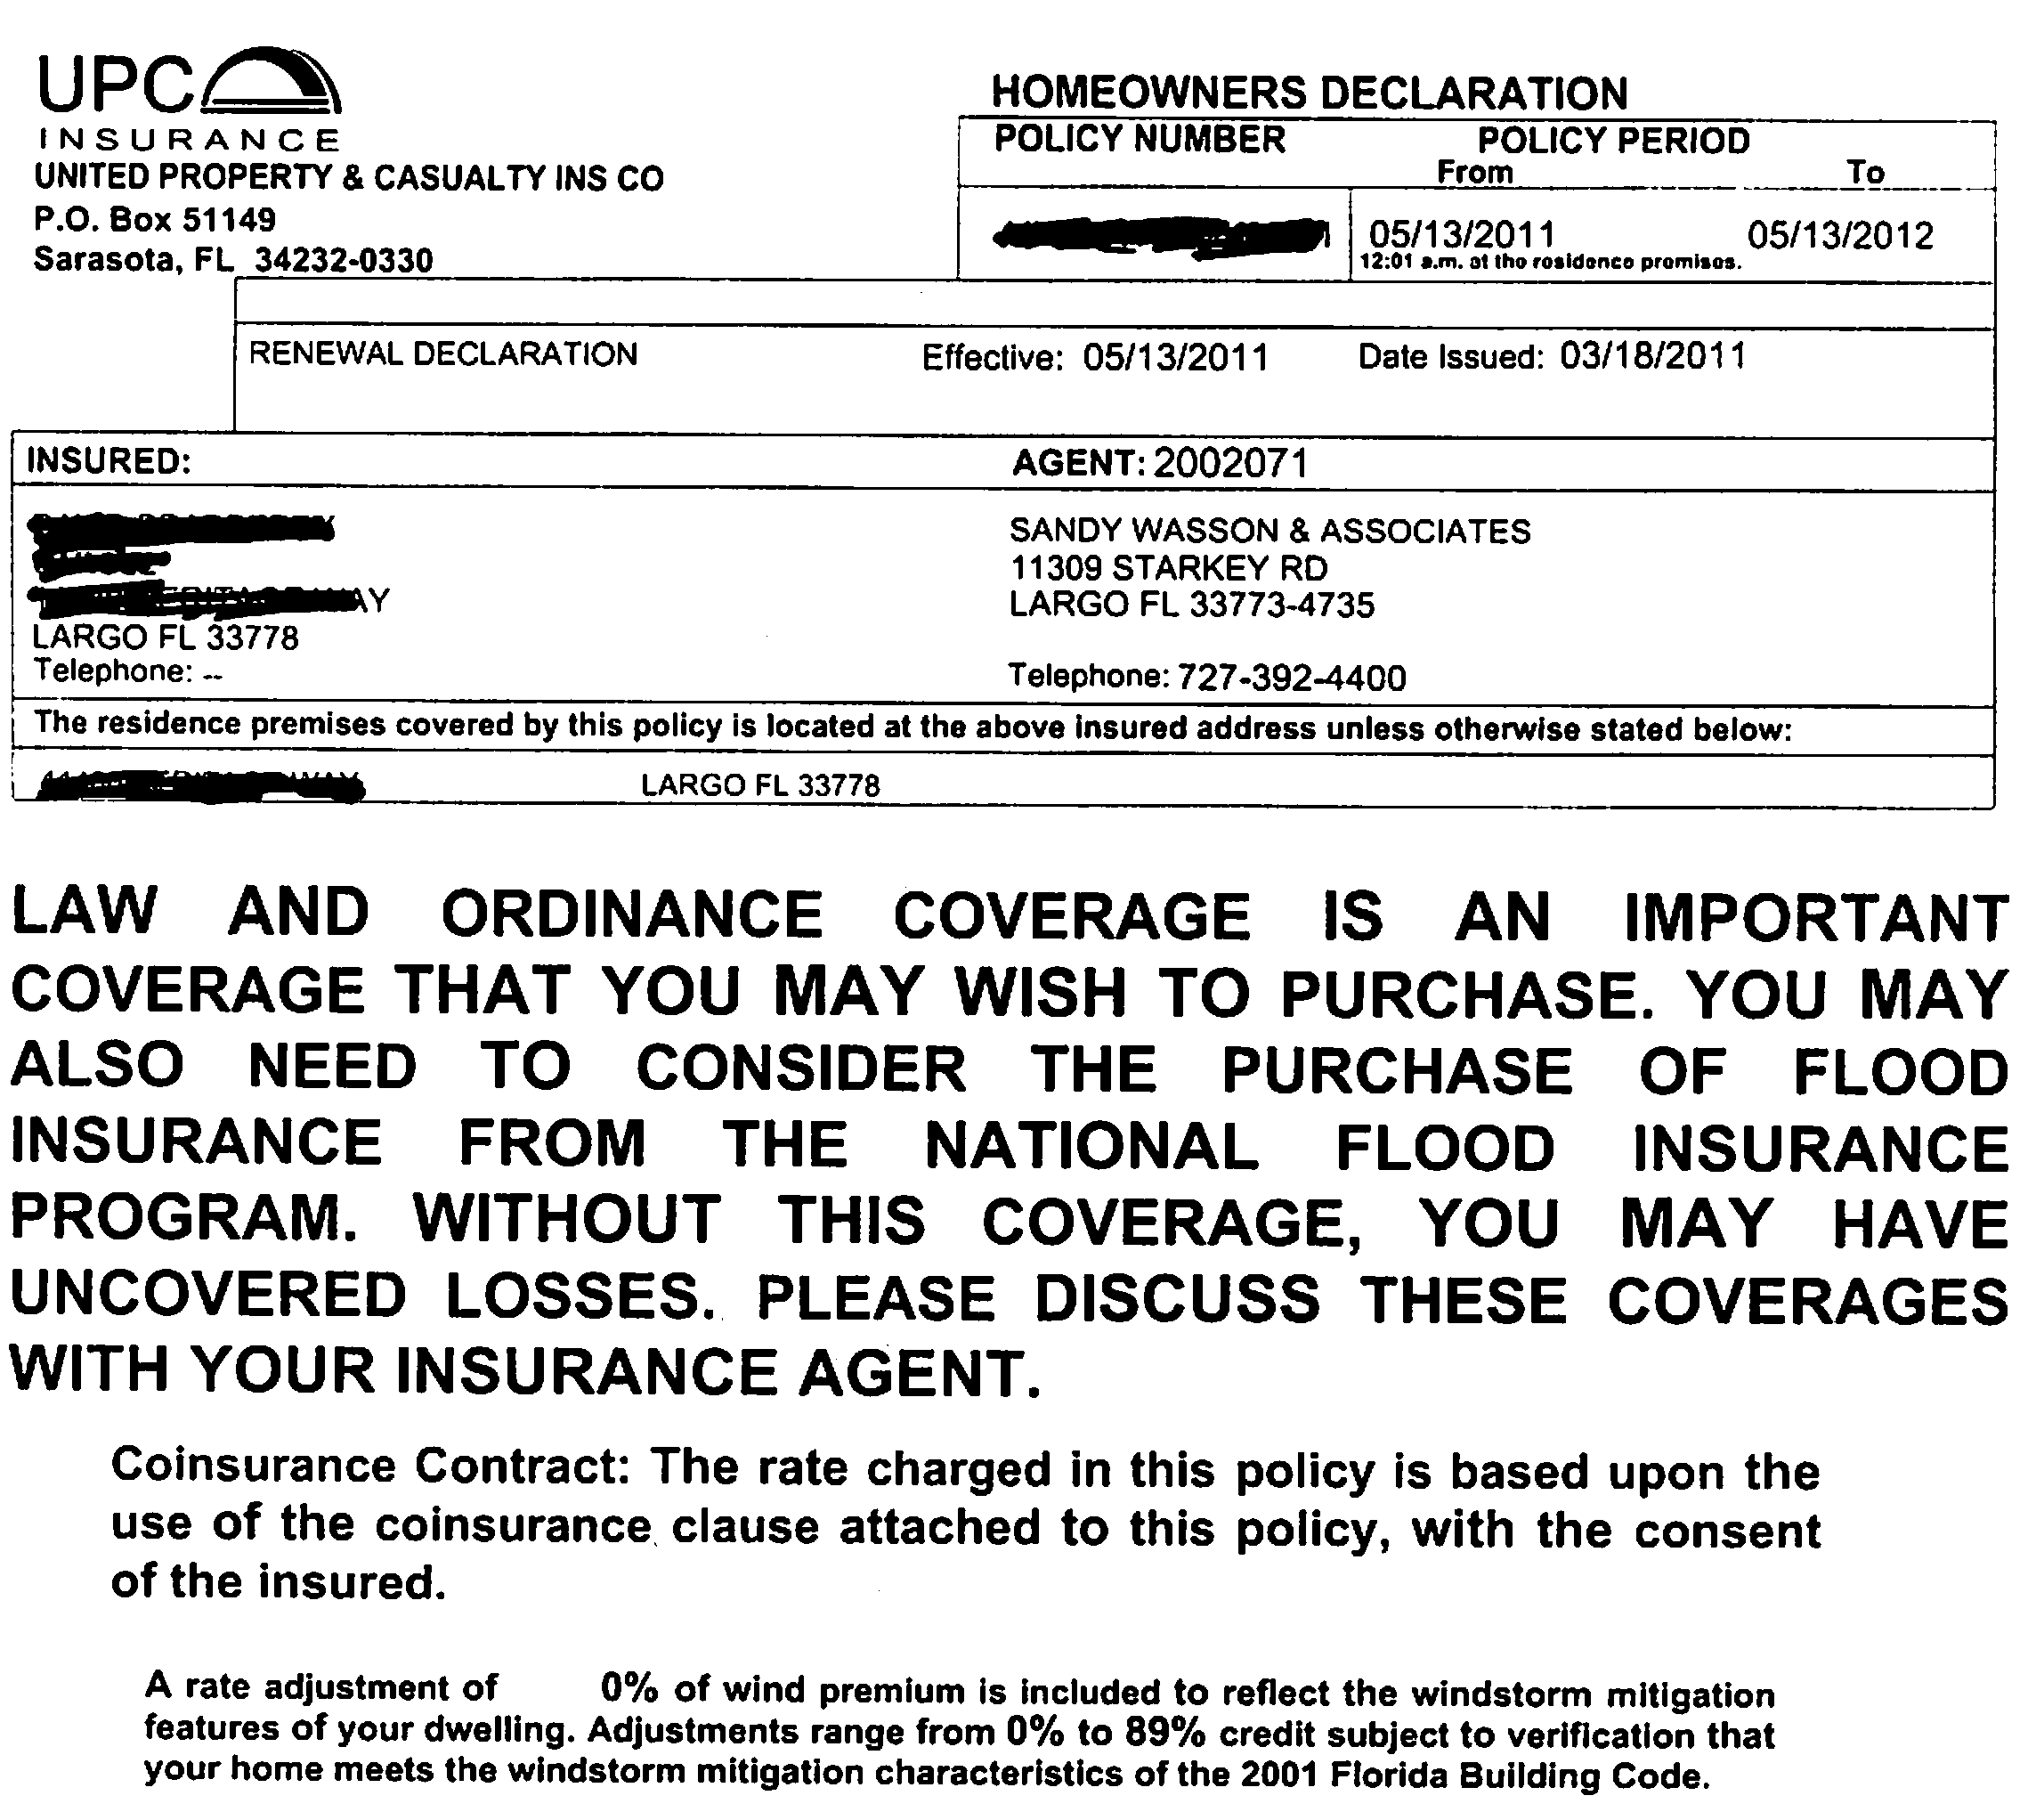
Law and Ordinance Coverage
Law and ordinance coverage is beneficial here in Florida. Suppose a hurricane were to rip right through your living room. When you go to repair your home, you find that there are new building codes and ordinances that are going to increase the cost of the repair. This homeowner’s insurance rider will help cover the costs of complying with the new building codes to a certain extent.
This insurance is not included in homeowner’s insurance. It must be added for an additional premium cost.

Slide 16
Riders Affecting…
Your Business

Slide 17
Worker’s Compensation
& Blue Cross/Blue Shield
If you, as an officer of a corporation, exempt yourself from workers compensation coverage and you have your group benefits with Blue Cross/Blue Shield, you may not have coverage for on the job injuries (24-hour coverage).
Most other healthcare companies such as Aetna and United Healthcare will simply surcharge the group if an officer exempts himself or herself.
Call your agent if you have questions or are unsure!

Slide 18

Equipment Breakdown Coverage
There are many aspects of your business that can easily be overlooked when it comes to insurance coverage.
Key equipment that keeps your operations running could fail for any number of reasons and require costly repairs.
Obtaining equipment breakdown insurance is a great way to protect yourself from expensive repairs down the line.

Slide 19
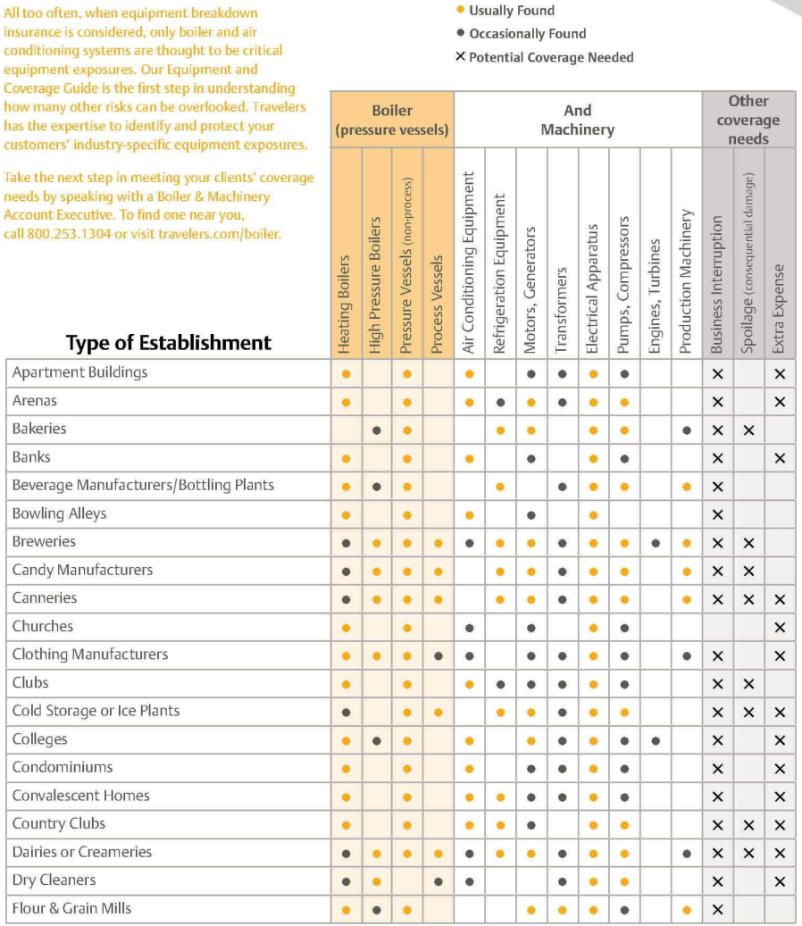
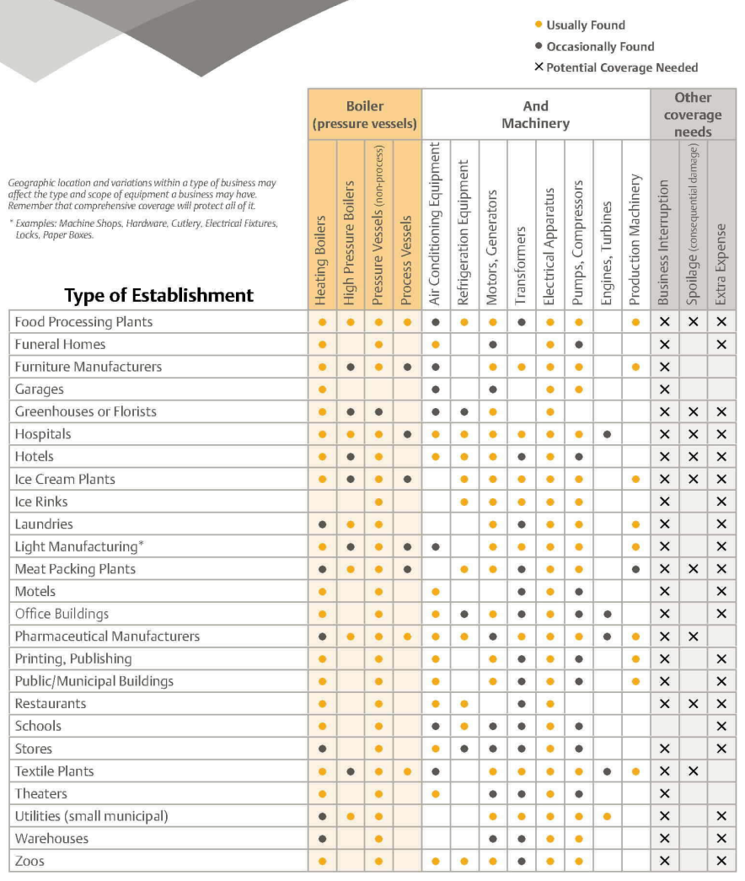
Equipment Breakdown Coverage
It is even easier to overlook the equipment that you are unaware of. This chart is a quick reference of the possible types of equipment a business could own based upon the type of establishment it is.

Slide 20
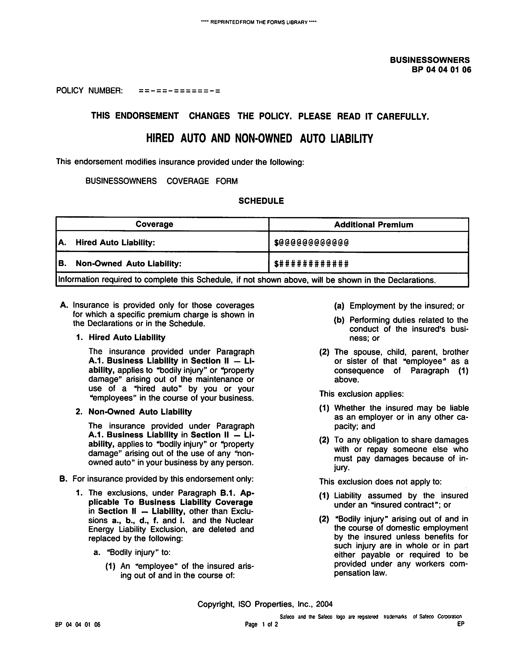
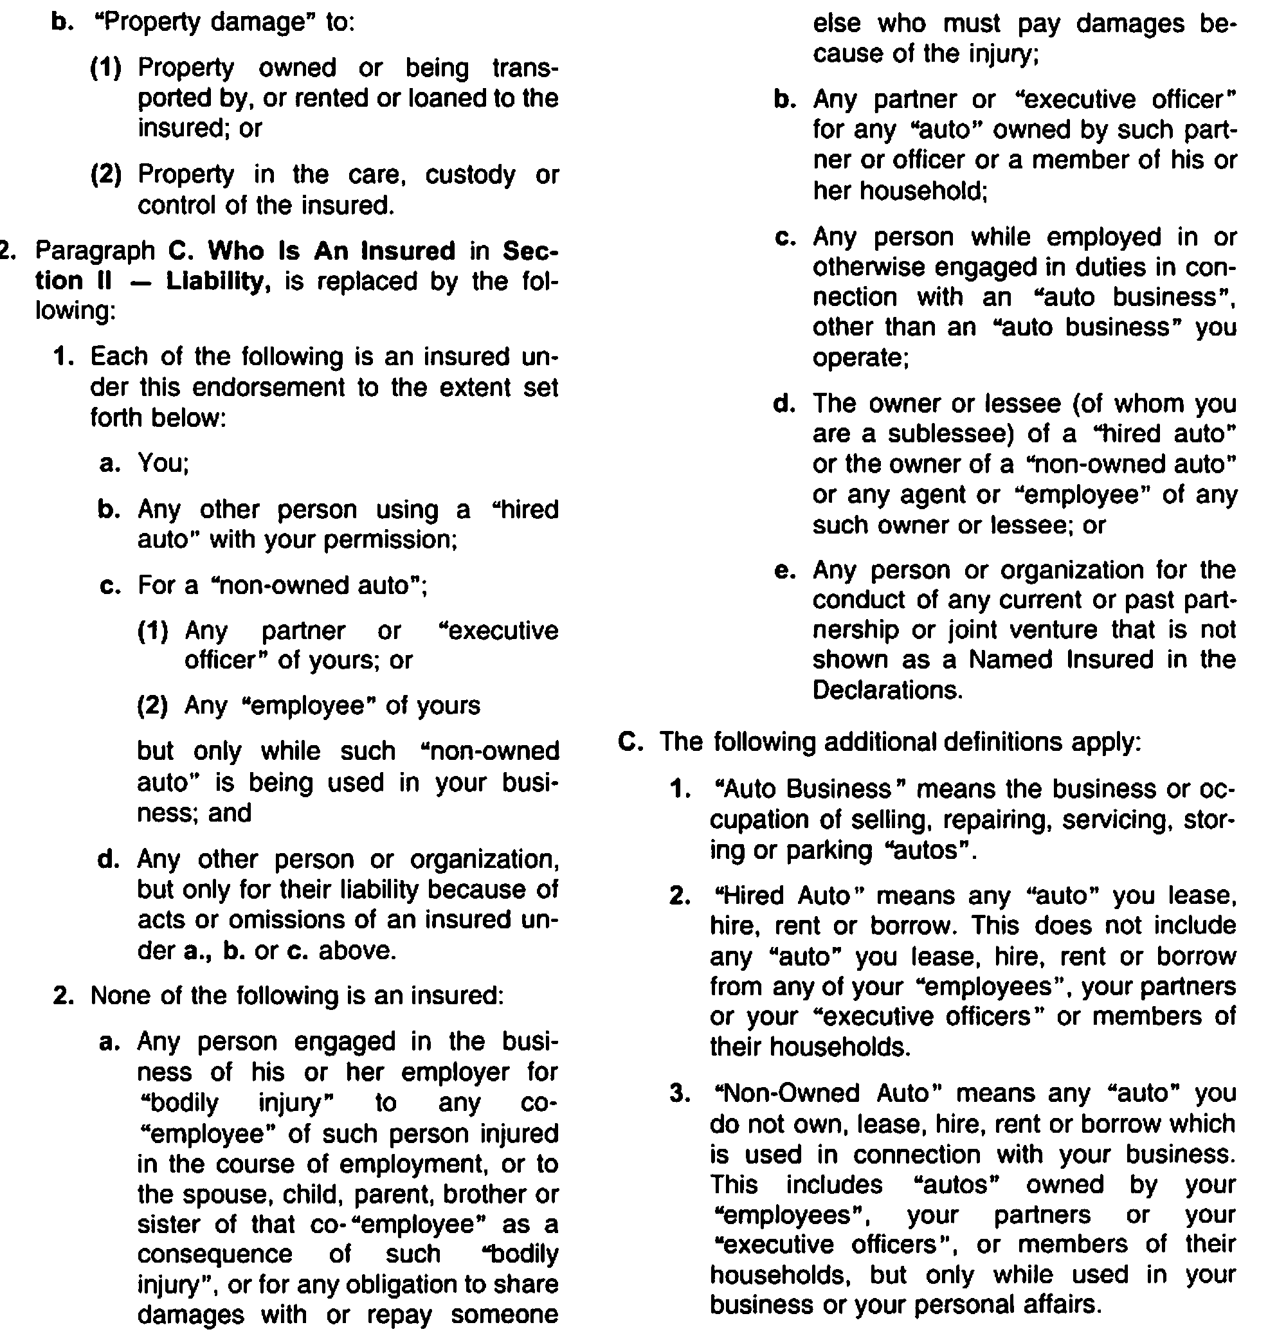
Hired Auto and Non-Owned Auto Coverage
This coverage comes in handy if you or an employee get in an accident while driving a car that is not owned by you, an employee, or the business.
It also covers liability on rental or other hired cars.
This is a liability insurance rider and, in most cases, does not cover physical damages to the automobile.
If your employees run business errands or you travel for business by car often, this is a good investment.

Slide 21
Author Biographies
Chuck Wasson, President, began working at Sandy Wasson & Associates Insurance in 1992. Prior to that he was an insurance adjuster and spent the last 30 days of his adjusting career in Miami following Hurricane Andrew. After entering the family agency, he began working with physicians which today accounts for the majority of the business at Wasson & Associates. He has a Bachelor of Science degree from the University of Florida and holds the Chartered Property & Casualty Underwriter and the Certified Insurance Counselors designations, both nationally recognized designations within the insurance industry.
Chuck is a past President of the Kiwanis Club of Pinellas Park is married and has two daughters. In his spare time, Chuck enjoys training and racing in Triathlons and completed Ironman Florida in 2004.
Contact Chuck by clwasson@wassonandassoc.com or call 727-392-4400.
Alan S. Gassman, J.D., LL.M. is an attorney practicing in Clearwater, Florida with the firm of Gassman Law Associates, P.A. Mr. Gassman’s primary practice focus over the past 25 years has been the representation of high net worth individuals, physicians and business owners in estate planning, taxation, and business and personal asset structuring.
In 2009 and 2010 Mr. Gassman authored and co-authored the following published articles. “Creditor Rights Under Private Annuities and Grantor-Retained Annuity Trusts in Florida”, The Florida Bar Journal, July/August, 2009. “Unconventional Uses of 529 Plans Should Not Be Ignored By Taxpayers and Their Advisors”, BNA Tax & Accounting, March 11, 2010. “Don’t Overlook the Benefits - Tax and Otherwise - of Private Operating Foundations” Estates, Gifts and Trusts Journal, 11/12/2009. “After Olmstead: Will a Multiple-member LLC Continue to Have Charging Order Protection?”, The Florida Bar Journal, December 2010. “Recent Adventures in Florida Tenancy By The Entirety - Important Developments” Leimberg Information Systems, Inc., June 18, 2009. “One Good Reason Not To Do A Roth IRA Conversion”, Leimberg Information Systems, Inc., September 11, 2010. “Mistakes Doctors Make Managing Their Practices and Investments”, Leimberg Information Systems, Inc., May 20, 2009.
In 2010 Mr. Gassman presented the following Webinars for professionals; Interesting Interest; Minimum and Maximum Interest Rates for Intra-Family Transactions and Applications of the OID Rules to Intra-Family Debt Obligations, BNA Tax & Accounting with Professor Jerry Hesch, August 18, 2009, Individual and Group Medical Practices: Tax, Health Law, and Creditor Protection Planning, BNA Tax & Accounting, March 2, 2010.
Mr. Gassman can be contacted at agassman@gassmanpa.com, or by phone at 727-442-1200. The Gassman Law Associates, P.A. website is www.gassmanlaw.com.

